Slide 1
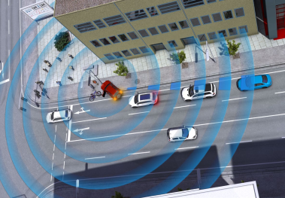
C-ITS
Awareness Driving

Slide 2

Awareness Driving
Similar examples of this is “Waze” (Traffic navigation app).
Without a user, there is no notice of an accident.

Slide 3
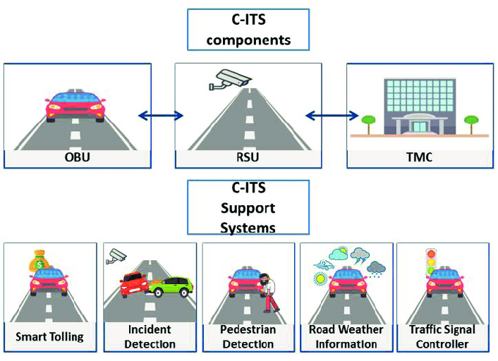
Awareness Driving
Take the user out of the notification process.
Ideal for scenarios like:
Dangerous Situation Warning
Stationary Vehicle Warning
Pre-/Postcrash Warning

Slide 4

HLN – SV Scenario
Hazardous Locations Notification – Stationary Vehicle: describes the use case of a broken-down car in the road.
DENM (Decentralized Environmental Notification Message): used to inform the infrastructure and alert vehicles.
Vehicle components in cooperation with a C-ITS OBU (Onboard Unit) notify nearby vehicles and RSUs (Roadside Unit) of the situation

Slide 5
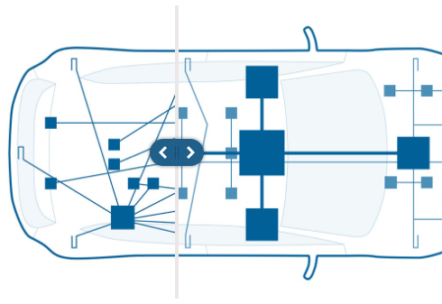
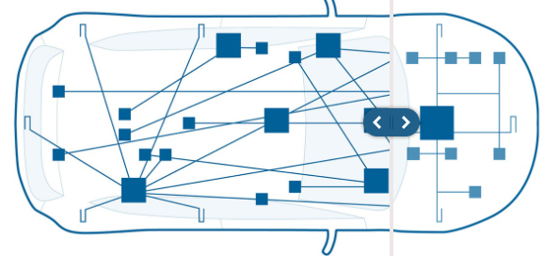
Hardware Automotive Control Units Distribution
Prev. Control Units or Modules were connected all over the vehicle. Now a more optimized architecture is being used.
Distributions can be such as:
Rear Zone
Front Zone
Central Zone / Cabin Zone

Slide 6
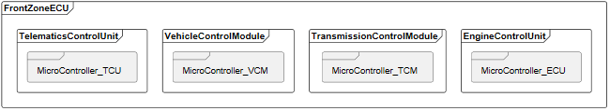
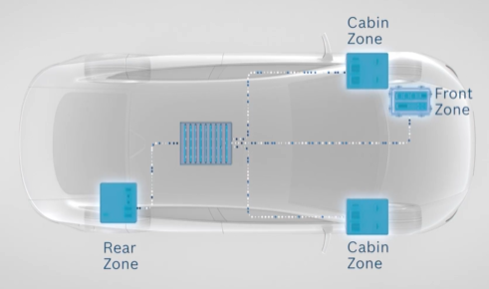
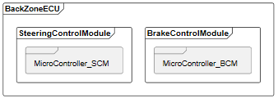
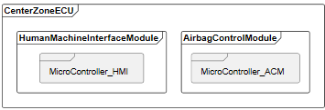
Hardware Car

Slide 7
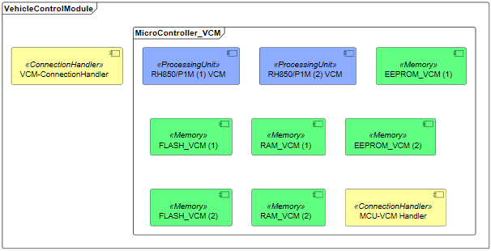

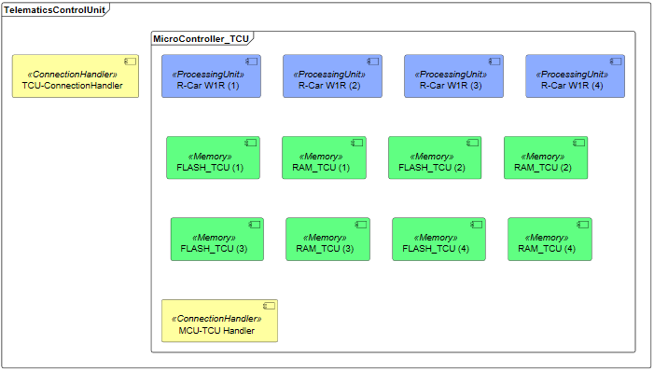
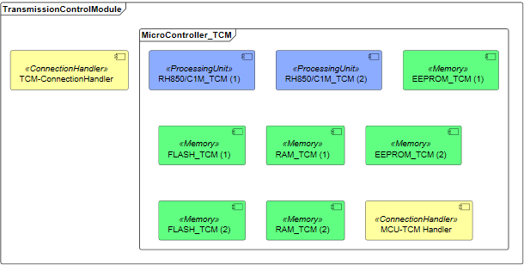
Front Zone

Slide 8
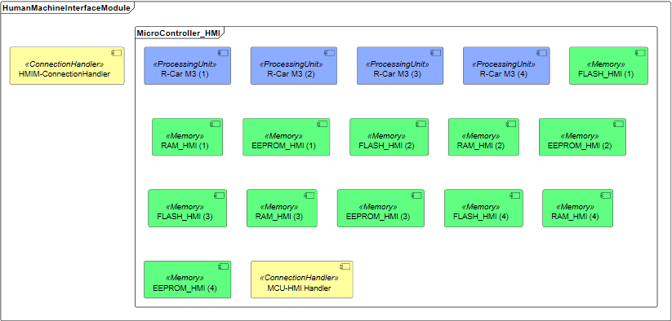
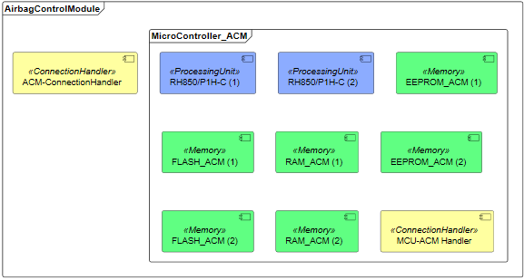
Central Zone

Slide 9
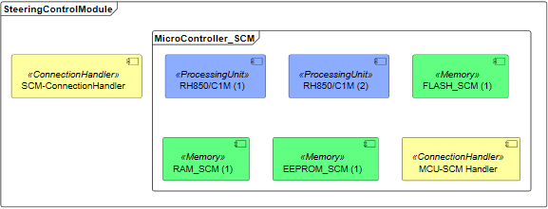

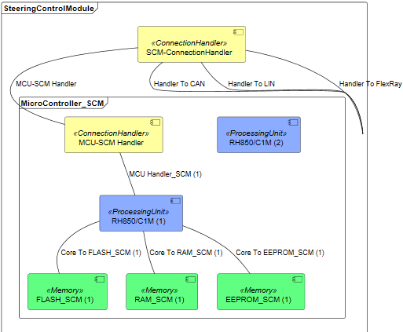
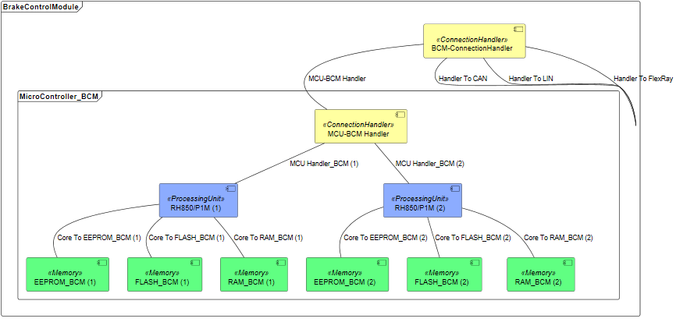
Rear Zone

Slide 10
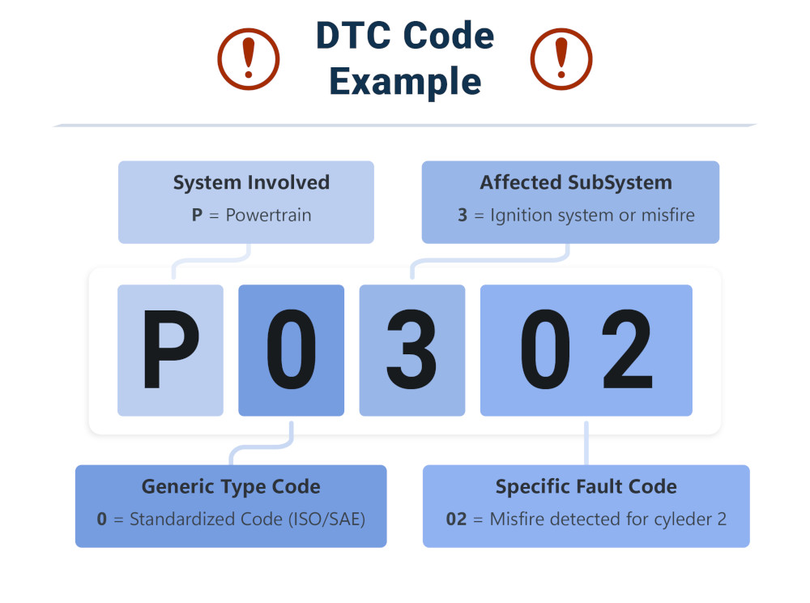
Software DTC (Diagnostic Trouble Codes)
Diagnostic Trouble Codes or OBD-II or J1939.
This codes are the way of communication of the vehicle to let the user what is happening inside. Notify you if there is a problem.
Using a telematics control unit (TCU), app or a gateway. You can access this codes to monitor the vehicle.
Fig. 8, DTC Code.

Slide 11
DTC (Diagnostic Trouble Codes)
First Character.
The part of the vehicle that has a fault.
Second Character
0: Standardized code.
1: Manufacturer-specific code.
Third Character
The subsystem of the vehicle that has a fault.
Fourth and Fifth Character
Exact problem that is active.
Values from 0-99.
Fig. 9, DTC Code.

Slide 12
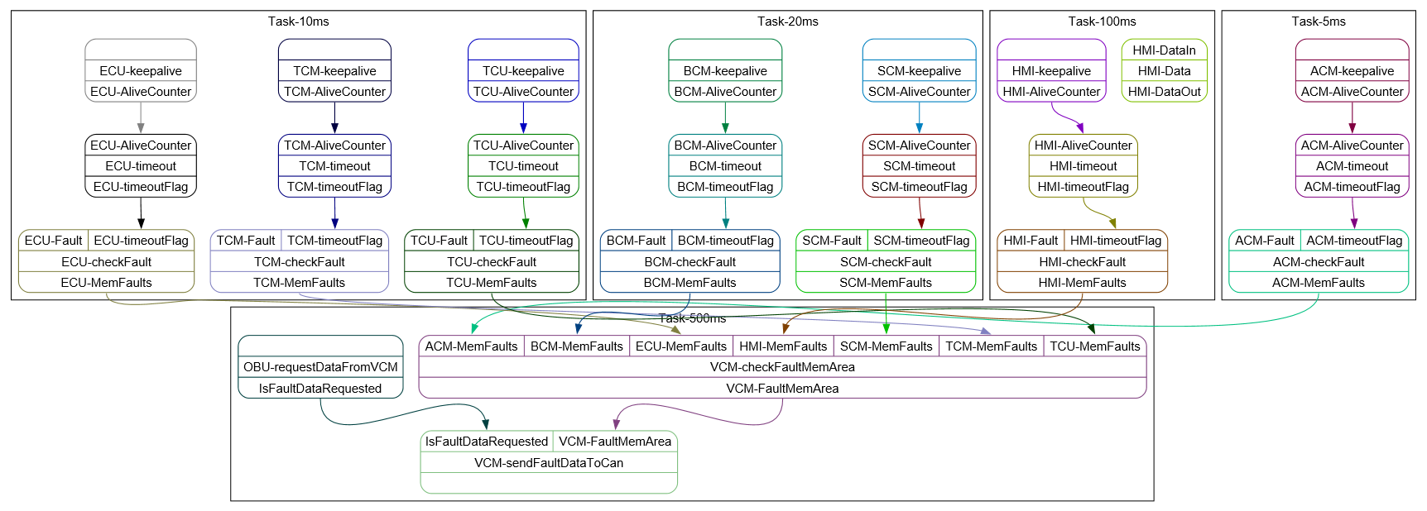
Software Model
The OBU communicates with the vehicle using mainly the fault memory area, which contains the Diagnostic Trouble Codes.

Slide 13
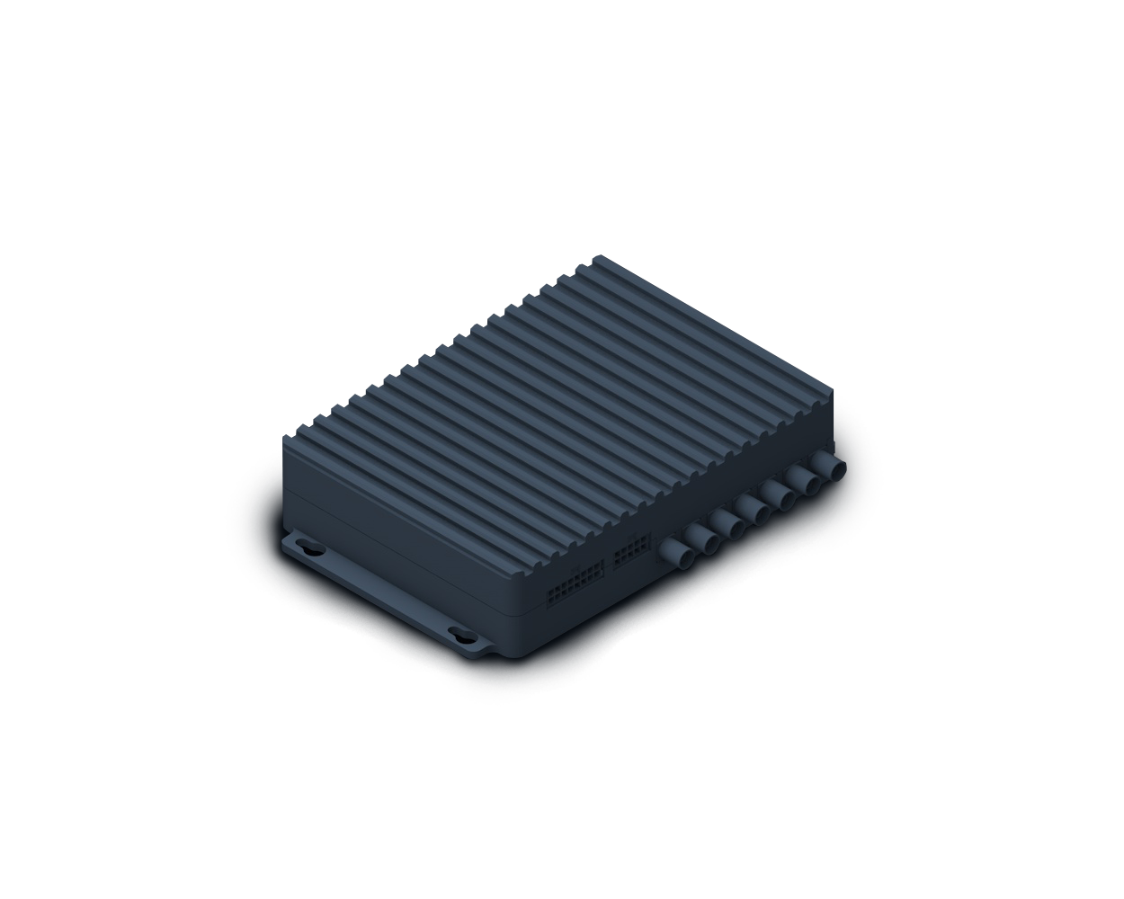
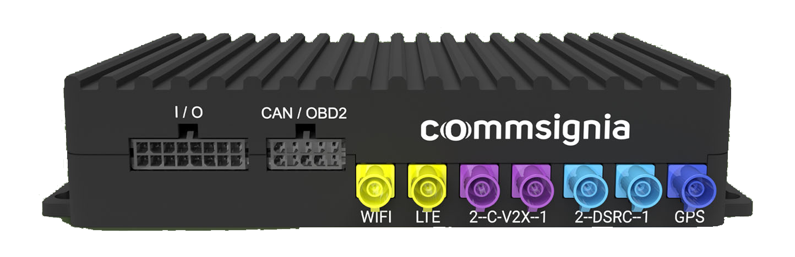
OBU
Onboard Unit providing C-ITS capabilities
Modeled after Commsignia’s ITS-OB4
Integrated into existing vehicle
Communicates mainly through CAN/OBD-II
Fig. 10, Commsignia OBU Ports
Fig. 9, Commsignia OBU

Slide 14
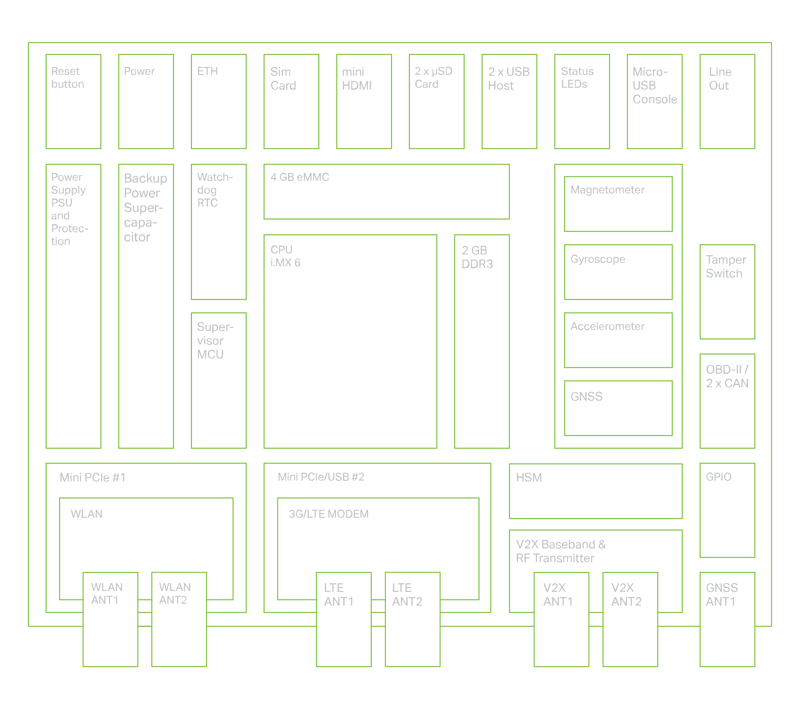
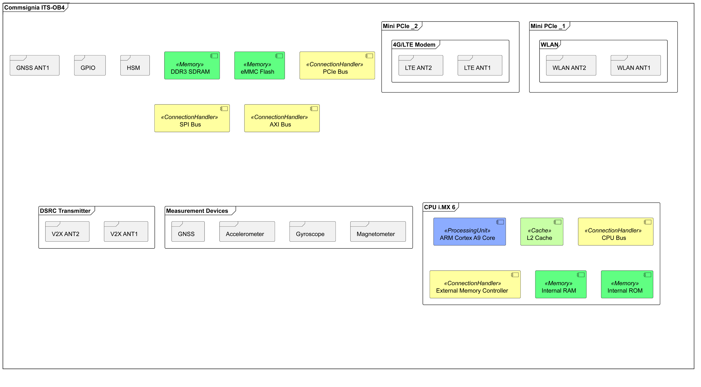
OBU - Hardware
Fig. 11, Commsignia OBU Architecture

Slide 15
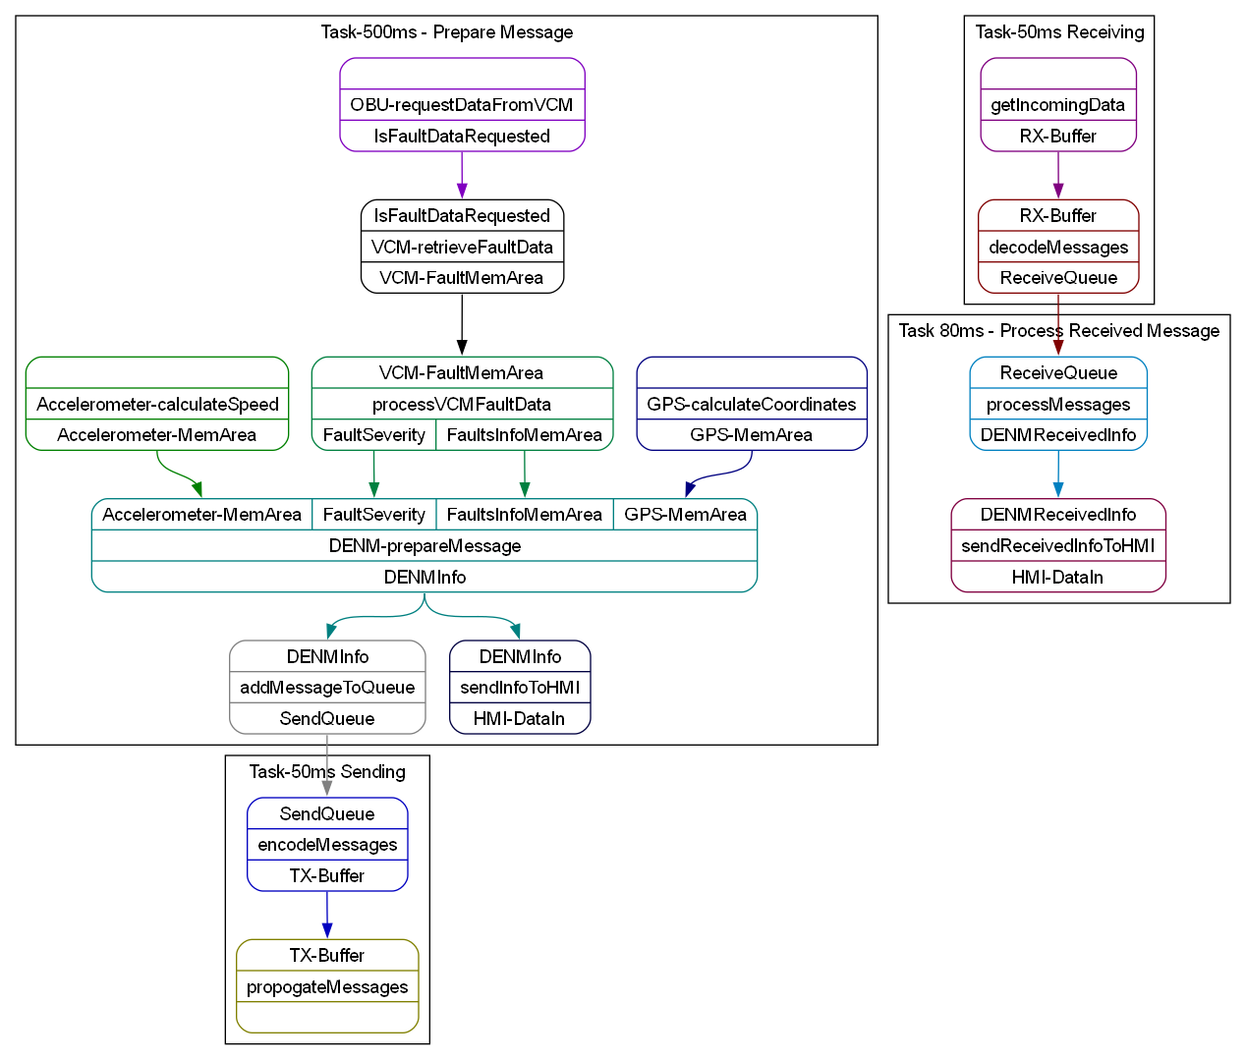
OBU - Software
The software checks for faults and communicates with the backend
Communication is either alerting backend of own fault or receiving info about another SV

Slide 16
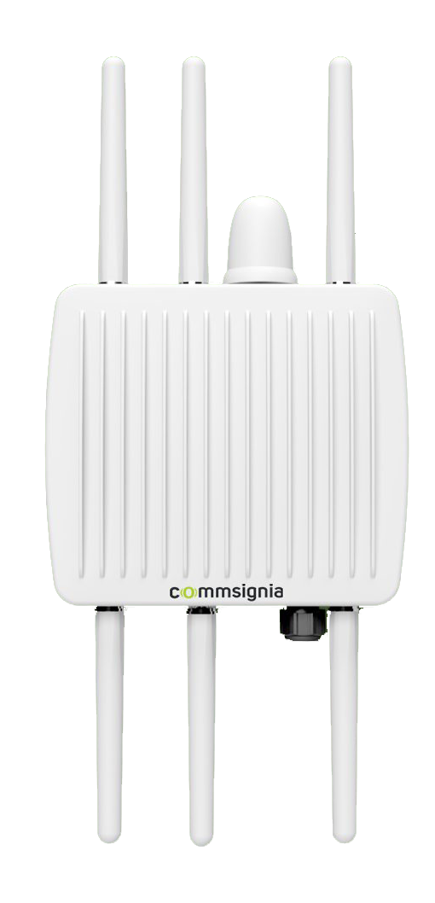
RSU
Roadside Unit facilitates communication between road users and infrastructure
Modeled after Commsignia’s ITS-RS4
Architecture is very similar to Commsignia’s ITS-OB4
Fig. 12, Commsignia RSU

Slide 17
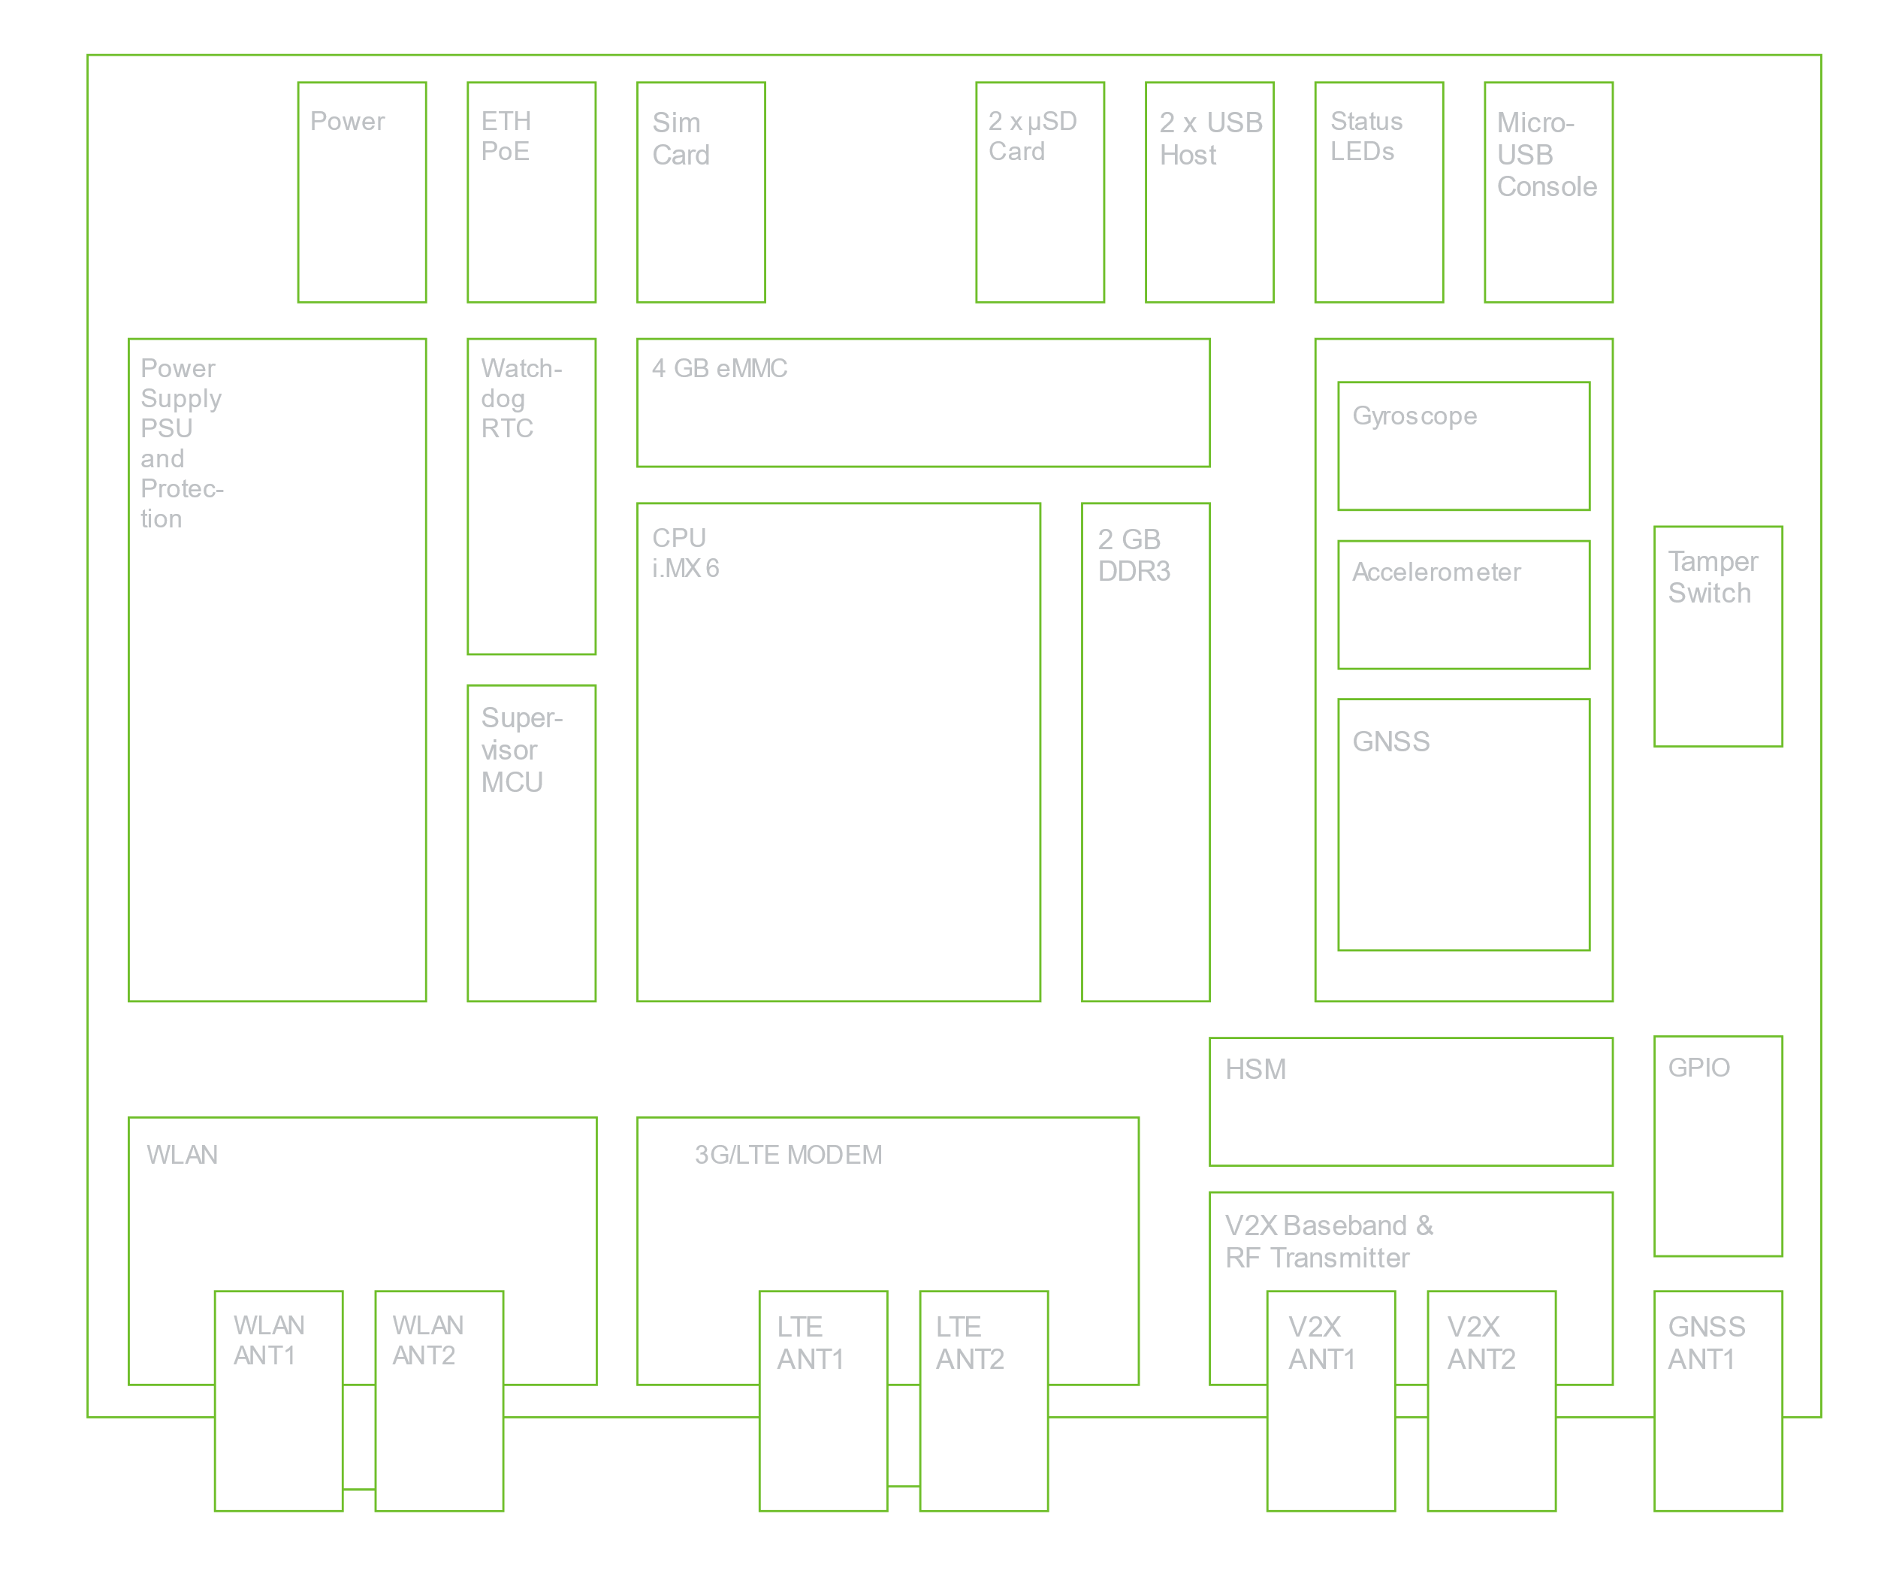
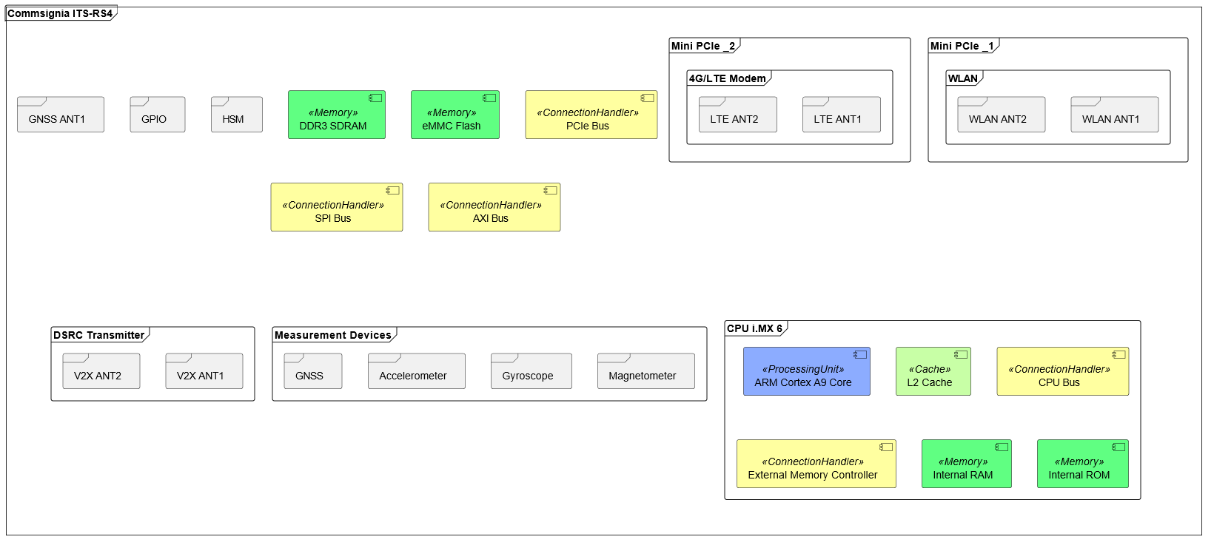
RSU - Hardware
Fig. 13, Commsignia RSU Architecture

Slide 18
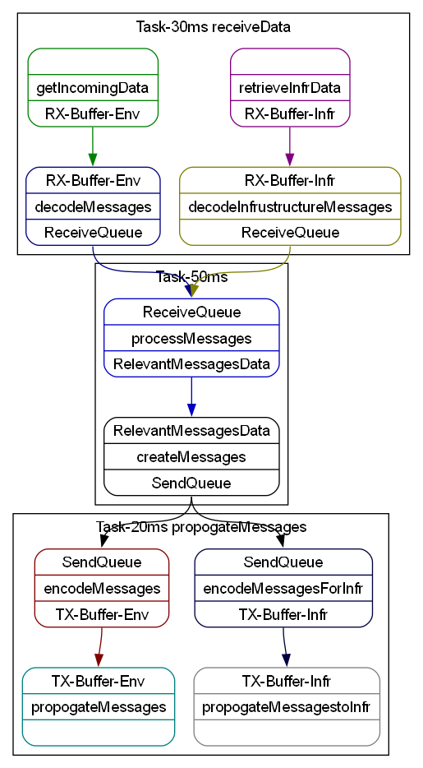
RSU - Software
RSU mainly handles propagation of messages between environment and infrastructure in this scenario

Slide 19
Further Work
DENM messages can also specify lane position information
This information could be used by ADAS systems and autonomous vehicles to adapt the vehicle’s driving lane.

Slide 20
Conclusion
C-ITS improves traffic safety and takes the user out of the notification process.
The Hazardous Locations Notification – Stationary Vehicle alerts drivers of a broken-down vehicle in the road.
For the model, a vehicle with three control unit zones was considered.
OBU and RSU units were modeled after Commsignia’s products.
Integration of lane position builds towards fully autonomous vehicles.

Slide 21
Thank You!
Questions?
Project files are also available on GitHub:
https://github.com/LF-RoGu/Model-Base-Systems

Slide 22
Fig. 1, https://www.car-2-car.org/fileadmin/_processed_/2/9/csm_Dangerous_Situation_Warning_010b9e61f5.jpg
Fig. 2, https://www.waze.com/website/assets/packs/media/images/og_rebrand/whatsapp-65b8f38489f59ff7ecf15b3655a320df.png
Fig. 3, https://www.researchgate.net/figure/C-ITS-System-Components_fig2_333254227
Fig. 4, https://www.smfmotor.com/wp-content/uploads/2021/03/What-to-do-in-a-car-breakdown.jpg
Fig. 5-7, https://www.bosch-mobility.com/en/solutions/control-units/zone-ecu/
Fig. 8, https://www.autopi.io/glossary/diagnostic-trouble-codes/
Fig. 9, https://www.commsignia.com/wp-content/uploads/2020/11/hardware_002_transparent.png
Fig. 10, https://www.commsignia.com/wp-content/uploads/2020/11/green_bg_obu_2021.jpg
Fig. 11, https://www.commsignia.com/wp-content/uploads/2020/11/obu_architecture_outlined.svg
Fig. 12, https://www.commsignia.com/wp-content/uploads/2020/11/green_bg_rsu.jpg
Fig. 13, https://www.commsignia.com/wp-content/uploads/2020/11/rsu_architecture_outlined.svg

