Slide 1
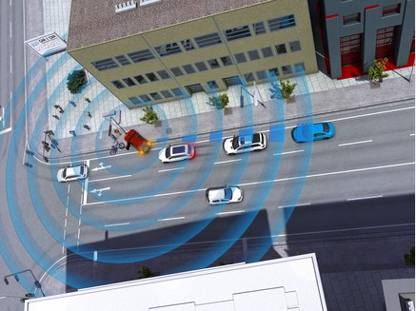
C-ITS
Awareness Driving

Slide 2

Awareness Driving
Similar examples of this is “Waze” (Traffic navigation app).
Without a user, there is no notice of an accident.

Slide 3
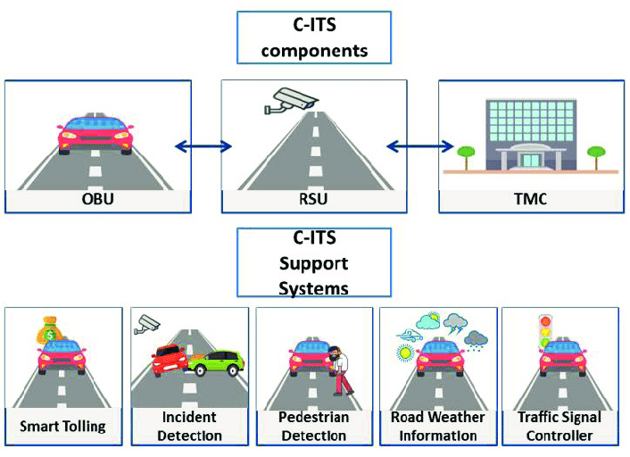
Awareness Driving
Take the user out of the notification process.
Ideal for scenarios like:
Dangerous Situation Warning
Stationary Vehicle Warning
Pre-/Postcrash Warning

Slide 4
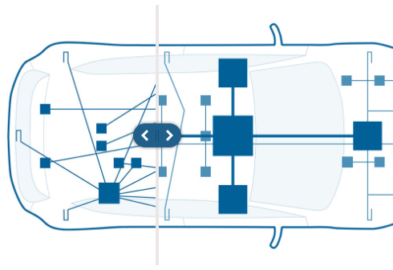
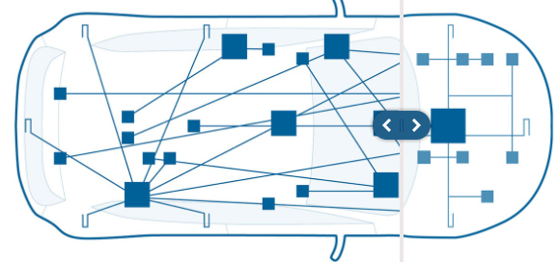
Hardware Automotive Control Units Distribution
Prev. Control Units or Modules were connected all over the vehicle. Now a more optimized architecture is being used.
Distributions can be such as:
Rear Zone
Front Zone
Central Zone / Cabin Zone

Slide 5
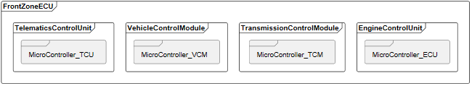
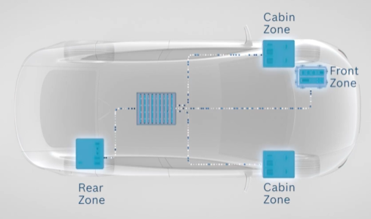
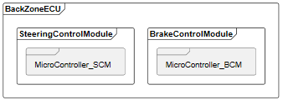
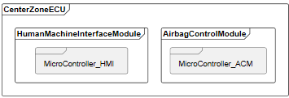
Hardware Car

Slide 6
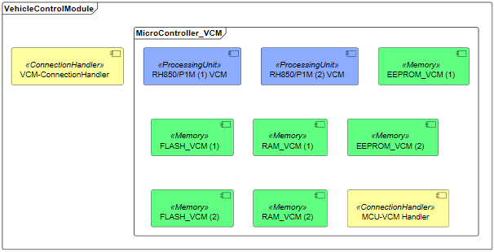

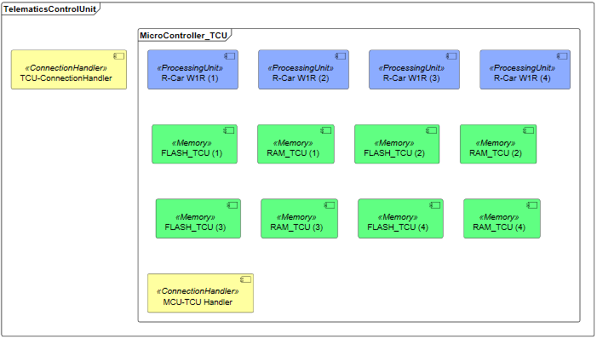
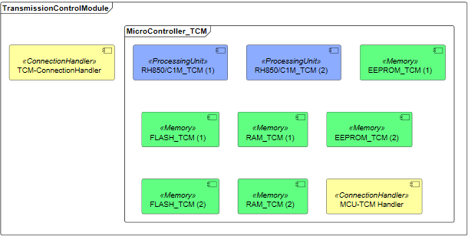
Front Zone

Slide 7
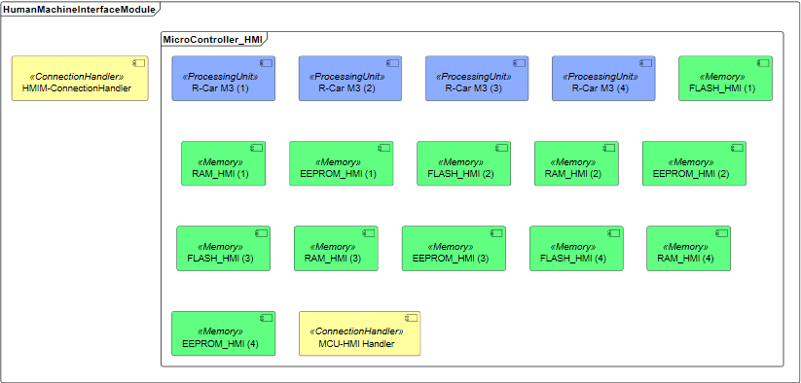
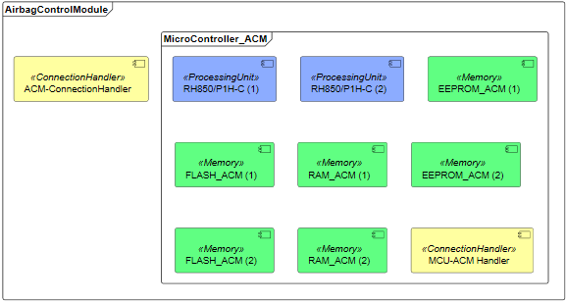
Central Zone

Slide 8
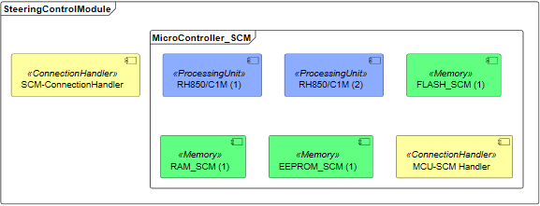

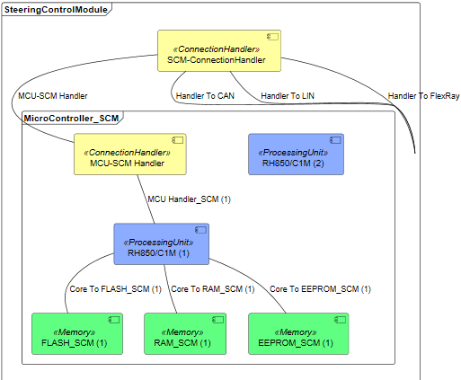
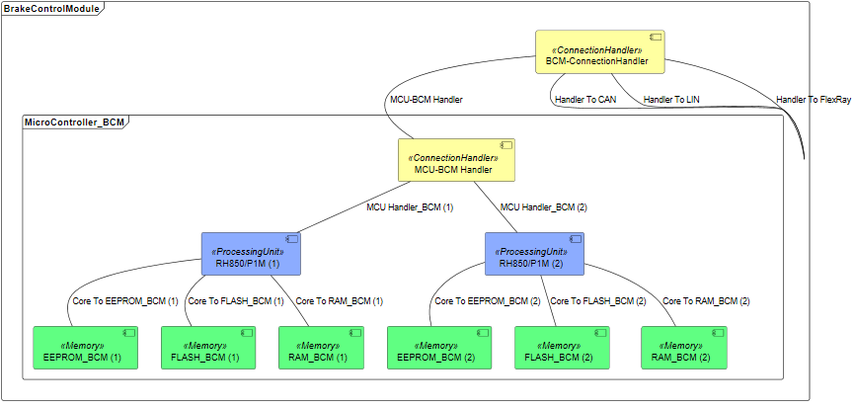
Rear Zone

Slide 9
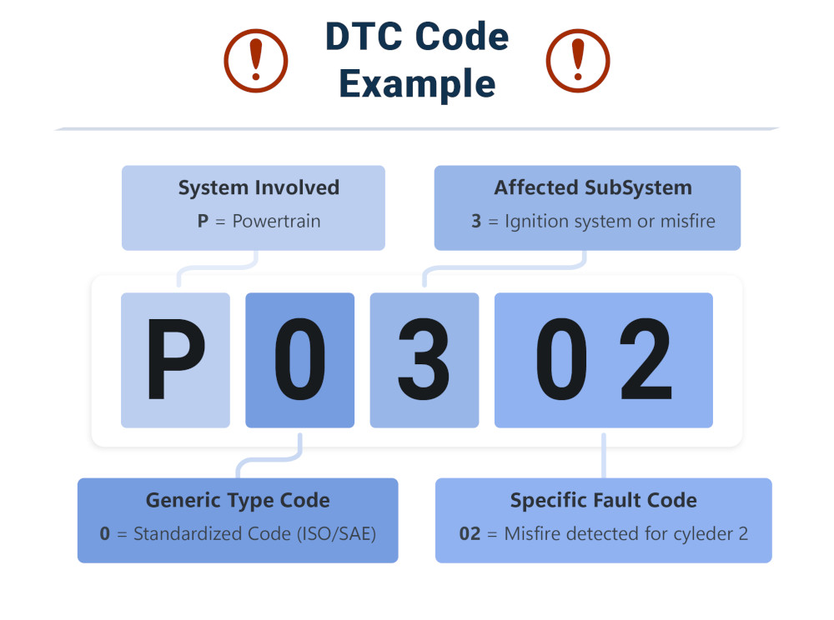
Software DTC (Diagnostic Trouble Codes)
Diagnostic Trouble Codes or OBD-II or J1939.
This codes are the way of communication of the vehicle to let the user what is happening inside. Notify you if there is a problem.
Using a telematics control unit (TCU), app or a gateway. You can access this codes to monitor the vehicle.
Fig. 7, DTC Code.

Slide 10
DTC (Diagnostic Trouble Codes)
First Character.
The part of the vehicle that has a fault.
Second Character
0: Standardized code.
1: Manufacturer-specific code.
Third Character
The subsystem of the vehicle that has a fault.
Fourth and Fifth Character
Exact problem that is active.
Values from 0-99.
Fig. 7, DTC Code.

Slide 11
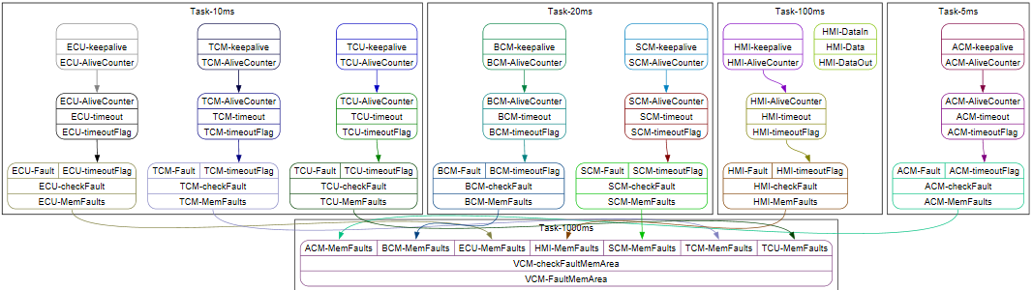
Software Model
The OBU communicates with the vehicle using mainly the fault memory area, which contains the Diagnostic Trouble Codes.

Slide 12
OBU

Slide 13
RSU

Slide 14
DTC

Slide 15
Software

Slide 16
Fig. 1, https://www.car-2-car.org/fileadmin/_processed_/2/9/csm_Dangerous_Situation_Warning_010b9e61f5.jpg
Fig. 2, https://www.waze.com/website/assets/packs/media/images/og_rebrand/whatsapp-65b8f38489f59ff7ecf15b3655a320df.png
Fig. 3, https://www.researchgate.net/figure/C-ITS-System-Components_fig2_333254227
Fig. 4-6, https://www.bosch-mobility.com/en/solutions/control-units/zone-ecu/
Fig. 7, https://www.autopi.io/glossary/diagnostic-trouble-codes/

