Slide 1
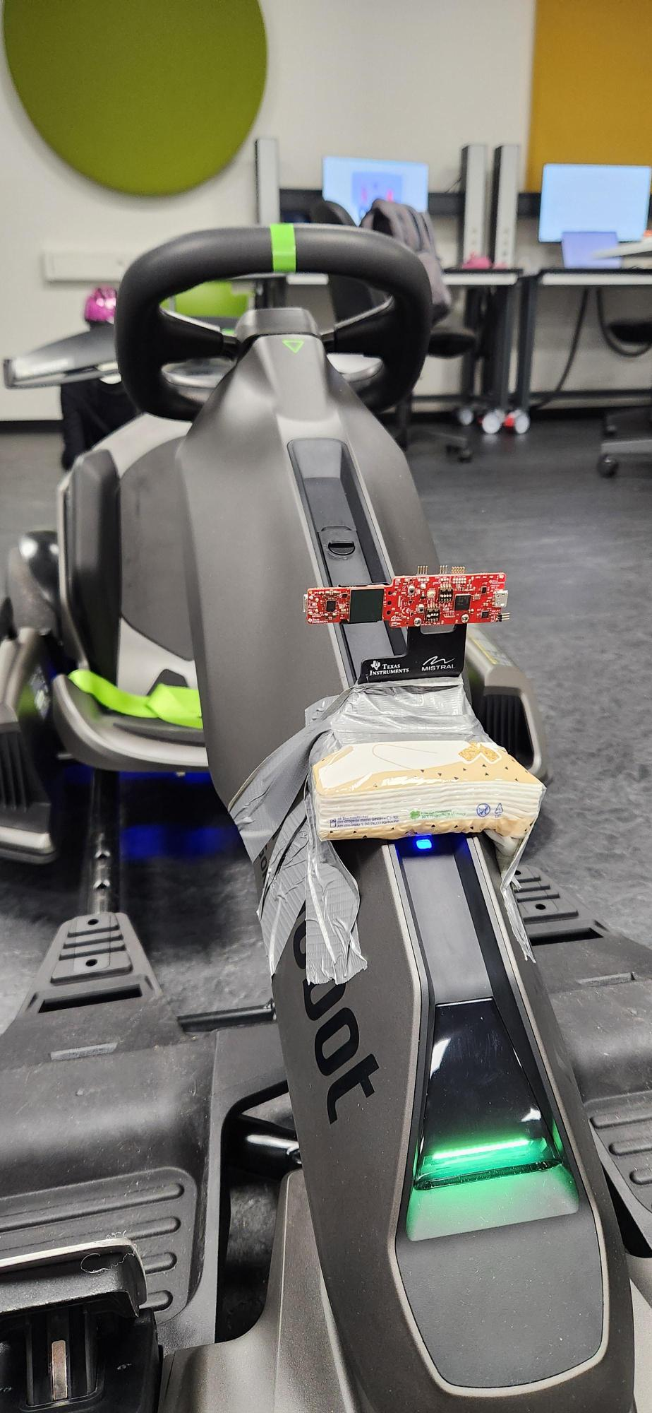
mmWave Radar-Based Object Detection and Collision Avoidance System
Project Summary and Implementation Overview

Slide 2
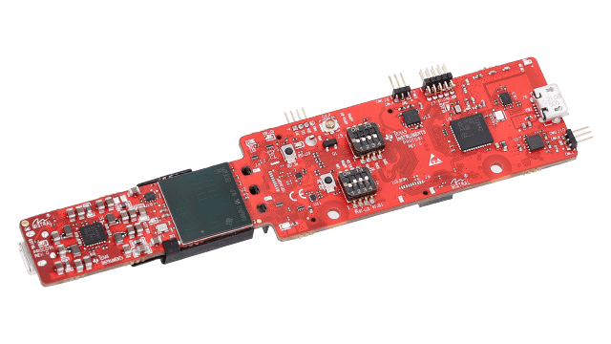
1. Project Overview
Real-time processing of radar data from the sensor.
Object detection and clustering using DBSCAN algorithm.
Self-speed estimation based on Doppler velocity.
Occupancy grid generation for spatial mapping to aid in decision-making.
Integration with a braking system for collision avoidance.
Notes:
This project aims to develop a real-time object detection and collision avoidance system using the IWR6843AOPEVM mmWave radar sensor. The system processes raw radar data to extract meaningful information about surroundings, estimate self-speed, detect obstacles, and trigger a braking mechanism when necessary.

Slide 3
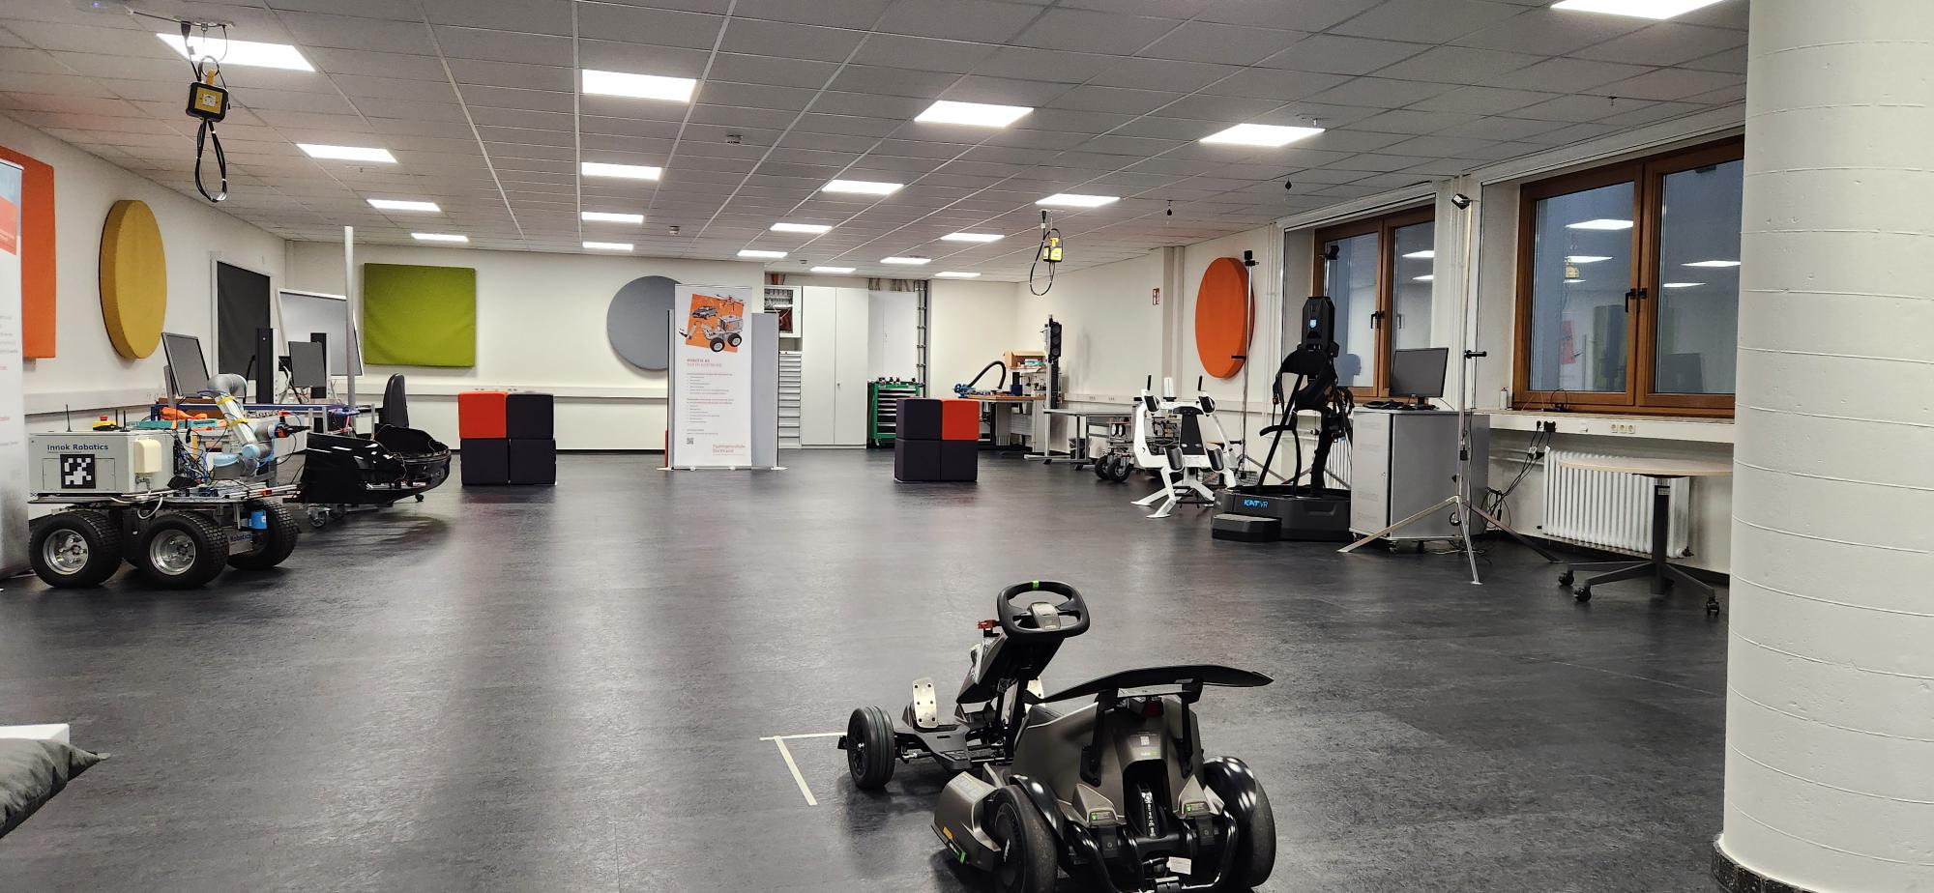
Intro to the car Segway Gokart Pro2

Slide 4
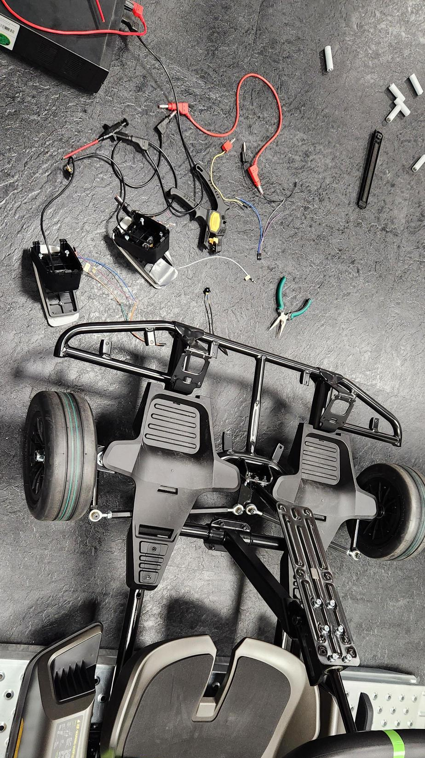
Reverse eng. About the car communication system
Understanding of the vehicle architecture.
How the system interacts with the real world.

Slide 5
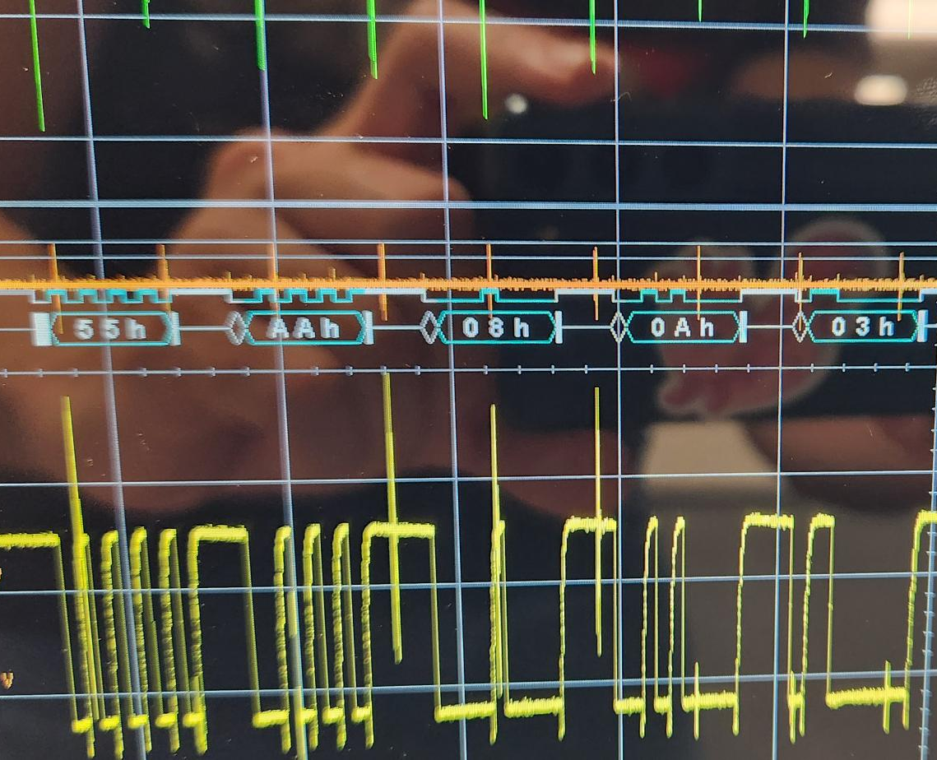
Reverse eng. About the car communication system
Understanding of the vehicle architecture.
How the system interacts with the real world.

Slide 6
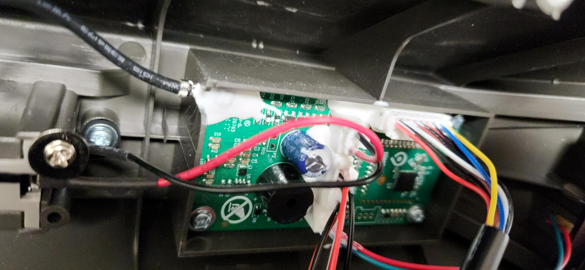
Reverse eng. About the car communication system
Connection to the communication system.

Slide 7
Info about the sensor
30 Frames per Second
Parameters
Etc

Slide 8

This project aims to develop a real-time object detection and collision avoidance system using the IWR6843AOPEVM mmWave radar sensor. The system processes raw radar data to extract meaningful information about surroundings, estimate self-speed, detect obstacles, and trigger a braking mechanism when necessary.

Slide 9
2. System Architecture
• Data Acquisition: Reads raw data from mmWave sensor.
• Data Processing: Filters noise, estimates speed, and clusters objects.
• Actuation: Activates brakes if an obstacle is detected.
• Uses a multi-threaded pipeline for real-time operation.

Slide 10
Data Acquisition
• The mmWave sensor continuously sends raw data via UART communication.
A serial thread reads and stores incoming data using PipelineLive.py or PipelineLiveRaspBerri.py scripts.
The dataDecoder module (dataDecoder.py) parses raw radar frames into structured point cloud data.

Slide 11
Data Processing Pipeline
• Frame Aggregation: Maintains historical frames.
• Point Filtering: Removes low-SNR and irrelevant points.
• Self-Speed Estimation: Uses Doppler velocities.
• Object Clustering: Groups detected objects with DBSCAN.
• Occupancy Grid Mapping: Generates 2D spatial maps.

Slide 12
4. Braking System
• Controlled via Raspberry Pi GPIO.
• Brake activates when an obstacle is detected within ‘x’ m.
• Implements a cooldown mechanism to prevent frequent activations.
• Ensures safe vehicle operation using real-time data.

Slide 13
5. Key Algorithms
• Kalman Filter: Smoothens velocity estimations.
• DBSCAN Clustering: Groups nearby points into objects.
• Doppler Filtering: Removes inconsistent velocity points.
• Occupancy Grid Mapping: Transforms radar data into a spatial grid.

Slide 14
Pipeline Variants
Pipeline.py: Processes pre-recorded radar data for debugging and visualization.
PipelineLive.py: Interfaces with the mmWave sensor in real-time.
PipelineLiveRaspBerri.py: Adds braking control via Raspberry Pi GPIO.

Slide 15
6. Results & Visualization
Point Cloud 3D Scatter Plots: Displays raw, filtered points, and clustered objects.
Velocity Graphs: Shows raw and filtered self-speed estimations over time.
Occupancy Grid Maps: Highlights areas with detected objects.

Slide 16
7. Future Improvements
• AI-based object classification.
• Further optimization for real-world deployment.

Slide 17
Potential Challenges
Data Interpretation: Translating raw radar signals into meaningful information about surroundings requires a thorough understanding of signal processing techniques.
Object Clustering: Implementing effective algorithms to group scattered radar points into real-world objects is non-trivial and may require experimentation with various clustering methods.
Collision Avoidance: Determining the threshold for triggering braking mechanisms needs careful consideration to avoid false positives or delays in processing.
Robustness: Ensuring the system operates reliably under diverse conditions, such as bad weather or obstacles causing radar interference, is crucial.

Slide 18
8. Conclusion
• Successfully integrates mmWave radar for object detection.
• Real-time speed estimation and clustering improve accuracy.
• Braking system ensures safety in dynamic environments.
• Paves the way for enhanced autonomous driving applications.

