Slide 1
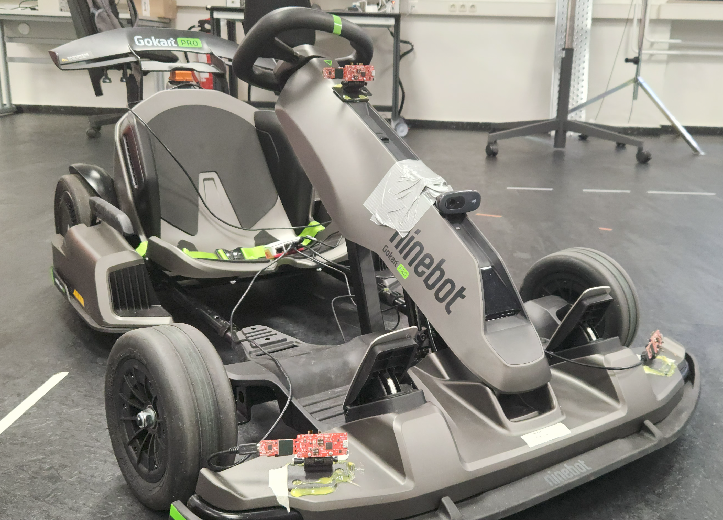
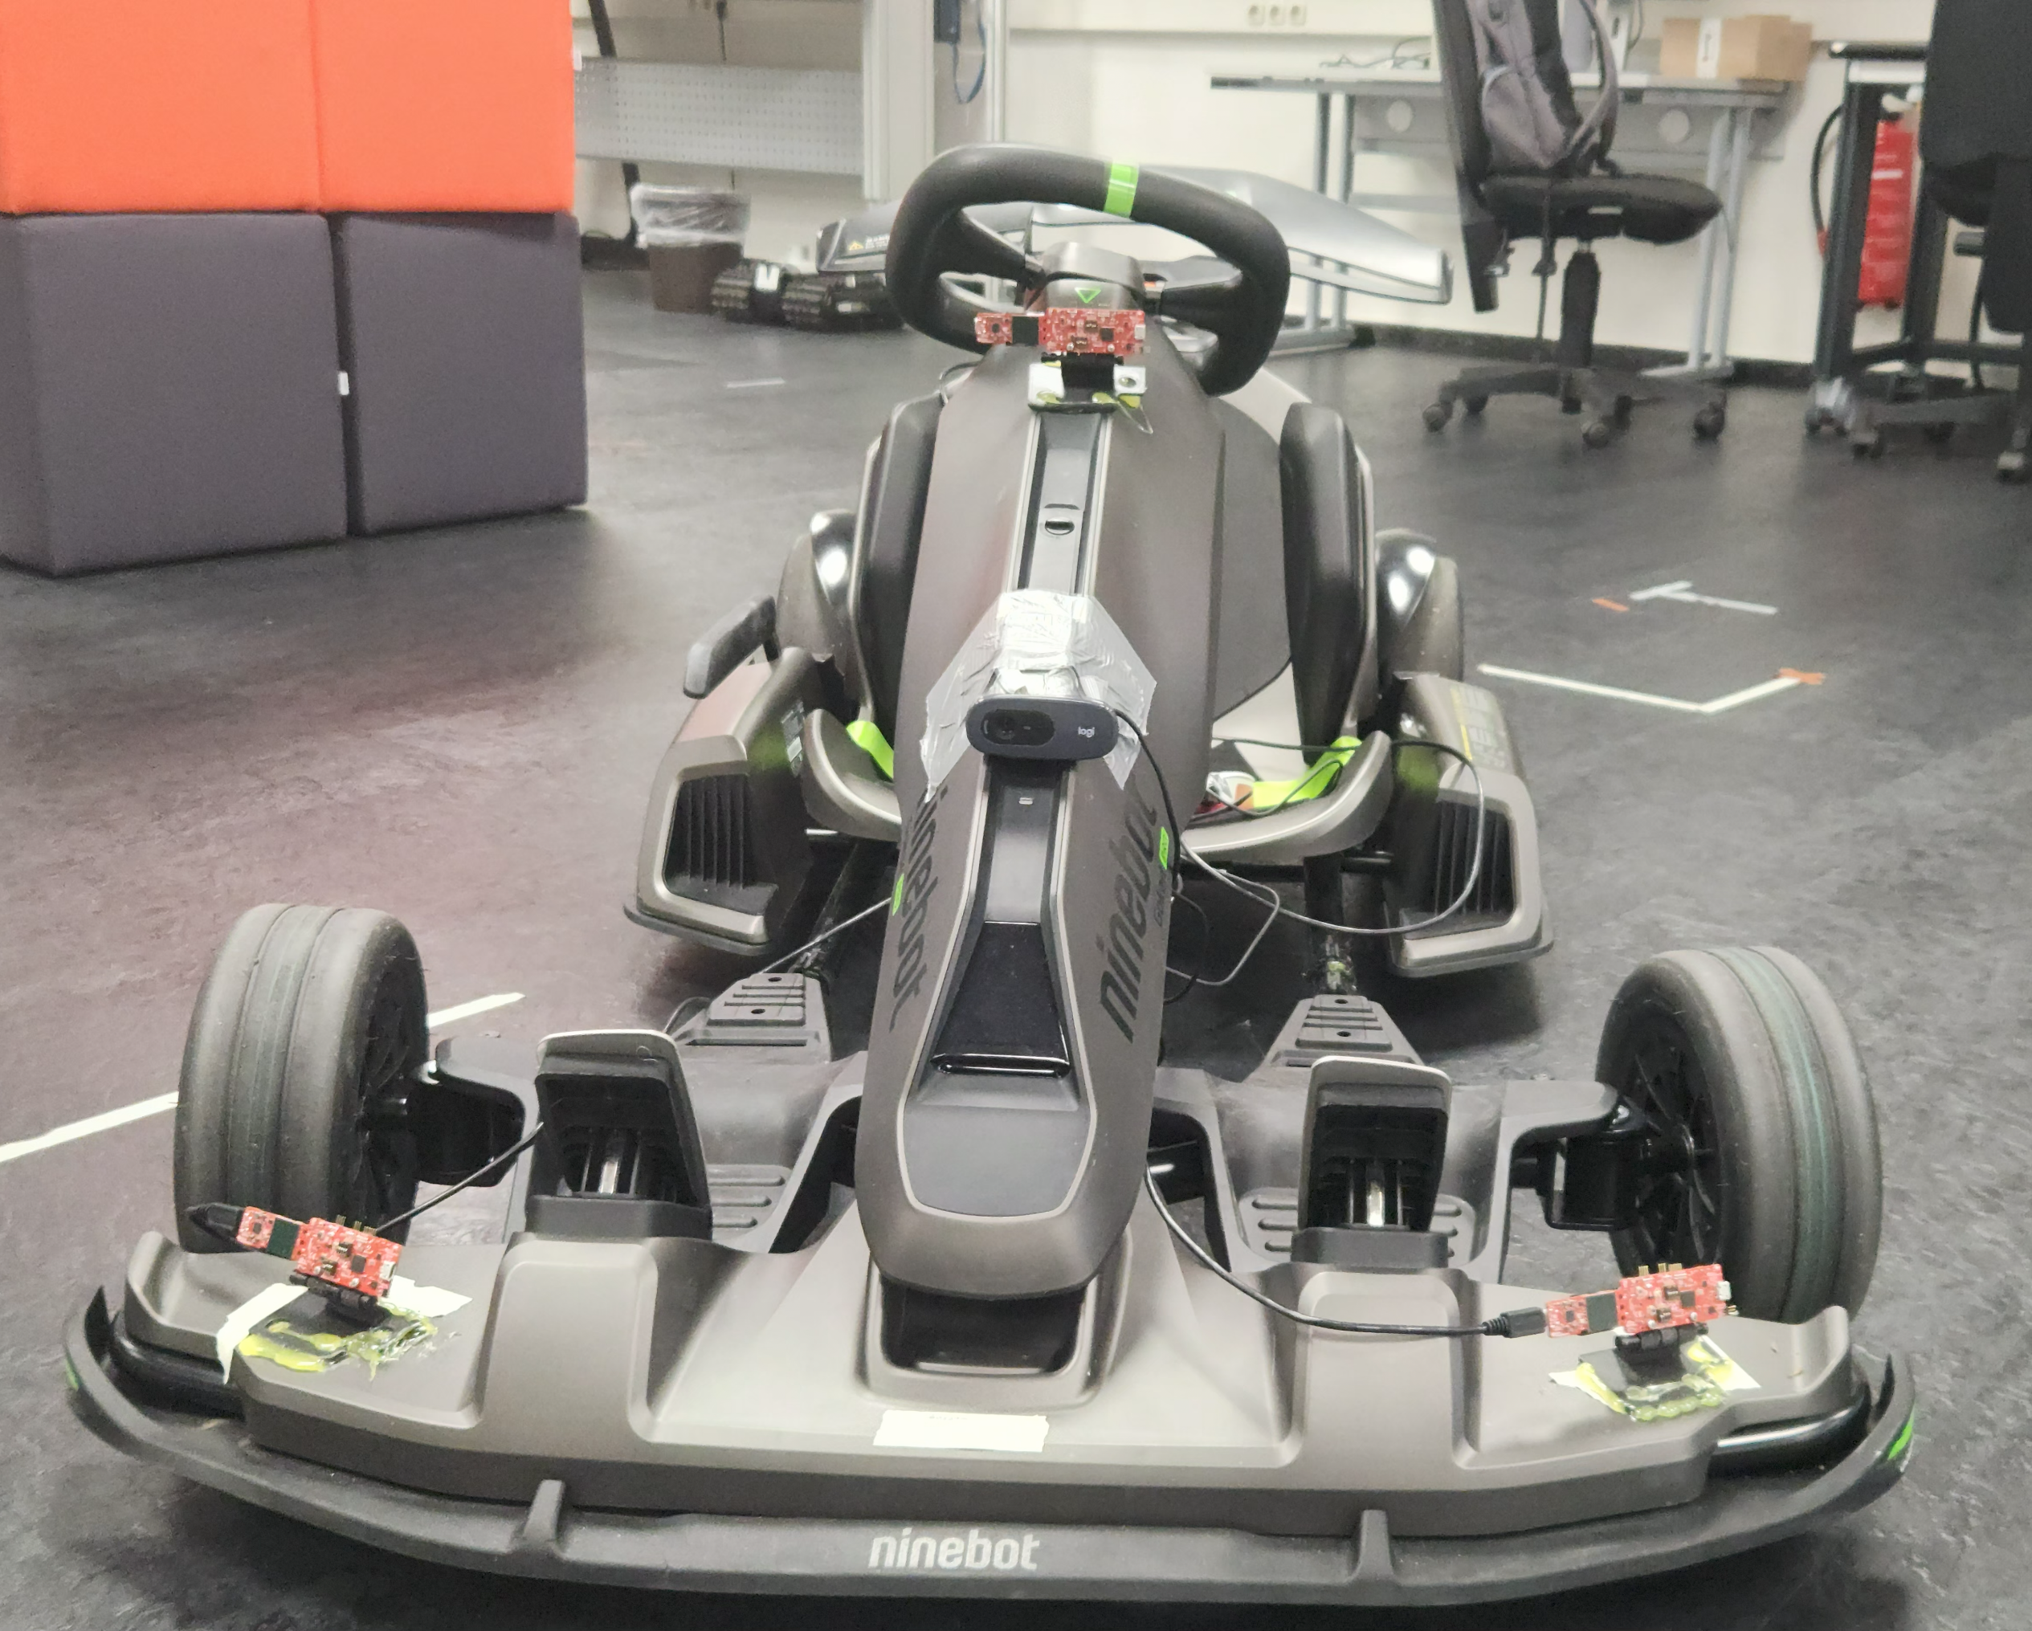
Hardware Setup
Ninebot Gokart PRO
Max. Speed: 40 km/h.
Max Distance: 25 km.
Max Acceleration: 1,02 G.
Drift-Assistance System.

Slide 2
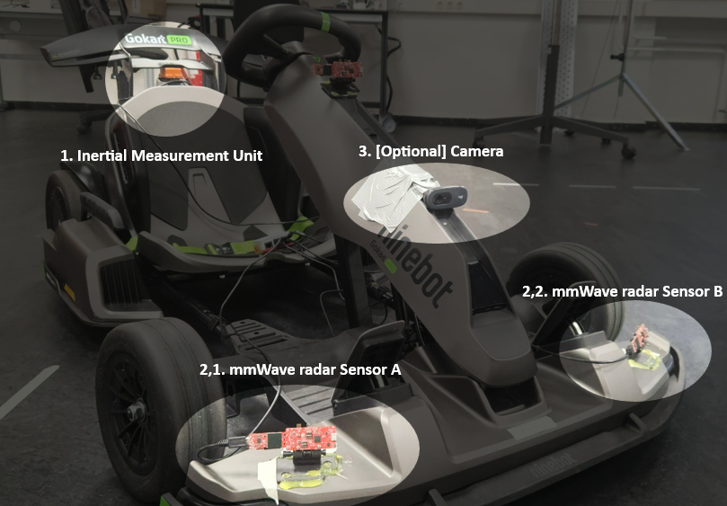
Hardware Setup
Sensors used for the project:
MTi-710, Inertial Measurement Unit.
IWR6843AOP, mmWave radar sensor.
Logitech C270 HD, Camera.

Slide 3
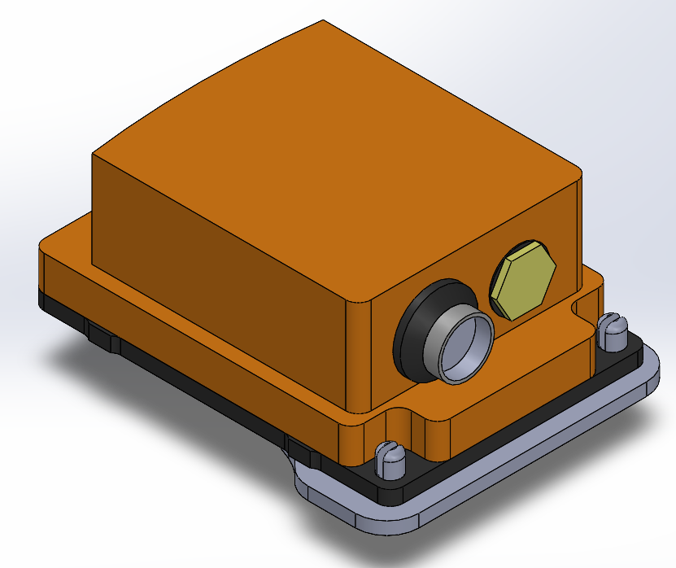
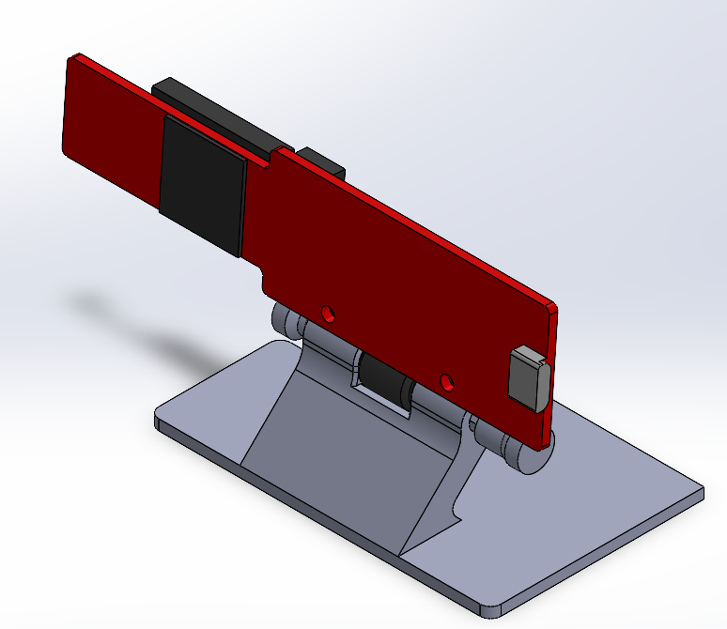
Hardware Setup
To securely integrate the sensors into the vehicle, custom 3D-printed mounts were designed.
Each mount ensures an optimal alignment and positioning of the sensors to maintain consistent measurement geometry.
The models were developed in CAD to ensure the following points:
MTi-710, ensure close to no tilt to the sensor to avoid post processing.
IWR6843AOP, ensure stability when mounted and possibility to tilt the sensor to modify the field of view.

Slide 4
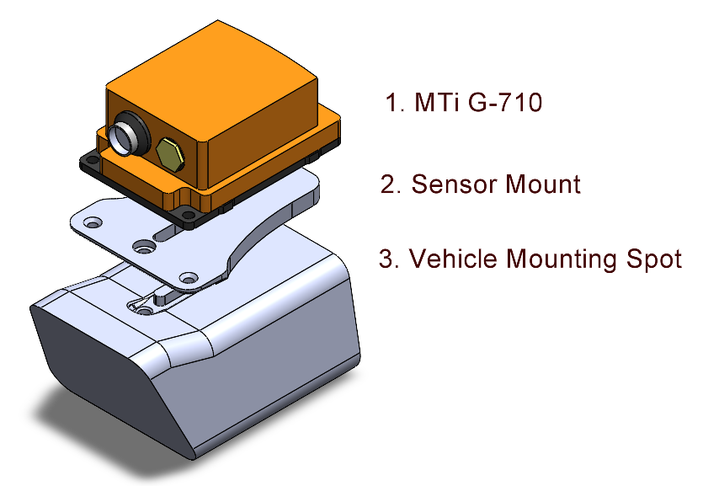
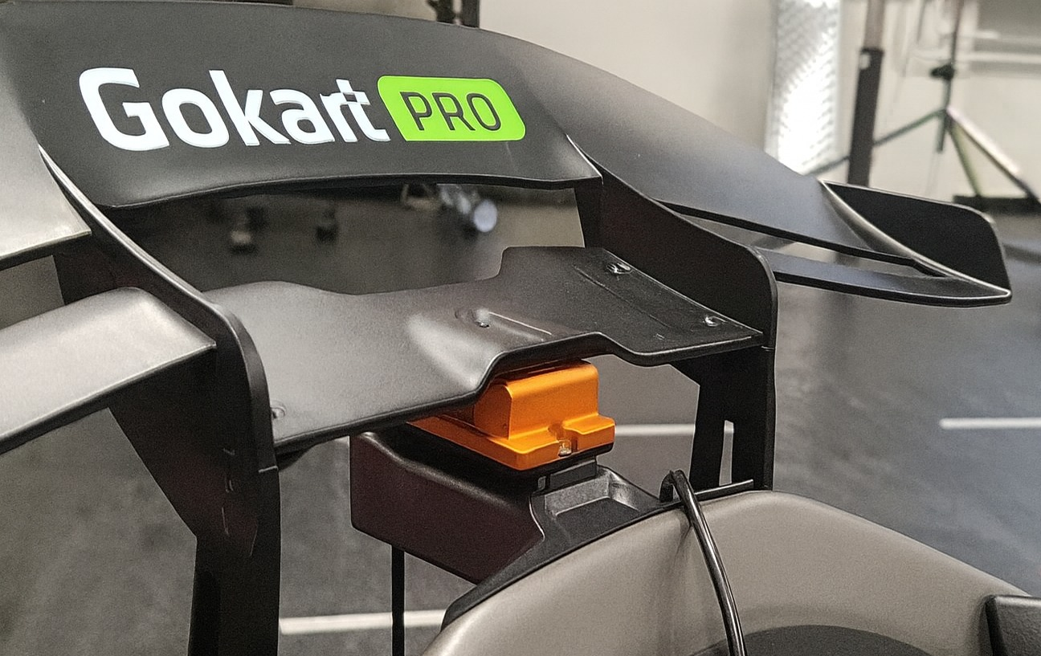
Hardware Setup
MTi-710
The integration of the IMU was an interesting one. As the nature of the IMU is to measure the inertia and rotation, the mounting of this sensor is crucial. Depending on the position a post-processing needs to be done to ensure accurate measurements or place it in an “ideal” position. For this vehicle the ideal place was found, however it needed a unique mount for the vehicle.

Slide 5
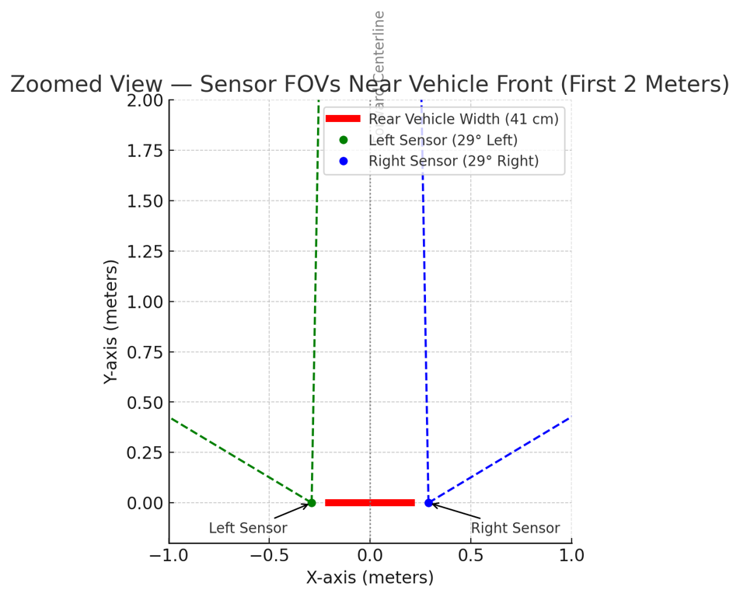
Hardware Setup
IWR6843AOP
The project utilizes a dual-radar setup. The goal of this setup is to enable a wider field of view and increase the translation accuracy even in tight turns.
A simulation was first made to decide the most appropriate location and rotation placement of the sensors. This to decide what would the FOV would look in the implementation.

Slide 6
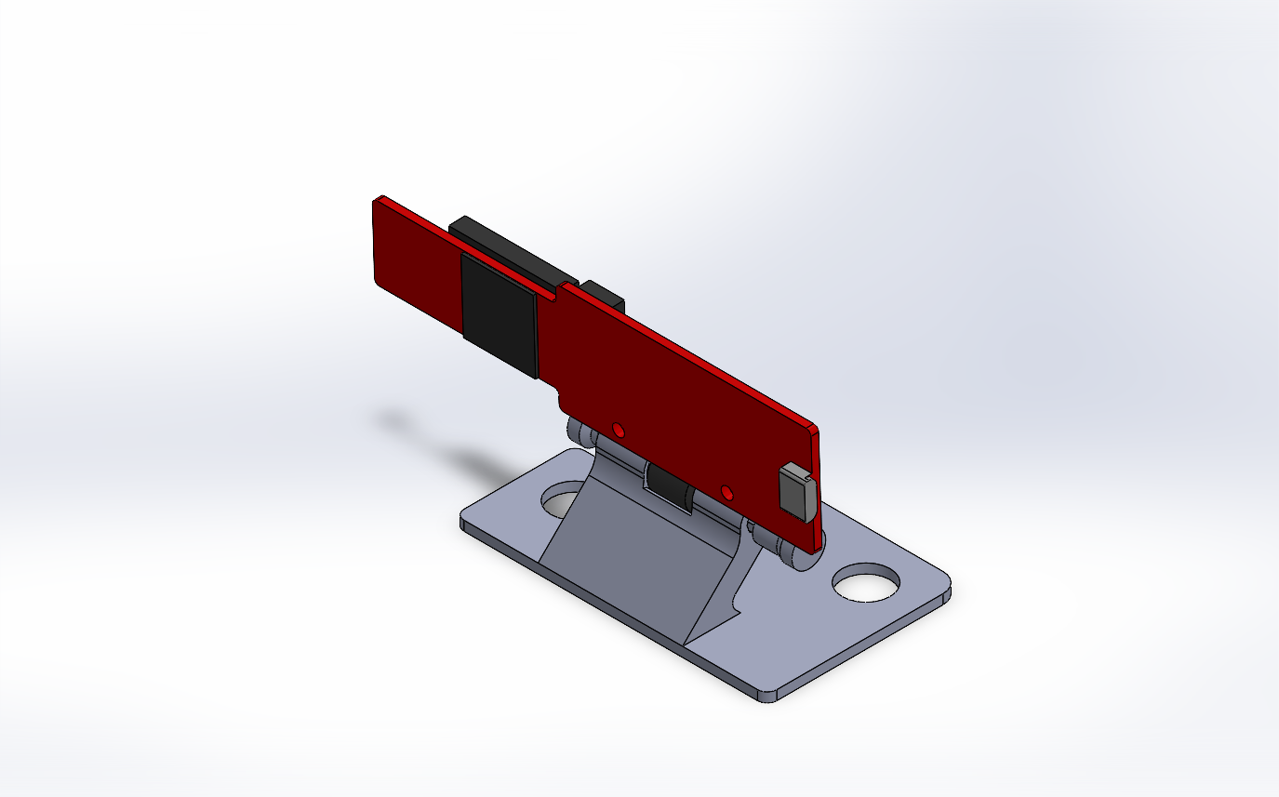
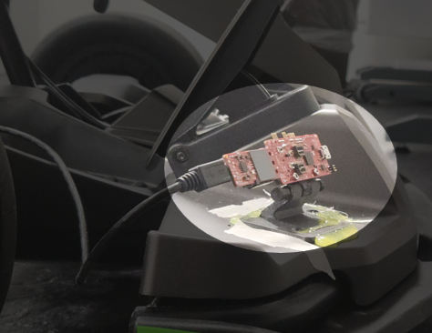
Hardware Setup
IWR6843AOP
X axis translation – 58 cm
X axis Tilt – 15 degrees.
Y axis rotation – 30 degrees.

Slide 7
Understanding how IWR6843AOP works
The mmWave radar emits frequency-modulated continuous waves (FMCW) that propagate through space and reflect surrounding objects.
By measuring the time delay and shift in frequency (Doppler effect) of the returned signal, the sensor estimates both range and relative velocity of the reflected targets.

Slide 8
Static and Dynamic Objects
Then the radar moves, reflected signals encode both object motion and the radar’s own motion.
  Static objects: Reflected Doppler shift arises from radar’s ego-motion.
  Moving objects: The measured Doppler includes both the object’s and the radar velocity components.

Slide 9
Problem Definition.
Limitations of Radar for Odometry.
Sparse point clouds.
  Radar detects only a few reflections per computed frame. Meaning weak geometric of non reflective material will not be easily detected.
Multipath and clutter.
  Indirect reflections from metallic or smooth surfaces create ghost points or unreliable doppler calculations.
Measurement noise.
  Low SNR and range quantization cause unstable point locations and Doppler outliers.
Dynamic scenes.
  Moving objects introduce inconsistent detentions between frames.

Slide 10
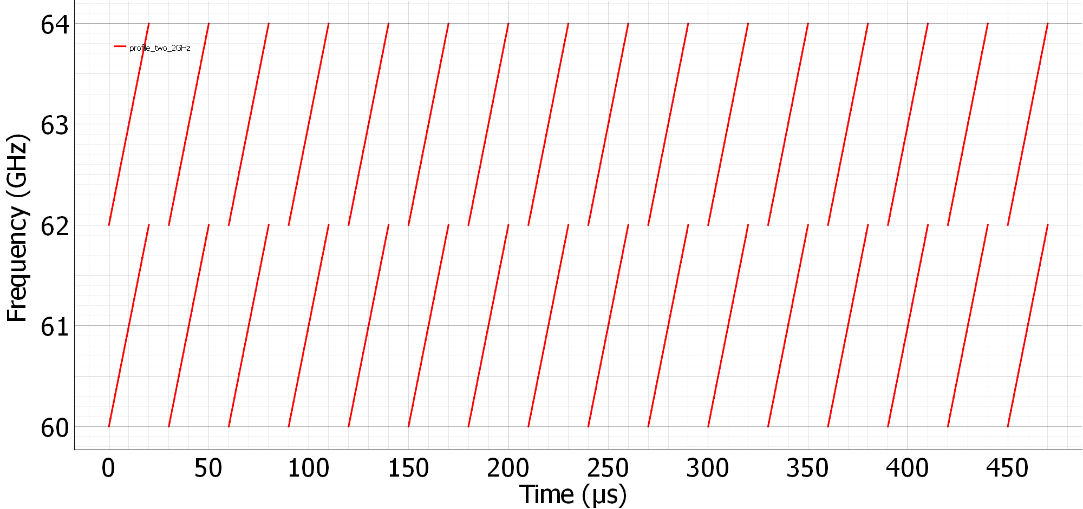
Problem Definition.
Limitation of a Dual-Radar setup.
To avoid the multipath of “ghost detections” when using 2 radars a simple solution is often used, such as using different frequencies in each sensors.
Sensor A: 60-62 GHz
Sensor B: 62-64 GHz

Slide 11
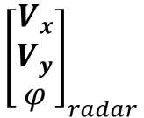
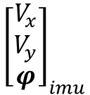
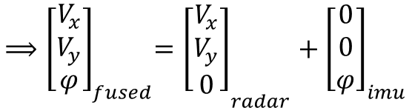
Problem Approach.
Why mmWave + IMU?
  Environmental robustness: Operates reliably under adverse conditions, such as rain.
  Doppler advantage: Directly measures radial velocity, reducing ambiguity in motion estimation.
  Inertial support: IMU provides pose estimates complementing radar’s data.
  Combined benefit:
    Radar provides translation.
    IMU provides consistent rotation.
and

Slide 12
Hardware Setup
IWR6843AOP

