Slide 1
Radar Odometry
Research Project weekly updates

Slide 2
Table of Content

Slide 3
Period Highlight - 4
Implementation of Vx and Vy
Validation of Vx and Vy
Obtain IMU

Slide 4
Period Highlight - 5
Progress
Python script with Vx and Vy.
Read Mti (IMU) sensor.
mmWave sensor Mount.
Next steps
Print MTi sensor mount.
Test sensor fusion recording.
Validate implementation of Vx and Vy .
Implement Vx and Vy with IMU values, for rotation.

Slide 5
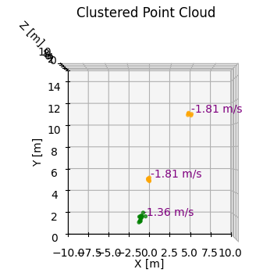
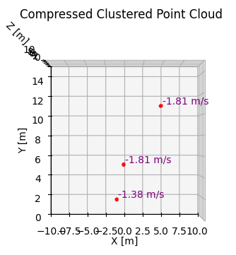
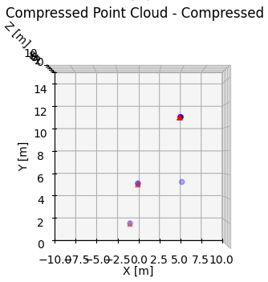
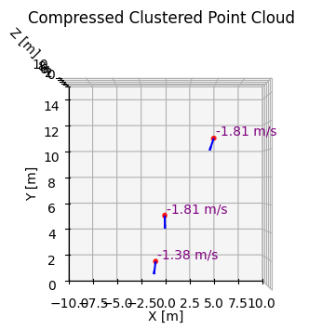
Period Highlight – 5 Vx & Vy Components

Slide 6
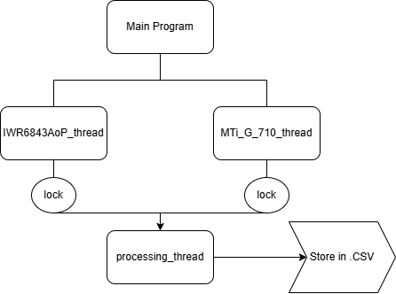
Period Highlight – 5 Sensor Fusion

Slide 7
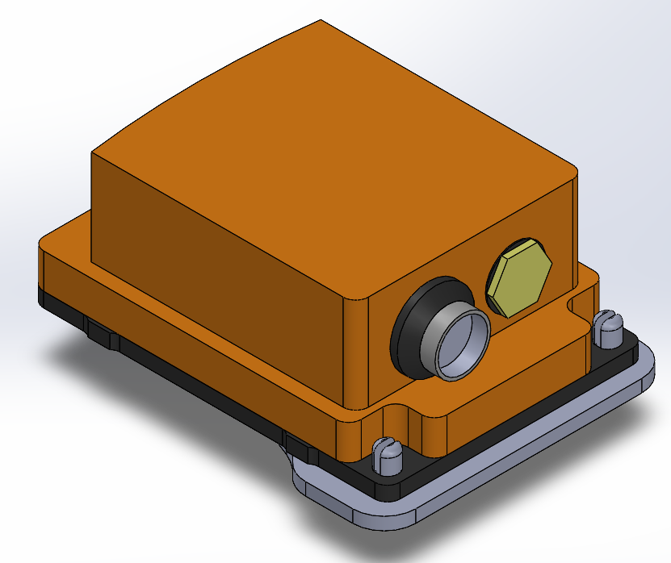
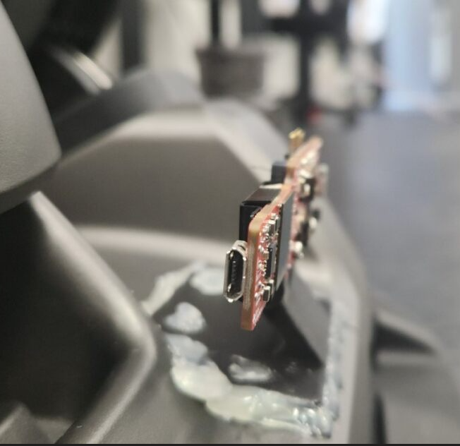
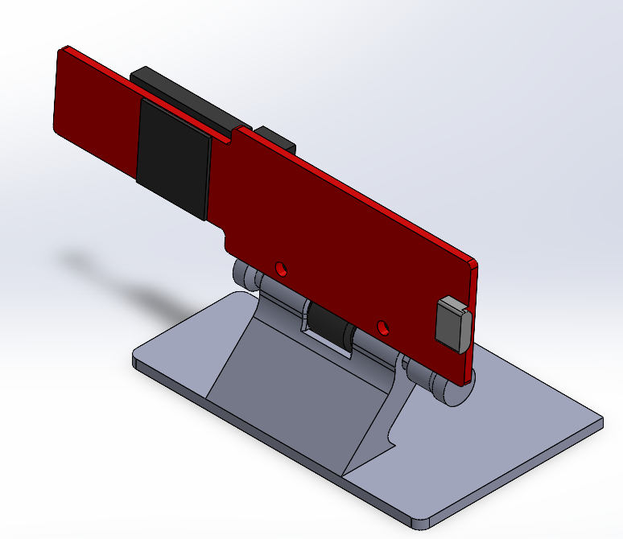
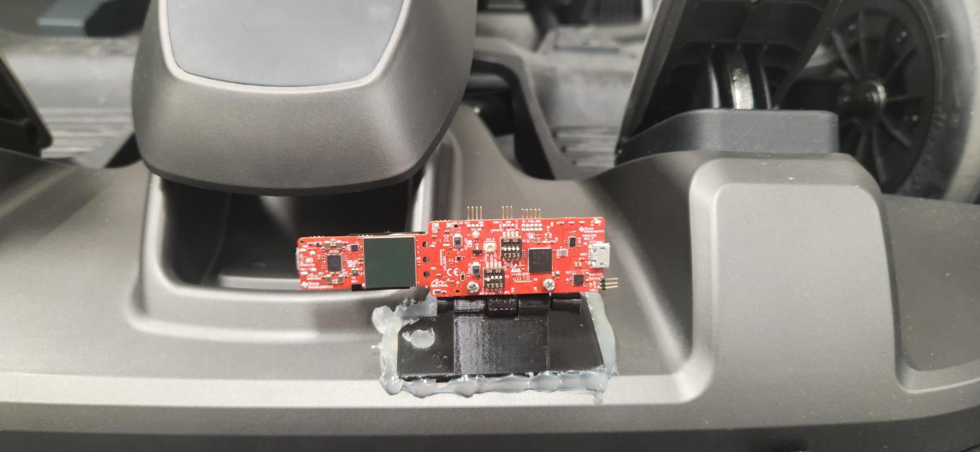
Period Highlight – 5 Hardware Implementations

Slide 8
Period Highlight - #

Slide 9
Period Highlight - #

Slide 10
Period Highlight - #

