Slide 1
Radar Odometry
Research Project weekly updates

Slide 2
Table of Content

Slide 3
Period Highlight - 4
Implementation of Vx and Vy
Validation of Vx and Vy
Obtain IMU

Slide 4
Period Highlight - 5
Progress
Python script with Vx and Vy.
Read Mti (IMU) sensor.
mmWave sensor Mount.
Next steps
Print MTi sensor mount.
Test sensor fusion recording.
Validate implementation of Vx and Vy .
Implement Vx and Vy with IMU values, for rotation.

Slide 5
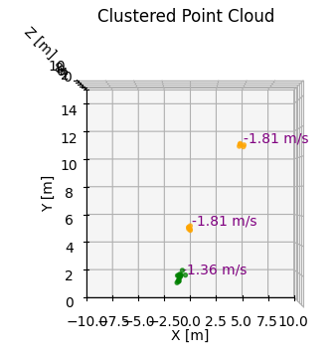
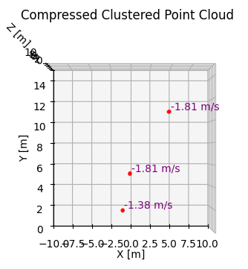
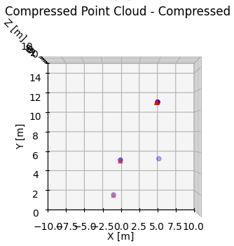
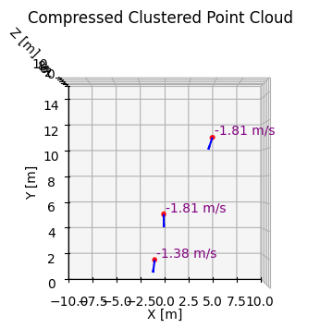
Period Highlight – 5 Vx & Vy Components

Slide 6
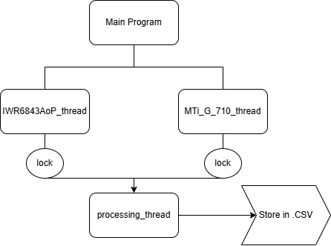
Period Highlight – 5 Sensor Fusion

Slide 7
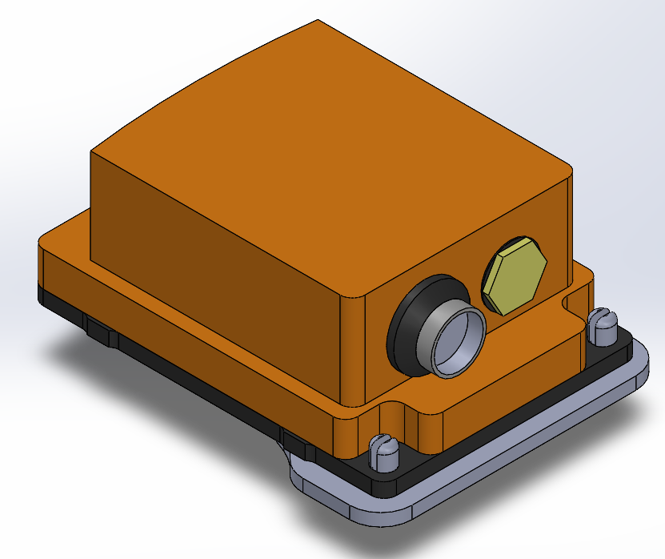
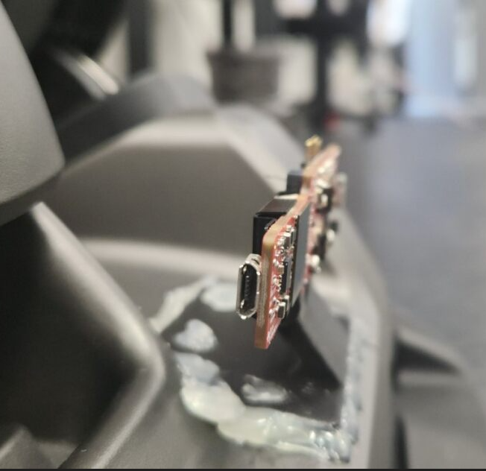
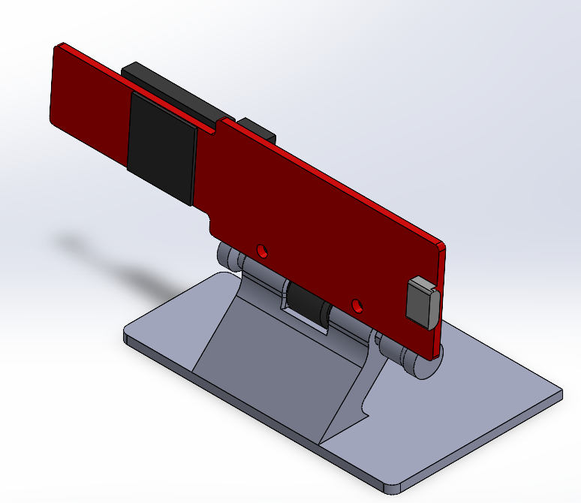
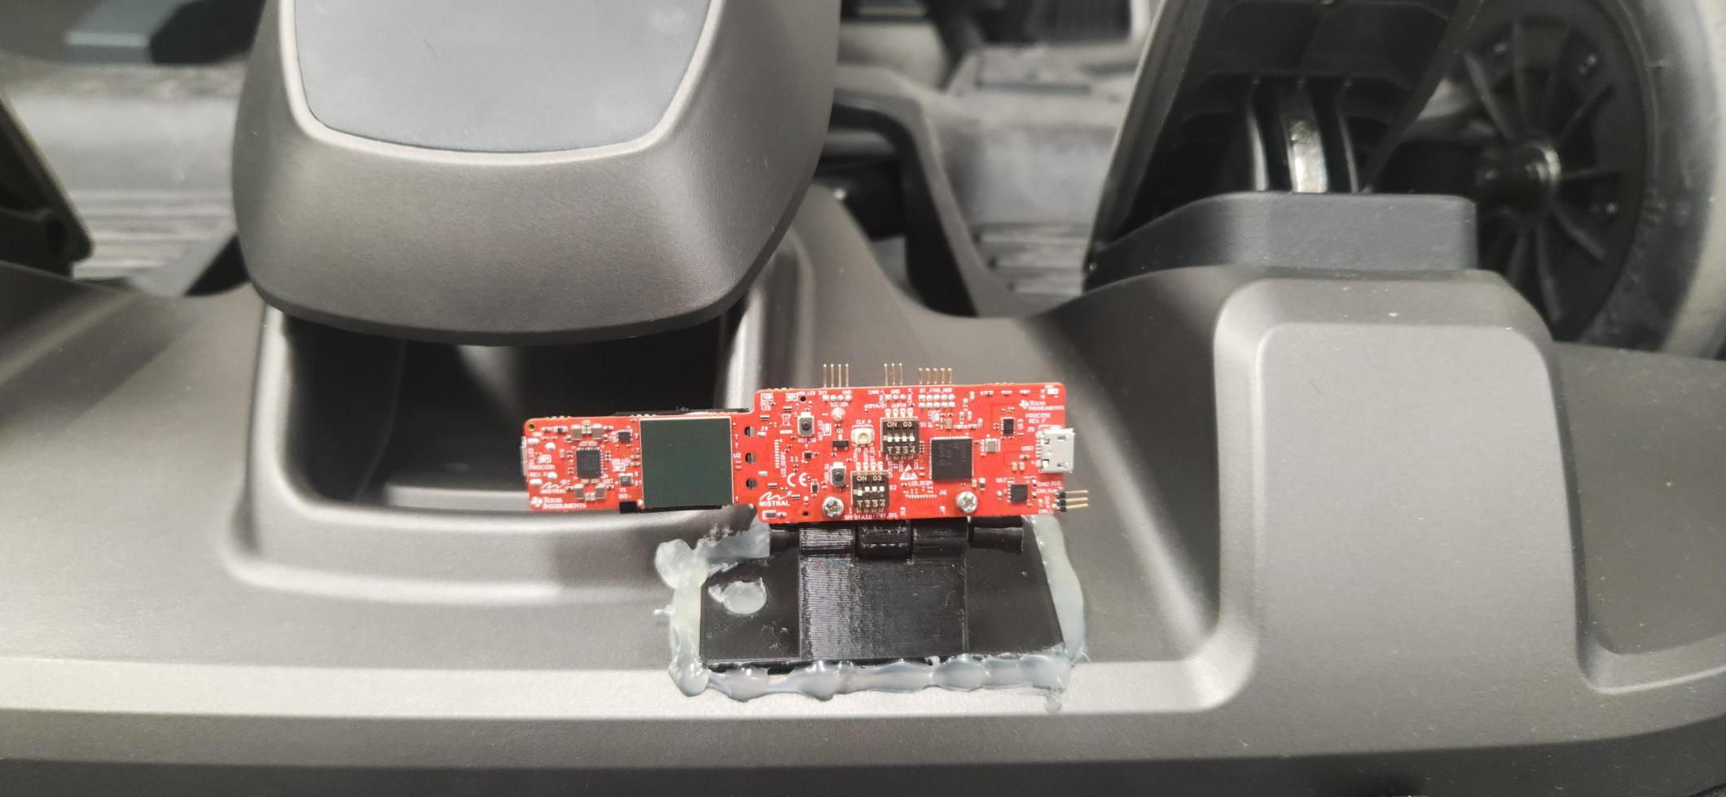
Period Highlight – 5 Hardware Implementations

Slide 8
Period Highlight - 6
Progress
Work and improve recording script for concurrent recording.
Print IMU sensor mount.
Next steps
Test in lab.
No access to lab this period.

Slide 9
Period Highlight – 7
Progress
Concurrent sensor logs.
IMU sensor mount.
Problems
IMU sensor mount broke.
Next steps
Incorporate new logs with visualization.
Incorporate VxVy with IMU data.
Investigate the role in this before implementation.
Create a draft.
Print again the IMU sensor mount.
Discuss second radar sensor. (?)

Slide 10
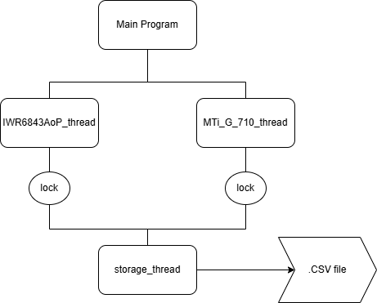
Period Highlight – 7 Sensor Fusion

Slide 11
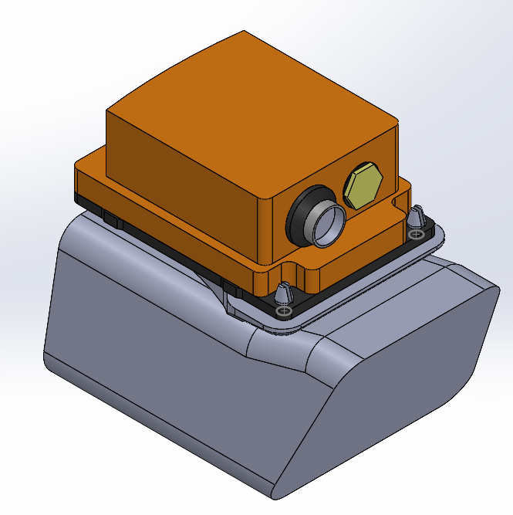
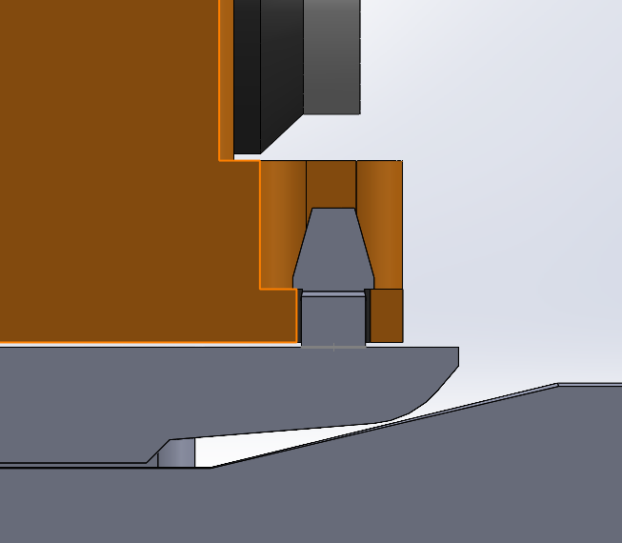
Period Highlight – 7 Hardware Implementations

Slide 12
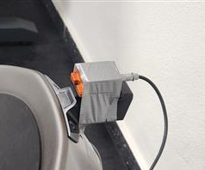
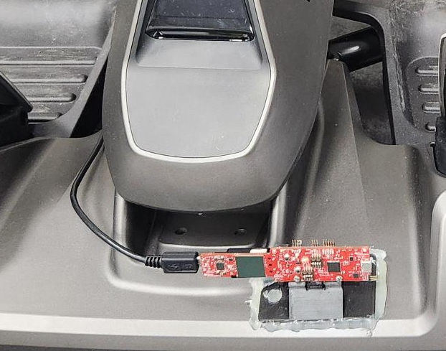
Period Highlight – 7 Hardware Implementations

Slide 13
Period Highlight – 8 Software Implementations
Cluster tracking
Still under refinement.
Tracking clusters using Euclidean distance to determine a unique ID.
Possible future implementation, using linear regression or polynomial regression accepting error.
Following a straight line a cluster that has been detected at least 2 times by Euclidean distance tracking.
Use that line to track future Clusters to assign the unique ID.
Avoid tracking once the cluster is in a certain distance from target.

Slide 14
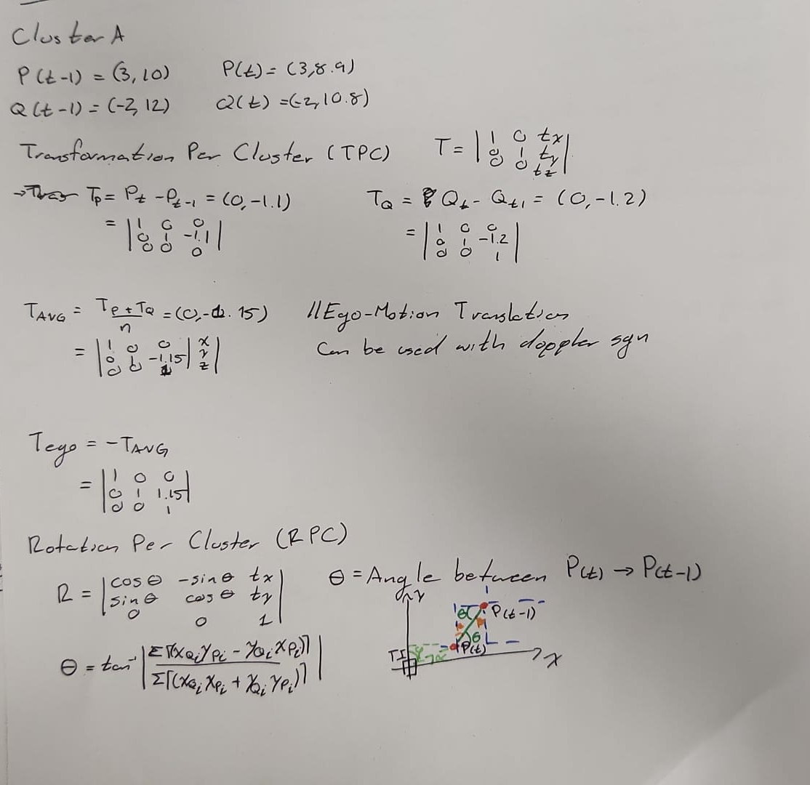
Period Highlight – 8 Software Implementations
Cluster per Cluster ICP
Whole scan vs CpC (Cluster per Cluster).

Slide 15
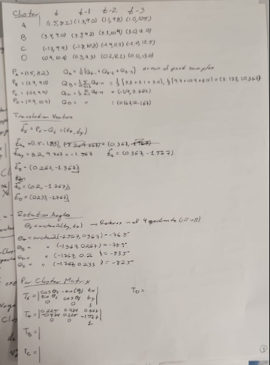
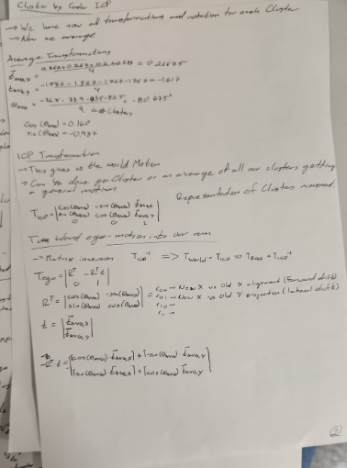
Period Highlight – 8 Software Implementations
Cluster per Cluster Analysis

Slide 16
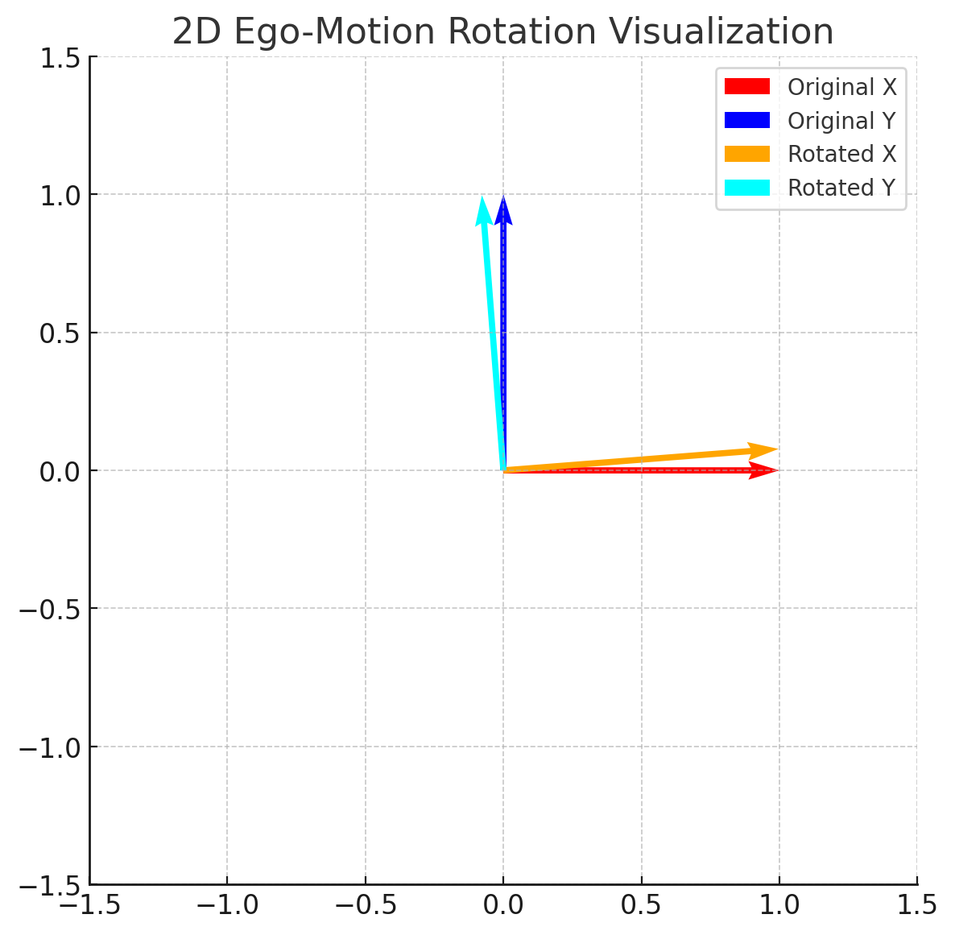
Period Highlight – 8 Software Implementations
Demonstration of the previous analysis.

Slide 17
Period Highlight – 8 Software Implementations
Demonstration of the previous analysis.

Slide 18
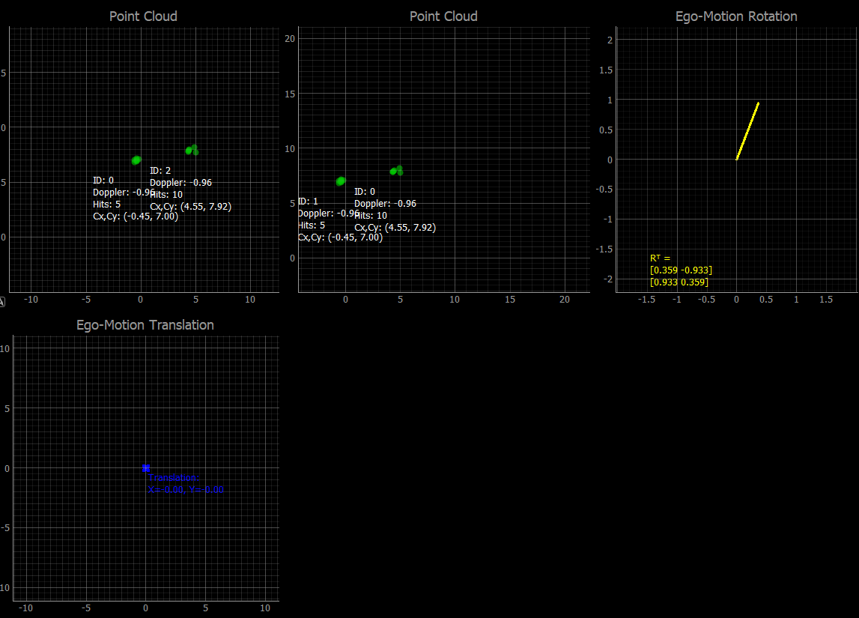
Period Highlight – 8 Software Implementations
Visualization moved to pyqtgraph for improvement since live visualization is now available.

Slide 19
Period Highlight – 9 Missed

Slide 20
Period Highlight – 10 Networking Preparations
Got in contact with Dr. Alexis Kostas from Norway.
Radar-Inertial ICP-based Pose Graph SLAM
Which later direct me to Morten Nissov, also from Norway.
Explain about the project that was implemented before and current work.
New material provided by them:
Instantaneous ego-motion estimation using Doppler radar
According to the paper results, this was done in last semester project.
Fusion of this work and current one is on the way.

Slide 21
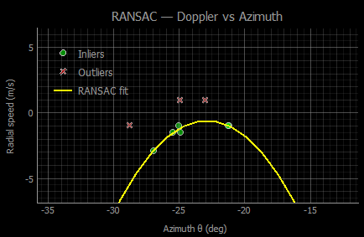
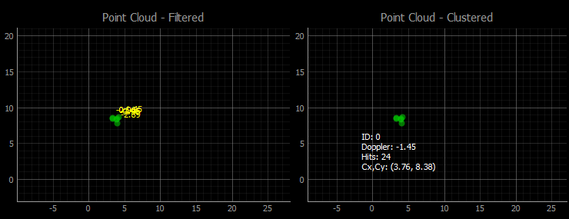
Period Highlight – 10 Software Implementations
Implemented filter using RANSAC

Slide 22
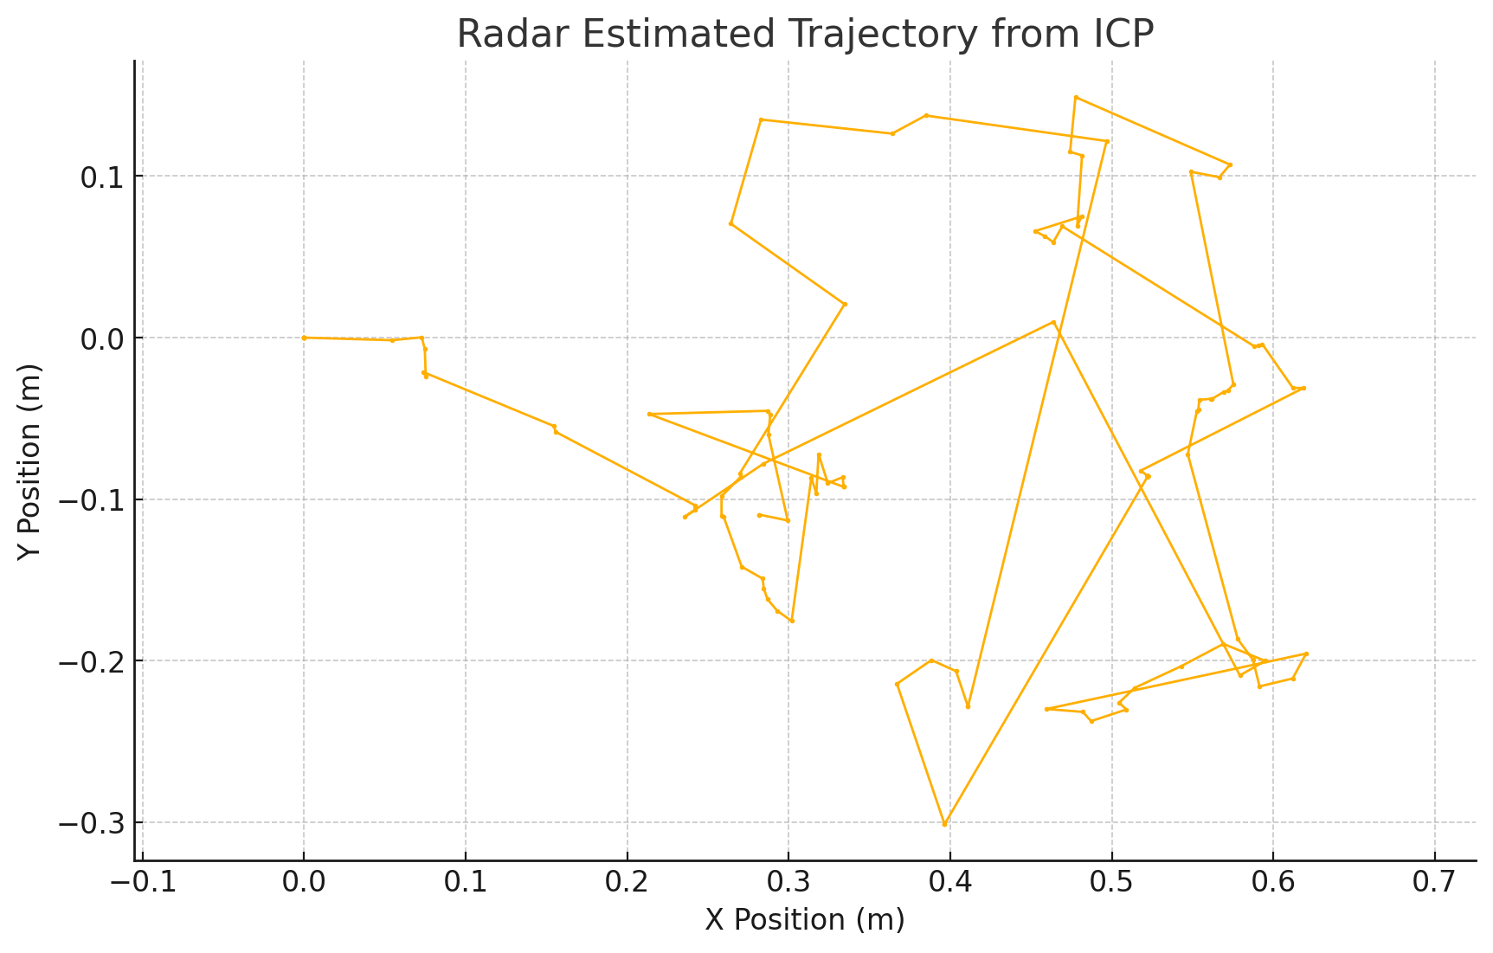
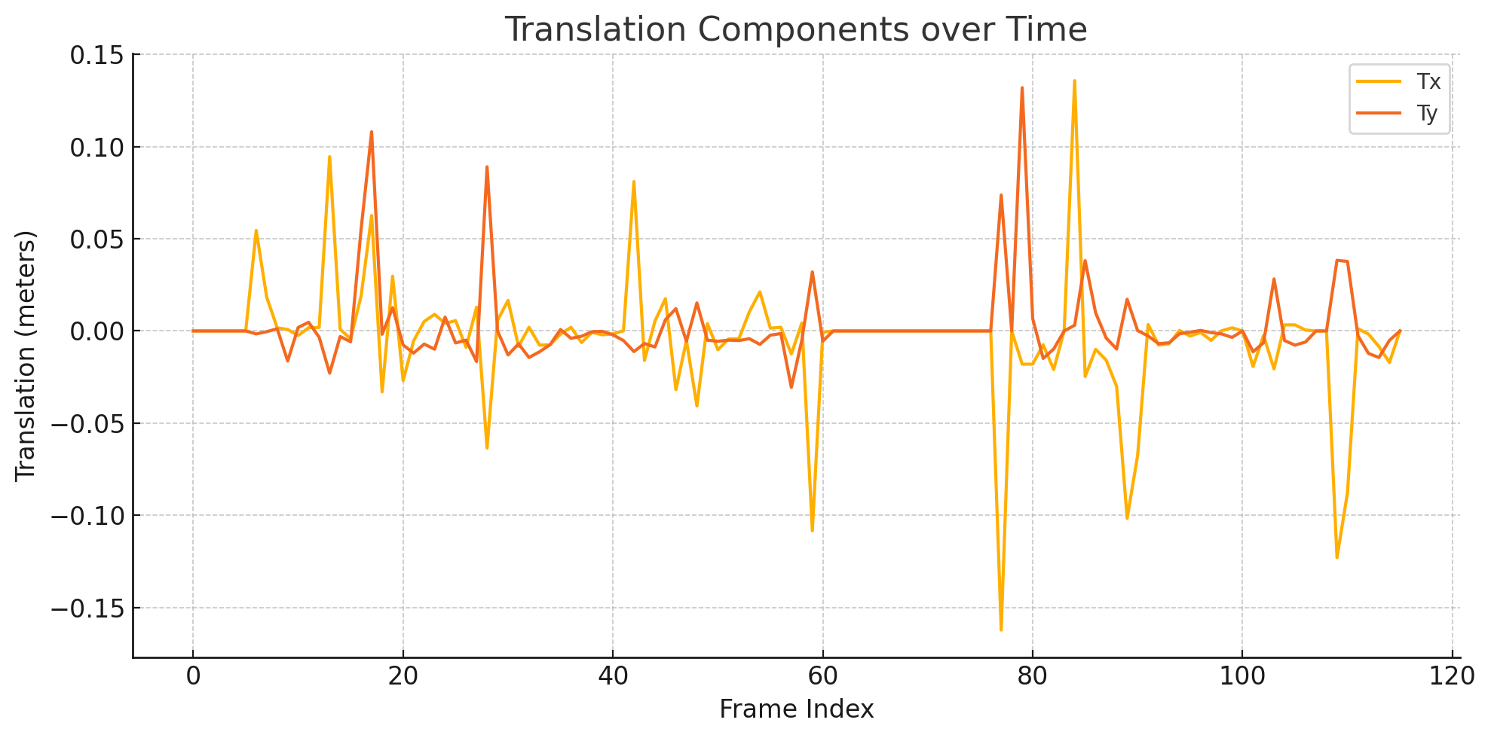
Period Highlight – 10 Software Implementations
Trajectory Hallway test

Slide 23
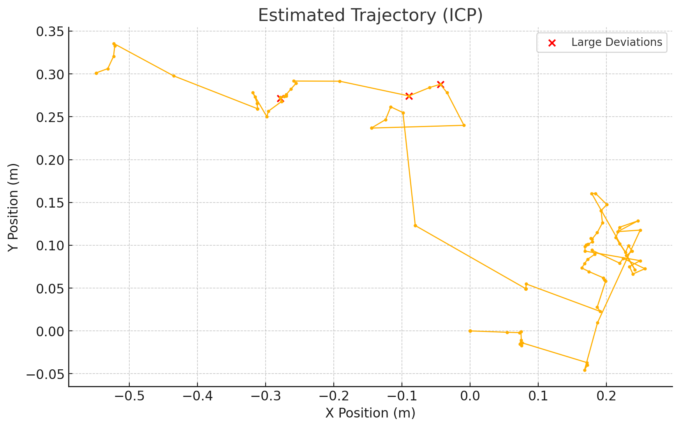
Period Highlight – 10 Software Implementations
Trajectory Hallway test

Slide 24
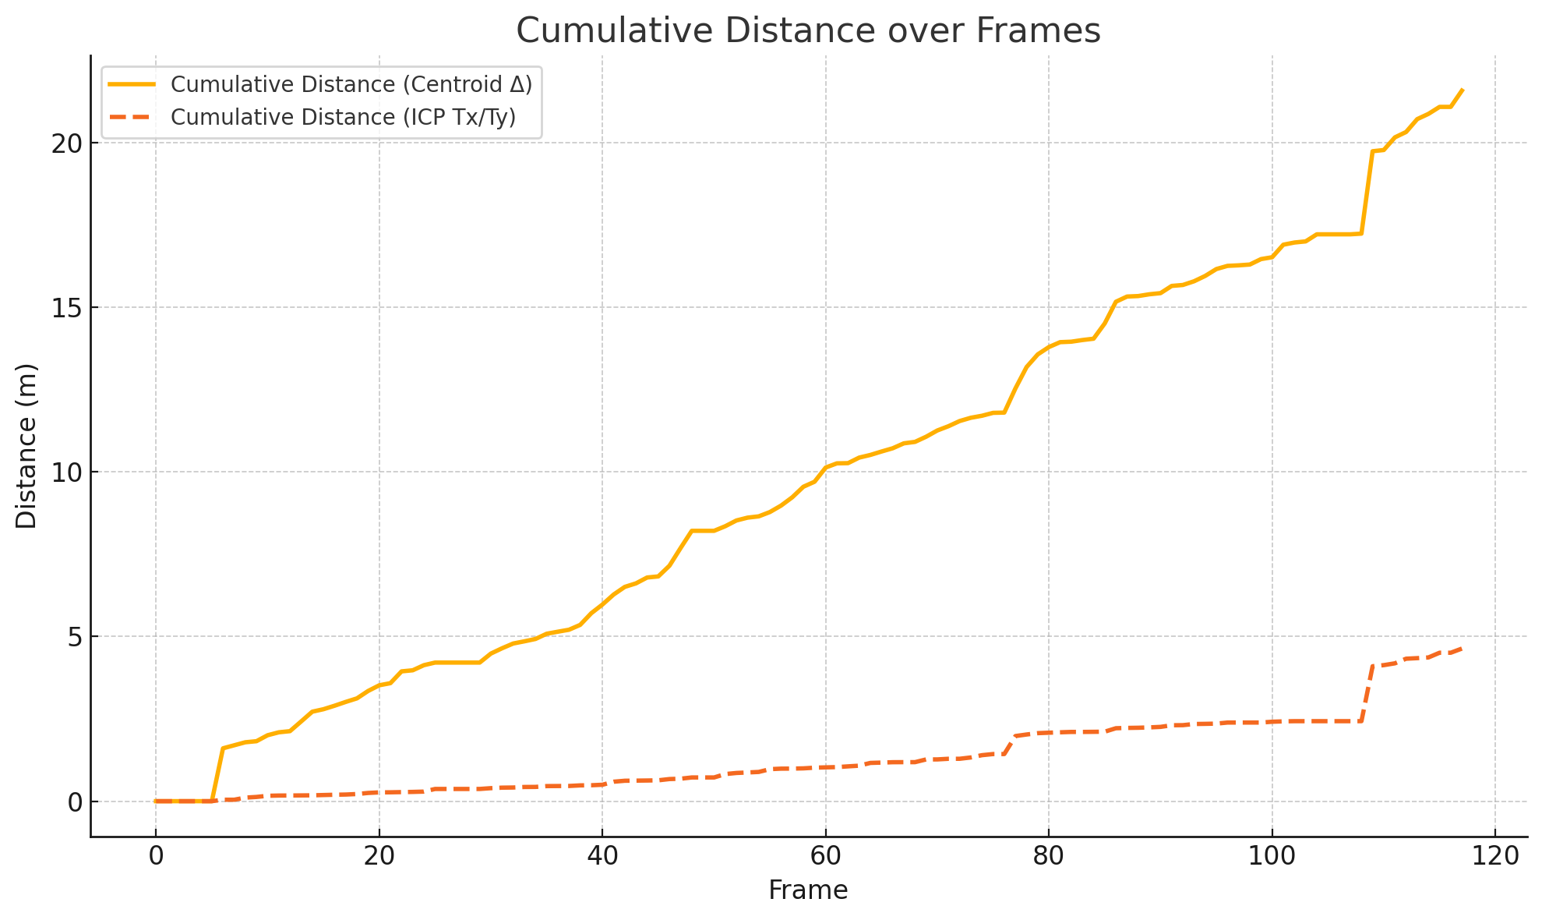
Period Highlight – 10 Software Implementations
Trajectory Hallway test

Slide 25
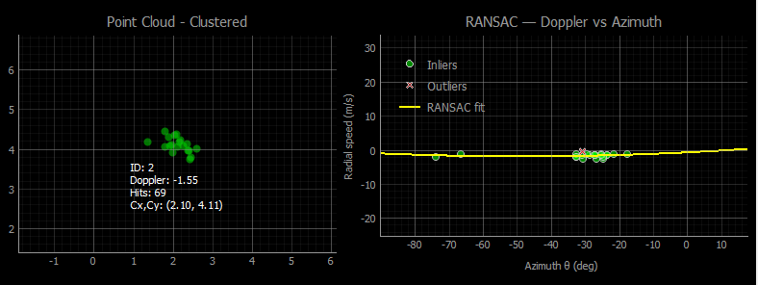
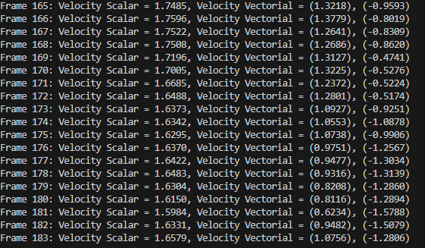
Period Highlight – 10 Software Preparations
Joining instant ego-motion using Doppler.

Slide 26
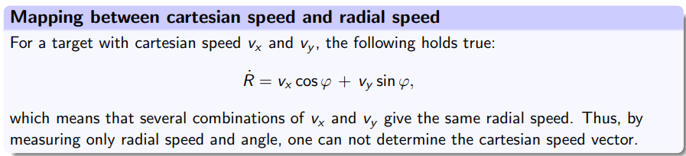
Period Highlight – 10 Hardware Preparations
Investigate and plan about inserting a second sensor.
Due to lack of continuous point clouds.
Positive results from merging Cartesian speed and ICP translation.
Image obtained from “Lecture_RadarSystem.pdf” by Andreas Becker.

Slide 27
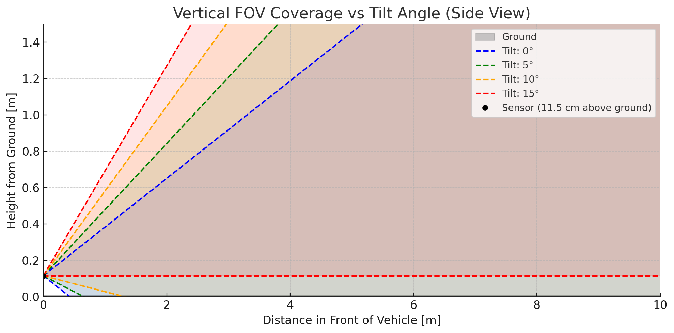
Period Highlight – 10 Hardware Preparations
Inclination Angle

Slide 28
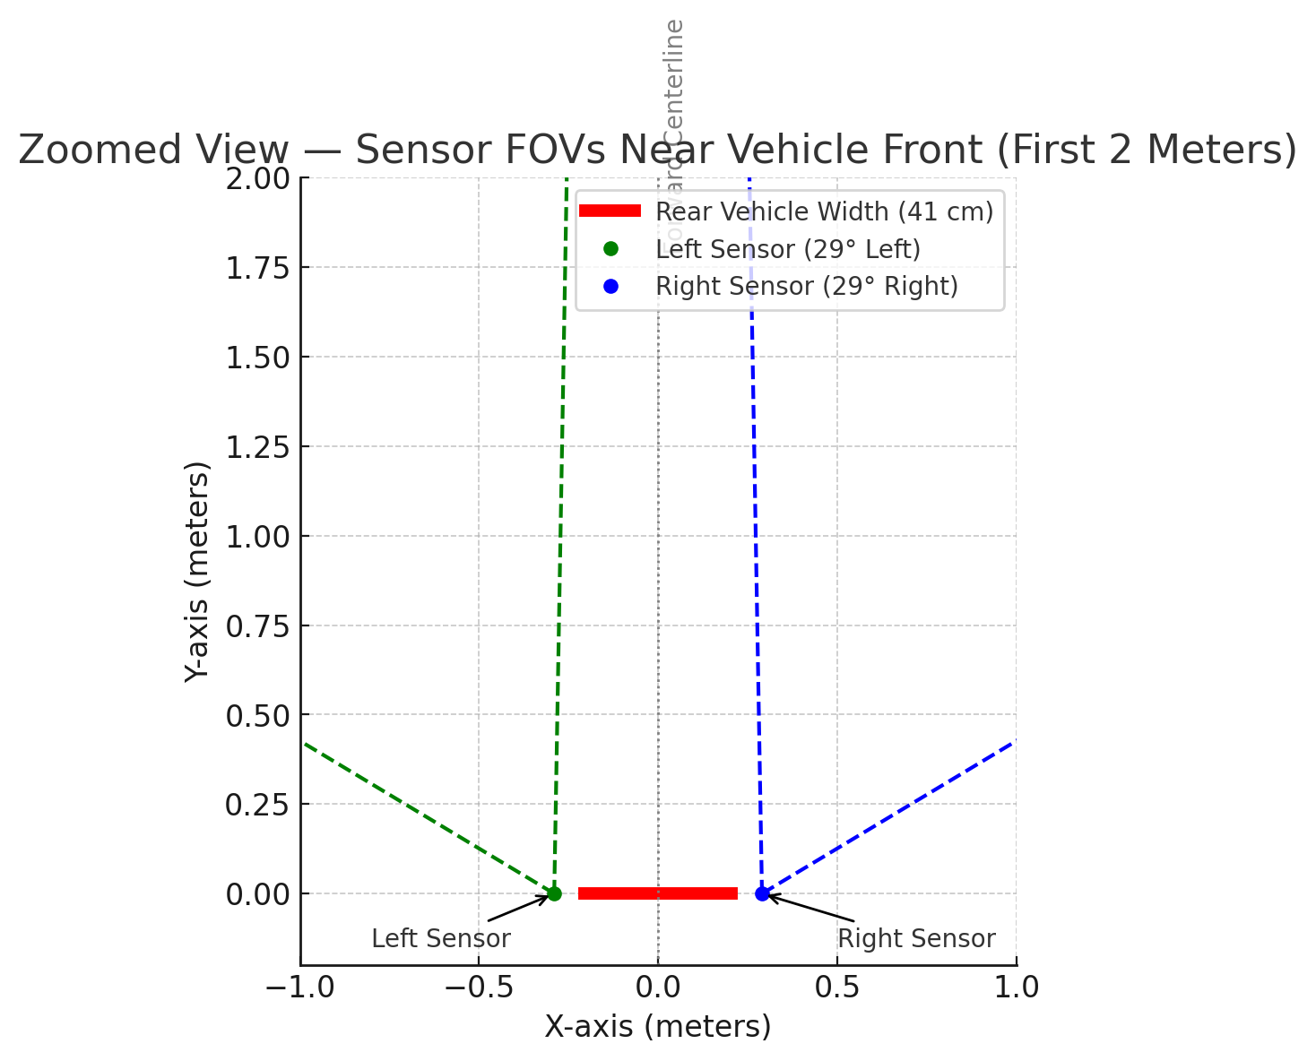
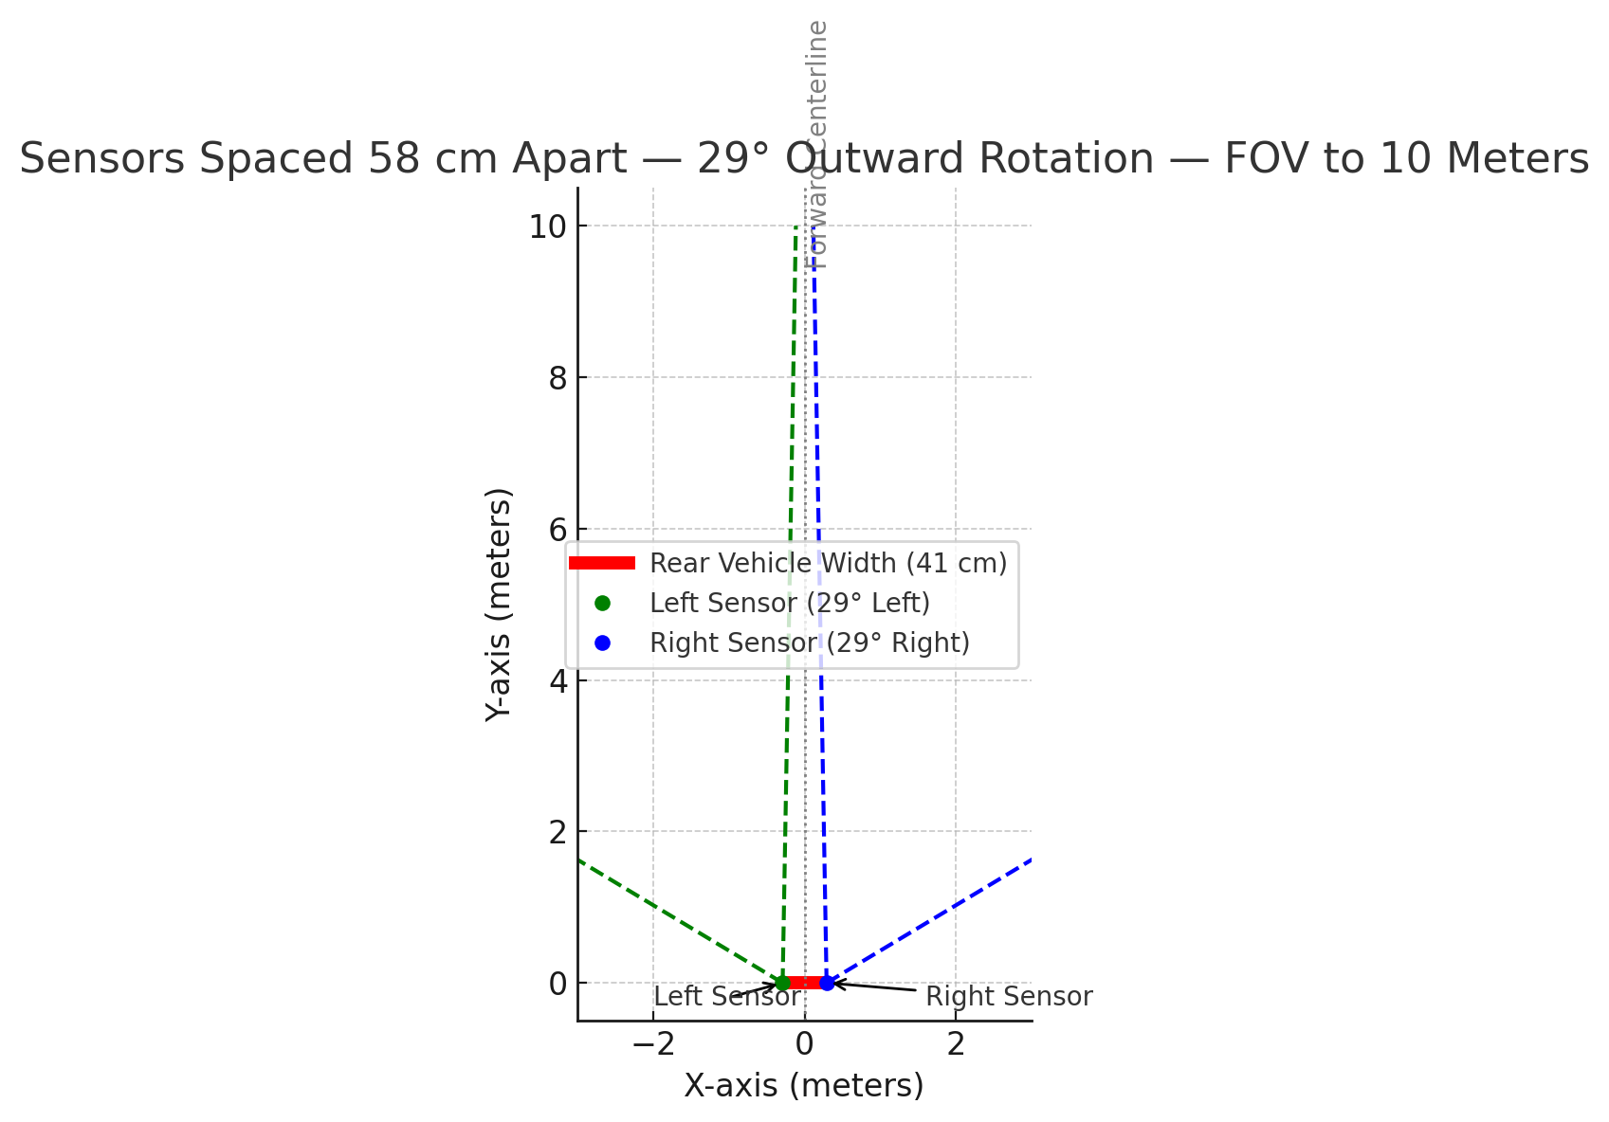
Period Highlight – 10 Hardware Preparations
Rotation Angle

Slide 29
Period Highlight – 11 Hardware Preparations
Implementation of both sensors.
Frequency offset: 1,9GHz
Sensor A (Left)
60 GHz to 61,98GHz
Sensor B (right)
62 GHz to 63,98 GHz

Slide 30
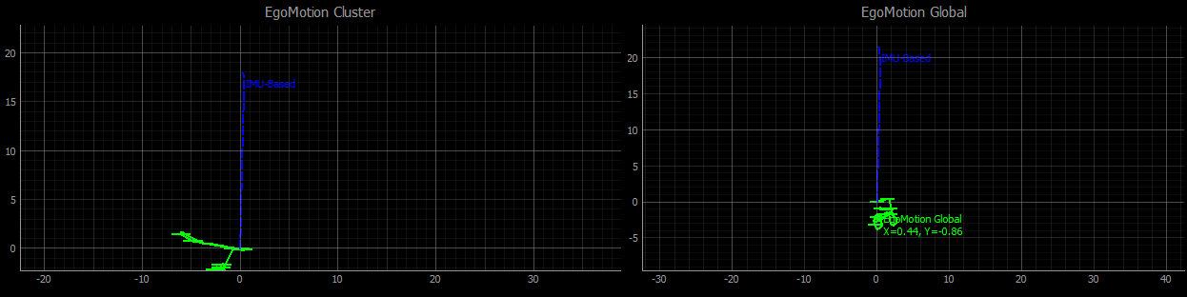
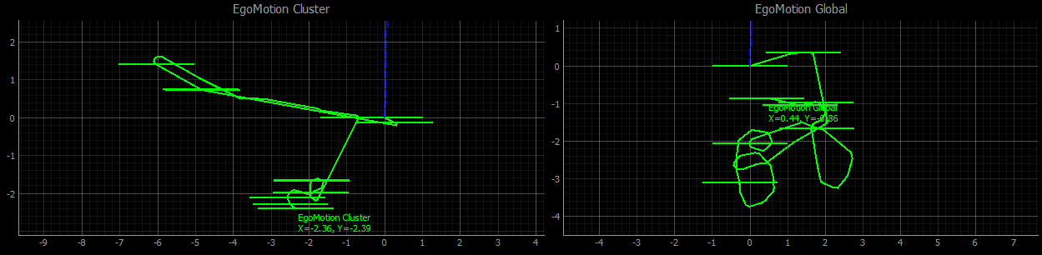
Period Highlight – 11 Software Progress
Implementation with single sensor.

Slide 31
Period Highlight – 12 Missed

Slide 32
Period Highlight – 13 Hardware Preparations
Implementation of both sensors.
Frequency offset: 1,9GHz
Sensor A (Left)
60 GHz to 61,98GHz
Sensor B (right)
62 GHz to 63,98 GHz

Slide 33
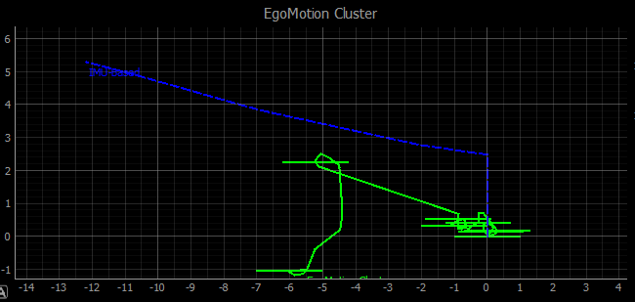
Period Highlight – 13 Software Progress
Implementation with dual sensor.
Measurements taken outside.
Given priority from most tracked cluster.
Distance still needs to be validated.
Rotation obtained with IMU.
Total of 7 recording were taken.
Lots of ground noise, due to bumpy road in parking lot.
Fixed with physical filtering and increasing the inclination of the radar.

Slide 34
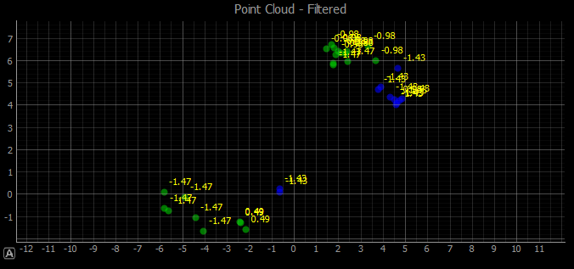
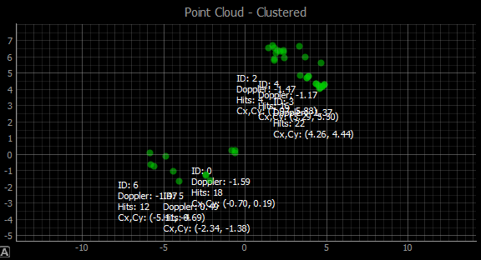
Period Highlight – 13 Software Progress
Point cloud improved.
Target use Doppler heatmap to increase results of pointcloud.
2 Sensors.
Green color left sensor
Blue color right sensor.
Problems with interference.
Problems after the 6mts mark.
Noise area as geometrical safe zone ends at 5 mts.
This due to the theoretical 90 degrees AoA (Angle of Arrival).

Slide 35
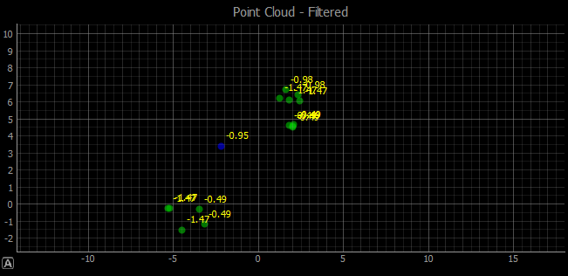
Period Highlight – 13 Software Progress
Problems when detecting moving targets.
Either not moving fast enough or problem with RANSAC config.
If moving target is close to out own self speed estimation. It can be perceived as static object.

Slide 36
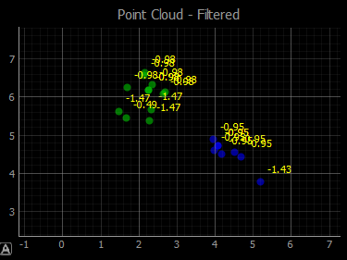
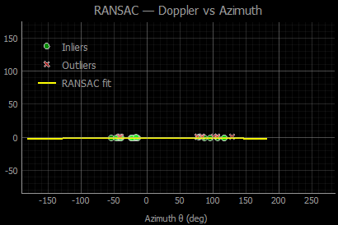
Period Highlight – 13 Software Progress
Static vs Moving Objects
Not in scope but it can be refined.
Improve RANSAC logic now that 2 sensors are incorporated to filter out moving objects, even at low speed.

Slide 37
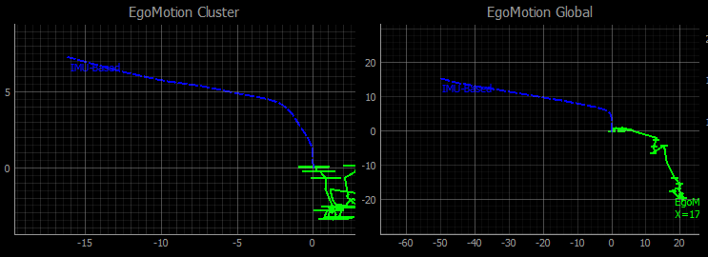
Period Highlight – 13 First result analysis
The Odometry and traction of the displacement is smoother using the whole point cloud.
However this can end with a lot of noise, meaning false targets since no post processing has been done.
By tracking the most successful tracked cluster we can improve the actual displacement on the vehicle.
In case this cluster is lost, we simply move to the following most successful tracked cluster.
Negative side, if no information is being sensed from the vehicle, no cluster is registered. Meaning no motion to be tracked.

Slide 38
Period Highlight – 13 First result analysis
Plan for the next 2 weeks:
Fix rotation algorithm obtained from the point cloud.
Work on the paper (currently working in it).
Improve (if time allowed) filtering logic to avoid tracking moving targets.
Differentiation between static vs moving targets.
Possible live visualization.
Currently simple implementation using TCP connection to laptop from RPi.
Visualization implemented with QT frameworks.

Slide 39
Period Highlight - #

