Slide 1
Radar Odometry
Research Project weekly updates

Slide 2
Table of Content

Slide 3
Period Highlight - 4
Implementation of Vx and Vy
Validation of Vx and Vy
Obtain IMU

Slide 4
Period Highlight - 5
Progress
Script with Vx and Vy.
Read MTi sensor.
mmWave sensor Mount.
Next steps
Test sensor fusion recording.
Print MTi sensor mount.

Slide 5
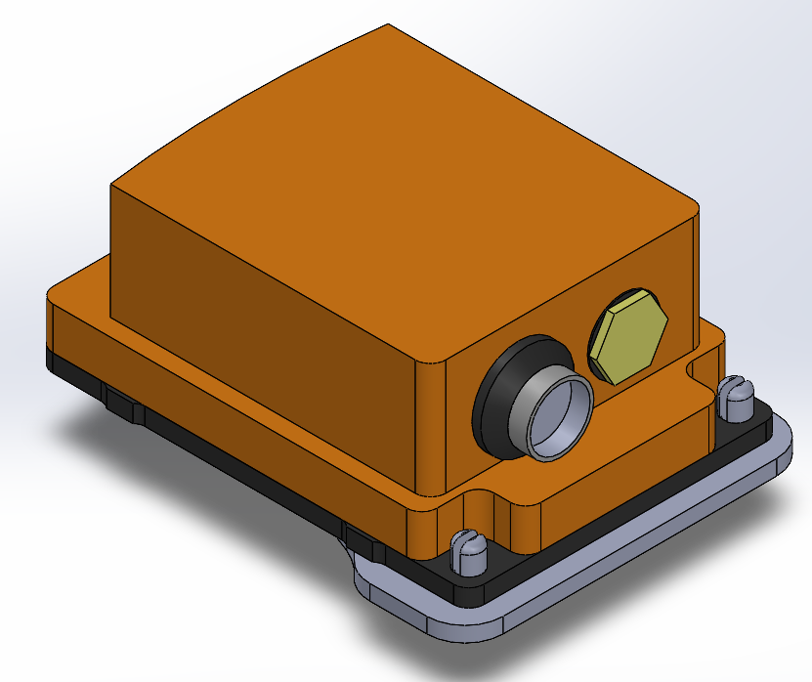
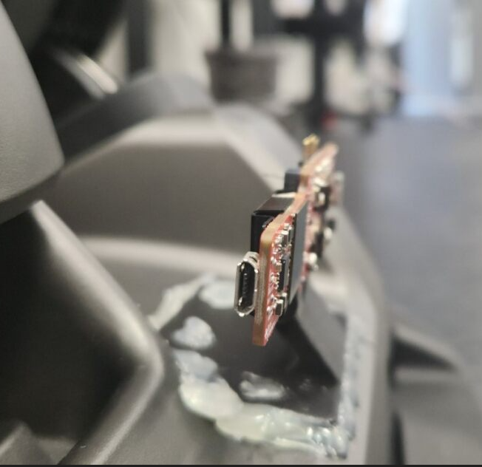
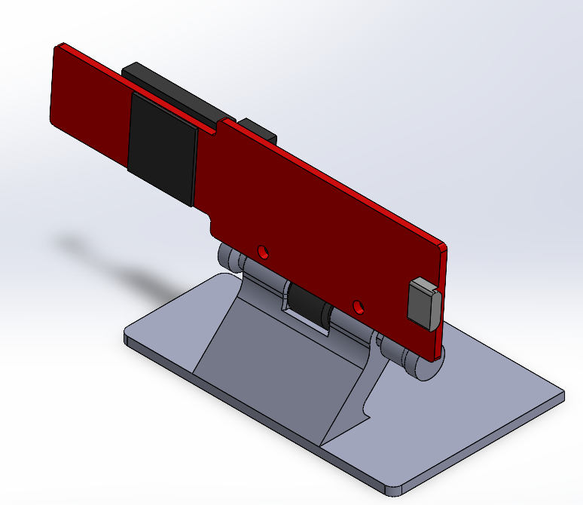
Period Highlight - 5

Slide 6
Period Highlight - #

Slide 7
Period Highlight - #

Slide 8
Period Highlight - #

