Slide 1
Radar Odometry
Research Project weekly updates

Slide 2
Table of Content

Slide 3
Period Highlight - 4
Implementation of Vx and Vy
Validation of Vx and Vy
Obtain IMU

Slide 4
Period Highlight - 5
Progress
Python script with Vx and Vy.
Read Mti (IMU) sensor.
mmWave sensor Mount.
Next steps
Print MTi sensor mount.
Test sensor fusion recording.
Validate implementation of Vx and Vy .
Implement Vx and Vy with IMU values, for rotation.

Slide 5
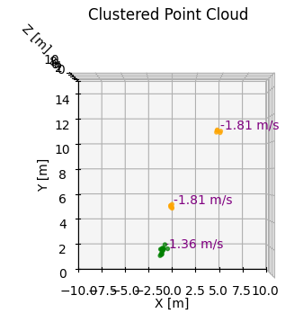
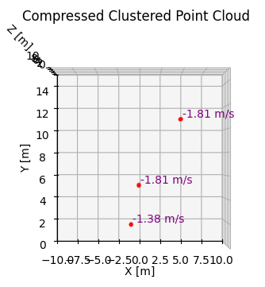
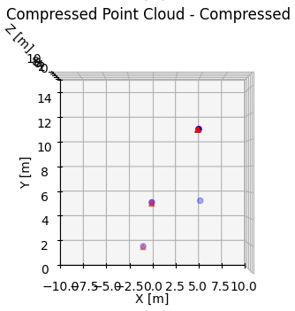
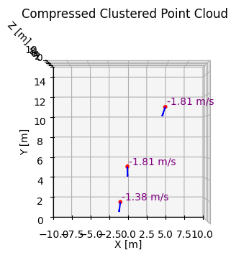
Period Highlight – 5 Vx & Vy Components

Slide 6
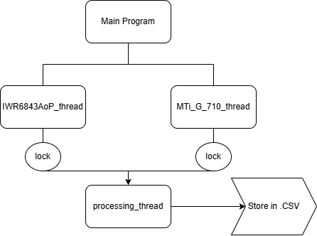
Period Highlight – 5 Sensor Fusion

Slide 7
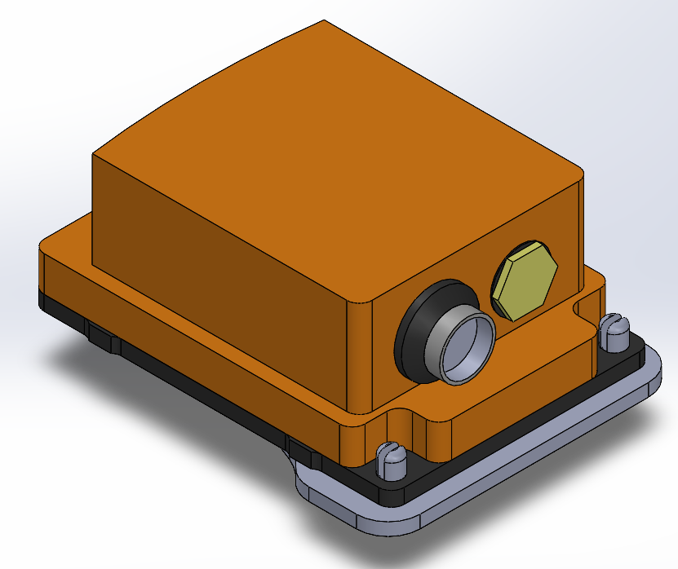
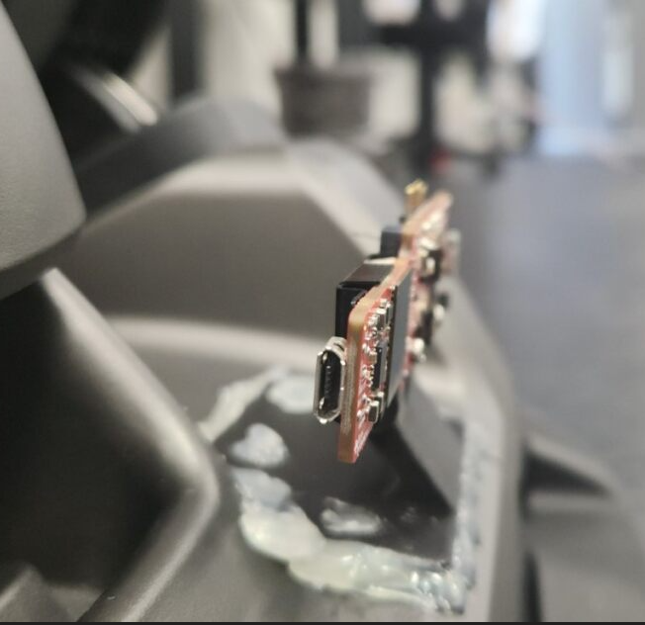
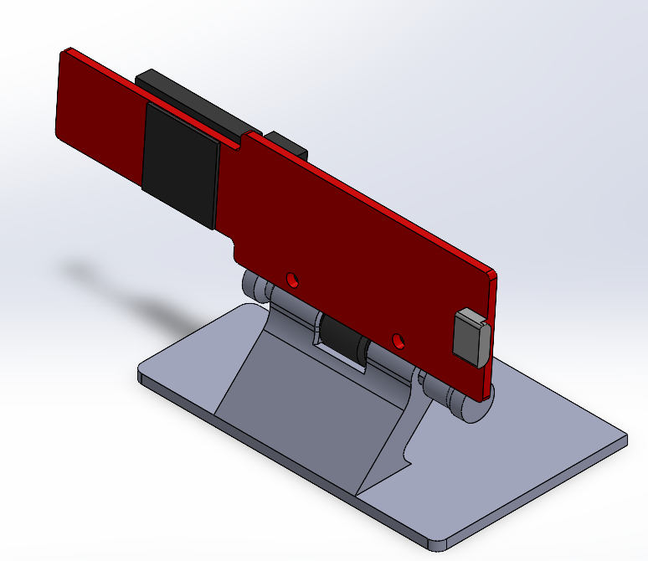
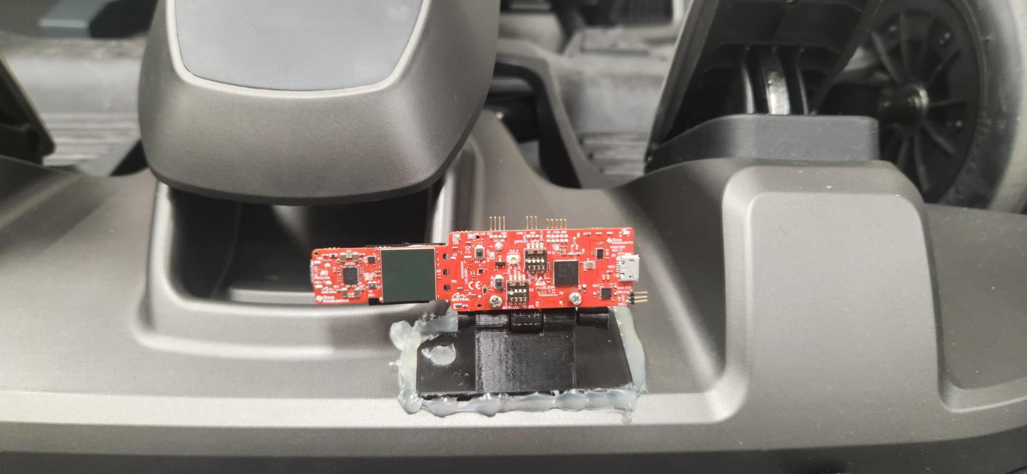
Period Highlight – 5 Hardware Implementations

Slide 8
Period Highlight - 6
Progress
Work and improve recording script for concurrent recording.
Print IMU sensor mount.
Next steps
Test in lab.
No access to lab this period.

Slide 9
Period Highlight – 7
Progress
Concurrent sensor logs.
IMU sensor mount.
Problems
IMU sensor mount broke.
Next steps
Incorporate new logs with visualization.
Incorporate VxVy with IMU data.
Investigate the role in this before implementation.
Create a draft.
Print again the IMU sensor mount.
Discuss second radar sensor. (?)

Slide 10
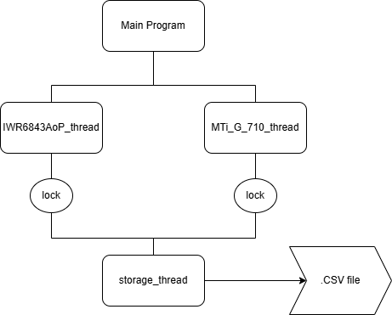
Period Highlight – 7 Sensor Fusion

Slide 11
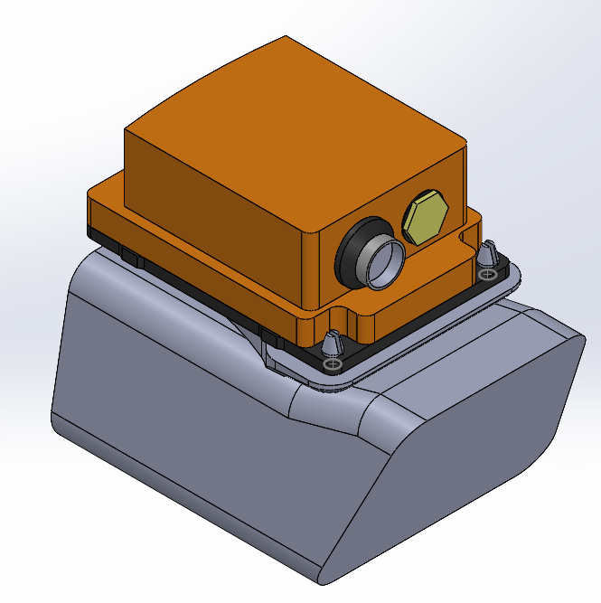
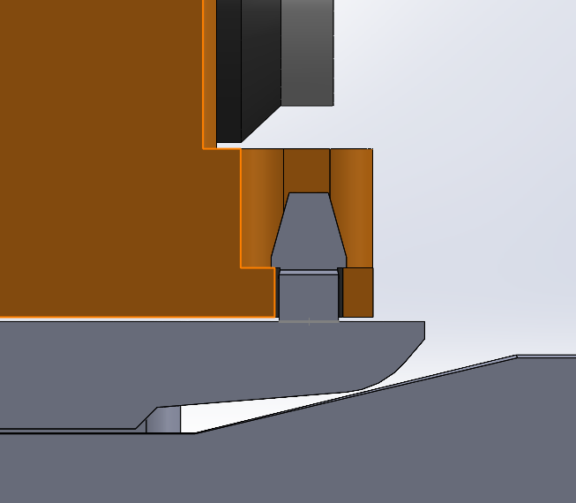
Period Highlight – 7 Hardware Implementations

Slide 12
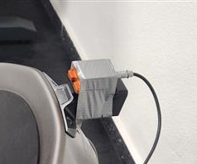
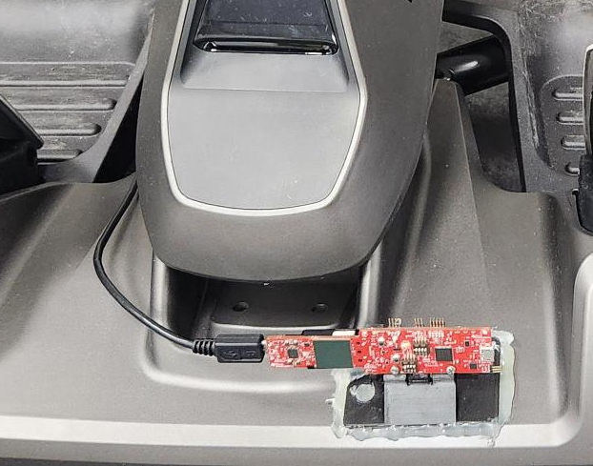
Period Highlight – 7 Hardware Implementations

Slide 13
Period Highlight – 8 Software Implementations
Cluster tracking
Still under refinement.
Tracking clusters using Euclidean distance to determine a unique ID.
Possible future implementation, using linear regression or polynomial regression accepting error.
Following a straight line a cluster that has been detected at least 2 times by Euclidean distance tracking.
Use that line to track future Clusters to assign the unique ID.
Avoid tracking once the cluster is in a certain distance from target.

Slide 14
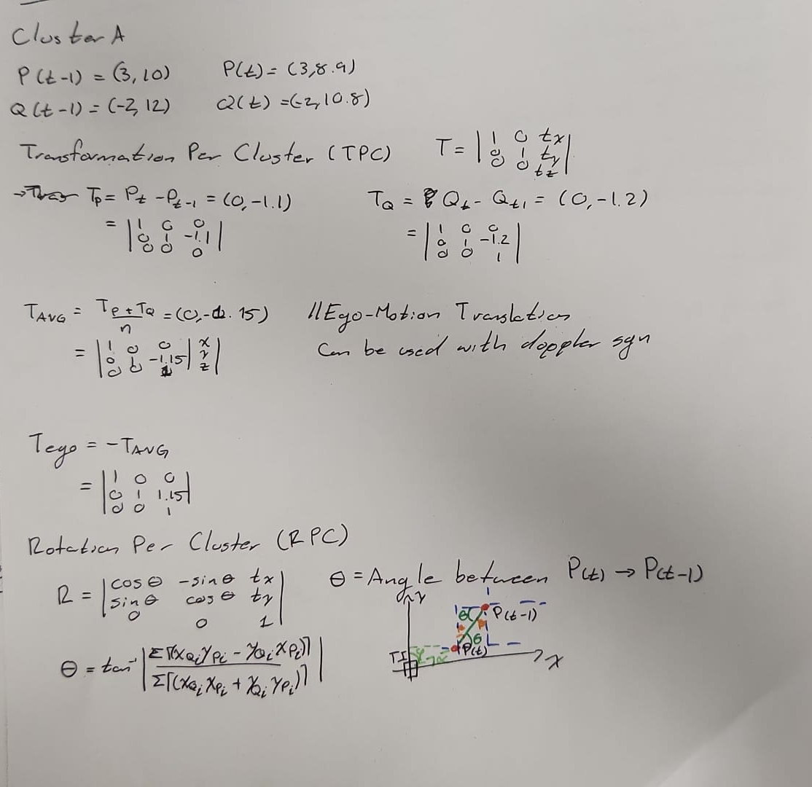
Period Highlight – 8 Software Implementations
Cluster per Cluster ICP
Whole scan vs CpC (Cluster per Cluster).

Slide 15
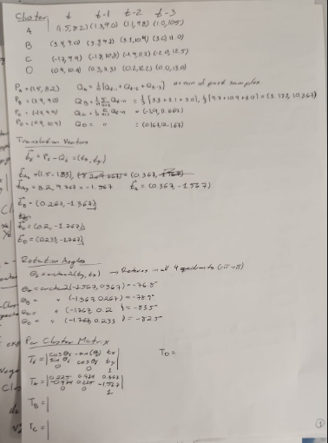
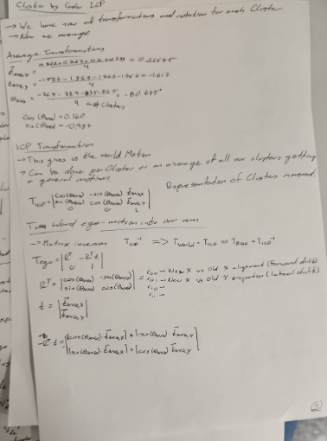
Period Highlight – 8 Software Implementations
Cluster per Cluster Analysis

Slide 16
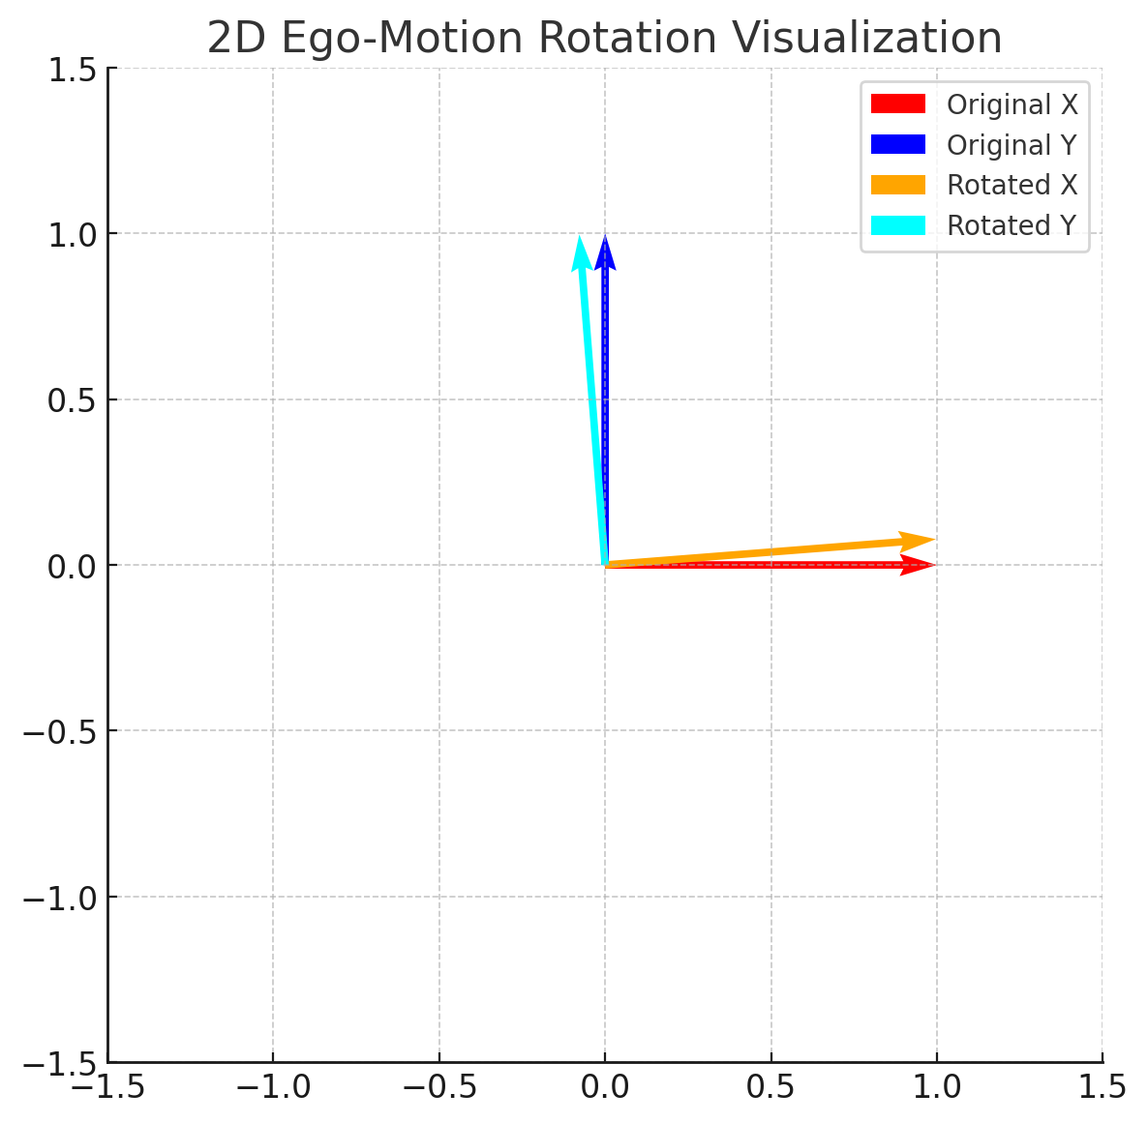
Period Highlight – 8 Software Implementations
Demonstration of the previous analysis.

Slide 17
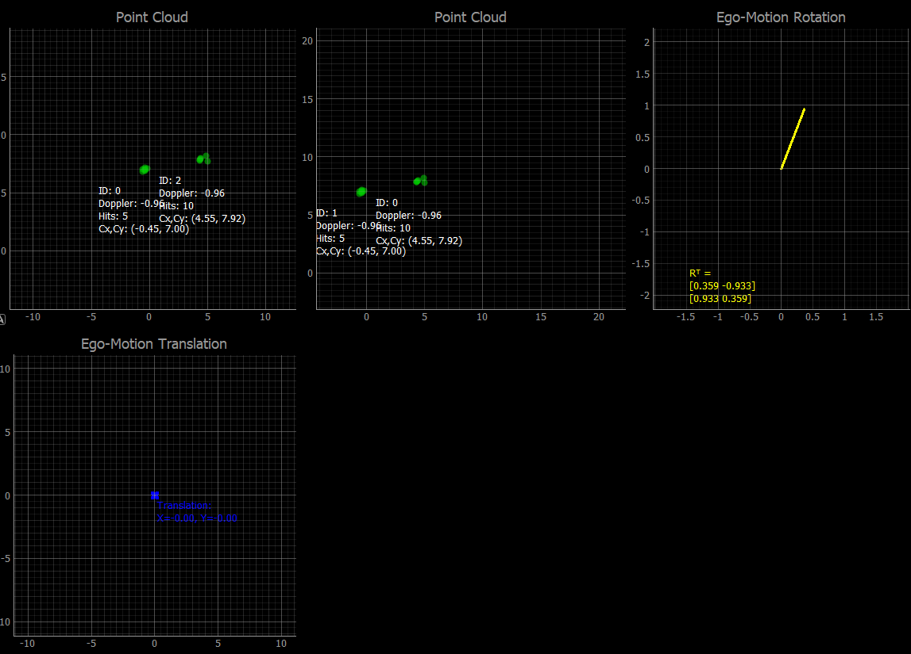
Period Highlight – 8 Software Implementations
Visualization moved to pyqtgraph for improvement since live visualization is now available.

Slide 18
Period Highlight – 10 Networking Preparations
Got in contact with Dr. Alexis Kostas from Norway.
Radar-Inertial ICP-based Pose Graph SLAM
Which later direct me to Morten Nissov, also from Norway.
Explain about the project that was implemented before and current work.
New material provided by them:
Instantaneous ego-motion estimation using Doppler radar
According to the paper results, this was done in last semester project.
Fusion of this work and current one is on the way.

Slide 19
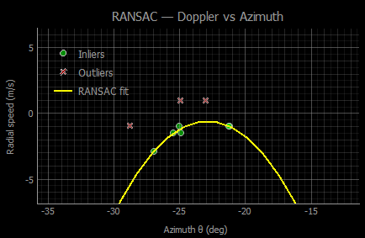
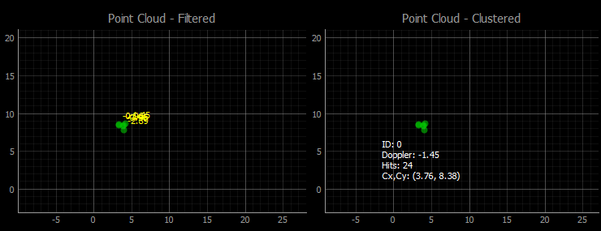
Period Highlight – 10 Software Implementations
Implemented filter using RANSAC

Slide 20
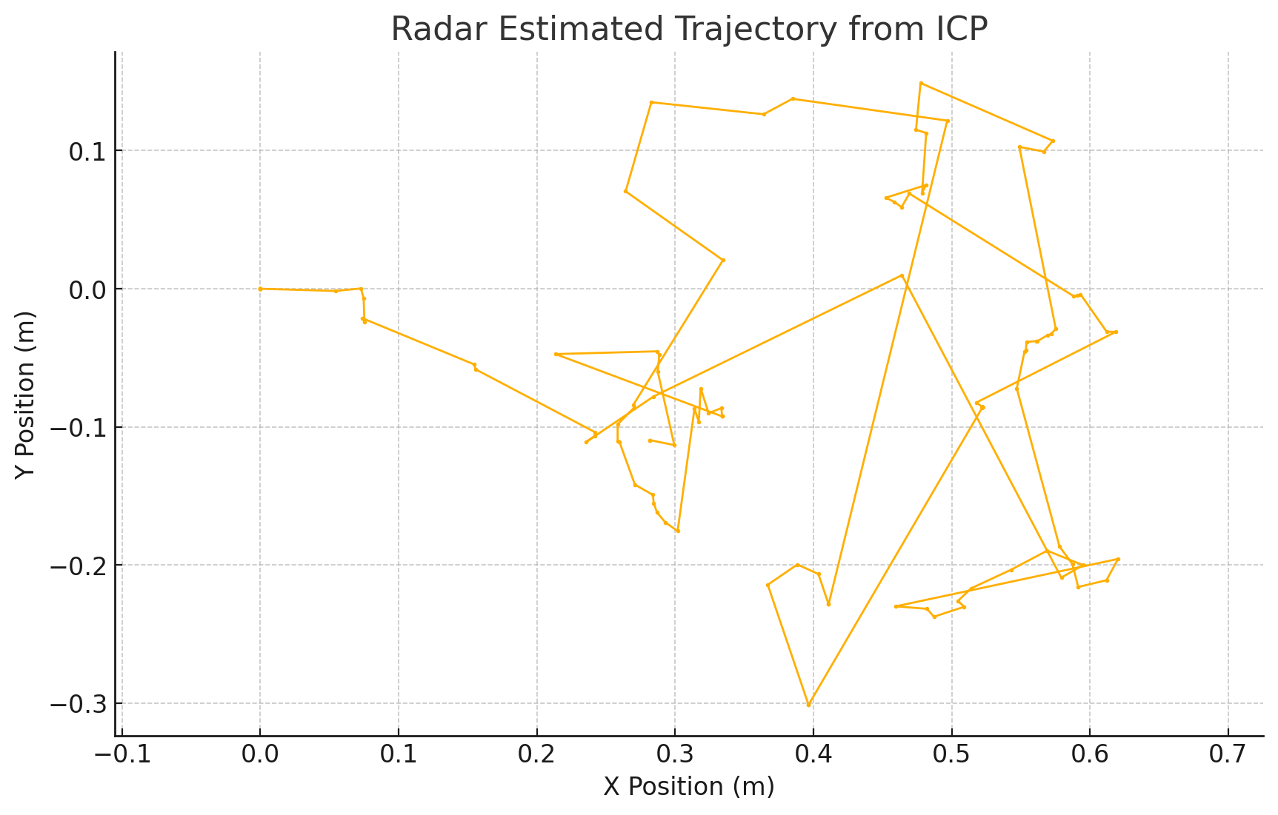
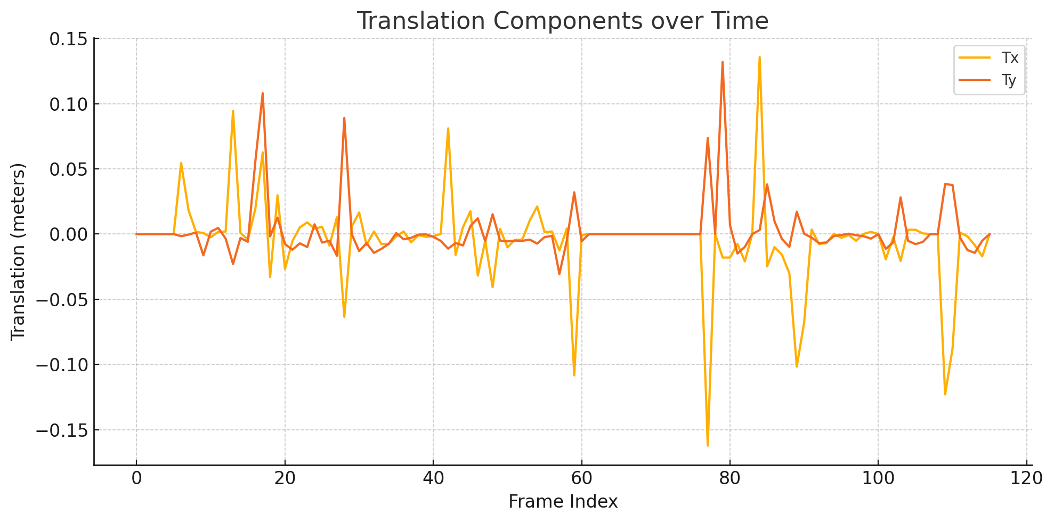
Period Highlight – 10 Software Implementations
Trajectory Hallway test

Slide 21
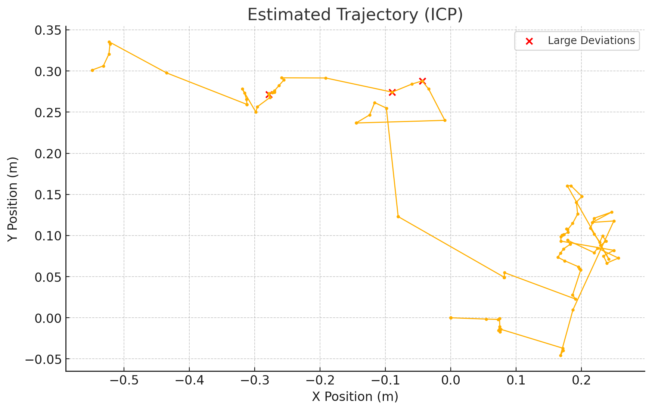
Period Highlight – 10 Software Implementations
Trajectory Hallway test

Slide 22
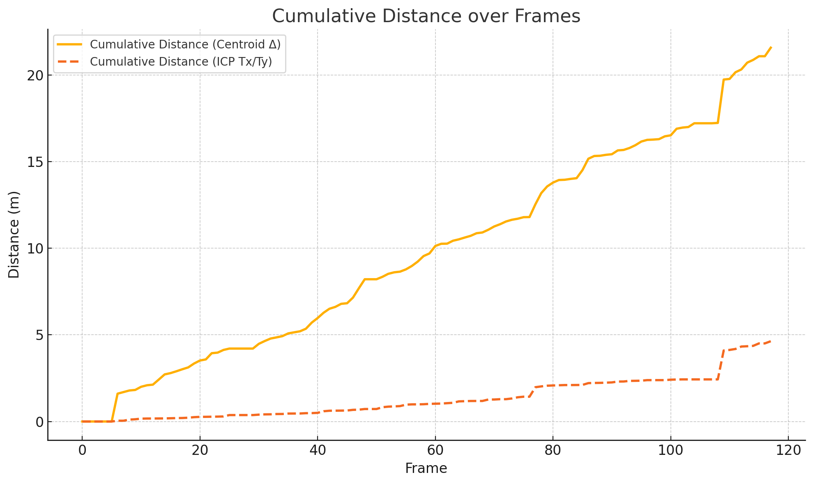
Period Highlight – 10 Software Implementations
Trajectory Hallway test

Slide 23
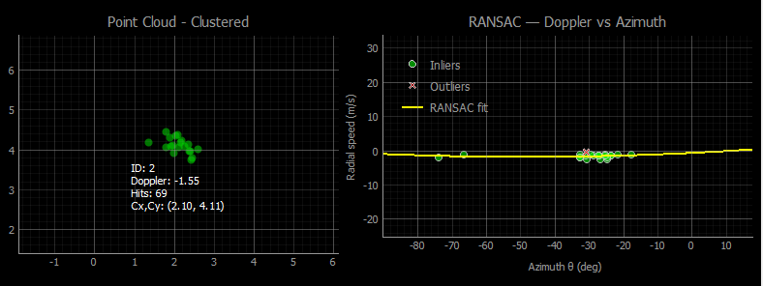
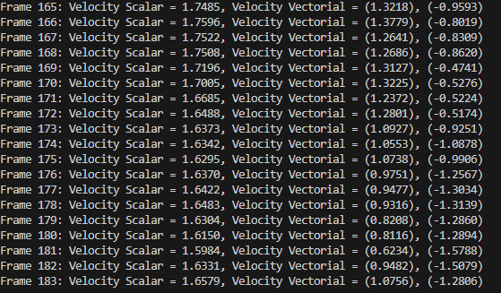
Period Highlight – 10 Software Preparations
Joining instant ego-motion using Doppler.

Slide 24
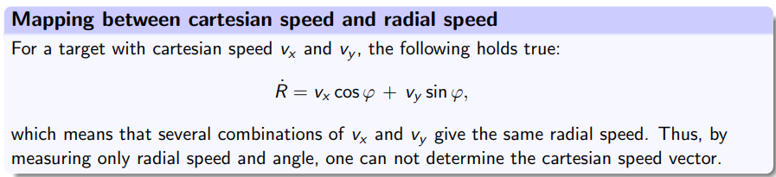
Period Highlight – 10 Hardware Preparations
Investigate and plan about inserting a second sensor.
Due to lack of continuous point clouds.
Positive results from merging Cartesian speed and ICP translation.
Image obtained from “Lecture_RadarSystem.pdf” by Andreas Becker.

Slide 25
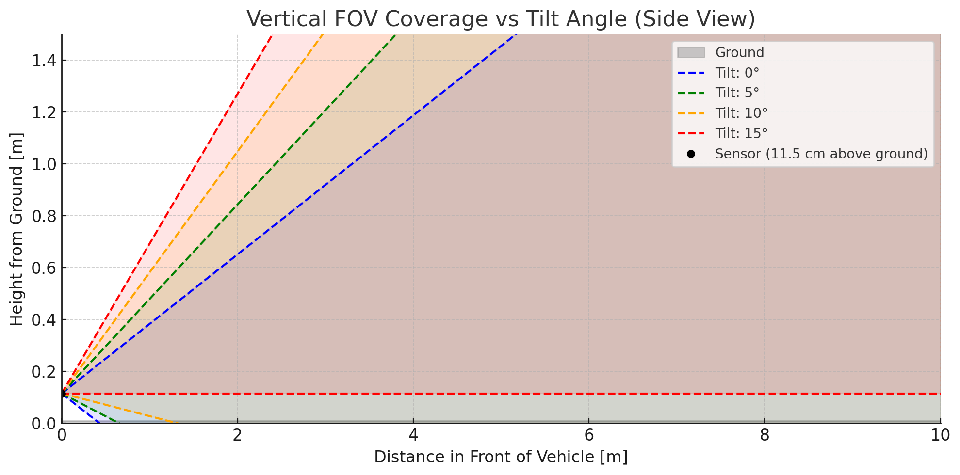
Period Highlight – 10 Hardware Preparations
Inclination Angle

Slide 26
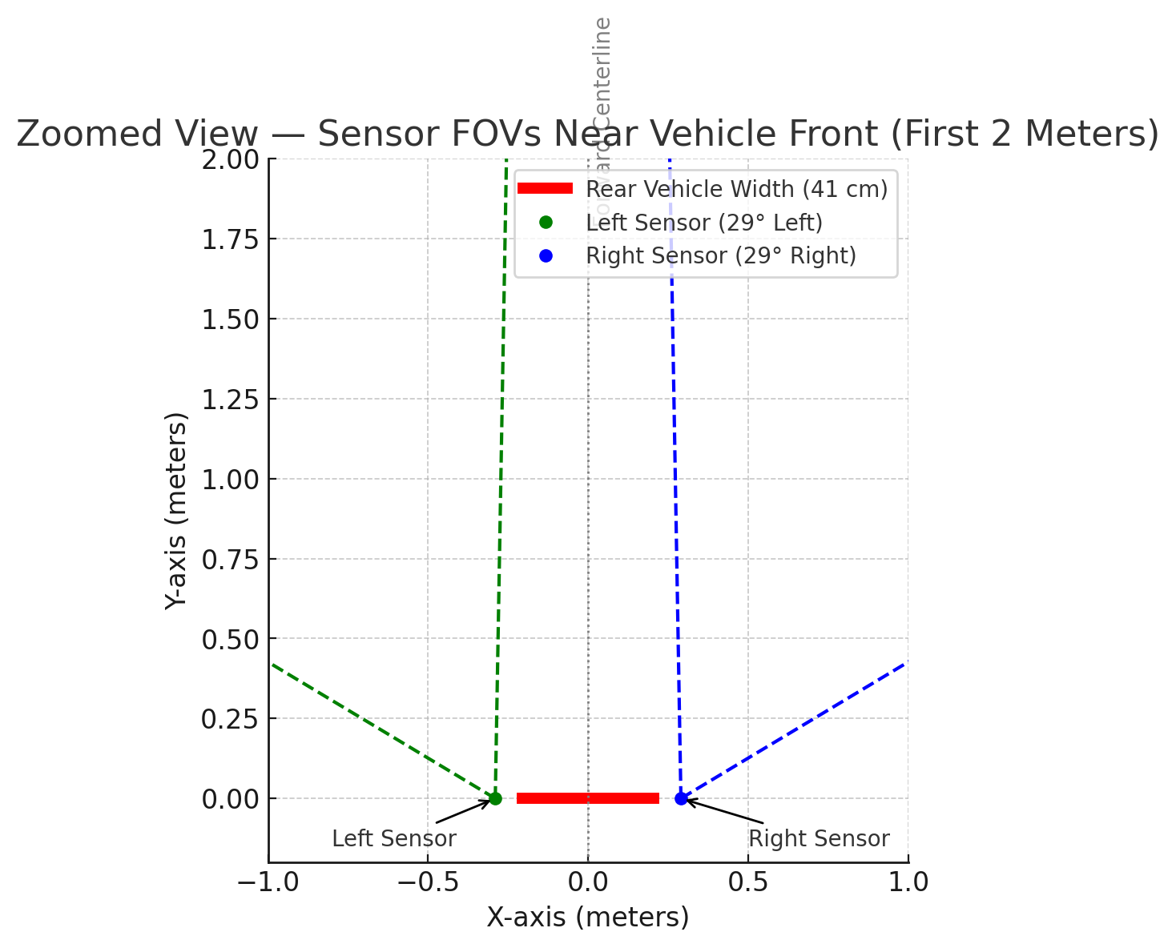
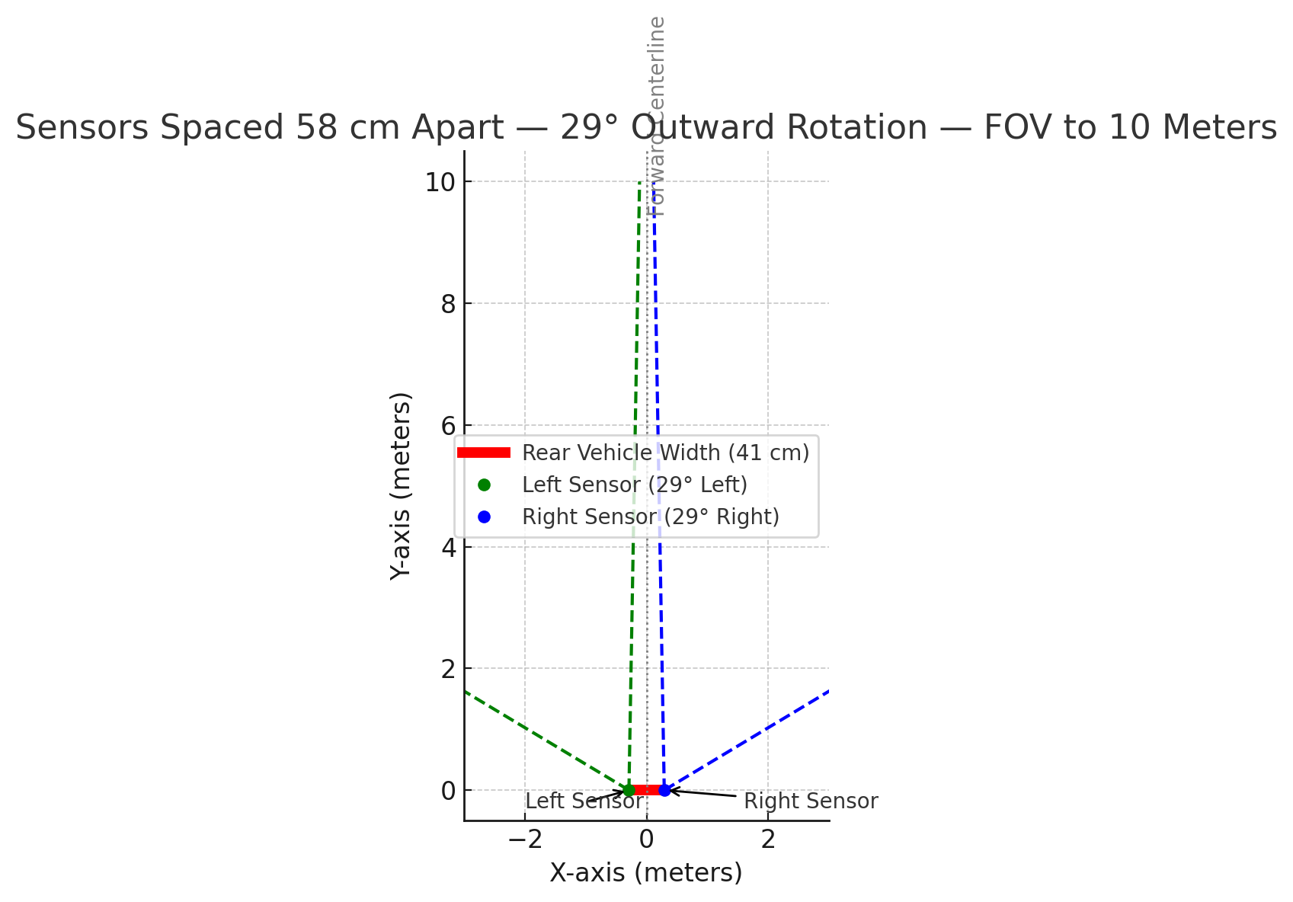
Period Highlight – 10 Hardware Preparations
Rotation Angle

Slide 27
Period Highlight – 11 Hardware Preparations
Implementation of both sensors.
Frequency offset: 1,9GHz
Sensor A (Left)
60 GHz to 61,98GHz
Sensor B (right)
62 GHz to 63,98 GHz

Slide 28
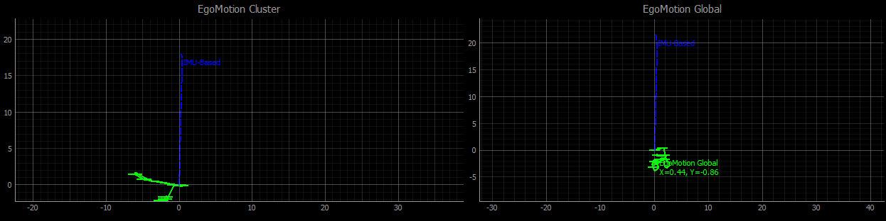
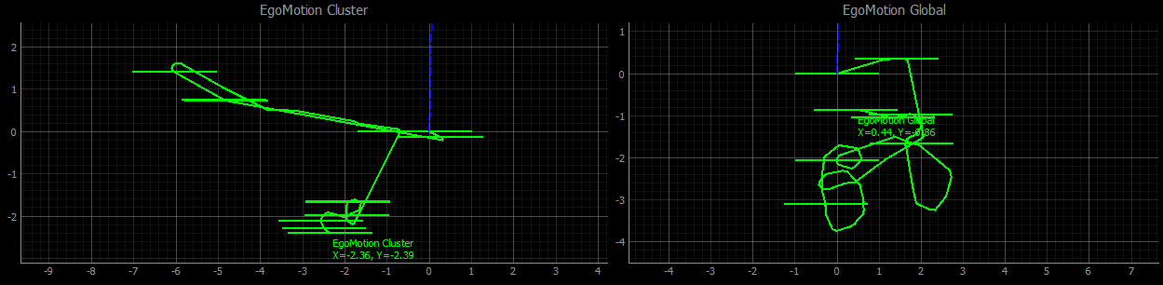
Period Highlight – 11 Software Progress
Implementation with single sensor.

Slide 29
Period Highlight – 11 Software Progress
Implementation with single sensor.

Slide 30
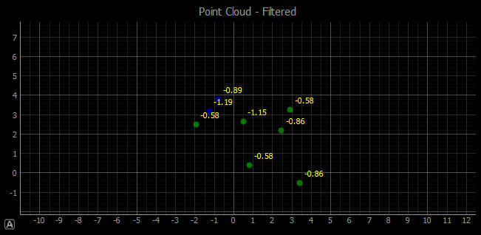
Period Highlight – 11 Software Progress
Implementation with dual sensor.
Improvements needed, at some point the recordings were working better than latest version.
Next goal is to roll back to that point and start from there.

Slide 31
Period Highlight - #

