Slide 1
Radar Odometry
Research Project weekly updates

Slide 2
Table of Content

Slide 3
Period Highlight - 4
Implementation of Vx and Vy
Validation of Vx and Vy
Obtain IMU

Slide 4
Period Highlight - 5
Progress
Python script with Vx and Vy.
Read Mti (IMU) sensor.
mmWave sensor Mount.
Next steps
Print MTi sensor mount.
Test sensor fusion recording.
Validate implementation of Vx and Vy .
Implement Vx and Vy with IMU values, for rotation.

Slide 5
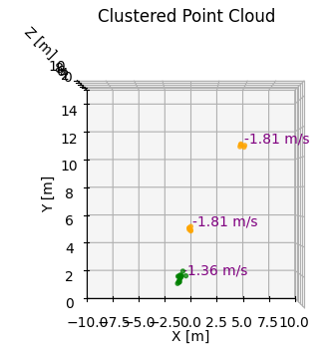
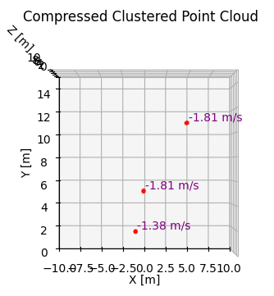
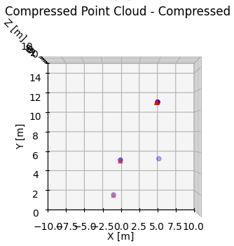
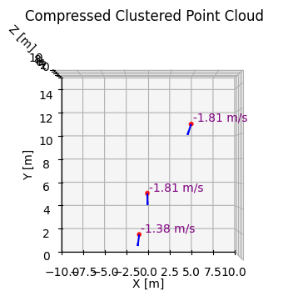
Period Highlight – 5 Vx & Vy Components

Slide 6
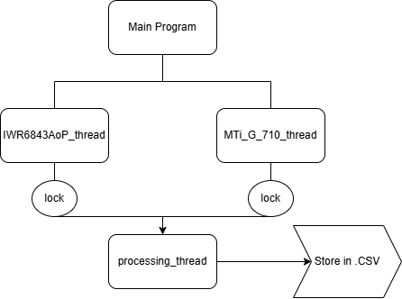
Period Highlight – 5 Sensor Fusion

Slide 7
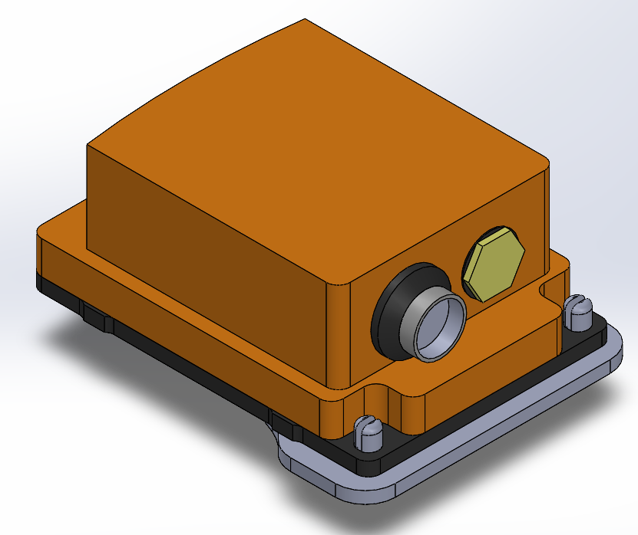
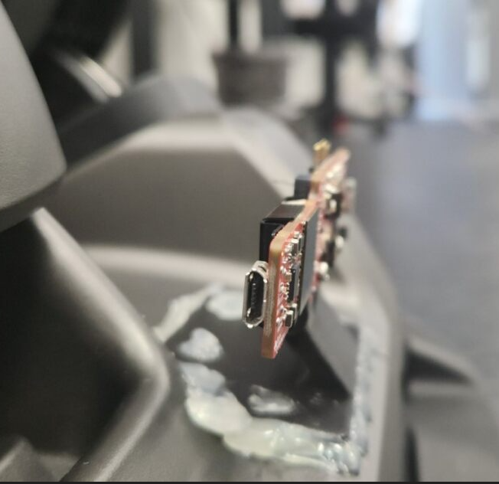
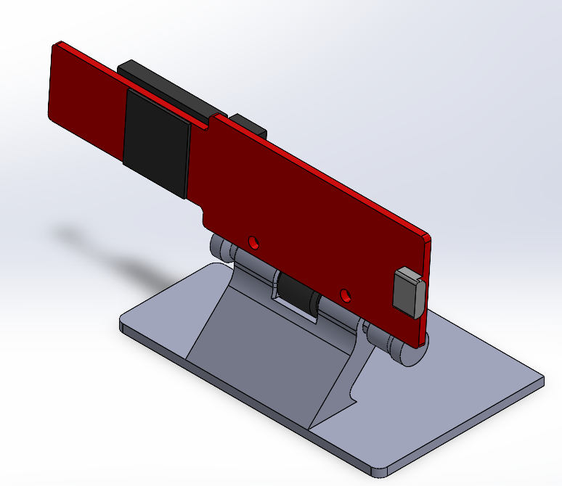
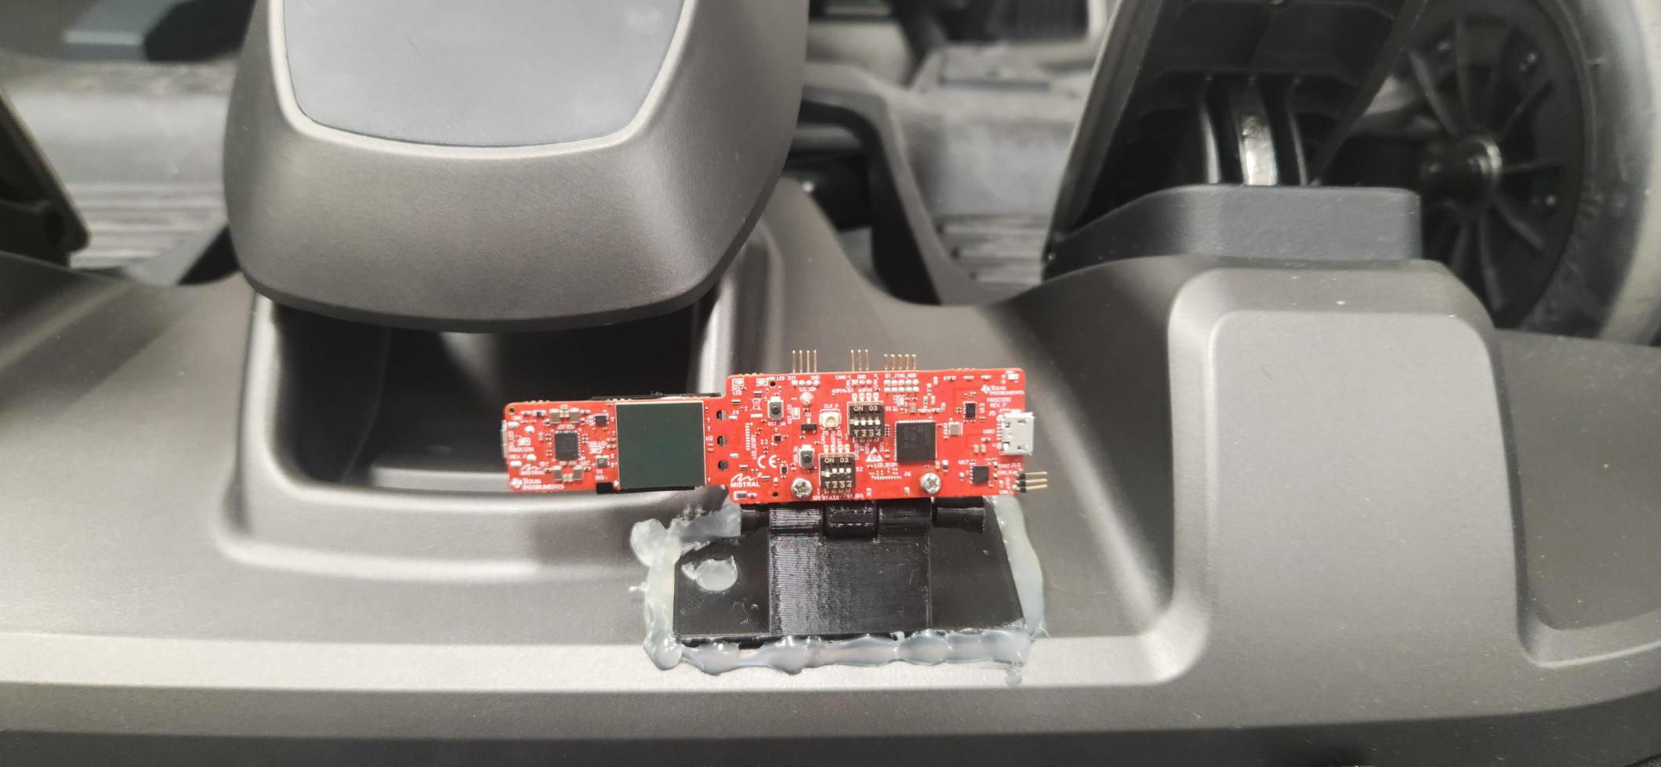
Period Highlight – 5 Hardware Implementations

Slide 8
Period Highlight - 6
Progress
Work and improve recording script for concurrent recording.
Print IMU sensor mount.
Next steps
Test in lab.
No access to lab this period.

Slide 9
Period Highlight – 7
Progress
Concurrent sensor logs.
IMU sensor mount.
Problems
IMU sensor mount broke.
Next steps
Incorporate new logs with visualization.
Incorporate VxVy with IMU data.
Investigate the role in this before implementation.
Create a draft.
Print again the IMU sensor mount.
Discuss second radar sensor. (?)

Slide 10
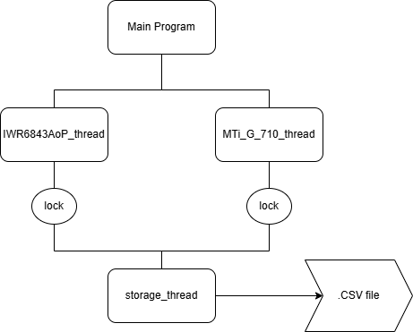
Period Highlight – 7 Sensor Fusion

Slide 11
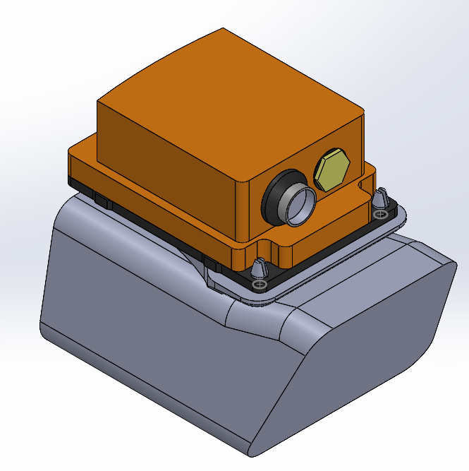
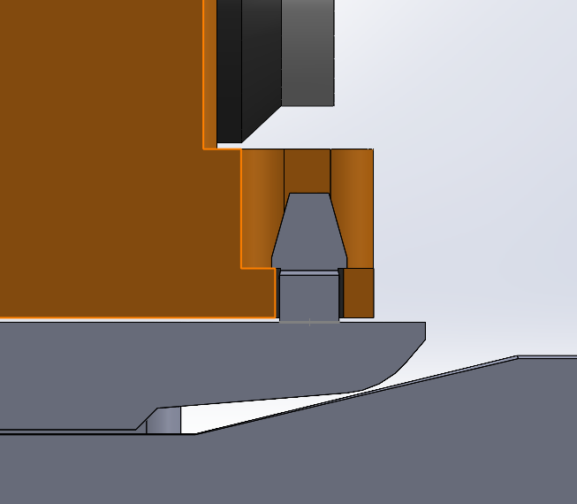
Period Highlight – 7 Hardware Implementations

Slide 12
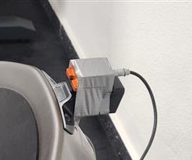
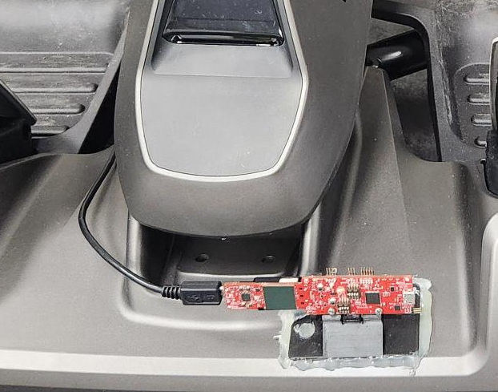
Period Highlight – 7 Hardware Implementations

Slide 13

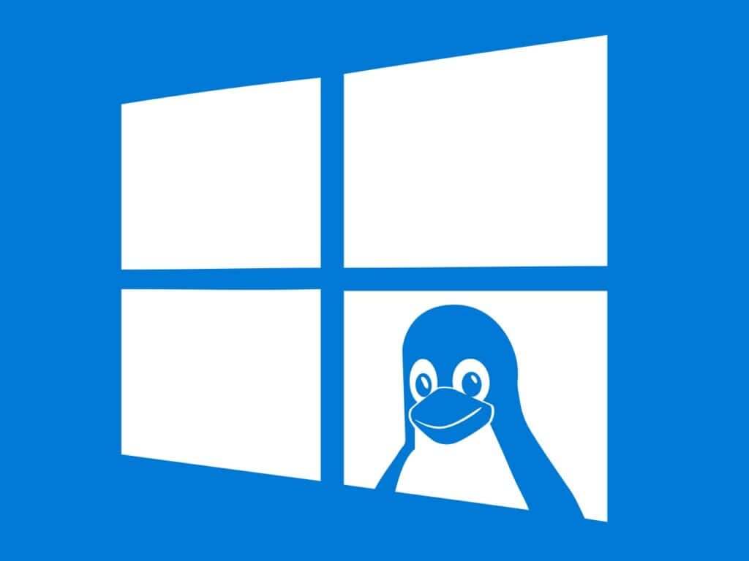
Period Highlight – 8 Software Implementations
Fig, WSL Linux.
https://cdn.shortpixel.ai/spai/q_lossy+ret_img+to_auto/linuxiac.com/wp-content/uploads/2022/11/wsl-1024x768.jpg
Fig, Visual Studio Community. https://forest.watch.impress.co.jp/img/wf/list/1501/256/visual_studio.jpg

Slide 14
Period Highlight – 8 Software Implementations

Slide 15
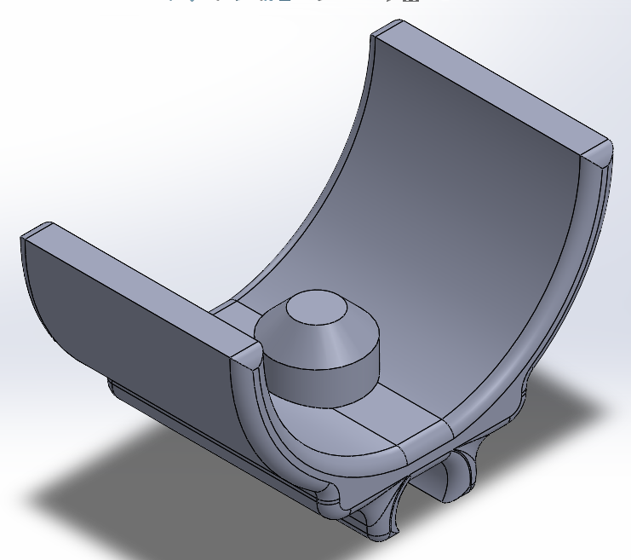
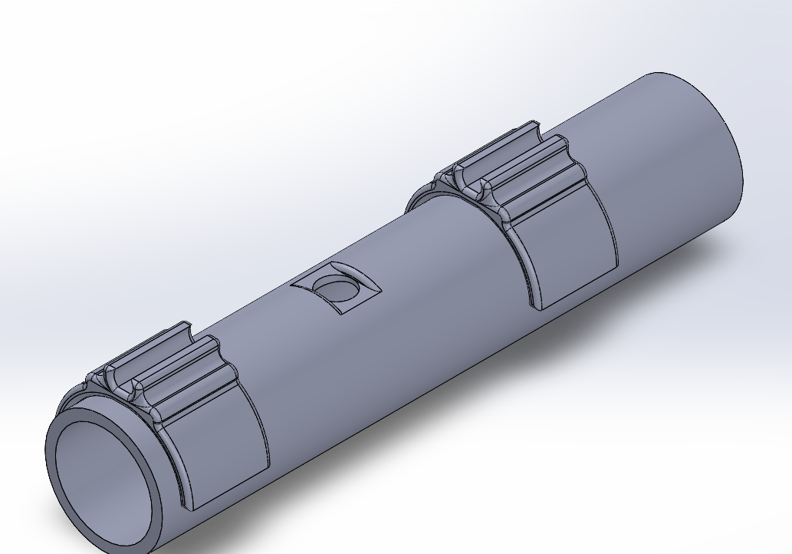
Period Highlight – 8 Hardware Implementations

Slide 16
Period Highlight - #

