Slide 1
Android Views & Layouts

Slide 2
Các loại layout:
LinearLayouts
RelativeLayouts
AbsoluteLayouts
TableLayouts
Constraints Layout

Slide 3
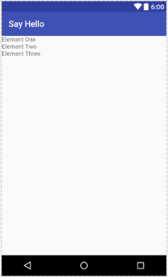

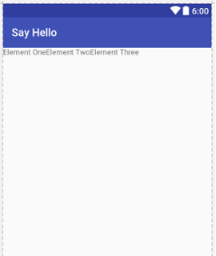
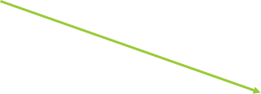


LinearLayouts
<LinearLayout xmlns:android= "http://schemas.android.com/apk/res/android" android:orientation="vertical" android:layout_width="fill_parent" android:layout_height="fill_parent" > <TextView android:layout_width="wrap_content" android:layout_height="wrap_content" android:text="Element One" /> <TextView android:layout_width="wrap_content" android:layout_height="wrap_content" android:text="Element Two" /> <TextView android:layout_width="wrap_content" android:layout_height="wrap_content" android:text="Element Three" /> </LinearLayout>

