Slide 1
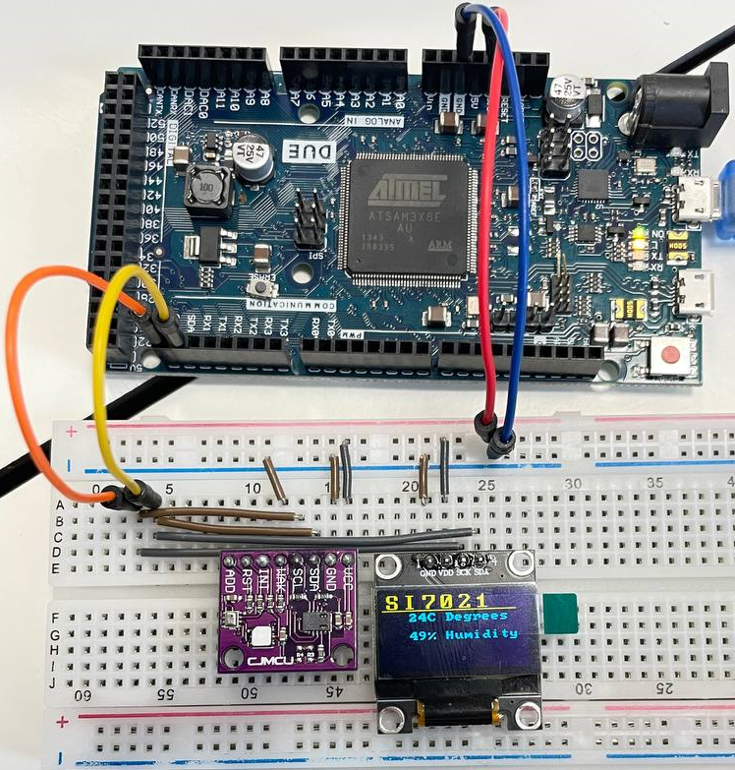
SI7021
Temperature and Humidity sensor
Chip shows the temperature and humidity of the room on the Oled display
Can be used to measure temperature of the room, of the fridge, of the addict and MORE!!
Luke Tenback

