Slide 1
Pandas Kennissessie
12-01-2021

Slide 2
Python – Pandas - Numpy
Python
Pandas
Series
DataFrame
Numpy
array / ndarray

Slide 3
Python
Numpy
numbers = [1, 2, 3, 4]
n = 0
total = 0
for x in numbers:
total += x
n += 1
mean = total / n
x = np.array([1, 2, 3, 4])
mean = x.mean()
Compiler
SLOW
Compiler
C code
C code
Numpy
FAST

Slide 4
Python
Numpy
List
Objects have a variable size.
Not easy to jump to the next object.
Less efficient memory usage.
Objects not stored as a continuous block.
Array
Objects have a fixed size.
Easy to jump to the next object.
Efficient memory usage.
Objects stored as a continuous block.
Object
[4 bytes]
Number
[4 bytes]
Object
[20 bytes]
Number
[4 bytes]
Number
[4 bytes]
Object
[6 bytes]
Number
[4 bytes]
Object
[10 bytes]

Slide 5
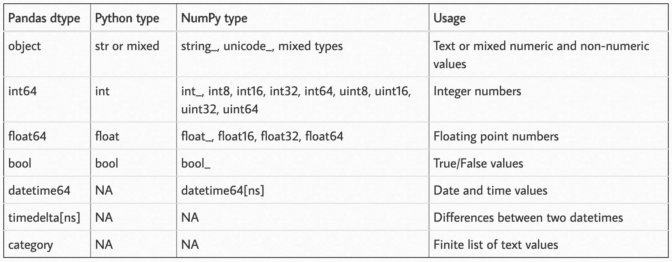
Numpy Data Types

