Slide 1

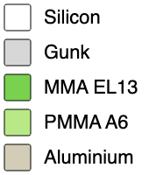
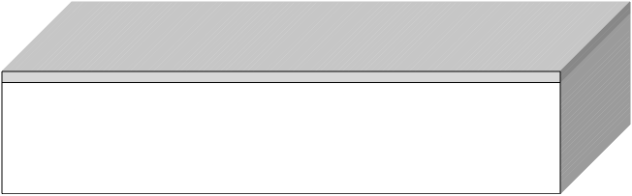
Step 1: Substrate Stack
Width: 5000 nm 5000 nm Layer 1: Silicon Thickness: 1000 nm Layer 2: Gunk Thickness: 100 nm
Comments: 111 crystal axix
STARTBLOX
Section: Dissipator Device Recipe
www.fabublox.com

Slide 2
Step 2: 3 Solvent Clean
Beakers + Sonicator
Chemical: Acetone Time: 5 mins Temp: 20 °C Ultra Sonic: true
Comments: Sonicate in Acetone for 6 minutes Sonicate in Methanol for 3 minutes Sonicate in IPA for 3 minutes
CUSTOMCLEAN
Section: Dissipator Device Recipe
www.fabublox.com

Slide 3
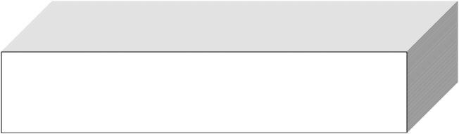
Step 3: DI Water Rinse
Beakers
Chemical: DI Water Time: 30 secs Temp: 25 °C Ultra Sonic: false
Comments: Dry with N2 gun
CUSTOMCLEAN
Section: Dissipator Device Recipe
www.fabublox.com

Slide 4
Step 4: Dehydration Bake
Bake Plate
Temp: 110 °C Time: 20 secs
Comments: 110 to 180 degree C allowed
BAKE
Section: Dissipator Device Recipe
www.fabublox.com

Slide 5
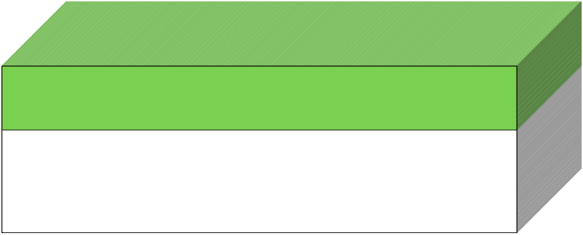
Step 5: Spin Resist
Spinner
Material: MMA EL13 Thickness: 620 nm Spin Speed: 3000 rpm Spin Time: 60 secs
Comments:
SPINCOATRESIST
Section: Dissipator Device Recipe
www.fabublox.com

Slide 6
Step 6: Softbake
Bake Plate
Temp: 180 °C Time: 300 secs
Comments:
BAKE
Section: Dissipator Device Recipe
www.fabublox.com

Slide 7
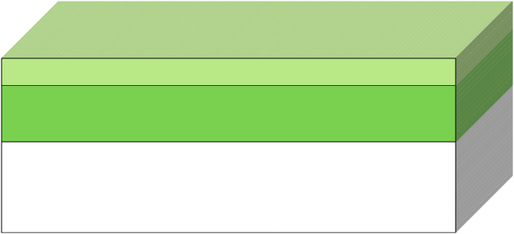
Step 7: Spin Resist
Spinner
Material: PMMA A6 Thickness: 300 nm Spin Speed: 4000 rpm Spin Time: 60 secs
Comments:
SPINCOATRESIST
Section: Dissipator Device Recipe
www.fabublox.com

Slide 8
Step 8: Softbake
Bake Plate
Temp: 180 °C Time: 300 secs
Comments:
BAKE
Section: Dissipator Device Recipe
www.fabublox.com

Slide 9
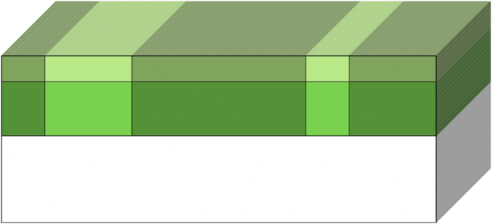
Step 9: Electron-Beam Lithography
Raith EBPG 5150
Voltage: 100 kV Current: 100 nA Dose: 290 µC/cm² Dwell Time: <none> ns
Comments:
EBL
Section: Dissipator Device Recipe
www.fabublox.com

Slide 10
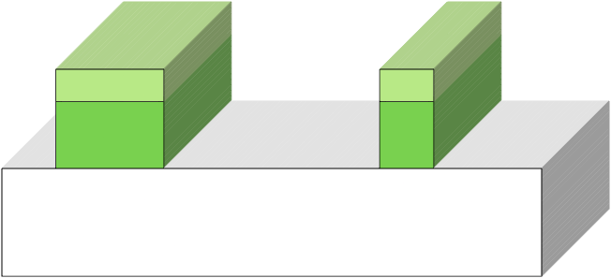
Step 10: Develop
Beaker
Developer: MIBK:IPA Time: 180 secs Temp: 20 °C
Comments: MIBK:IPA = 1:1
DEVELOP
Section: Dissipator Device Recipe
www.fabublox.com

Slide 11
Step 11: Pre-Ash
YES 02 Plasma
Material: Gunk Depth: 0 nm Gasses: Oxygen Etch Rate: <none> nm/s Time: 30 secs RF Power: 60 Watts Pressure: 0.3 Torr
Comments:
PLASMA-ASH
Section: Dissipator Device Recipe
www.fabublox.com

Slide 12
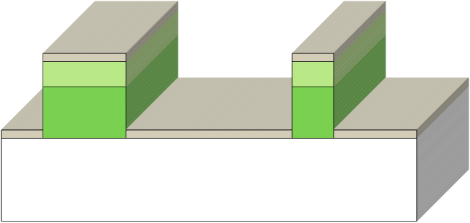
Step 12: E-beam Evaporation
Angstrom
Material: Aluminium Thickness: 1000 Å Deposition Rate: 4 Å/s Beam Current: <none> Amps Beam Voltage: <none> kV Pressure: <none> Torr Deposition Angle: 0°
Comments:
EBEAMEVAP
Section: Dissipator Device Recipe
www.fabublox.com

Slide 13
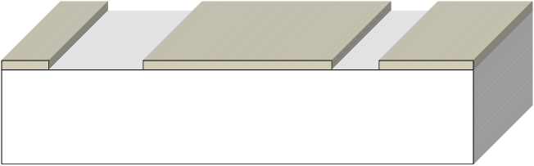
Step 13: Lift-Off
Beaker + Sonicator
Solvent: Acetone Time: 3 hours Temp: 45 °C
Comments:
LIFTOFF
Section: Dissipator Device Recipe
www.fabublox.com

Slide 14
Step 14: 3 Solvent Clean
Beaker
Chemical: Acetone Time: 30 secs Temp: 25 °C Ultra Sonic: true
Comments: Sonicate the chip in the acetone liftoff beaker for 30 seconds (more time if the liftoff has not been completed.)
With the acetone wash bottle in the other hand, take the chip out of the acetone slowly as maintaining a stable jet of acetone to the chip to make sure there is no liftoff metal chips left on the device;
immediately dip the chip in the next beaker before the solvent dries out.
Sonicate in methanol for 10s,
similarly to step 2, transfer the chip from the methanol beaker to the IPA beaker.
Sonicate in IPA for 10s, and transfer the chip from the IPA beaker to the DI water beaker with the same technique.
CUSTOMCLEAN
Section: Dissipator Device Recipe
www.fabublox.com

Slide 15
Step 15: DI Water Rinse
Beaker
Chemical: DI Water Time: 30 secs Temp: 25 °C Ultra Sonic: false
Comments: Dry with N2 gun
CUSTOMCLEAN
Section: Dissipator Device Recipe
www.fabublox.com

