Slide 1


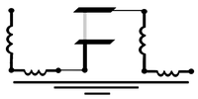
Tutorial 1: Introducing SQuADDS
Sadman Ahmed Shanto
Qiskit Fall Fest 2024
10/14/24
Superconducting Qubit And Device Design and Simulation database

Slide 2


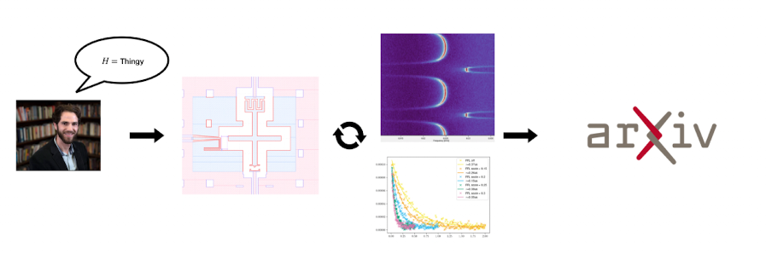

Typical Workflow:
SQuADDS Worklow:
Guess the physical design layout for your chosen $\hat{H}$
Simulate and update the device design
Fabricate and Measure the device
Learn that simulation was incorrect…
Use reality as your simulation….
Use SQuADDS to access a DB of dense validated accurate simulation results
Query for your desired device design
Go fabricate, measure, analyze and publish 🎉
money++
time++
*yes, this is my PI

Slide 3

The Problem:
Given a point in $\hat{H}$space how do we find the associated point design space (i.e. the .gds file) ?
$\hat{H}$ Space
Design Space

Slide 4

Our Solution:
measured
Select a device whose design space parameters are known
Measure the associated $\hat{H}$parameters of interest
$\hat{H}$ Space
Design Space

Slide 5

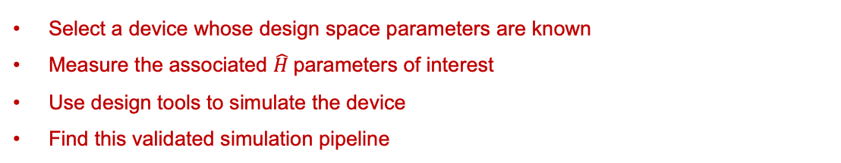
Our Solution:
measured
simulated
Select a device whose design space parameters are known
Measure the associated $\hat{H}$parameters of interest
Use design tools to simulate the device
Find this validated simulation pipeline
validated sim
$\hat{H}$ Space
Design Space

Slide 6
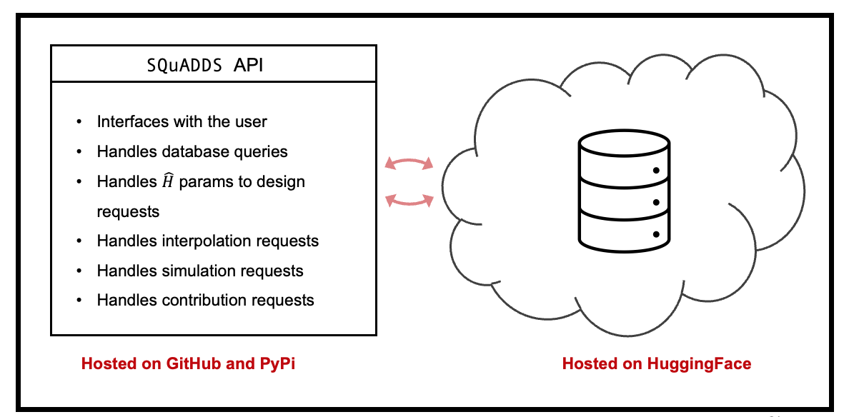
Our Solution:
The goal is to create a database of such validated simulation results and workflows
🤗
$\hat{H}$ Space
Design Space

Slide 7
Tutorial 1 Objectives
Understand the Database Structure
Understand SQuADDS python API to query the Database

