Slide 1
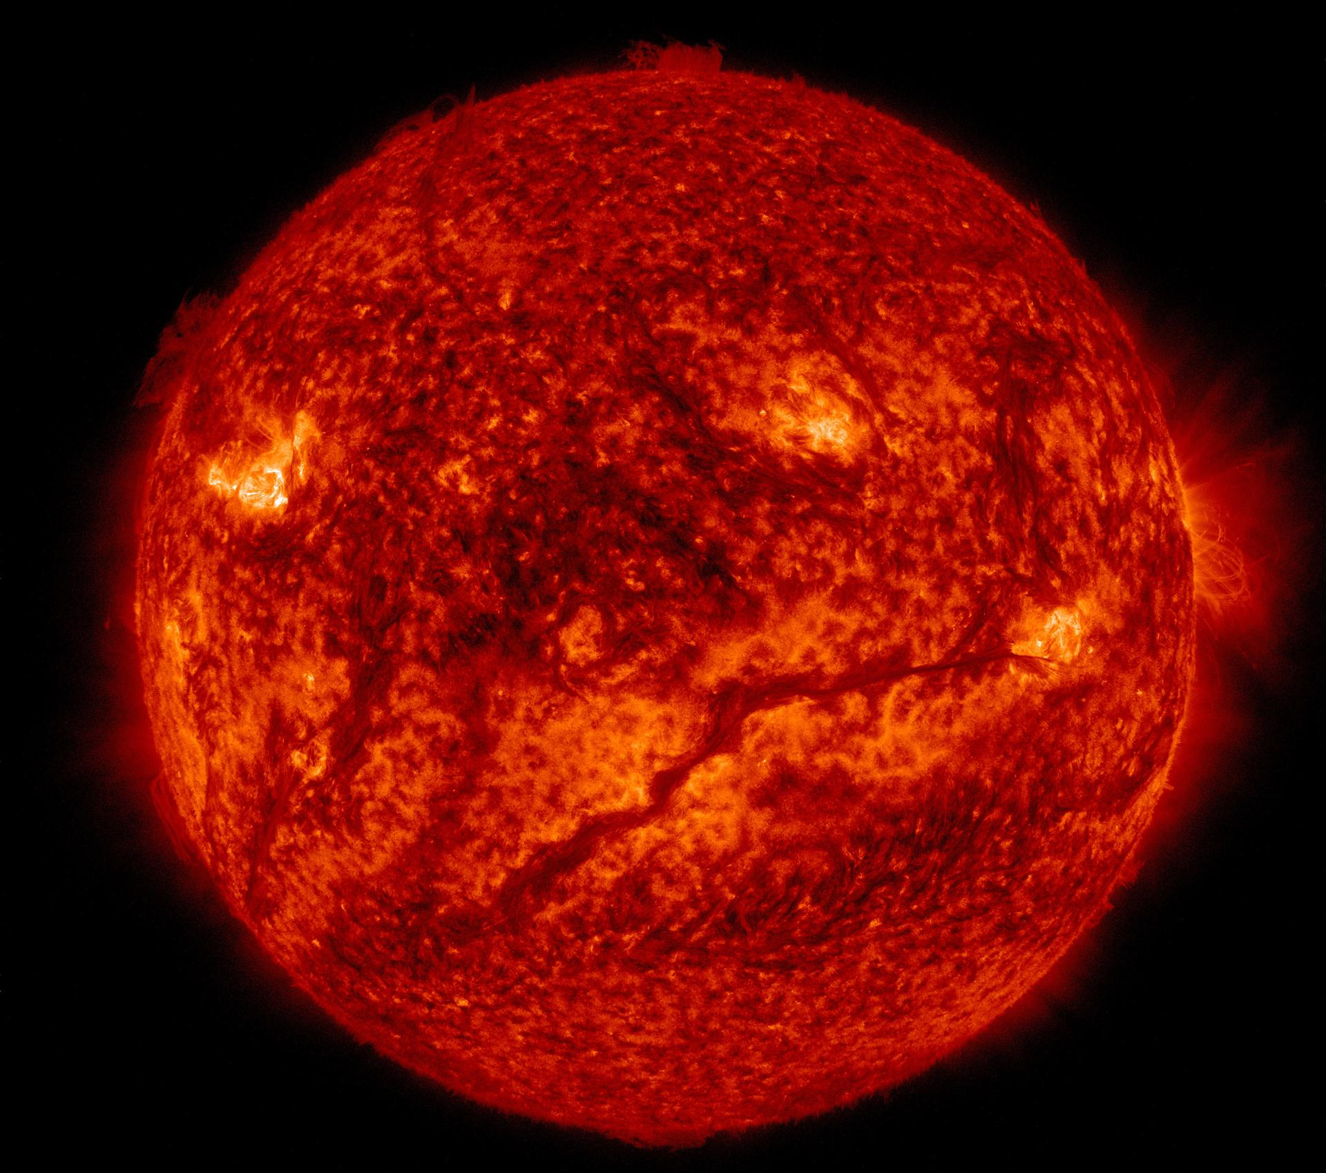
Solar
System
A neighborhood built by gravity, sunlight, and deep time
Editable 8-slide visual tour
NASA image sources; simplified educational scale
Notes:
Open with the idea that the solar system is not a list of planets. It is a dynamic system organized by the Sun's gravity.

Slide 2
The Sun is the anchor
99.8%
of the solar system's mass is in the Sun.
Fusion lights the worlds
Energy from the Sun drives climates, seasons, and photosynthesis on Earth.
Gravity sets the tempo
Planets, moons, comets, and dust all move inside the Sun's dominant pull.
Everything else is tiny
The planets are spectacular, but they are the thin outer punctuation.
Data: NASA Solar System Exploration. Image: NASA/SDO.
Notes:
Use this slide to reset scale. The Sun is the object that makes a solar system a system.

Slide 3
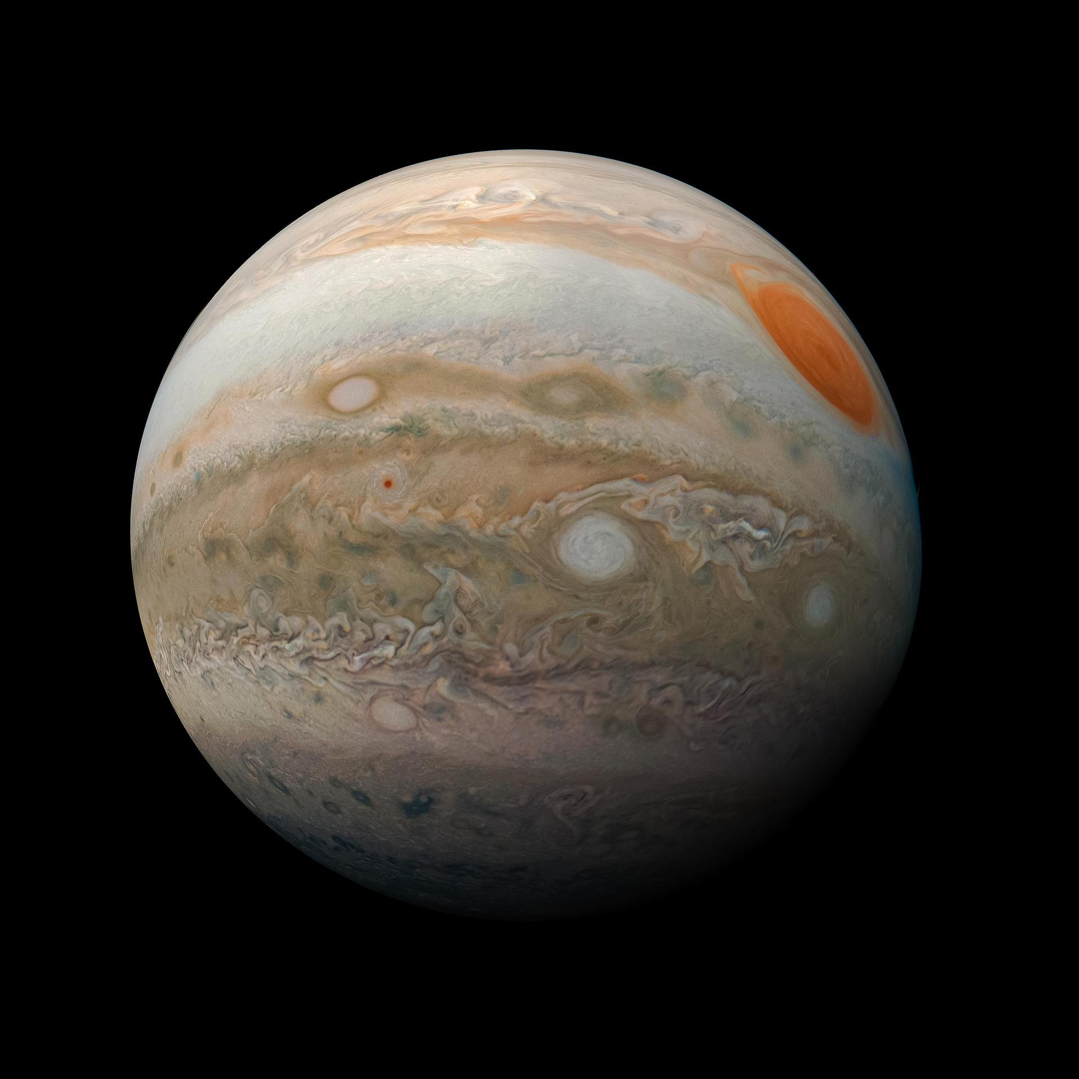
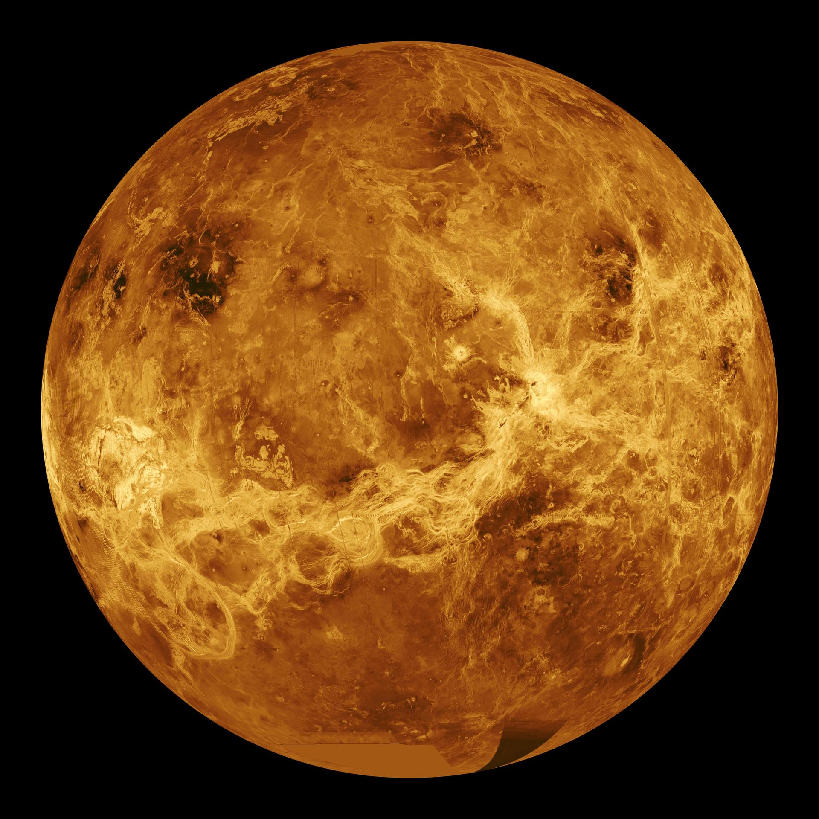
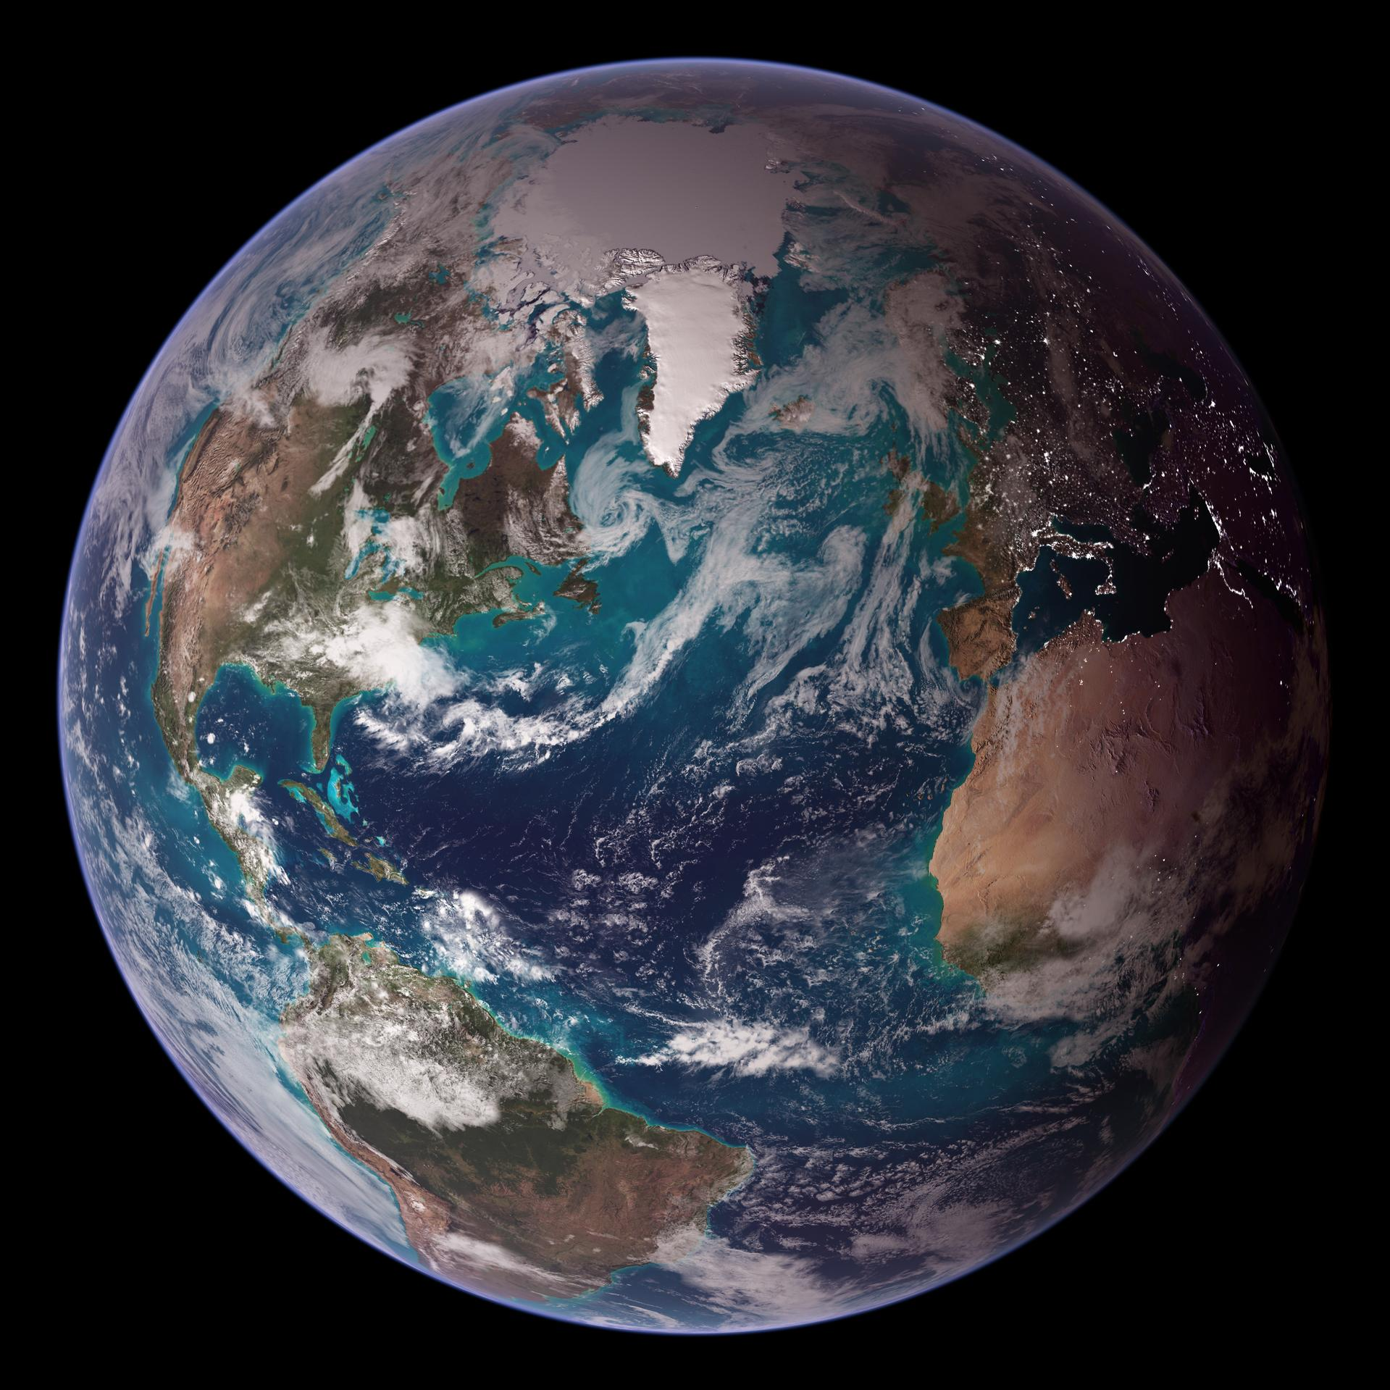
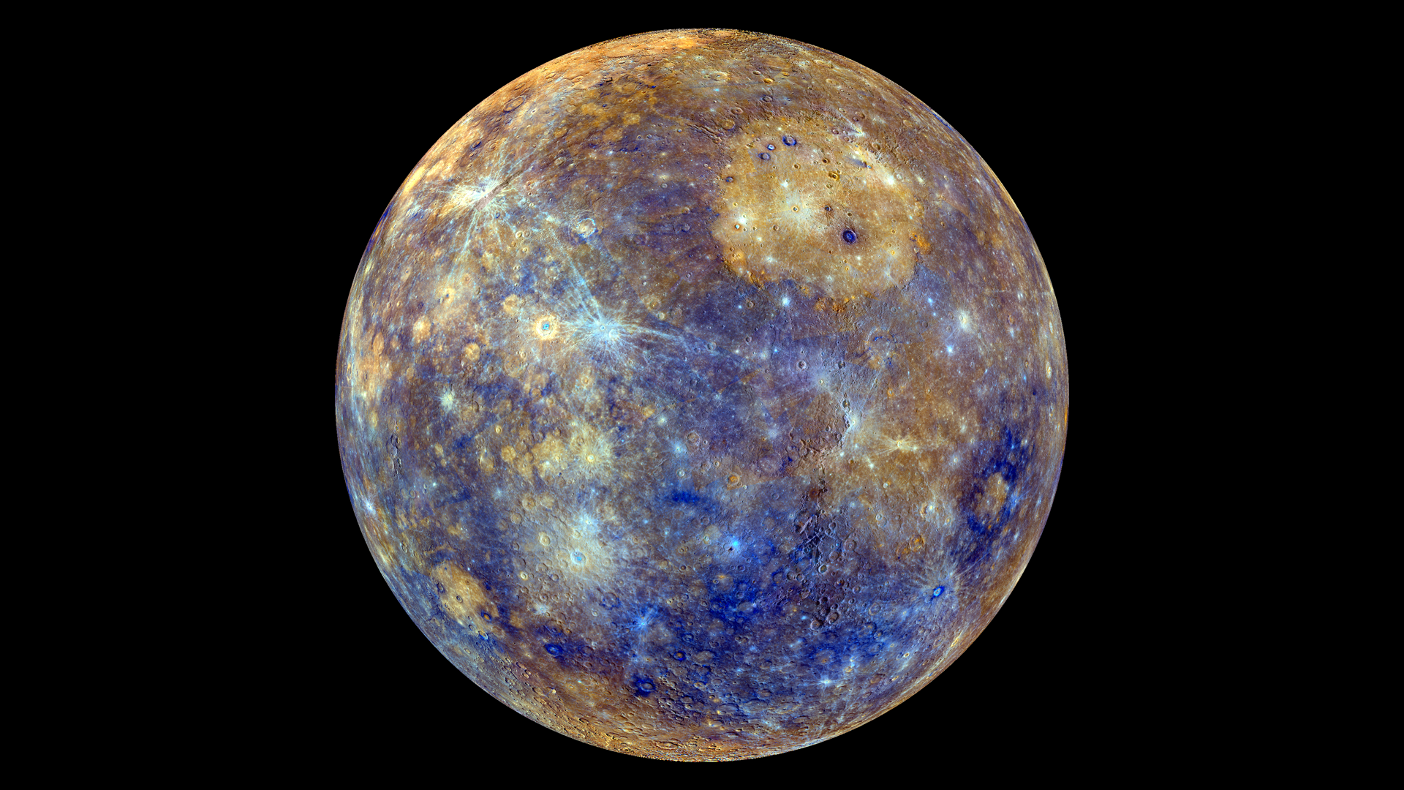
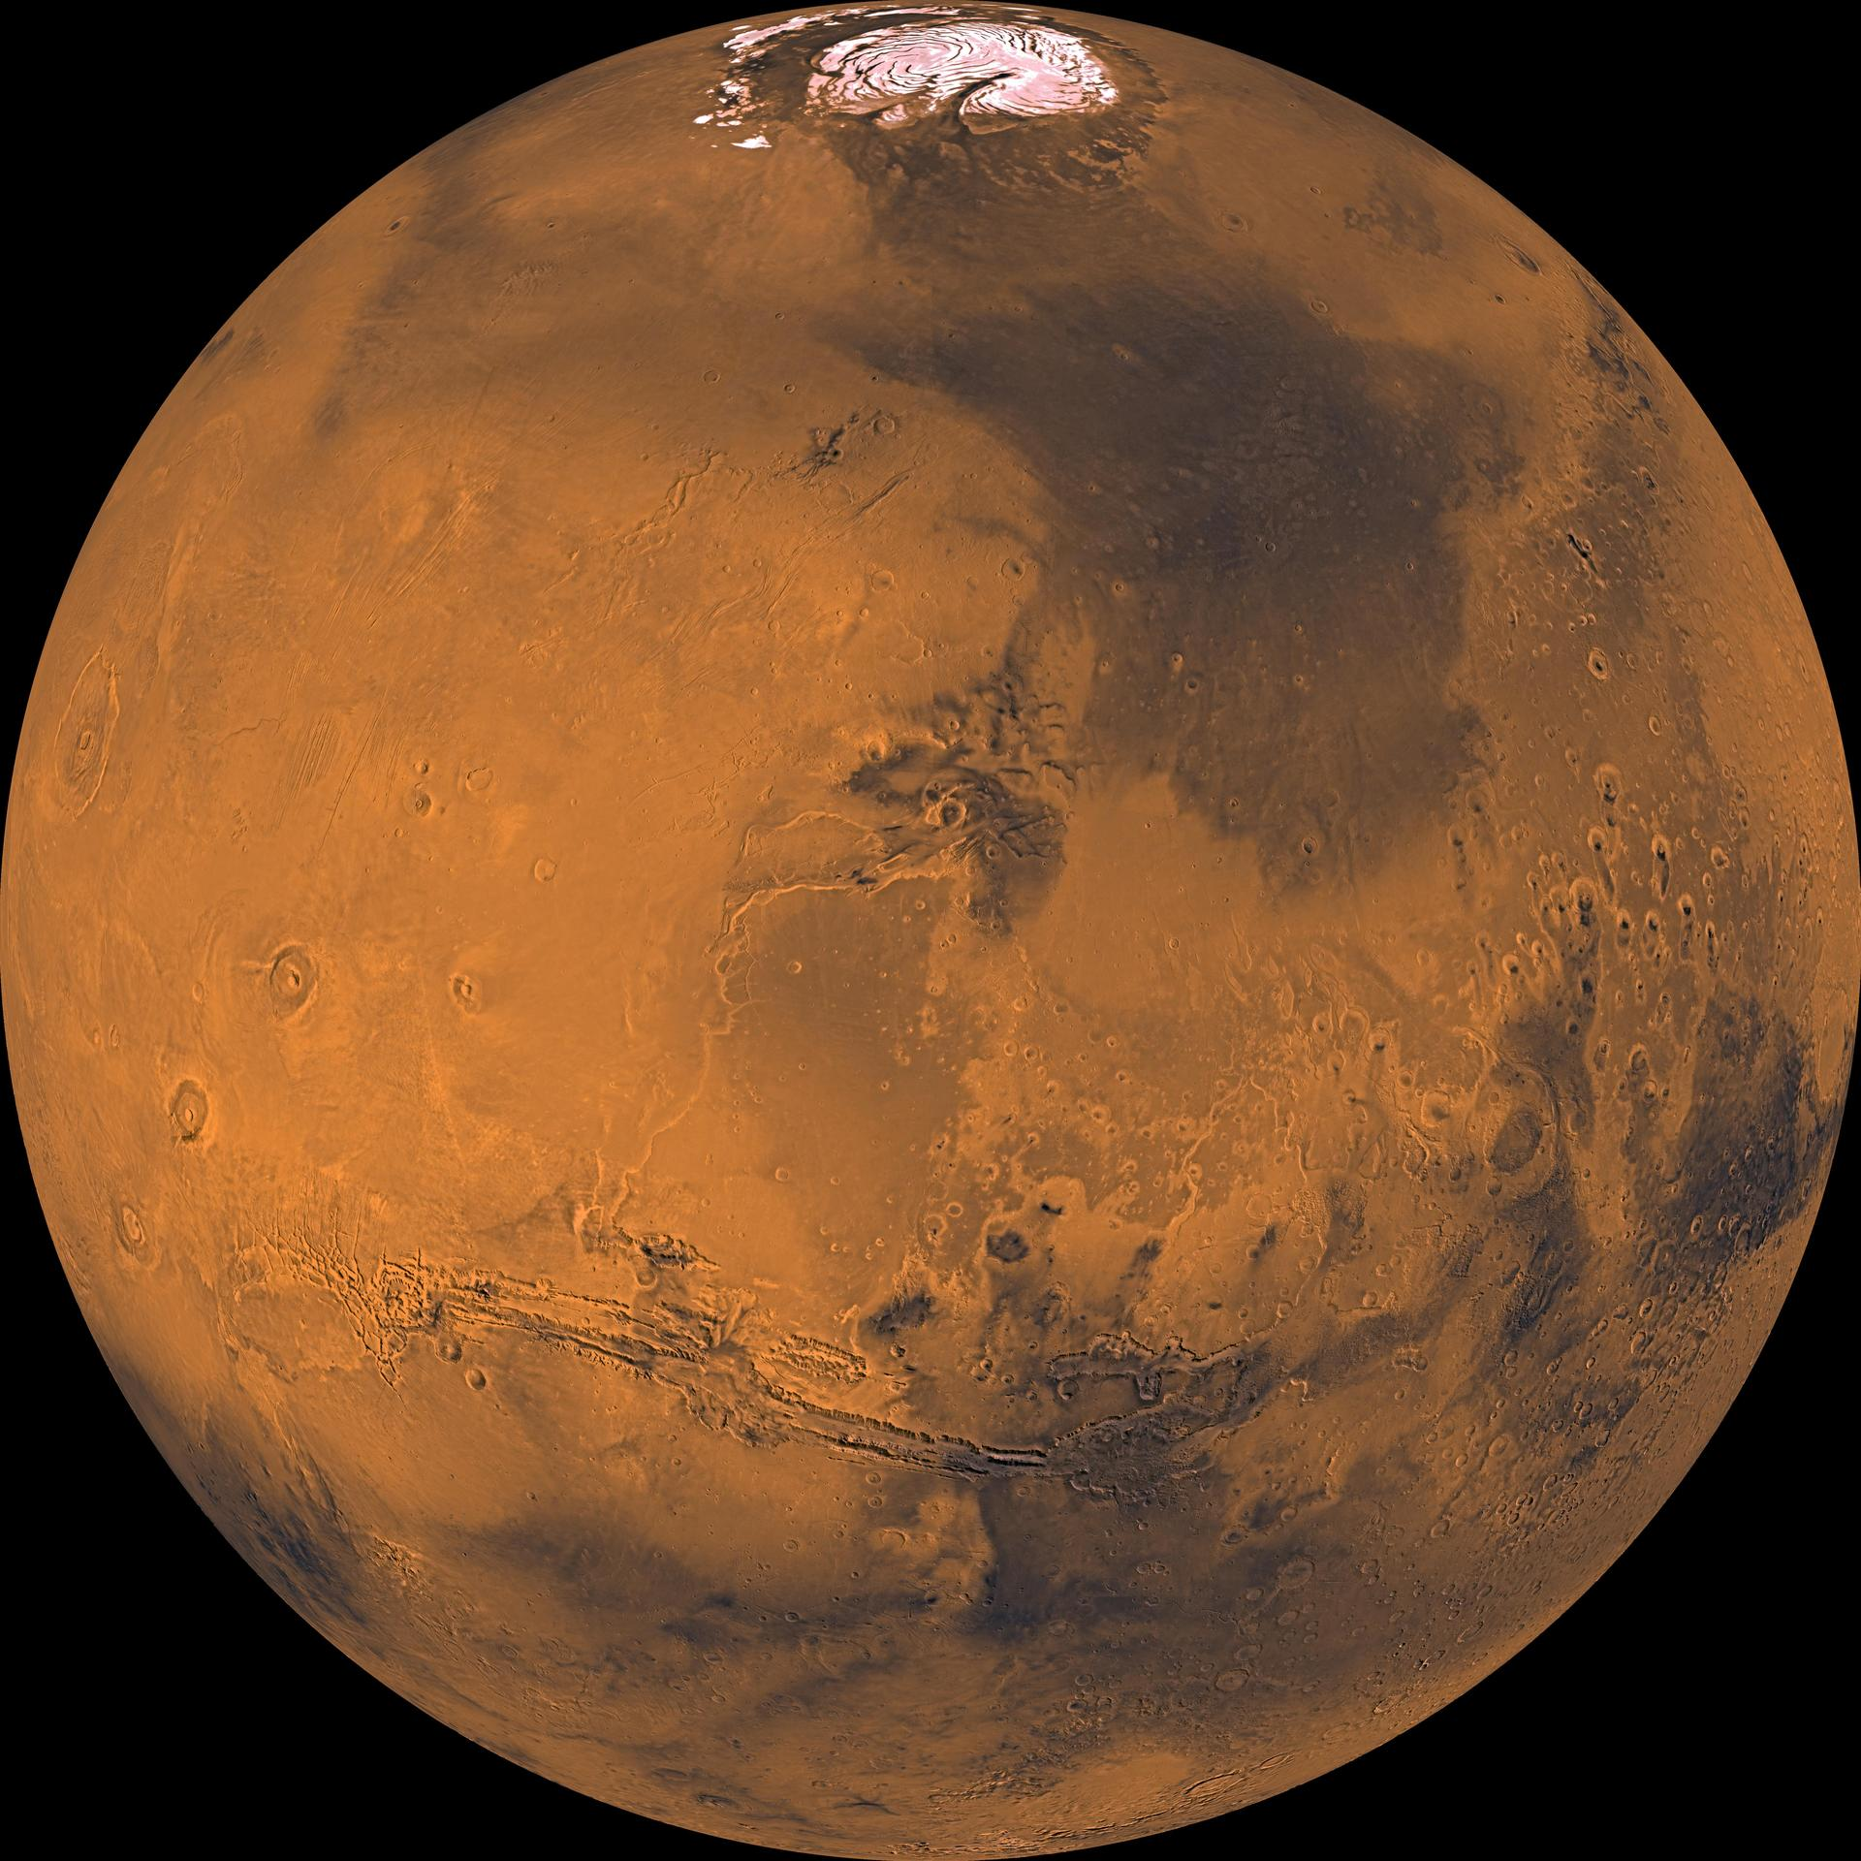
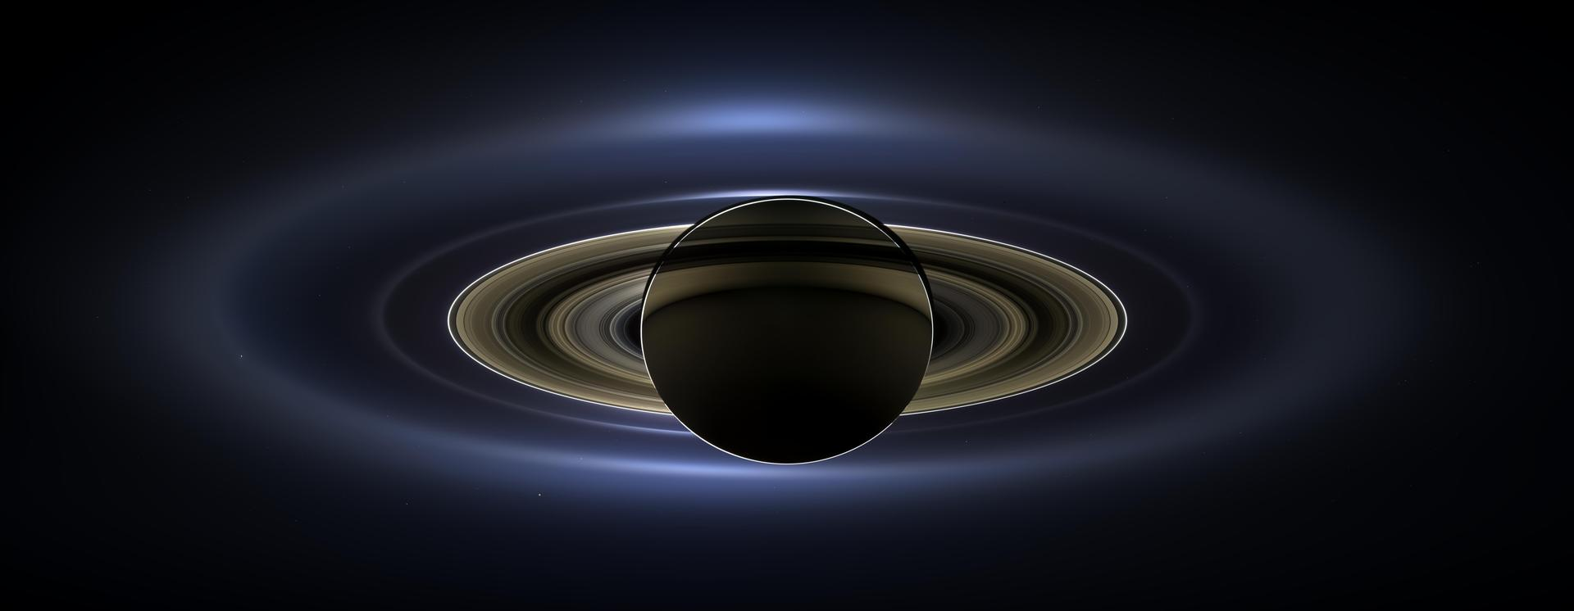
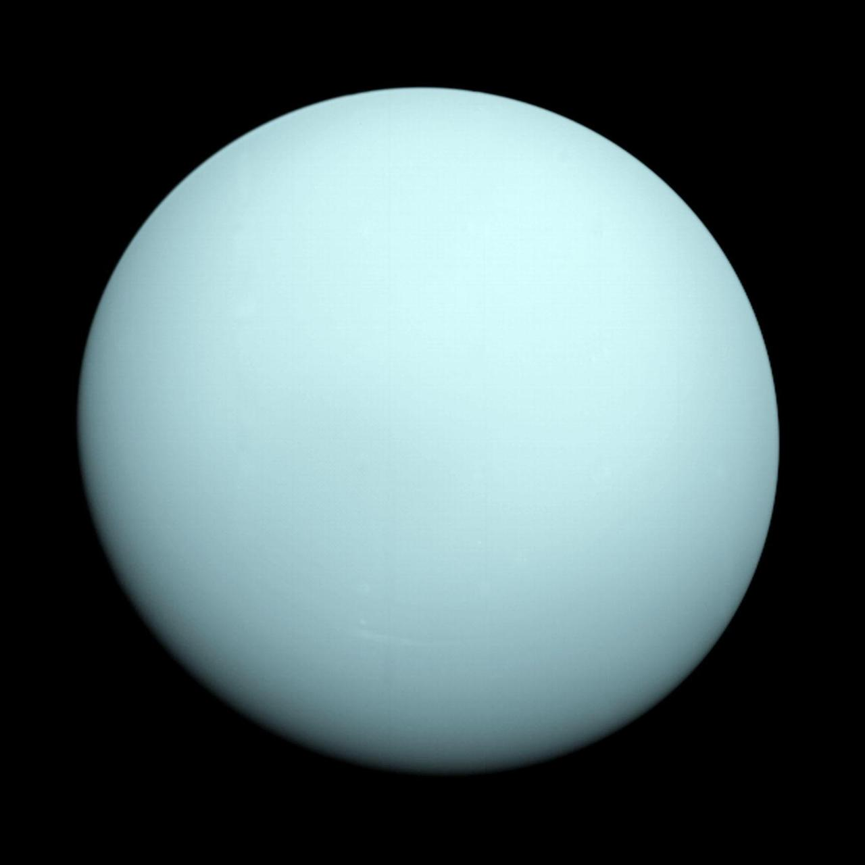
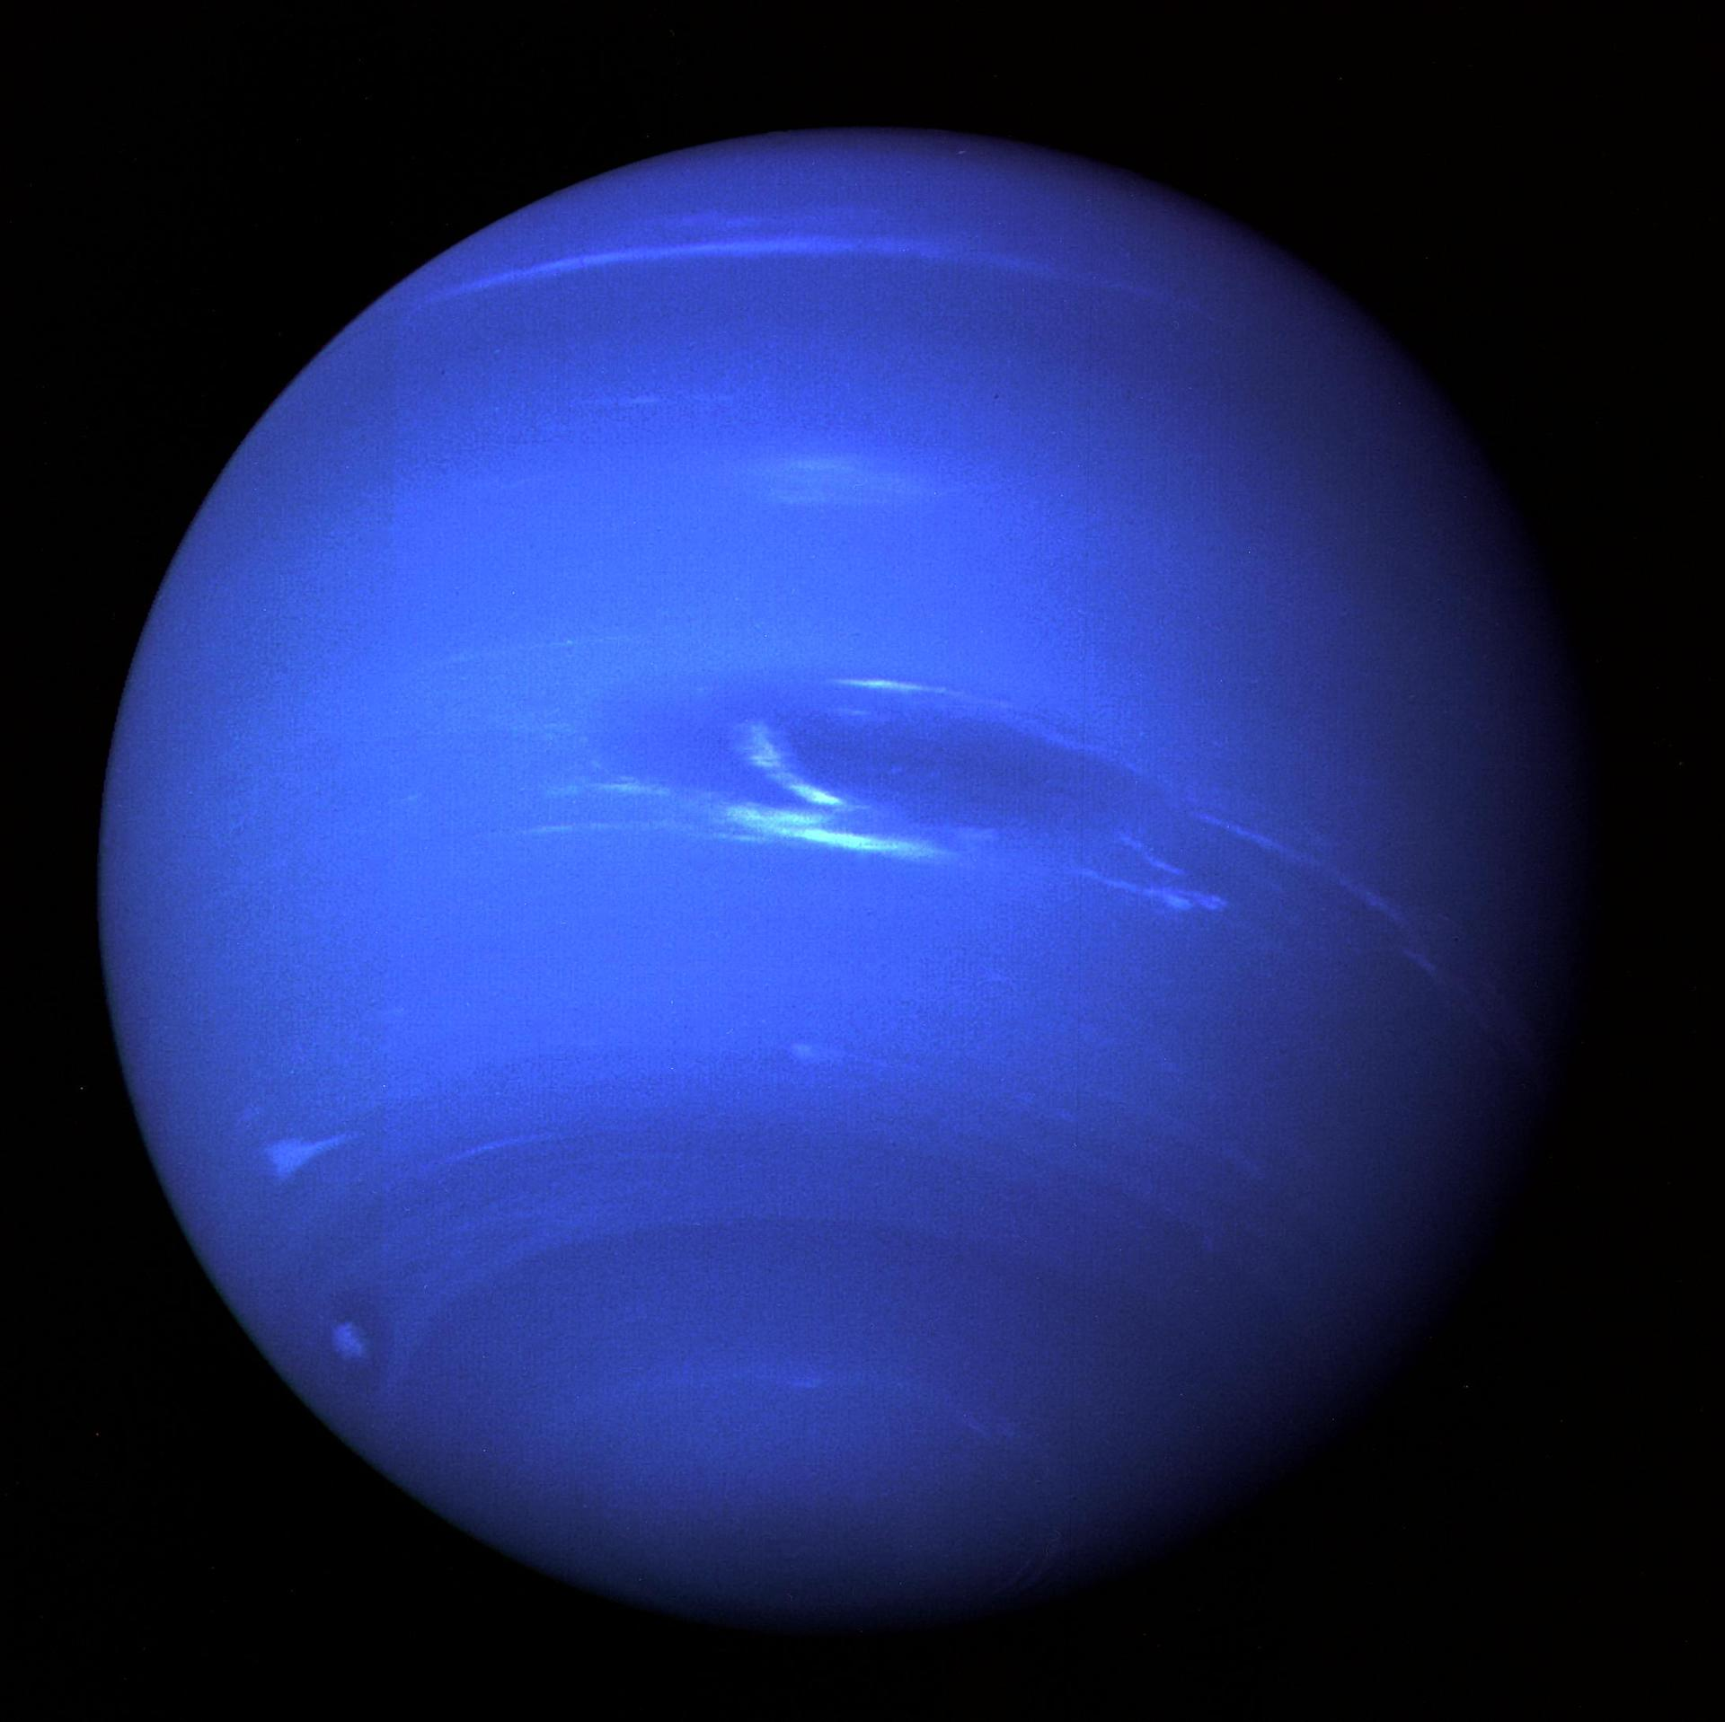
Eight planets, two families
Small rocky worlds close to the heat. Giant worlds where gas, ice, rings, and moons take over.
Rocky inner worlds
Gas and ice giants
Mercury
Mars
Venus
Earth
Uranus
Neptune
Jupiter
Saturn
Not to scale
Planet portraits: NASA/JPL/GSFC. Layout groups by composition, not physical scale.
Notes:
The viewer should remember the family split: terrestrial planets inside, giant planets outside.

Slide 4
Distance is the trick
Planet sizes are memorable. The empty space between them is the real scale lesson.
30x
Neptune orbits about thirty times farther from the Sun than Earth.
The solar system is mostly distance with bright punctuation.
Data: NASA Solar System Exploration; values rounded in astronomical units.
Notes:
This is the scale reveal. Even the chart compresses the inner planets near the baseline.

Slide 5
The inner worlds are four rocky experiments
Same basic ingredients. Very different atmospheres, temperatures, and histories.
Mercury
Venus
Earth
Mars
airless, cratered, extreme
thick clouds, runaway greenhouse
liquid water and active life
cold desert, ancient rivers
The habitable zone is not a magic ring. Atmosphere, geology, and time decide the outcome.
Images and data: NASA/JPL/GSFC. Distances and sizes are simplified for presentation.
Notes:
Treat the four inner planets as a natural experiment in planetary evolution.

Slide 6
Beyond Mars, scale changes again
The outer planets are systems in miniature, with rings, storms, magnetic fields, and dozens of moons.
Jupiter
Saturn
Uranus
Neptune
storm engine
ring laboratory
tilted ice giant
blue wind world
largest planet; a moon system of its own
icy rings turn gravity into visible structure
rotates on its side, likely after a giant impact
far, cold, and still dynamically active
Images and data: NASA/JPL/GSFC. Distances and sizes are simplified for presentation.
Notes:
The giant planets are not just bigger rocks. They are complex worlds with their own internal systems.

Slide 7
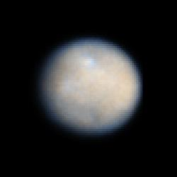
The leftovers are records
Asteroids, comets, dwarf planets, and moons preserve clues from the early solar system.
Asteroid belt
rocky fragments between Mars and Jupiter
Kuiper Belt
icy bodies beyond Neptune, including Pluto
Comets
ice-rich messengers with long looping paths
Moons
worlds around worlds, some with oceans
Ceres
a dwarf planet in the asteroid belt
The small stuff is not debris in the story. It is the archive.
Images and topic references: NASA/JPL. Small-body categories simplified for teaching.
Notes:
Use Ceres as a concrete example that small worlds can be scientifically rich.

Slide 8
The point of the map is us
Studying the solar system turns big human questions into places we can visit, measure, and compare.
Origins
Life
How did planets assemble?
Where can chemistry become biology?
Climate
Exploration
What makes a world stable or hostile?
How do we move farther without losing home?
A solar system is a mirror with eight planets, countless small worlds, and one home.
Images and data: NASA/JPL/GSFC. Closing synthesis by deck author.
Notes:
Close by making the science feel connected to origin, habitability, climate, and exploration.

