Slide 1

Data Science Portfolio Presentation
Lessa Fleming
Syracuse University
lgersten@syr.edu
Notes:
Welcome to my Data Science portfolio presentation.

Slide 2

Agenda
Introduction
Course Overview/Learning Objectives
Projects and Business Applications
Conclusion
Notes:
In this presentation, we will cover the learning objectives for the Masters of Applied Data Science program. We will review the projects I have completed in this program and their business applications and how these specific projects met my learning goals.

Slide 3

Lessa Fleming
Born in Syracuse, NY
Associates in Paralegal Studies
Bachelors in Computer Science
Masters of Science in Applied Data Science (2024 Graduation)
2 years in analytics at United Healthcare
Currently a Senior Claims Business Process consultant at UHC
Notes:
My name is Lessa Fleming, I was born in Syracuse NY, and lived there until 3 years ago when I moved to South Carolina and started a small hobby farm. I currently have an associate in paralegal studies and a bachelor’s in computer science from Rasmussen University. I started my journey with plans to become a lawyer when I realized my passion for data and analytics while obtaining my Computer Science degree. This led me to SU to pursue my master’s in applied data science. I continued to pursue this passion by moving into a technical analyst role, and now a senior claims business process consultant working in Oracle.

Slide 4
Syracuse University’s Applied Data Science program is a program that works with two schools of study to prepare a student upon graduation to gain insights from data and provide actionable feedback on those insights.
Courses
Data Administration Concepts and Database Management IST 659 | Introduction to Data Science IST 687
Applied Machine Learning IST 707 | Big Data Analytics IST 718
Quantitative Reasoning for Data Science IST 772 | Business Analytics SCM 651
Scripting for Data Analysis IST 652 | Advanced Big Data Management IST 769
Cloud Management IST 615 | Introduction to Information Security IST 623
Information Visualization IST 719 | Applied Data Science Portfolio IST 782
After choosing a track and completing all the required courses upon graduation a student should be able to demonstrate a range of skills including:
Collect, store, and access data by identifying and leveraging applicable technologies.
Create actionable insight across a range of contexts (e.g., societal, business, political), using data and the full data science life cycle.
Apply visualization and predictive models to help generate actionable insight.
Use programming languages such as R and Python to support the generation of actionable insight.
Communicate insights gained via visualization and analytics to a broad range of audiences (including project sponsors and technical team leads.
Apply ethics in the development, use, and evaluation of data and predictive models (e.g., fairness, bias, transparency, privacy).
Notes:
Syracuse University’s Applied Data Science program is a program that works with two schools of study to prepare a student upon graduation to gain insights from data and provide actionable feedback on those insights. I took a strategic approach to my data science education, focusing on analytics and visualizations to gain valuable insights from data. By choosing machine learning, analytics, and learning multiple scripting languages, I’ve widened my scope for potential career paths in analytics. My choice to move into visualization courses was done to not only uncover insights but also effectively present them. This approach I felt gave me a diverse skill set that would make me stand out as a candidate and open many career paths.

Slide 5
During my time in the Applied Data Science Masters program, I was able to highlight the skills and requirements in these 5 course projects
Introduction to Data Science – Variables that affect health insurance charges
Scripting for Data Analysis- AirBnB Prices and what affects them
Applied Machine Learning- Data Scientist Salaries
Big Data Analytics- Honey Bee Production
Advanced Big Data Management- SC weather Analysis

Slide 6
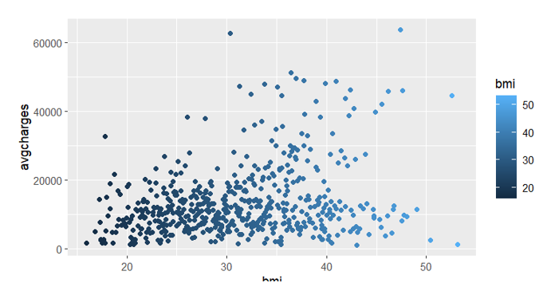
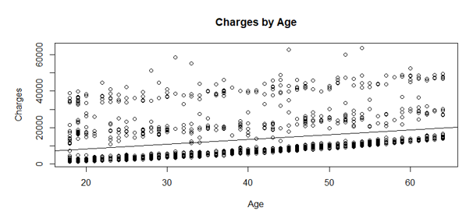
Introduction to Data Science
Identify a problem and the data needed for addressing the problem.
Perform basic computational scripting using R and other optional tools.
Transform data through processing, linking, aggregation, summarization, and searching.
Organize and manage data at various stages of a project life cycle.
Determine appropriate techniques for analyzing data.
Notes:
The health insurance charge project effectively fulfilled my learning requirements across multiple dimensions of data science. Demonstrating proficiency in data handling, I collected, stored, and accessed data, identifying dataset demographics and assessing the need for cleaning. Despite dataset limitations, I successfully extracted actionable insights regarding variables impacting insurance charges, showcasing my ability to generate insights across different contexts. Through regression modeling and visualization techniques, I was able to analyze the data to identify significant variables and convey insights visually, while also applying programming skills in R for data manipulation and model creation. By creating a Shiny app and developing a prediction function, I communicated insights to a broad audience, including non-technical users, thus meeting the requirement for communication. Though not explicitly mentioned, ethical considerations were taken into account, aligning with the need to apply ethics in data and predictive models. Overall, my project encompassed the entire data science life cycle, demonstrating the ability to handle data, derive insights, apply various techniques, communicate findings effectively, and consider ethical implications.

Slide 7
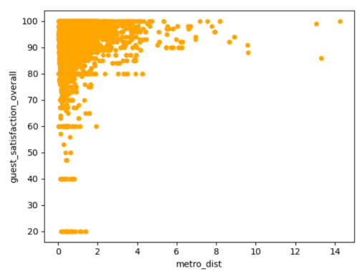
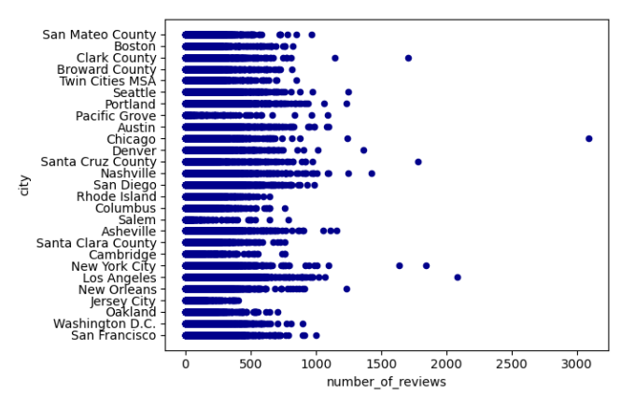
Scripting for Data Analysis
Obtain a dataset
Create Business questions
Organize, clean, and analyze data
Provide visualizations
Actionable feedback and data results
Notes:
This project centered on analyzing two Airbnb datasets from Kaggle, this project met my learning requirements in several key aspects. Beginning with data handling and management, I was able to efficiently process the datasets, distinguishing between the AB_US and Combined Europe datasets and managing their large size by creating a sampled version for analysis. Utilizing Jupyter notebooks, I organized the data into separate data frames for analysis. Through data cleaning and manipulation, I ensured that only relevant columns were retained and appropriately renamed for clarity, exemplifying proficiency in data preprocessing. Employing descriptive statistics, scatter plots, correlation analysis, and pivot tables, I explored the relationships between variables such as price, location, and customer satisfaction, demonstrating a comprehensive understanding and application of visualization and analytical techniques. Furthermore, I effectively communicated the project findings and insights, concluding Airbnb rental trends in different geographical contexts, such as the impact of location proximity to metro stations on rental types in Europe and the influence of city, availability, and price on rental bookings and customer satisfaction. Overall, this project showcases the data science principles and techniques, aligning closely with the learning requirements and showcasing my ability to derive actionable insights from complex datasets.

Slide 8
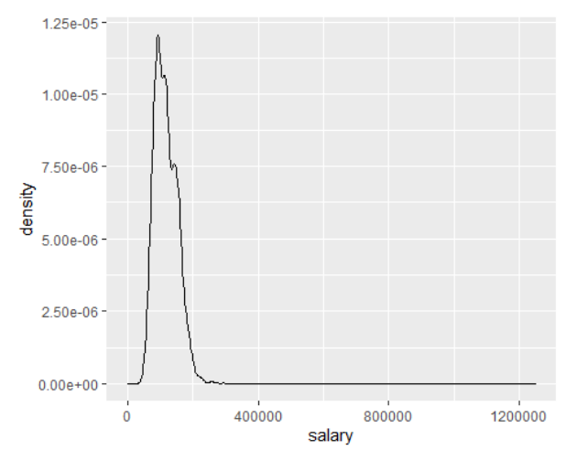
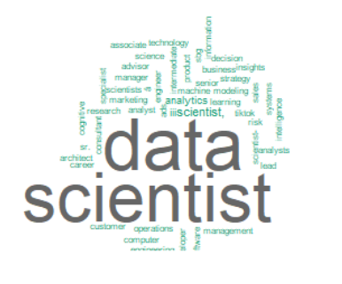
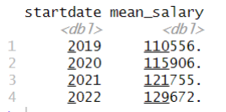
Applied Machine Learning
The objective of the project is to use the main skills taught in this class to solve a real data mining problem.
Obtain a data set
Clean, organize, and prepare data
Analyze and provide actionable results.
Notes:
For my Machine Learning project, I focused on analyzing a dataset of Data Science salaries from 2019 to 2022 sourced from Kaggle, this project helped to demonstrate my ability to use multiple analysis methods to predict future salaries and inform negotiation strategies for Data Scientist roles. Despite encountering challenges with the initial dataset, which necessitated the use of a replacement dataset, I was able to prepare the data, ensuring it was clean and structured for analysis in R. Through descriptive statistics, I gained insights into the distribution and trends of salaries across different years, identifying notable increases in mean salaries over time. Utilizing visualization techniques such as histograms, density charts, and word clouds, I was further able to explain salary distributions and key terms in job descriptions. Moving into data mining, I applied probability tables and machine learning models such as Naïve Bayes and decision trees to predict future salaries and determine optimal negotiation strategies. The analysis revealed steady increases in Data Scientist salaries year over year, with significant variations in average salaries across cities. Ultimately, the prediction analysis suggests a negotiated salary range for 2023 between $124,671 and $134,671, providing valuable insights for individuals seeking Data Science roles. Overall, this project demonstrates a comprehensive application of data science techniques to address real-world questions and inform decision-making in a professional manner.

Slide 9
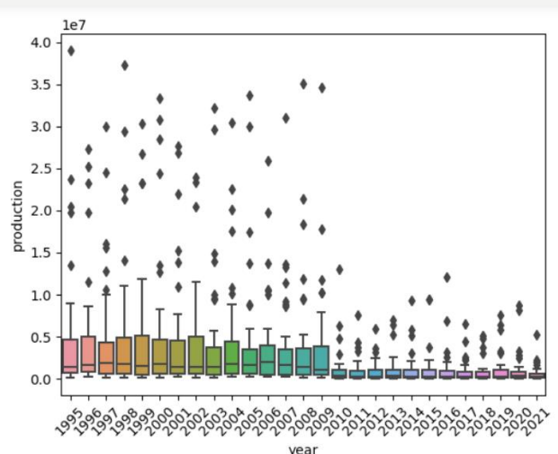
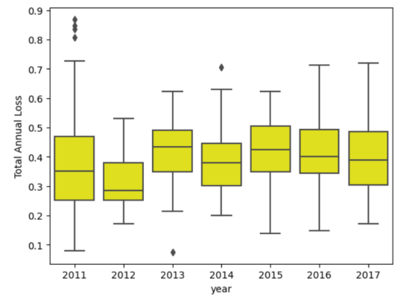
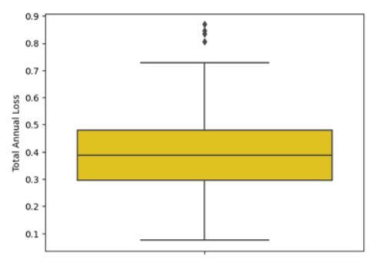
Big Data Analytics
Students will identify a data-focused problem, bring together different data sources, conduct analysis, draw conclusions, and produce a report explaining the results. Students are to demonstrate the ability to select the appropriate analytical methods for the chosen problem; interpret the data, model, analysis, and findings; draw appropriate conclusions; and present the results in a meaningful way.
Notes:
For the Big Data Analytics class my project centered on the analysis of two datasets regarding honeybee production and colony loss, effectively addressing critical issues related to declining bee populations and its implications. Through meticulous examination, it was observed that the overall number of colonies, honeybee production, and beekeepers are experiencing a consistent decline, posing significant ecological concerns. To address these challenges, a recommendation is proposed to allocate funding for incentivizing beekeeping and bee-saving initiatives, aiming to bolster beekeeping efforts and mitigate colony losses. By enhancing the quantity and quality of beekeeping practices, it is anticipated that the number of colonies and honey production can be positively impacted. Furthermore, considering the correlation between production levels and honey prices, such incentives could lead to potential cost reductions in the future. The project's research questions encompass various aspects, including trends in colony loss, honey production, price fluctuations, and predictive analysis by state. Hypotheses were formulated to explore these questions, anticipating trends such as increasing colony losses and declining honey production over time. Two datasets were utilized, retrieved from Kaggle, each providing valuable insights into colony loss, honey production, and related factors across different states and years. Notable findings include the prevalence of colony loss and declining honey production trends, particularly evident from 2011 to 2017. Despite challenges in fitting ARIMA models for predictive analysis, the project still discerned significant trends, indicating the likelihood of continued colony losses and their far-reaching consequences. Ultimately, the recommendation for funding incentivized beekeeping initiatives emerges as a crucial step towards safeguarding the bee population and maintaining a healthy ecosystem. Through this proactive approach, the project underscores the importance of collective efforts in addressing the pressing issue of declining bee populations and its broader ecological impact. My project encompasses various aspects of data analysis, visualization, prediction, and communication, showcasing proficiency in addressing real-world problems using R while considering ethical implications and communicating findings effectively to stakeholders.

Slide 10
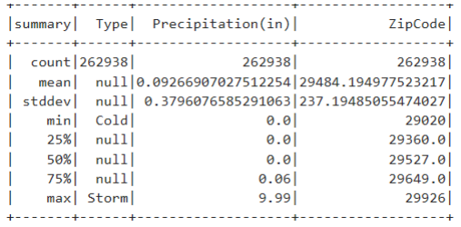
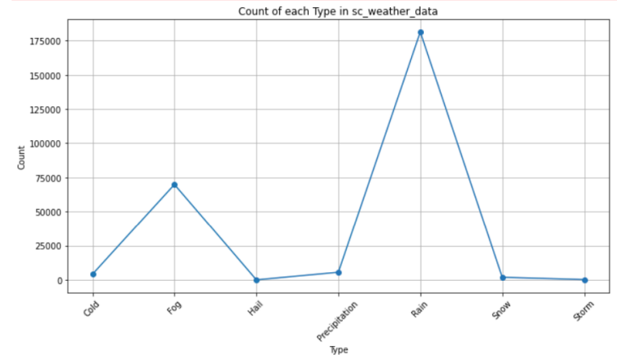
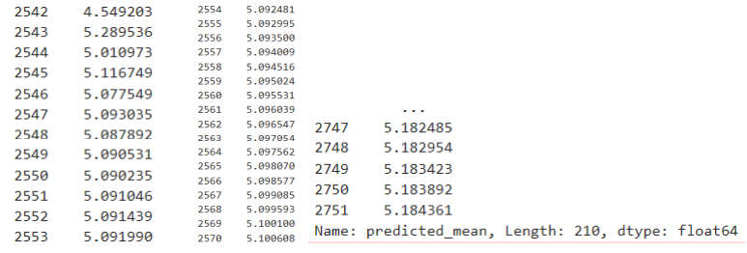
Advanced Big Data Management
Work in self-assembled teams of one to three students.
Devise your own case study and data set to work on.
Identify outcomes that you intend to do, and why.
Data sourcing
Notes:
This project involved analyzing weather data for the entire US from 2016 to 2022, focusing specifically on South Carolina (SC) to predict weather patterns for 2023 and 2024. After downloading the dataset from Kaggle, it was loaded into Jupyter, cleaned, and filtered to create a dataset specifically for SC. The analysis included viewing summary statistics for precipitation and zip codes, plotting the distribution of precipitation across zip codes, and forecasting precipitation using ARIMA. The project utilized Python programming in Jupyter for data manipulation, visualization, and forecasting. Through this analysis, the project demonstrated proficiency in data collection, cleaning, analysis, and forecasting using applicable technologies (Python in Jupyter). It also applied visualization techniques to gain insights into weather patterns, communicated findings effectively through summary statistics and plots, and utilized predictive models to generate actionable insights, meeting the specified learning requirements. Additionally, by focusing on weather forecasting, the project showcased an understanding of the full data science lifecycle, from data collection to prediction, while considering ethical implications such as the impact of weather on communities and environments.

Slide 11
Conclusion
Having a background in computer science, exploring analytics and data science felt like an exciting transition. The courses I engaged in and the skills I refined were pivotal in shaping my personal and academic growth. The projects and coursework have equipped me to advance in my current career, enabling me to offer more profound insights into our data. By persistently practicing and refining my skills, I am preparing myself to transition into a data science role within my company.
https://lfleming21.github.io/index.html
Notes:
Through the completion of various projects spanning different domains such as analytics, data science, and weather forecasting, I have gained valuable insights and skills that directly align with my learning requirements. These projects have enabled me to proficiently collect, clean, and analyze diverse datasets using programming languages like R and Python, fulfilling the need to leverage applicable technologies for data manipulation and analysis. By applying visualization techniques and predictive models, I have successfully generated actionable insights across different contexts, from societal issues like honeybee population decline to business analytics in predicting data science salaries. Additionally, communicating these insights effectively to diverse audiences, including project sponsors and technical team leads, has been a crucial aspect of these projects, contributing to my ability to articulate findings clearly and persuasively. Furthermore, these projects have underscored the importance of ethical considerations in the development and use of data and predictive models, ensuring fairness, transparency, and privacy in my analyses. Overall, these projects have provided me with a comprehensive understanding of the data science lifecycle, from data collection to prediction, and have equipped me with the skills and knowledge necessary to address real-world challenges across various domains while upholding ethical standards.

