Slide 1
Shares: An Analysis of THE Factors that lead IN increased of news popularity
Group 10 – Lince Rumainum & John Osborn
lince.f.rumainum-1@ou.edu
john.c.osborn-1@ou.edu

Slide 2

Background
The goal of a news article is to become popular. News articles are not written to be hidden under a bush. The biggest questions for online news companies must face is how to make their articles more popular. A more article is successful or popular when it generates shares. The more shares the better. Our goal for this model is to be able to predict how a story will do and be able to give direction about how to write a story in the first place.

Slide 3
Problem
The Problem can be broken down in two ways:
What attributes cause an article to be more popular?
Can we accurately predict the number of shares an article will get based on its metadata.
This Photo by Unknown Author is licensed under CC BY-SA

Slide 4
Data Discovery

Slide 5
Data Set
39797 article data present
All articles were published by mashable.com
61 Attributes
58 Predictive
2 non-predictive
1 target
No missingness

Slide 6
Data Preparation

Slide 7
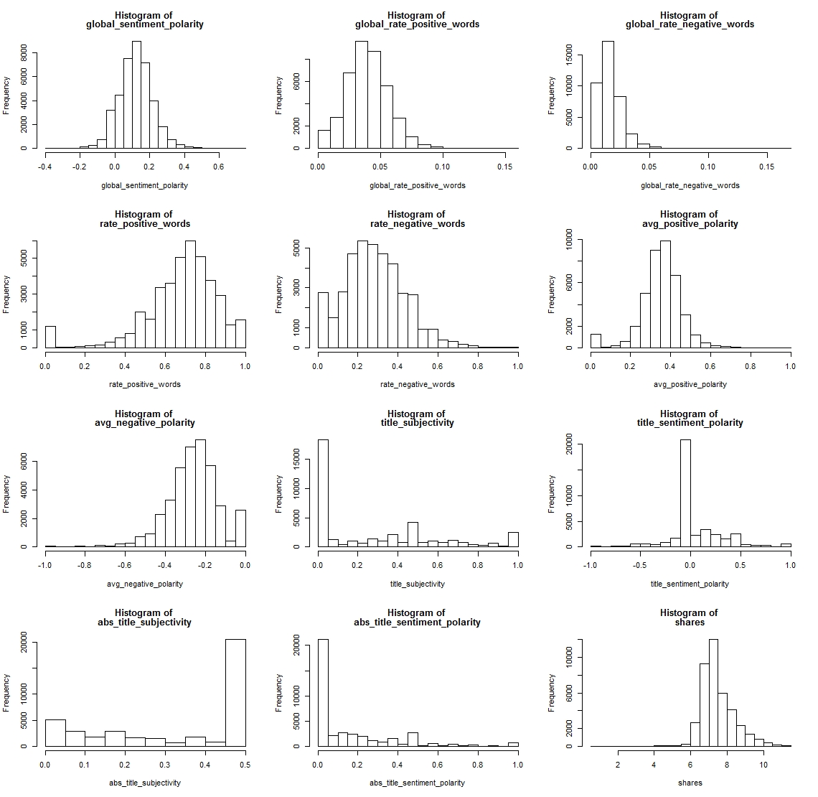
Skewness
Many of the variables were skewed and needed to be normalized

Slide 8
Feature Engineering
To reduce dimensionality, as well as factorize the data, we are combining the day of the weeks and the data channel variables.
To do this, we changed all the data with the value of one into their respective column and factorize them using their appropriate names. Next, we united the columns, both for days and data channels, together using the unite() function from the tidyr package.
We also removed the is_weekend variable because it is contained in the day variable.

Slide 9
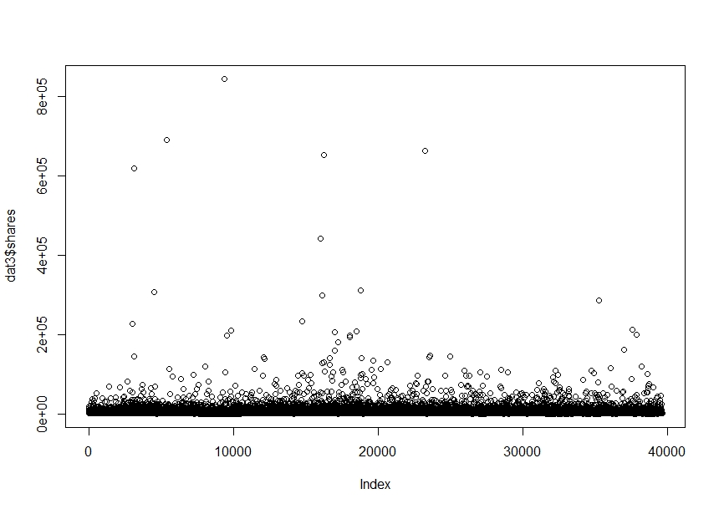
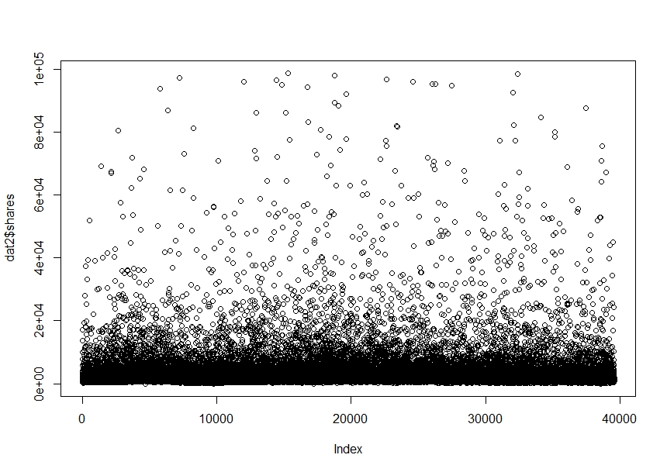
outliers
As shown on the plots for shares up to 100,000 (bottom plot) and over 100,000 (upper plot), the outliers in shares data had to be removed. Since attributes with shares data that are over 100,000 would cause inconsistencies in the predicting model since there are not enough data to analyze in that range. In this case, there are less than 0.15% data out of this data set that were shared for over 100,000.

Slide 10
Variables Removal
We removed several variables because they did not fit within our scope of work. Our scope is the article itself and not external factors, such as links.
The keyword variable deal with the links inside the article since we believe they are external factor and independent of the article itself. Our goal is to more global articles and not only within the mashable website.
We also removed the self reference shares because they deal with external articles and not the article itself.

Slide 11
Modeling

Slide 12
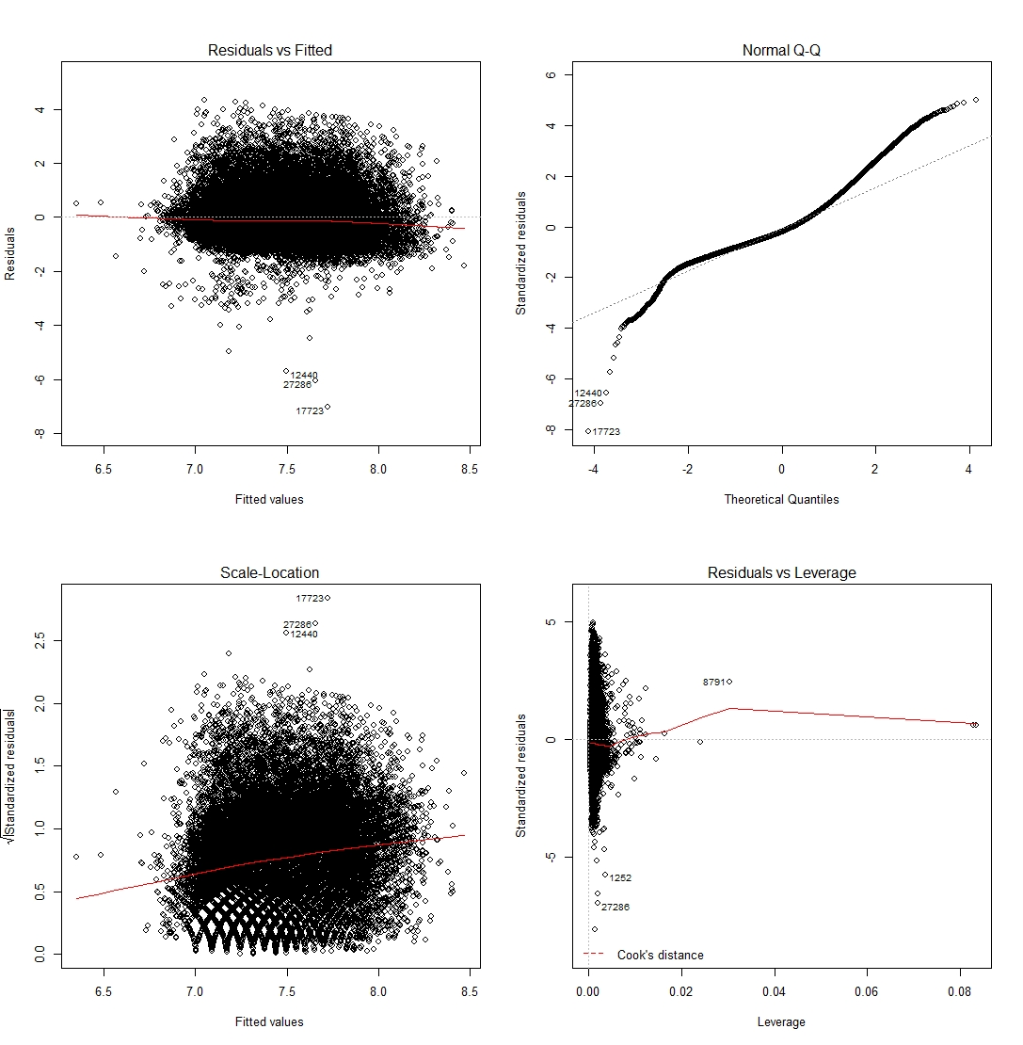
LINEAR MODEL
The plots show the behavior of the linear model. It shows:
The Residuals vs Fitted plot : we want that to be as close to zero as possible,
The Scale-Location plot: we want it to be equally spread across the predictors,
The Normal Q-Q plot: we want our data to be as close to normal distribution as possible, which is indicated by a positive slope linear trend line, and
The Residuals vs Leverage: which help indicates if there are still cases with high leverage data.

Slide 13
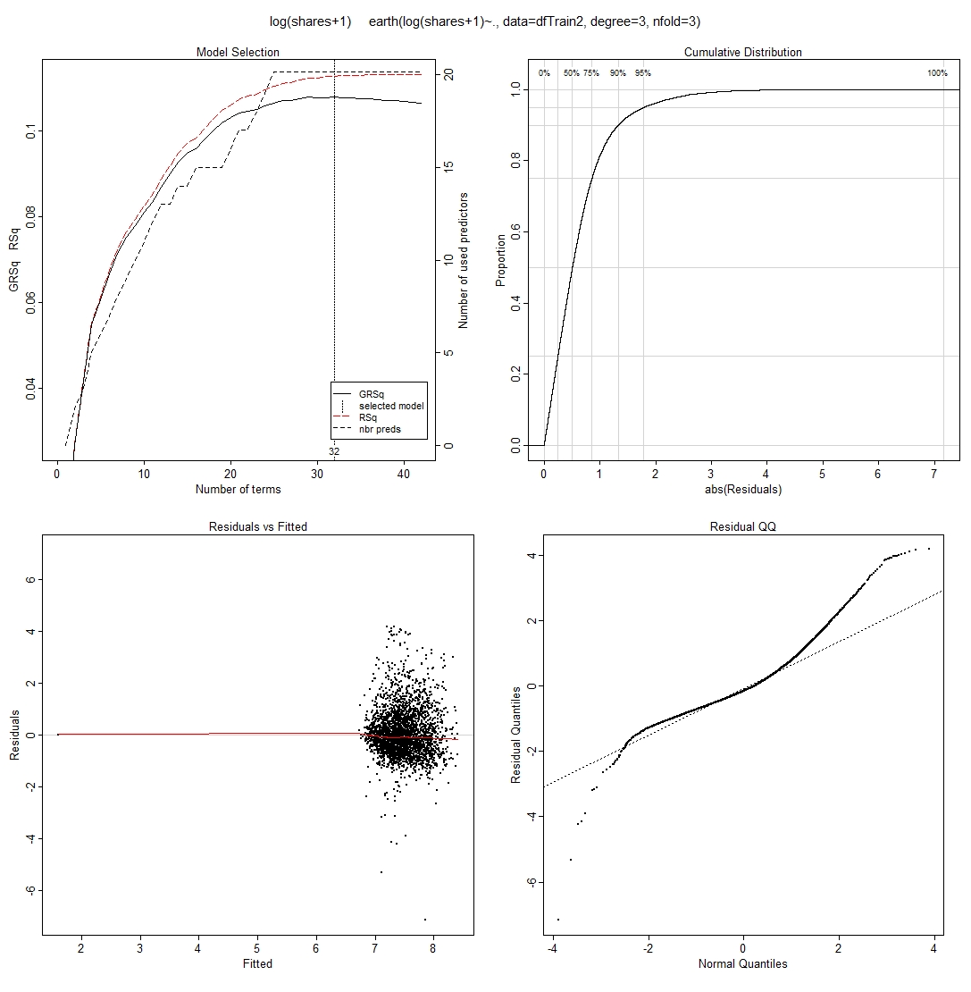
Multivariate Adaptive Regression Splines(MARS) MODEL
The Residuals vs Fitted plot of the MARS model shows improvement than the OLS model’s Residuals vs Fitted plot
Although, the Normal Q-Q plot of the MARS model does not seem to improve much at all than the OLS model’s Normal Q-Q plot

Slide 14
RMSE RESULT COMPARISON BETWEEN MODELs
Model | RMSE
kNN | 0.8079
MARS | 0.8296
OLS | 0.8335
SVM | 0.8528
treeBag | 0.8660
avNNet | 6.4702

Slide 15
Conclusion

Slide 16
CONCLUSION
It is important to try different data wrangling methods to help with creating new features, transforming skewed data, and reducing the dimensionality of the data set
Choosing which attributes to use for data modeling is critical to be able to create a training model that can predict the number of shares
Using all the variables is not always necessary, in fact, by intelligently reducing the dimension of the data, creating an over-fitting model can be prevented
Using a non-linear model does not necessarily mean better RMSE result

