Slide 1
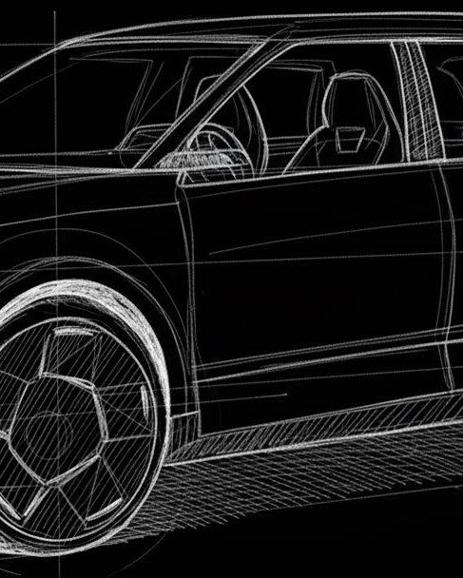
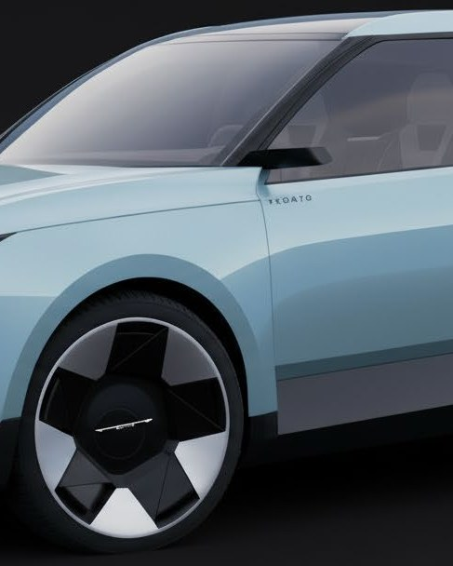
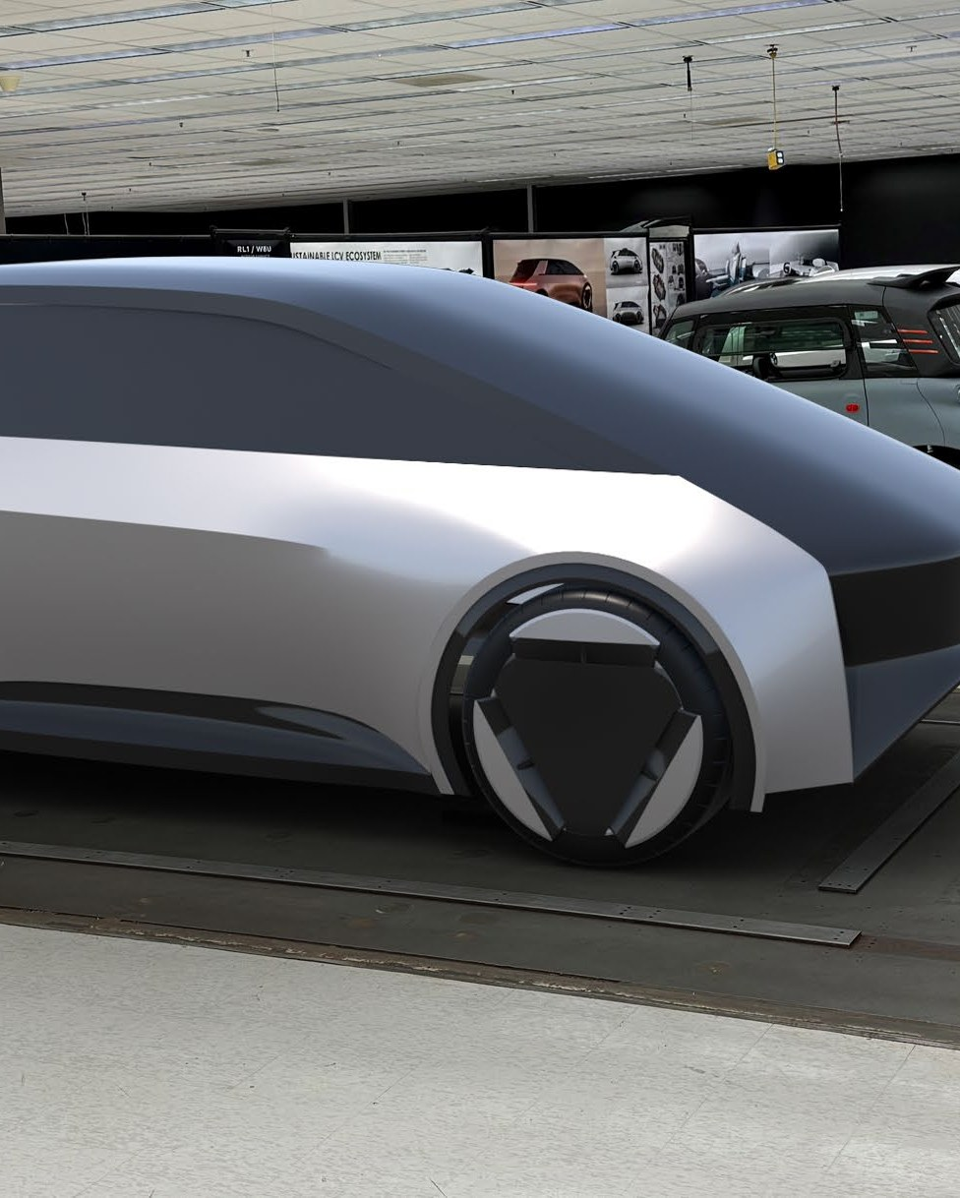
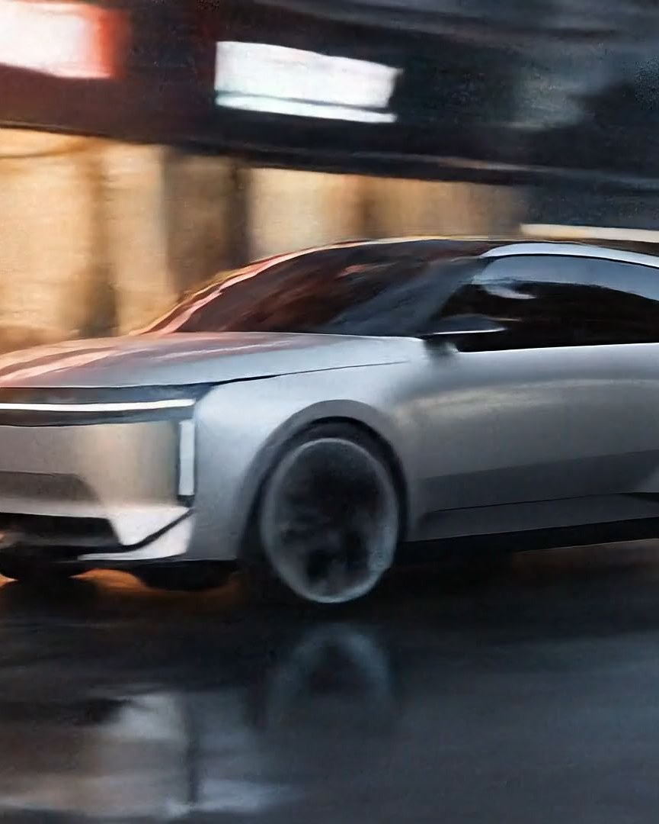
SKETCH
VIZCOM RENDER
STELLANTIS DESIGN
EXECUTIVE UPDATE · 2026
AI IN DESIGN
From experimentation to deployment.
AR REVIEW
AI VIDEO
Where Design has built operational AI capability today — and the direction we are heading next.
PREPARED BY
FOR
Lou Gasevski
Design Leadership
Director · Chrysler Design Exterior
Thiele · Gilles · Krugger · Jones · Zuehlke

Slide 2
DESIGN
.
INTELLIGENCE
01 · THE BASELINE
HOW VEHICLE DESIGN TRADITIONALLY WORKS
A sequence of specialist stages — each delivering value, each adding handoff time.
Designer intent moves through many hands before it reaches a leadership decision. Every transition translates the work into a new medium — and a new opportunity for drift.
01
Sketch
WHERE TIME GOES
02
Surfacing
Specialists in series
Each stage depends on the prior one. Designers, CDD, clay modelers, Unreal/VRED teams, animation studios, and external suppliers each take their turn.
03
Clay
04
Visualization
Intent in translation
Sketches become surfaces. Surfaces become clay. Clay becomes renders. Each translation absorbs hours and risks losing the original design intent.
05
Animation
06
Leadership Review
Late visibility for leadership
07
Iteration
Reviews happen after the program has traveled a long way. Course correction is expensive once clay is cut, supplier work is in flight, and animation is rendered.
02
/ 14

Slide 3
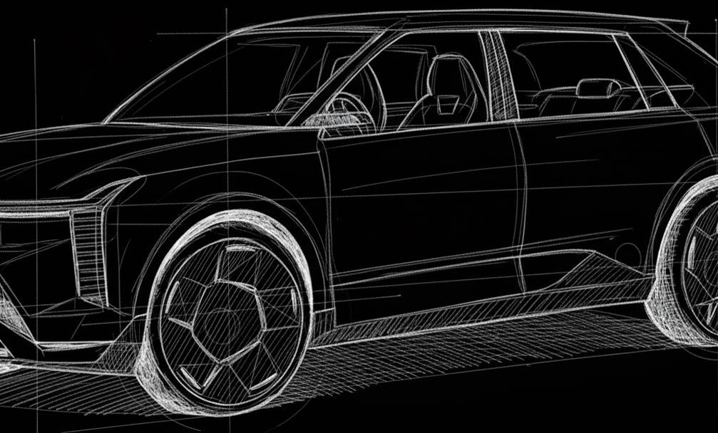
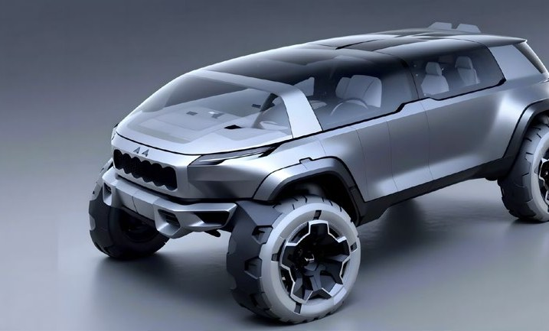
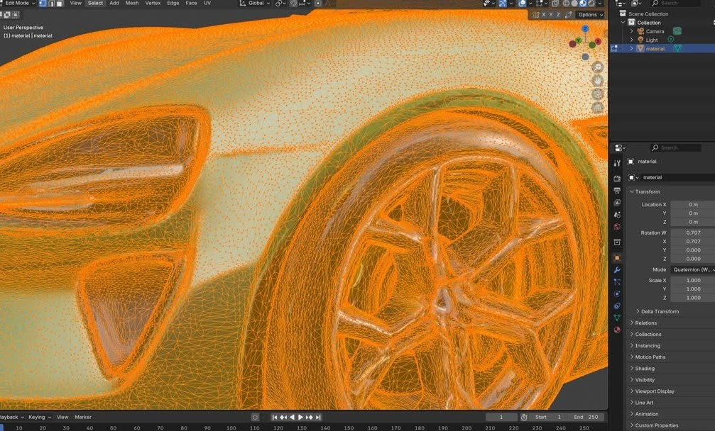
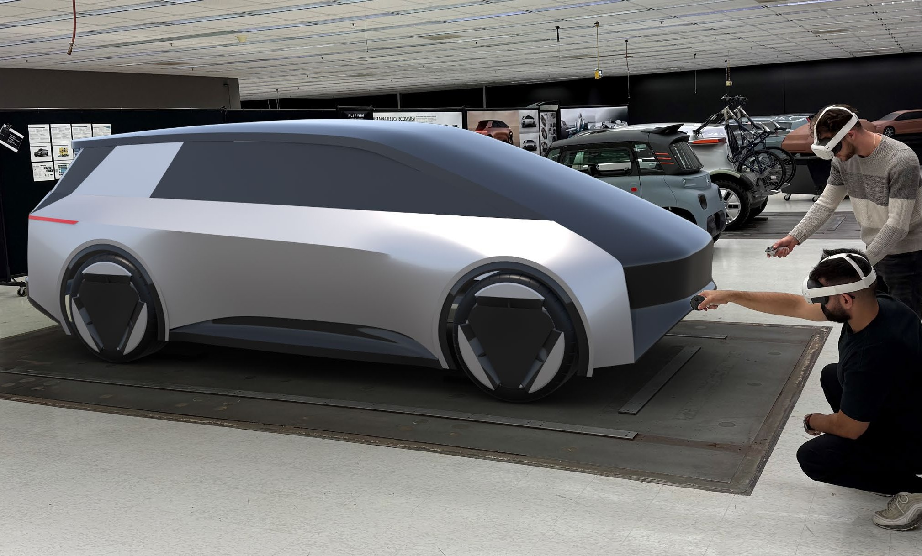
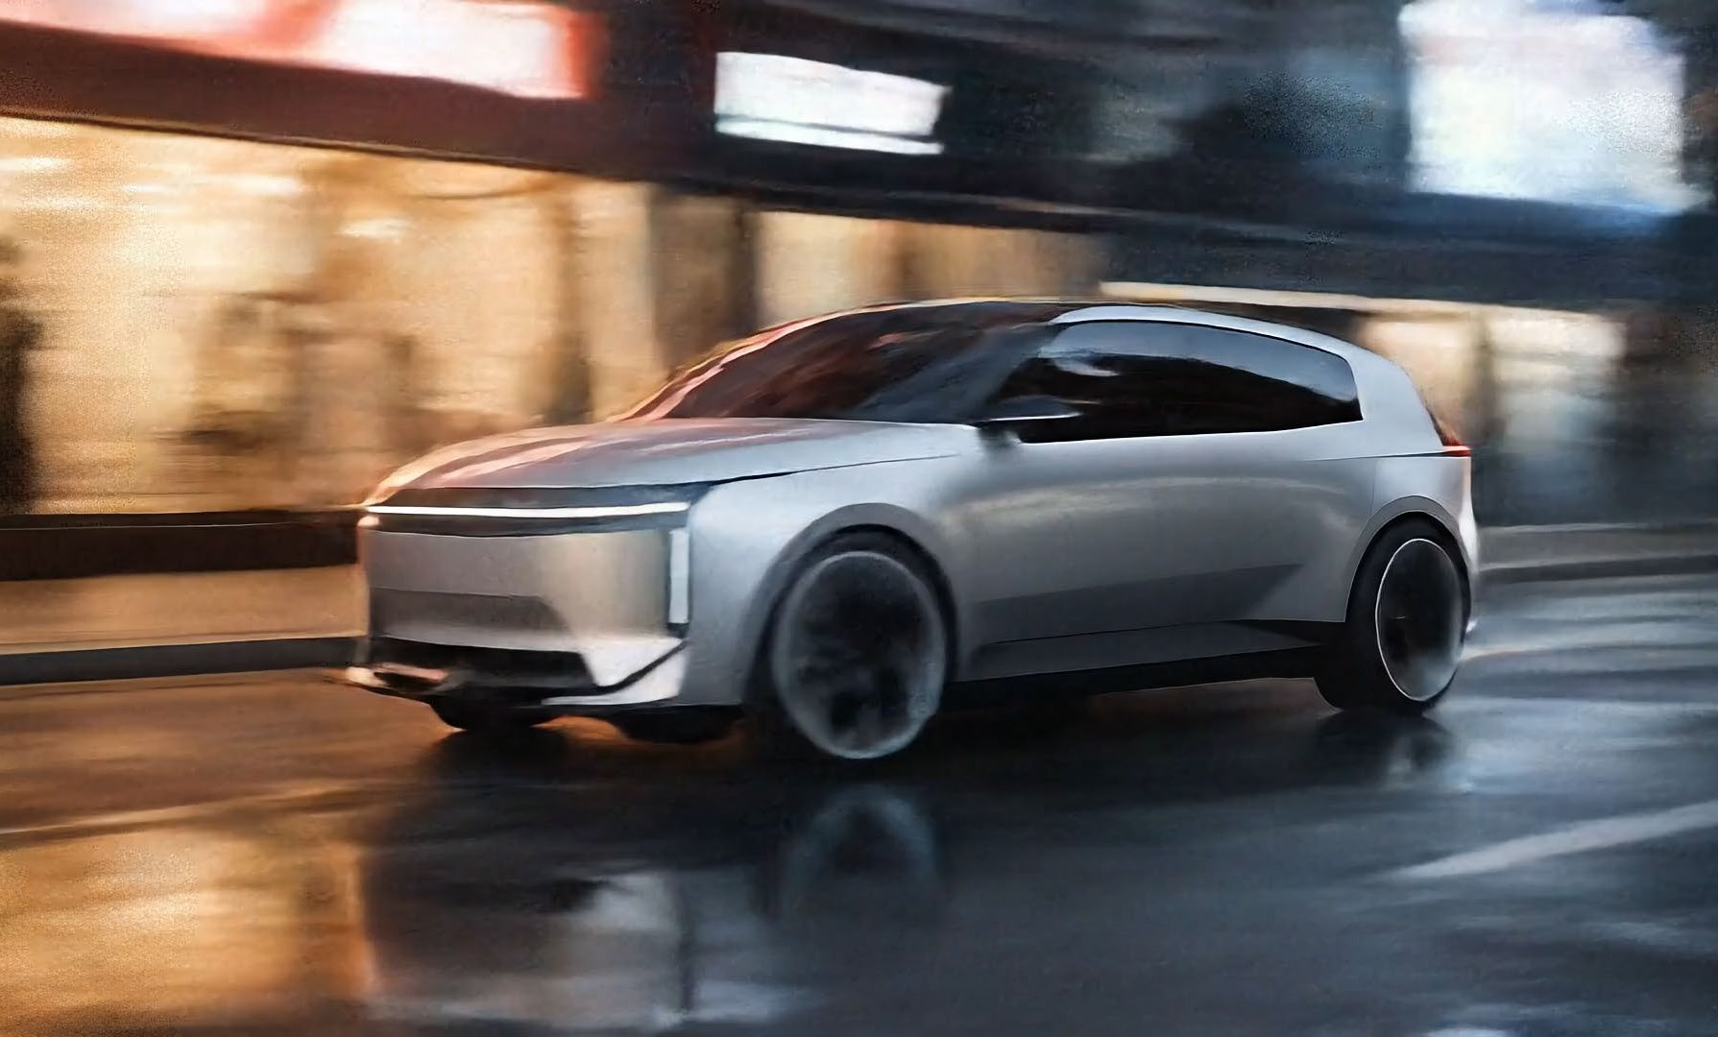
DESIGN
.
INTELLIGENCE
02 · THE NEW WORKFLOW
HOW AI + AR CHANGES THE PROCESS
Fewer hands. Less translation. Earlier, better-informed decisions.
01
02
03
04
05
SKETCH
VIZCOM
3D
AR
AI VIDEO
Designer intent
AI render
Geometry
Full-scale review
Story + context
FEEDS DIRECTLY INTO LEADERSHIP REVIEW
Designers carry intent further into the process — leadership sees richer artifacts earlier, when course corrections are still inexpensive.
03
/ 14

Slide 4
DESIGN
.
INTELLIGENCE
03 · WHAT WE HAVE ACCOMPLISHED
WHAT WE HAVE ACCOMPLISHED
Not experimentation. Operational deployment across the design organization.
DEPLOYMENT · ADOPTION · TRAINING
VIZCOM
VIZCOM · NA PDO
RUNWAY
GRAVITY SKETCH
200
50
50+
Live
Global licenses approved
North America PDO licenses
Global licenses
AR studio deployment
Visualization platform deployed across all design regions.
Production design organization fully equipped.
AI motion and video deployed across regions.
Full-scale review and 3D sketch active in studios.
TRAINING · GLOBAL
Structured training delivered across Exteriors, Interiors, and Advanced teams — across regions. Designers are self-sufficient for the majority of early visualization work.
04
/ 14

Slide 5
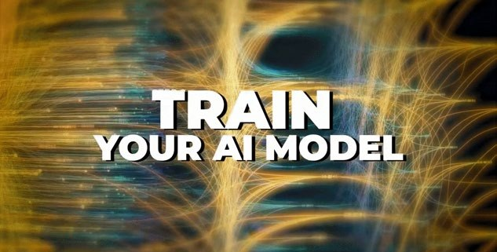
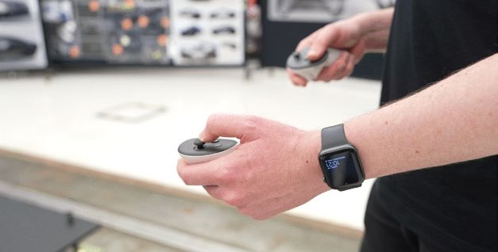
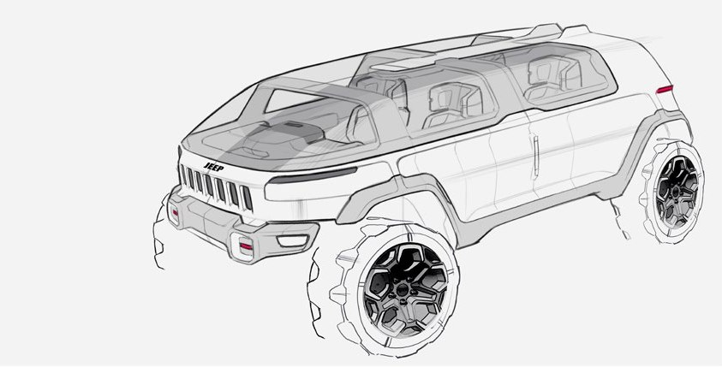
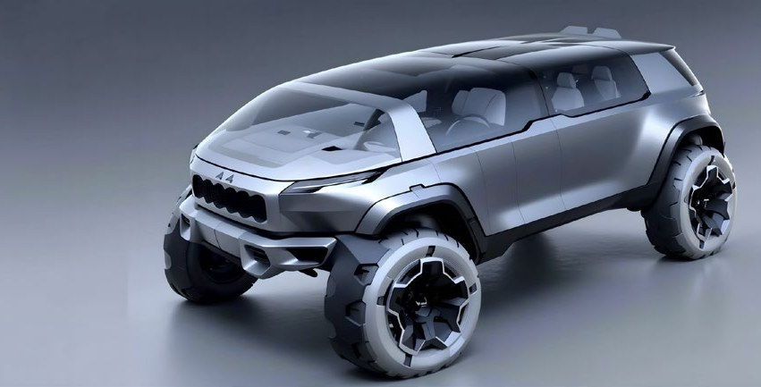
DESIGN
.
INTELLIGENCE
04 · AI ACCELERATED VISUALIZATION
AI ACCELERATED VISUALIZATION
Sketch to refined render — in a single working session, owned entirely by the designer.
Real work from a current PDO program. The designer's intent is preserved at every step — AI compresses execution time, not creative judgement.
01
02
03
04
SKETCH
RENDER
REFINEMENT
CONTEXT
Designer captures intent
AI lifts to photoreal
Material, surface, light
Final theme exploration
Compressed from days of back-and-forth into a single working session — without leaving the designer's file.
05
/ 14

Slide 6
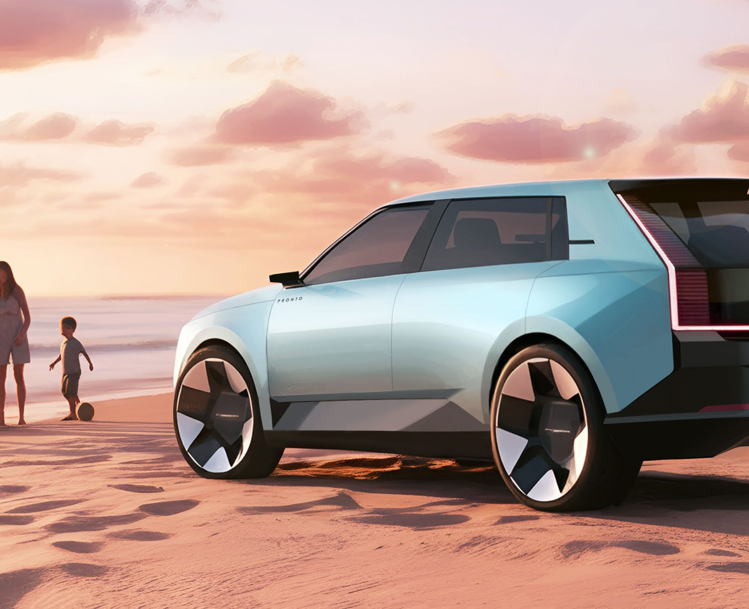
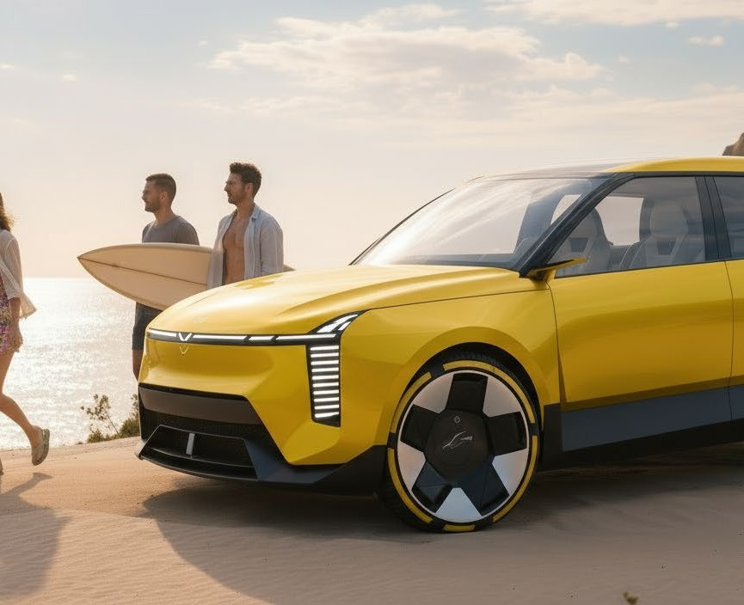
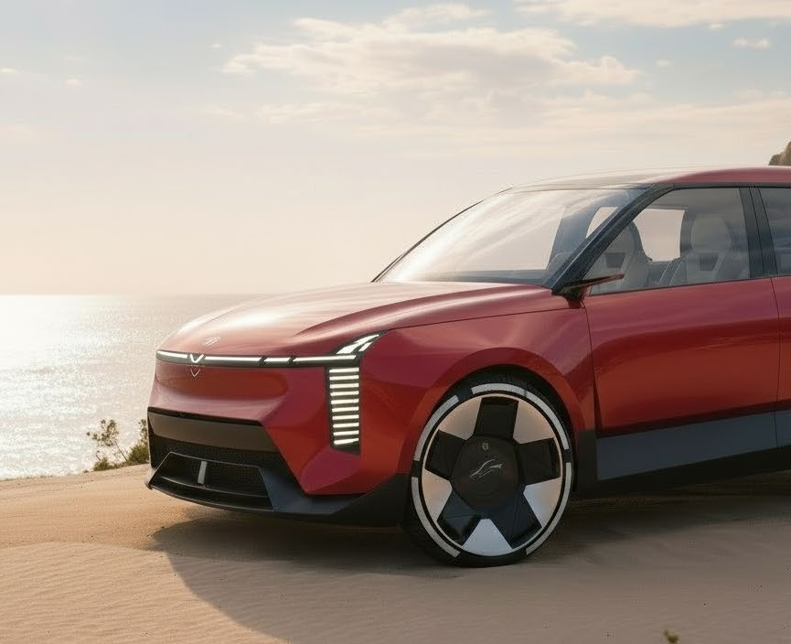
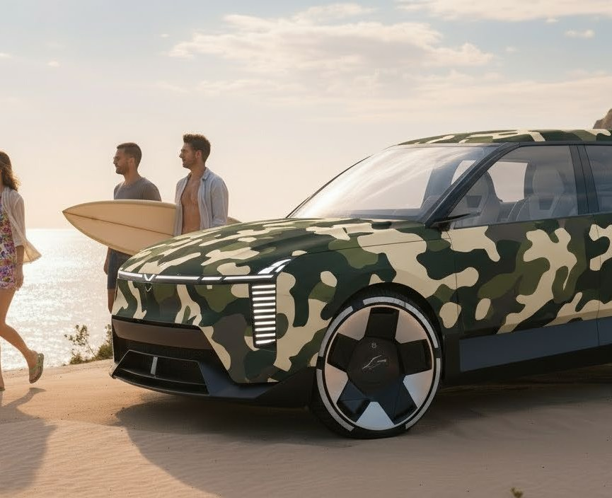
DESIGN
.
INTELLIGENCE
05 · RAPID THEME EXPLORATION
RAPID THEME EXPLORATION
One sketch. Four directions. More ideas before commitment.
Theme exploration that previously required serial review now happens in parallel — letting leadership see the design space, not just a single direction.
THEME A
THEME B
THEME C
THEME D
Heritage blue
Adventure yellow
Performance red
Off-road camo
Same scene, same proportions, multiple directions — explored in hours, not weeks. Leadership sees the option space before a direction is locked in.
06
/ 14

Slide 7
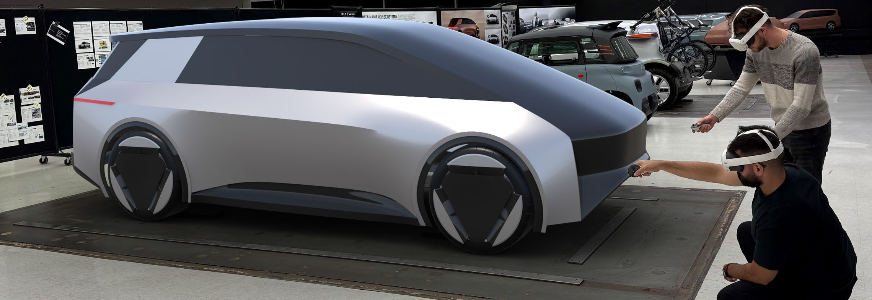
DESIGN
.
INTELLIGENCE
06 · FROM 2D TO FULL-SCALE AR
FROM 2D TO FULL-SCALE AR
This is not AI imagery. This is AI influencing decisions.
Designers and leadership review themes at full scale in AR — evaluating proportion the way customers will experience the vehicle, before specialists invest weeks in geometry.
GRAVITY SKETCH · AR REVIEW IN STUDIO
EARLIER PROPORTION REVIEW
EARLIER DECISION MAKING
EARLIER GLOBAL ALIGNMENT
Walk around a full-size virtual model. Proportions are evaluated in space — not implied from a poster.
Leadership reviews themes that look and feel like vehicles. Decisions move forward at sketch-stage cost.
Studios across regions stand around the same model — virtually. Interpretation drift between sites collapses.
AI extending into 3D and AR — not just image generation.
07
/ 14

Slide 8
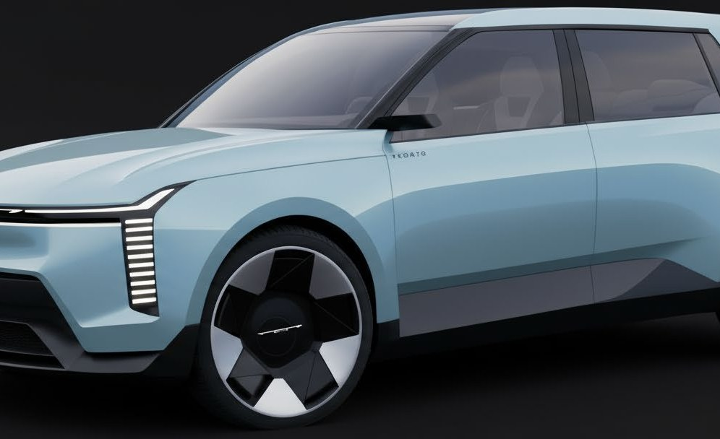
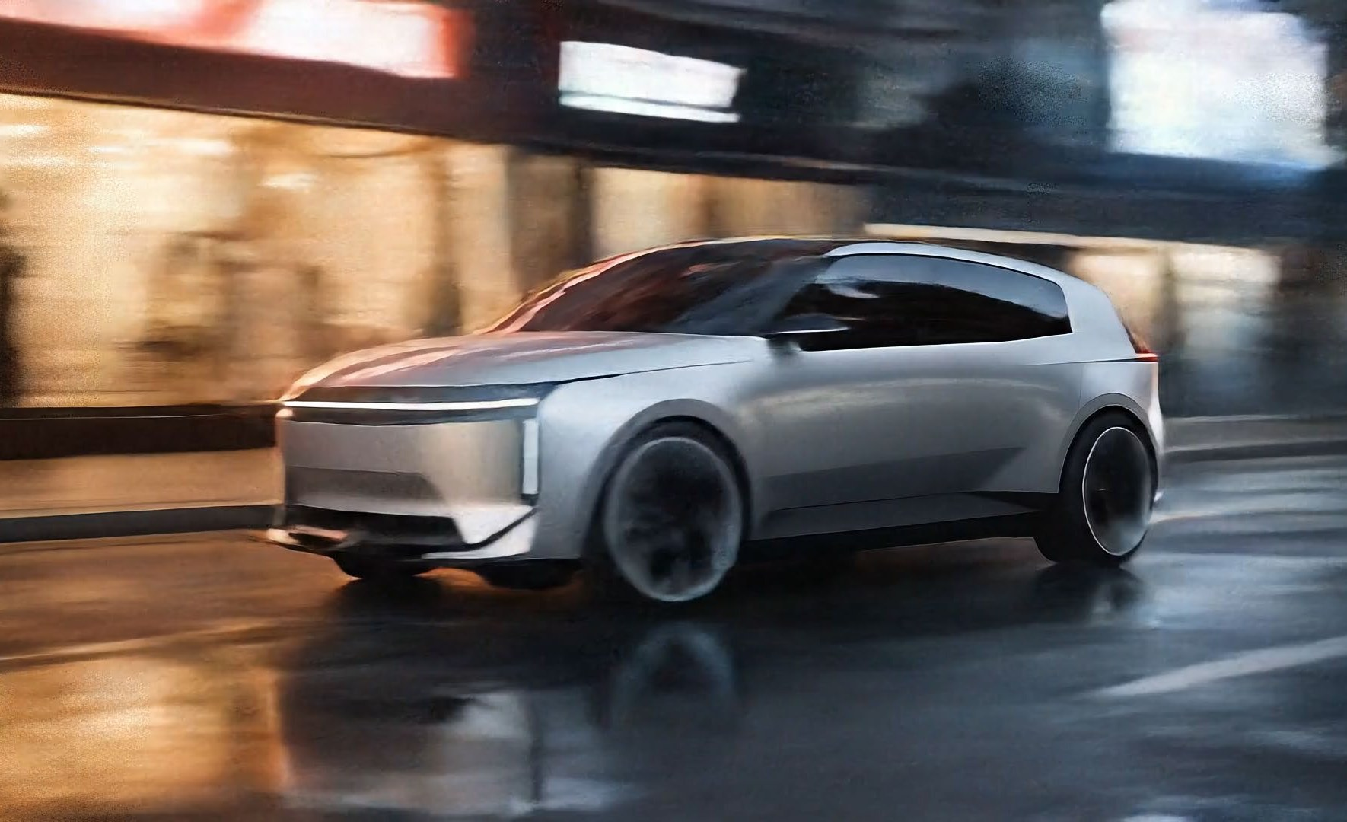
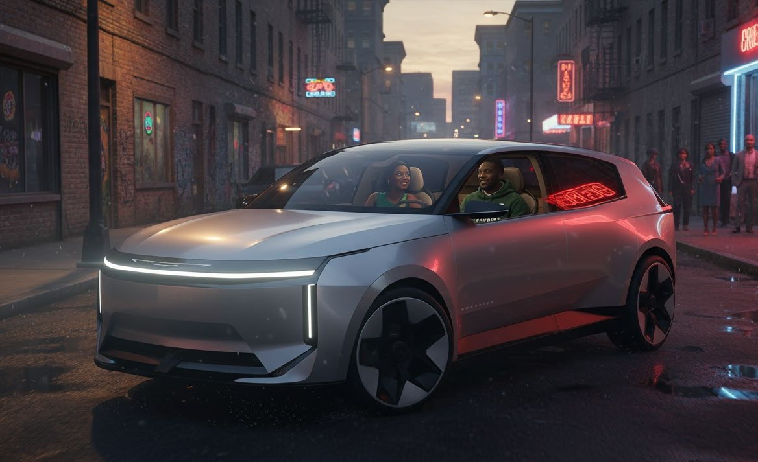
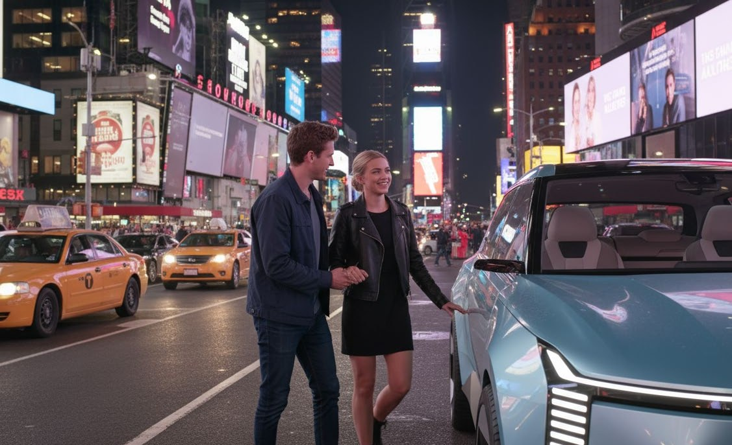
DESIGN
.
INTELLIGENCE
07 · AI STORYTELLING
AI STORYTELLING
Design intent — delivered as cinematic story, by the design team itself.
01
STILL
02
MOTION
03
STORY
04
PRESENTATION
Designer render
Vehicle in motion
Character, place, emotion
Leadership-ready narrative
BEFORE · TRADITIONAL
AFTER · AI-ENABLED
Designers · CDD · Unreal · VRED · Animation · Suppliers
1 – 2 designers using Vizcom · Runway · Veo
TYPICAL DURATION
OWNERSHIP
TYPICAL DURATION
OWNERSHIP
8 – 12 weeks
External
2 – 5 days
Internal
08
/ 14
Stories produced by the design team — in days, not weeks.

Slide 9
DESIGN
.
INTELLIGENCE
08 · BUSINESS IMPACT
BUSINESS IMPACT
Four outcomes leadership can feel today.
SPEED
PRODUCTIVITY
COMMUNICATION
COLLABORATION
Sketch to render in minutes. Theme exploration in days. Storytelling in less than a week.
Designers handle visualization and narrative work that previously required external teams.
Design intent travels with motion, context, and emotion — not just static frames.
Global studios share live 3D and AR data. Regions iterate on the same model in real time.
Designer judgement spends less time waiting and more time deciding.
Studio capacity expands without expanding headcount.
Leadership and stakeholders align on what the vehicle is meant to be.
Distance and timezone are no longer constraints on the studio.
Real outcomes the studios feel weekly — measured, not promised.
09
/ 14

Slide 10
DESIGN
.
INTELLIGENCE
09 · WHAT WE ARE EXPLORING NEXT
WHAT WE ARE EXPLORING NEXT
From tools to capabilities — owned by Design.
01
02
03
DESIGN INTELLIGENCE
AUTOMATION
AGENTIC AI
Connected institutional memory across the design organization.
Repetitive studio operations moved into reliable systems.
AI collaborators that analyze, suggest, and iterate with designers.
04
05
06
ENGINEERING INTEGRATION
KNOWLEDGE SYSTEMS
DIGITAL EXPERIENCES
Design intent connected to engineering constraints, earlier.
Customer insight, rationale, and decisions retained as memory.
Design extending into the digital touchpoints customers live with.
These are not tool categories. They are capability categories that compound with use.
10
/ 14

Slide 11
DESIGN
.
INTELLIGENCE
10 · AUTOMATION + AGENTIC AI
AUTOMATION + AGENTIC AI
AI that supports the work of designers — with designers in control.
Move the predictable, repeatable work off designers. Return their time to the work only designers can do.
KNOWLEDGE RETRIEVAL
RESEARCH
DOCUMENTATION
WORKFLOW ORCHESTRATION
DESIGN SUPPORT
Find prior work, prior decisions, and prior rationale without searching across folders and inboxes.
Customer, competitor, and trend signal gathered and synthesized continuously.
Meetings captured. Decisions logged. Design rationale preserved as institutional memory.
Coordinate routine handoffs between people, tools, and disciplines without ticket-pushing.
Surface relevant references, package constraints, and prior themes — at the moment they are needed.
Designers remain in authorship. AI handles the work that distracts from authorship.
11
/ 14

Slide 12
DESIGN
.
INTELLIGENCE
11 · DESIGN INTELLIGENCE
DESIGN INTELLIGENCE — THE CONNECTED SYSTEM
Five domains of intelligence — connected into a single learning system.
Customer insight, planning logic, design rationale, engineering trade-offs, and manufacturing reality — today held separately, connected so every program contributes to the next.
01
02
03
04
05
Customer Intelligence
Planning Intelligence
Design Intelligence
Engineering Intelligence
Manufacturing Intelligence
Research, segmentation, voice-of-customer.
Portfolio strategy, segment opportunity, timing.
Theme decisions, review rationale, brand DNA.
Package constraints, trade-offs, lessons learned.
Producibility, supplier capability, launch realities.
Reduce the distance between insight and action. Transform information into understanding. Transform understanding into better products.
12
/ 14

Slide 13
DESIGN
.
INTELLIGENCE
12 · THE FUTURE
THE PATH FORWARD
Each step builds on the last. Every project makes the next project better.
CAPABILITY OVER TIME
A staircase, not a leap. Each phase builds the next.
05
Design Intelligence
04
Automation + Agentic AI
03
Workflow Transformation
02
AI Assisted Design
01
Traditional Design
Specialist-driven, sequential, physical.
Tools accelerate individual tasks.
Process compressed across studios.
Capability operating with designers.
Organization-wide learning system.
13
/ 14

Slide 14
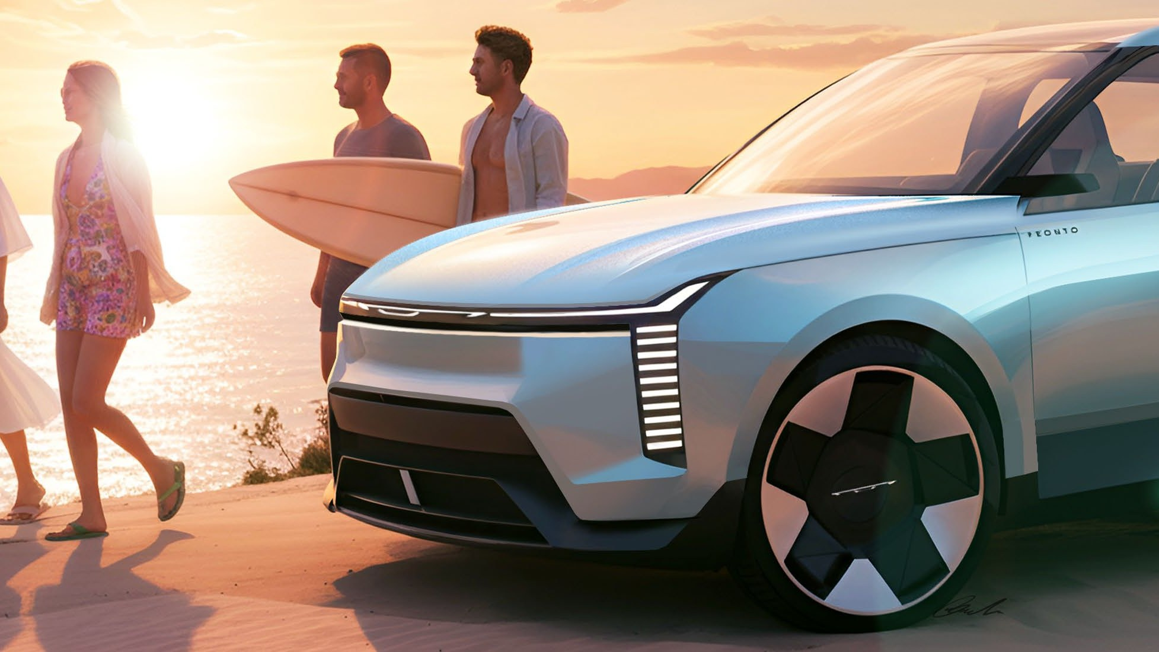
DESIGN
.
INTELLIGENCE
13 · CLOSING
FROM
THROUGH
INTO
TOWARD
Tools
Workflows
Capabilities
Intelligence
THE TAKEAWAY
Over the past year, Design has proven that AI can accelerate workflows and improve decisions.
The next opportunity is using automation, agentic systems, and connected knowledge to build a smarter, faster, more capable design organization.
LOU GASEVSKI · CHRYSLER DESIGN EXTERIOR
14
/ 14

