Slide 1


Welcome to
Electrical Design and
Wiring for F.I.R.S.T
Championship 2006

Slide 2
Presenters
Chris Noble - Team 1018 Mentor
  Cornerstone Controls Engineer
Darrell Noble - Team 71 Mentor
  Beatty International Engineer

Slide 3
Basic Electronic Theory
White and red wire is positive DC voltage
Black is negative DC voltage
Pressure Switch is an Input ONLY
Chassis is not a conductor
Install electrical and control wiring so that it is laid out logically and contained with tie wraps, spiral tubing, or shrink tubing
Protect your electrical control system from other robots

Slide 4
Spike
Simply a Relay or On/OFF Switch
Controlled by a 5VDC Output from controller through software
Has Reverse polarity
Components Wired to Spikes:
  Air Valves, Compressor
  Low current Motors
Rated and fused at 20 amps except compressor 20 amp breaker

Slide 5
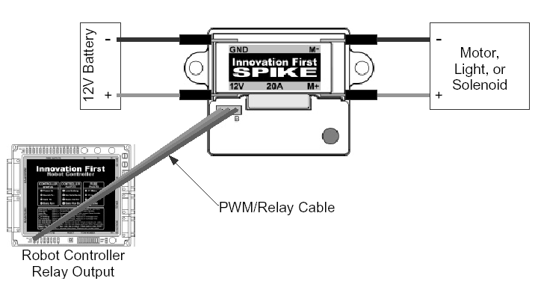
Spike

Slide 6
Victors/PWM
Victor 884
Pulse Width Modulation
Provides Proportional Controls
Calibration
Break Mode
Coast Mode

Slide 7
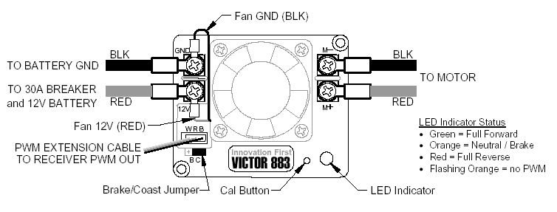
Victors/PWM

Slide 8
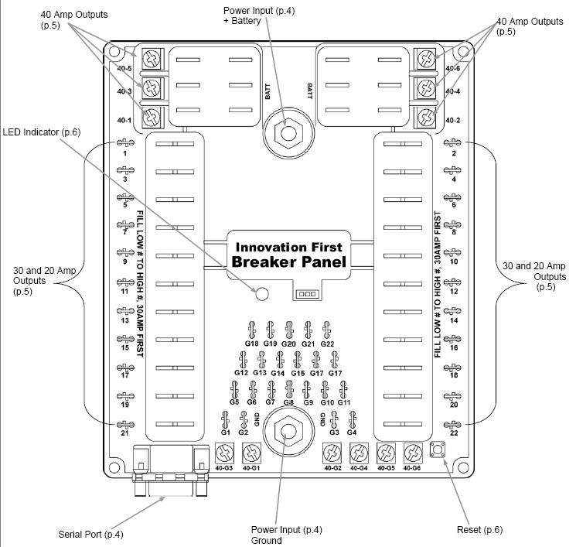
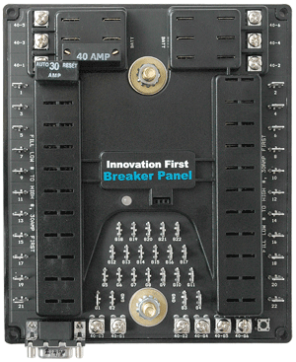
Circuit Breaker Panel

Slide 9
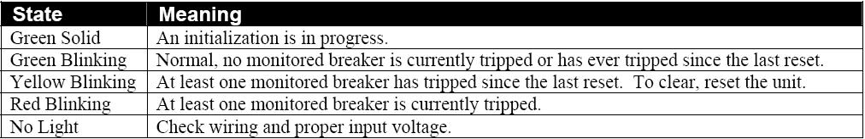
Circuit Breaker Panel
No longer have to guess if breaker is tripped
  Status Light
Info can be sent back to Operator

Slide 10
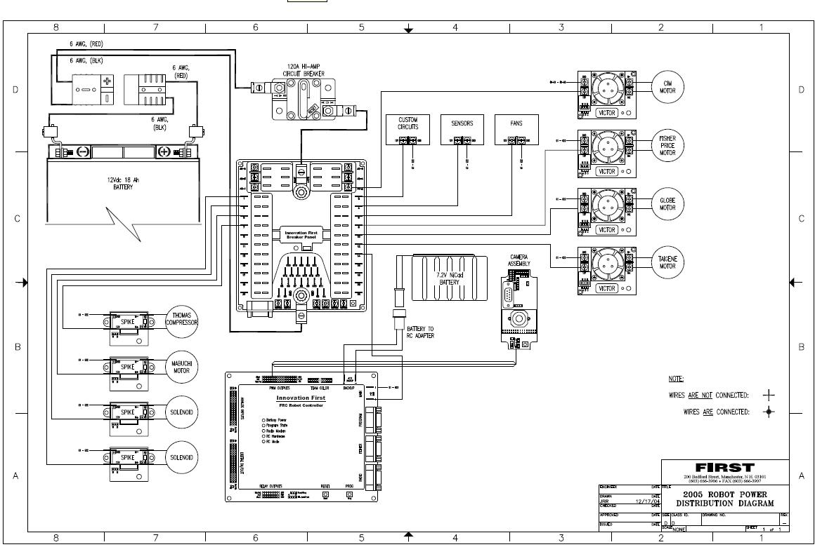
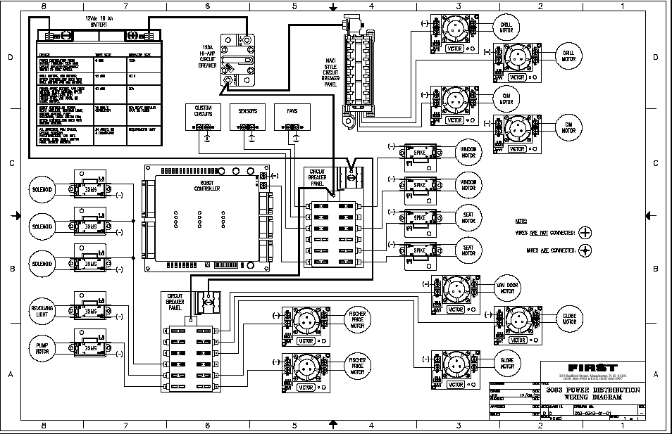

Slide 11
Wiring Requirements
Device | Wire Type | Circuit Breaker
Power distribution from battery through 120A Main Circuit Breaker/Disconnect Switch to fuse panels | 6 AWG/red & black | 120A
Speed Controllers used with CIM and Fisher-Price Motors | 12 AWG/red & black | 40 A
Speed Controllers used with Van Door, or Globe motors | 14 AWG/red & black | 30A
Wire size is minimum, larger is also acceptable

Slide 12
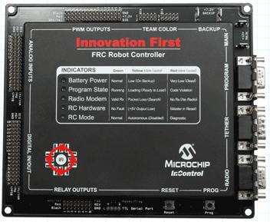
Features of 2006 Controller
C programming language
Fast PWM outputs (2ms update)
More memory
Battery Backup
  (FULL only)

Slide 13
Custom Circuits
May Not
  Directly Control Outputs
  Interfere with Operation of Other Robots
  Used for Wireless Communications
  Connect to programming, tether, competition ports

Slide 14
IO for FULL-RC 2006
Interrupt Inputs | 6
Digital I/O | 16, Each can be In or Out
Analog Inputs | 16 (10-bit)
Digital Input Sampling Frequency (typical) | 100KHz
Analog Input Access Time | 10μSec
Relay Outputs | 16 (8 Fwd, 8 Rev)
PWM Outputs, Standard refresh every 17mSec | 12
PWM Outputs, Fast refresh up to every 2mSec | 4

Slide 15
Common Features
User Microcontroller Brand | Microchip PIC
User Microcontroller Type | 18F8520
User Processor Speed | 10 MIPS*
Variable Space | 1800 bytes + 255 bytes EE²
Program Space | 32K
Programming Language | PIC C
Programming Tools | Microchip MPLAB IDE
Serial Ports | TTL Serial (115Kb) and RS232 Program (115Kb)

Slide 16
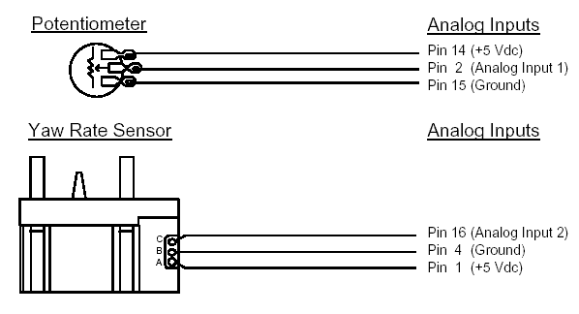
Robot Sensors

Slide 17
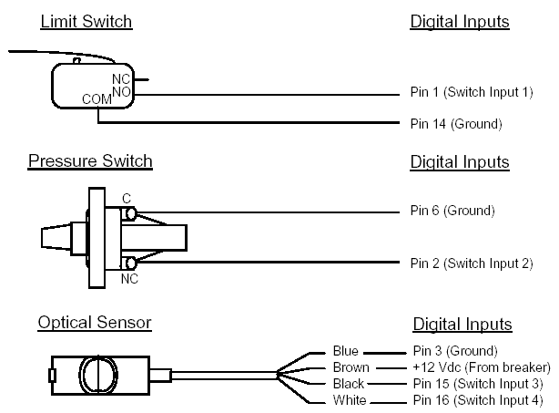
Robot Sensors Cont.

Slide 18
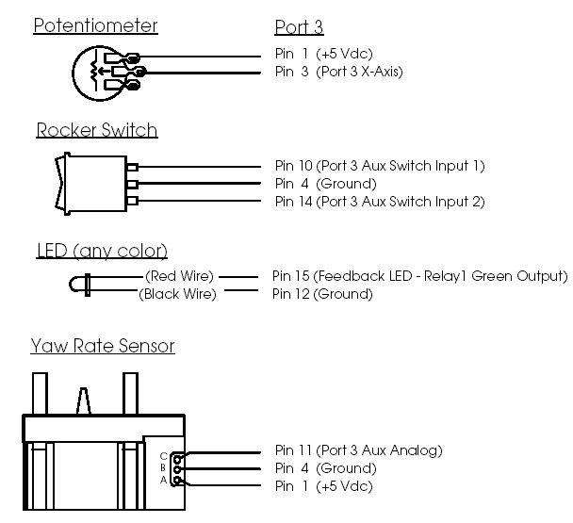
Robot Sensor Cont.

Slide 19
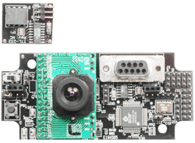
CMUcam2 Vision System

Slide 20
CMUcam2 Vision System
Clock Rate 75 Mhz.
Programmability Reprogrammable via Parallax SX-Key? module and software.
User I/O 4 Inputs plus 1 switch input.
Servo Outputs 5 User controlled. Servo1 (Pan) and Servo2 (Tilt) can be set for auto tracking colors.
Serial Communication via RS-232 or TTL. RS-232
Baud Rate Selection 115200 (default/recommended), others- 57600, 38400, 19200, 9600, 4800, 2400, 1200 baud.
Video Output Black & White TV - NTSC standard
Servo Power Jumper selectable - Internal or External (comes with jumper installed for Internal selection).
Enclosure Use Radio Shack 4"x2"x1" Project Enclosure Box, part number: #270-1802

Slide 21
Sensor Reading
Refresh rate is Important
Don’t want to miss counts
(RPM x Counts/min)
-------------------------- = counts/sec
60
1.0 sec
------------- = length of count
counts/sec

Slide 22
Biggest problems of robot electrics
Wire coming out of copper connector
Breaking Battery terminals off of robot controller
Battery falling out
Battery coming disconnected
Forgot to change battery

Slide 23
Common Sources of Trouble
PWM light blinking
  Normal when no radio
  No PWM cable connected
  No wire or a broken wire to motor
  Balance off on Trim
Check connection
No Power or Fuse
Wired properly
Motor Overloaded Thermo protected

Slide 24
Trouble Shooting
Motor not being driven at all
  Check PWM signal light
  Check PWM cable
  Check power leads from breaker panel
  Check power leads to motor
  Programming

Slide 25
Trouble Shooting
Motor moves in one direction only
  Use Volt meter to see voltage on output is
    -12 VDC in one direction
    0 VDC neutral
    +12 VDC in opposite direction
If any of these are not Correct
  Replace Victor

Slide 26
Trouble Shooting
Servos not working
  Servo power come from back up battery
  Plug battery in
  Charge battery

Slide 27
Always
Have the battery SECURED
Have the battery connection SECURELY attached in a match
Insulate battery terminals

Slide 28
Never Never wire with power on !

Slide 29
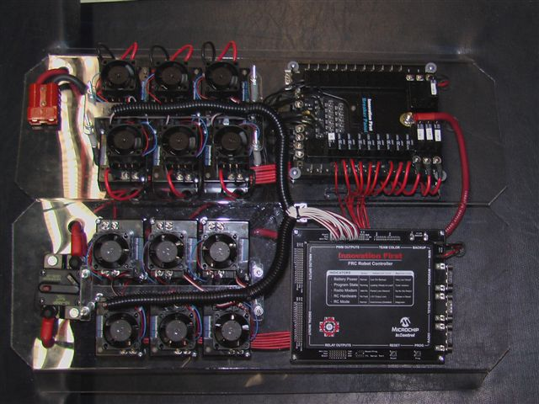
494

Slide 30
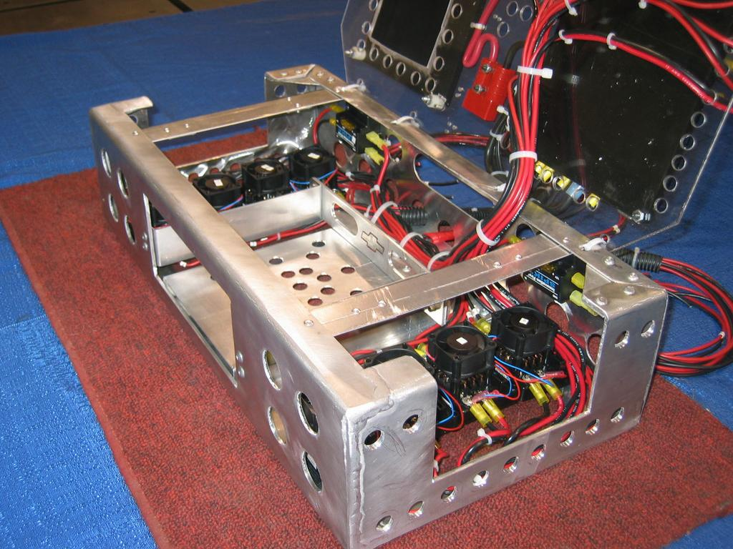
27

Slide 31
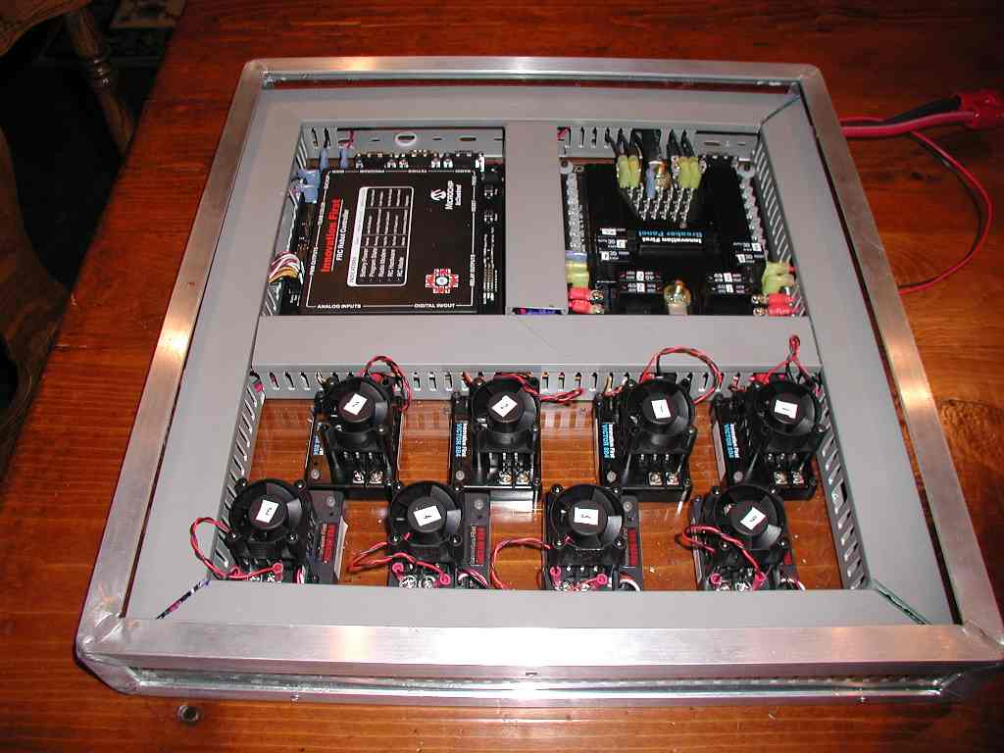
27

Slide 32
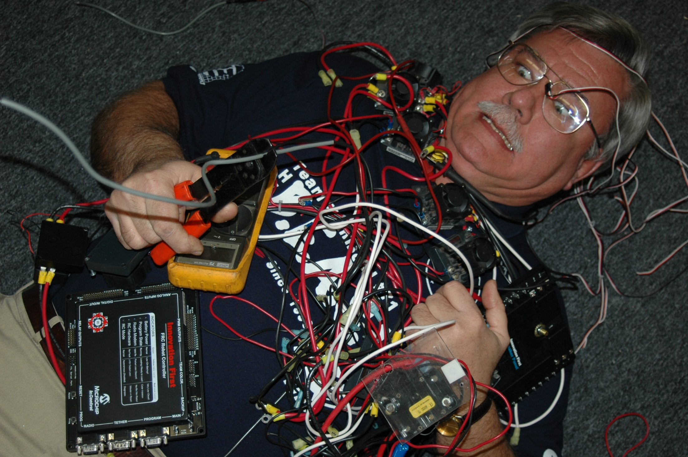
Don’t end up like this!!!

Slide 33
More Information
FIRST website
  Documentation
Innovation FIRST
  www.innovationfirst.com
The FIRST Software Repository
  www.frcsoft.com
Chief Delphi

Slide 34
Questions?
Are there any Questions
Remember
  A neat robot is a safe reliable robot
  Read the Rules, then if Not Sure, ask another Team
Presentation will be available at
  www.indianafirst.org or
  www.usfirst.org

