Slide 1



검사/품질 , (VH 직속)
검사/품질 , (Division of PO M Production)

Slide 2
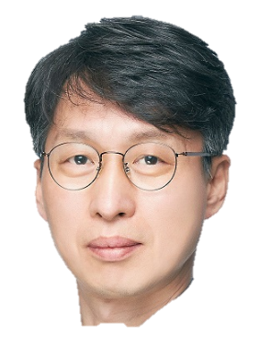



생산운영 , (Division of OLED TV Production)
생산운영 , (Division of OLED TV Production)

Slide 3
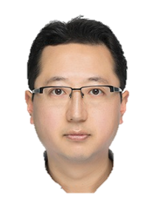



공정/장비, (Division of OLED TV Production)
공정/장비, (VH 직속)

Slide 4


설계/개발, (Department of PO Process Development)
설계/개발, (Division of OLED TV Production)
LGD Building

