Slide 1
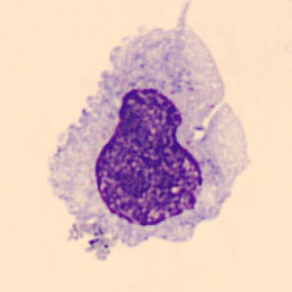




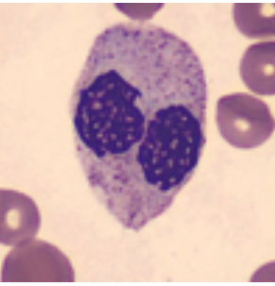









$$Unseed Data$$
$$same image with bigger size$$
$$Train with a single data$$
$$Model$$
$$new image with same size$$
$$PPO$$
$$Test$$
$$Policy π$$
$$new image with bigger size$$

