Slide 1



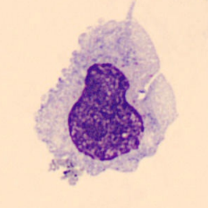

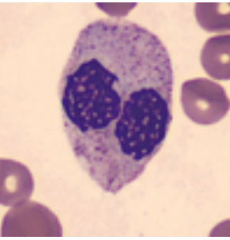


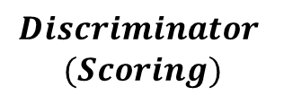







$$Train with only One Small Data$$
$$Model$$
$$PPO$$
$$Policy π$$
$$Unseen Data$$
$$same image with bigger size$$
$$Discriminator \\ (Scoring)$$
Generated
Mask
$$Test$$
$$new image with same size$$
$$new image with bigger size$$

