Slide 1
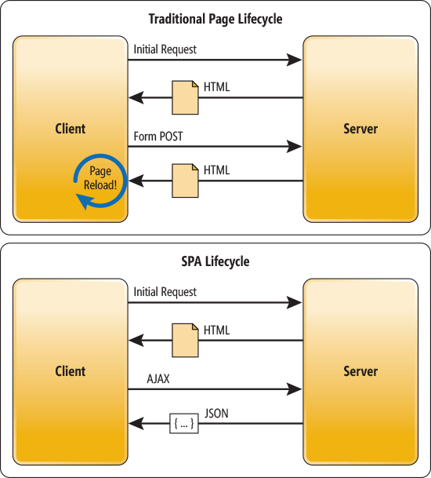
SPA (Single Page Application)
Web apps that load a single HTML page and dynamically update that page as the user interacts with the app.

Slide 2






SPA (Single Page Application)
In SPA, after the first page loads, all interaction with the server happens through AJAX calls.
Notes:
The client-side Javascript handles the routing instead of the browser

Slide 3
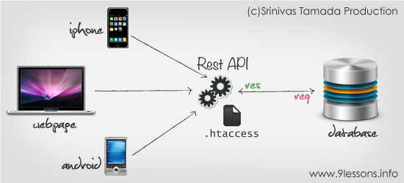
SPA (Single Page Application)
You could replace the entire back end. As long as you don’t change the API, you won’t break the client.

Slide 4
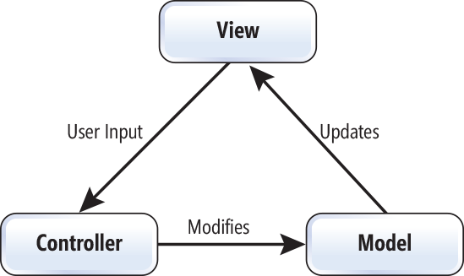
The MVC and MVVM Patterns
The goal of MVC is to factor the code into three separate responsibilities.
Notes:
The model represents the domain data and business logic.
The view displays the model.
The controller receives user input and updates the model.

Slide 5
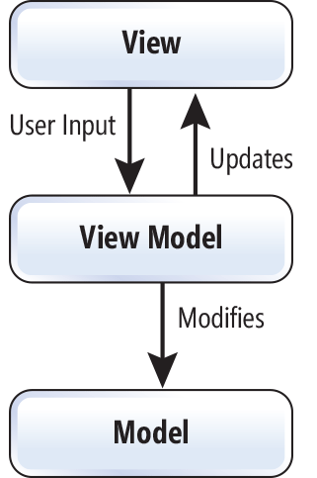
The MVC and MVVM Patterns
A more recent variant of MVC is the MVVM pattern.
Notes:
The model still represents the domain data.
The view model is an abstract representation of the view.
The view displays the view model and sends user input to the view model.
In a JavaScript MVVM framework, the view is markup and the view model is code.

Slide 6

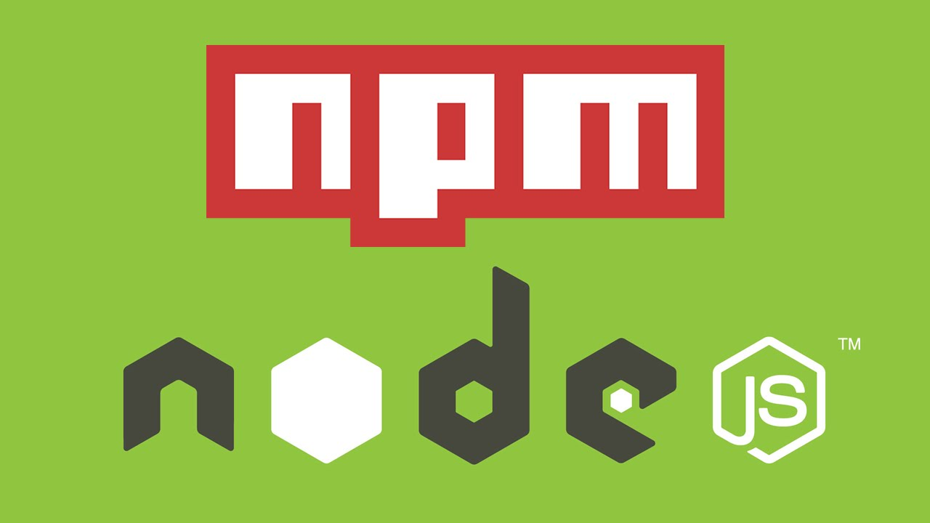

Instalación del ambiente de trabajo
Necesitamos Git para la descarga de software oficial desde github.com
https://git-scm.com/download/
Necesitamos también instalar npm para administrar nuestras dependencias
https://nodejs.org/en/download/
Necesitamos instalar bower para que maneje nuestras dependencias
https://bower.io/#install-bower

Slide 7

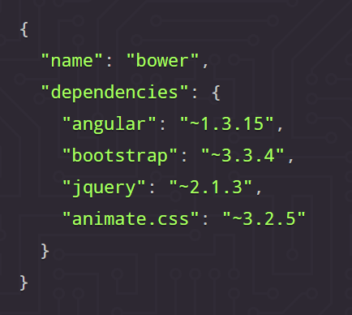
Instalación del ambiente de trabajo
Necesitamos instalar un task runner que nos permita compilar, minificar, ofuscar y distribuir nuestro código fuente de forma automática.
https://gruntjs.com/getting-started
Usando bower creamos el archivo bower.json, el cual mantendrá un registro de que paquetes se deben instalar y su versión.
bower init
bower install angular --save

Slide 8
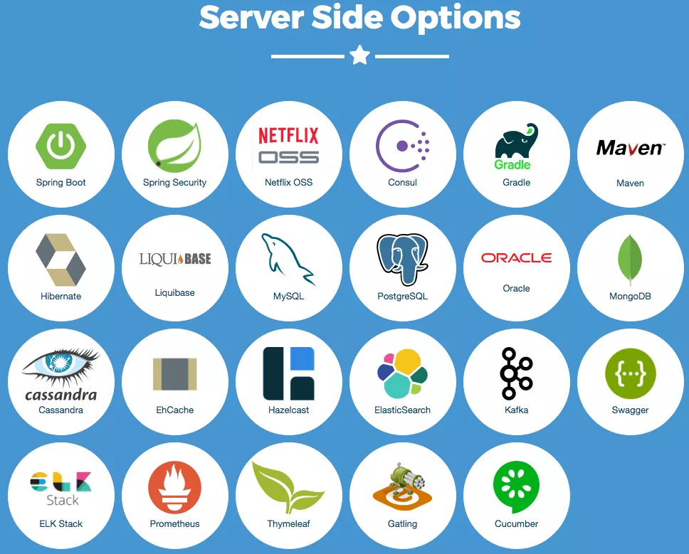
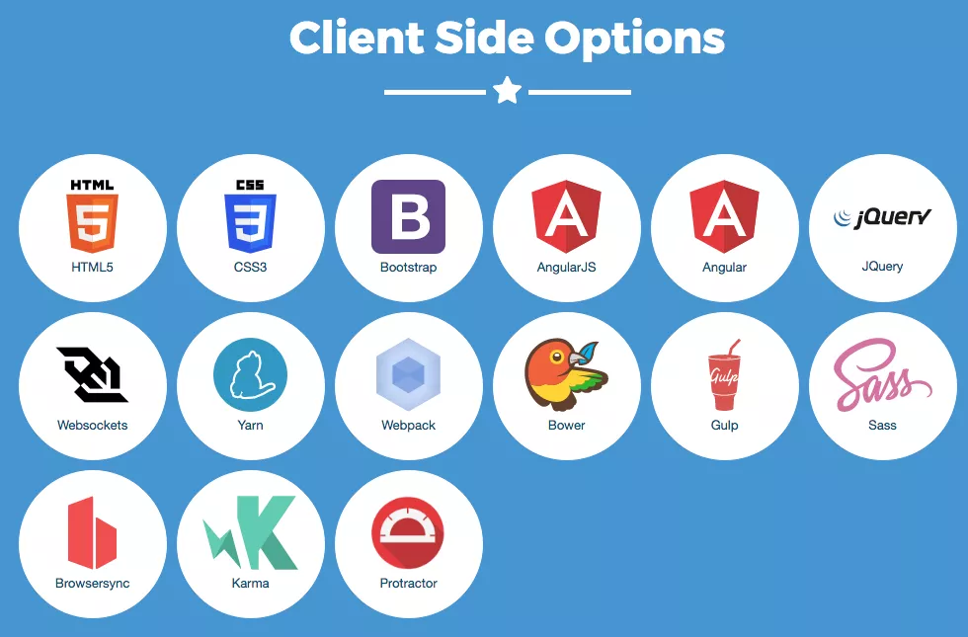
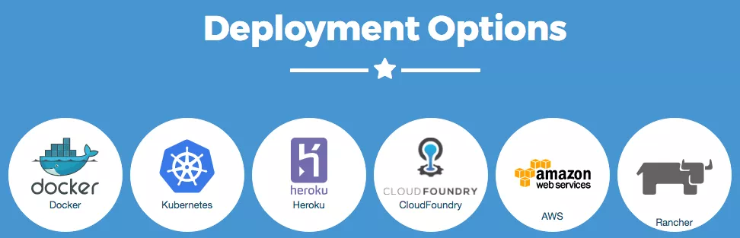

Slide 9
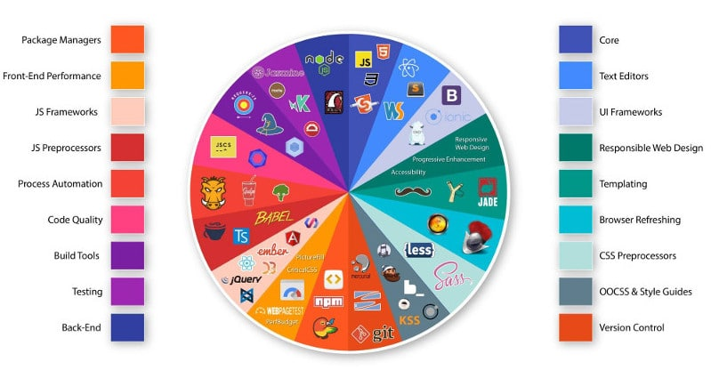

Slide 10
Gruntfile.js
Controla todas las tareas y da de alta los comandos en consola que Grunt debe realizar.
https://github.com/mishoo/UglifyJS2#minify-options
jshintrc.txt
Aquí se definen los criterios que debe seguir el parser de javascript para avisar sobre los errores en el código.
http://jshint.com/docs/options/

Slide 11




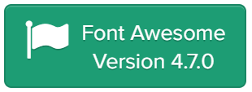
Uso de librerias importantes
https://github.com/chieffancypants/angular-loading-bar
https://github.com/angular/material
https://github.com/angular-ui/bootstrap
https://limonte.github.io/sweetalert2/
http://fontawesome.io/examples/

