Slide 1
FarReach: Write-back Caching in Programmable Switches
Siyuan Sheng¹, Huancheng Puyang¹, Qun Huang², Lu Tang³, and Patrick P. C. Lee¹
¹The Chinese University of Hong Kong ²Peking University ³Xiamen University
USENIX ATC 2023
Notes:
(prepare laser pointer)
Hi, I am Siyuan Sheng from The Chinese University of Hong Kong.
Today I am going to present our recent work, named “FarReach: Write-back Caching in Programmable Switches”.

Slide 2
Writes in Key-value Stores
Writes dominate in production key-value storage workloads
20% of Twitter’s Twemcache clusters are write-intensive
Facebook’s RocksDB for AI services has 92.5% of read-modify-writes
Challenges for high write performance
High round-trip latencies in transmission, queuing, and processing
Skewness introduces imbalanced server loads
Notes:
Our study aims to improve the write performance of key-value stores.
Recent studies have shown that write-intensive workloads dominate production key-value stores, such as Twitter’s Twemcache clusters (OSDI’20) and Facebook’s RocksDB production (FAST’20).
Therefore, it is important to improve write performance for write-intensive workloads.
However, there exist some challenges for high write performance.
First, each write suffers from high round-trip latencies, including switch-to-server transmission latency, extra queuing latency if server is overloaded, and server-side processing latency.
Second, for distributed key-value stores, skewed workloads could incur load imbalance and hence a small number of servers will be bottlenecked, which can undermine write performance further.

Slide 3
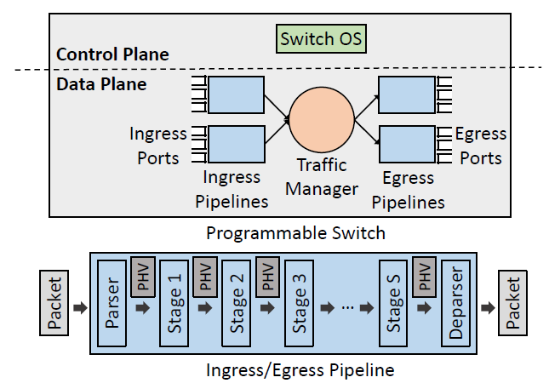
In-switch Write-back Cache
Programmable switches can help improve write performance
Switch OS controls multi-pipeline data plane
Each pipeline has multiple stages with stateful memory
Write-back policy: caches popular write records in switch without immediately updating servers
Programmable switch architecture
Notes:
Programmable switches provide an opportunity to improve write performance of key-value stores.
Here is the architecture of programmable switches.
Each programmable switch has two parts: a control plane and a data plane.
The control plane of a switch (i.e., switch OS) can control the multi-pipeline data plane.
In the data plane, each pipeline has multiple stages to process traversed packets with stateful memory.
Therefore, we can apply a write-back policy to cache popular records into in-switch memory without updating servers immediately, which can absorb writes and improve write performance.

Slide 4
Challenges
Performance challenge
Scarce switch resources require offloading cache management to controller → high controller-to-switch latency
Availability challenge
Synchronization between switch and servers is required to keep latest records available
Reliability challenge
Latest records may be lost in switch failures under write-back caching
Notes:
However, there exists some challenges for in-switch write-back caching.
The first one is a performance challenge.
As programmable switches have restricted resource limitations, we have to offload cache management to a controller.
As the controller is much slower than switch data plane, the high control-to-switch latency will degrade I/O performance.
The second one is an availability challenge.
As the latest records could be stored either in the switch or servers under the write-back policy, we need to synchronize the switch and servers to ensure that latest records are always available to clients.
However, the slow control-plane processing can lead to large synchronization overhead.
The last one is a reliability challenge.
Under the write-back policy, switches can cache latest records which have not been updated to servers.
After switch failures, all such latest records will be lost and undermine reliability.

Slide 5
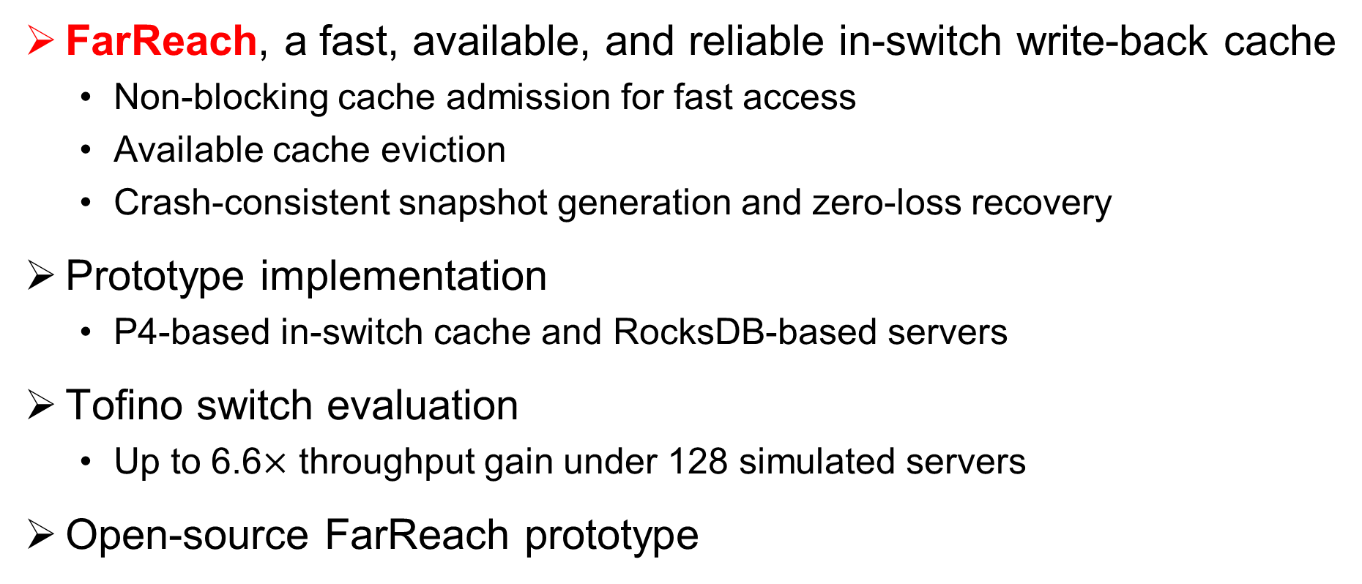
Our Contributions
FarReach, a fast, available, and reliable in-switch write-back cache
Non-blocking cache admission for fast access
Available cache eviction
Crash-consistent snapshot generation and zero-loss recovery
Prototype implementation
P4-based in-switch cache and RocksDB-based servers
Tofino switch evaluation
Up to 6.6$×$ throughput gain under 128 simulated servers
Open-source FarReach prototype
Notes:
To solve the three challenges, we propose FarReach, a fast, available, and reliable in-switch write-back cache.
Here are our main contributions:
We mainly propose three design features, i.e., non-blocking cache admission for fast access, available cache eviction for the availability challenge, and crash-consistent snapshot generation for the reliability challenge.
We also implement a prototype based on a Tofino switch. We implement the in-switch cache by P4 language and server-side key-value stores by RocksDB.
We evaluate FarReach by extensive experiments. For example, FarReach can achieve a throughput gain by up to 6.6X a state-of-the-art in-switch cache under 128 simulated servers.
We have open-sourced our prototype.

Slide 6
Design overview
FarReach architecture
In-switch cache absorbs writes with cache hits
Controller performs cache management through switch OS
Carefully co-design control and data planes
Notes:
Before going to the details, let me first introduce the design overview of our architecture.
As you can see, we deploy an in-switch cache to absorb writes with cache hits under a write-back policy to improve write performance.
Due to switch limitations, we offload cache management to controller, which is performed through interfaces provided by switch OS.
In the following slides, I will show how to carefully co-design the control and data planes to fix the challenges mentioned before.

Slide 7
Problem of Cache Admission
Suppose that a request triggers cache admission
Subsequent writes arrive at switch before admission
Blocking subsequent writes undermines I/O performance
Absorbing subsequent writes in switch undermines availability
Notes:
First, we consider the performance challenge.
Here is the problem of performance in cache admission.
Suppose that a client-issued request (say a write) on a popular record triggers a cache admission decision.
Before the controller admits the hot record into switch, as controller is much slower than switch data plane, subsequent writes on the admitted record can arrive at the switch.
If we simply block the subsequent writes, we will undermine I/O performance.
While if we absorb the subsequent writes in switch under the write-back policy without blocking, the controller will overwrite the latest version carried by subsequent writes by the stale version of admitted record, and hence undermine availability.

Slide 8
Non-blocking Cache Admission
Process subsequent writes in server without blocking
Mark admitted record as “outdated” as server is latest
Conservatively forward subsequent reads to server for availability
Mark admitted record as “latest” as early as possible
Notes:
To fix the problem, we propose non-blocking cache admission.
Our insight is that we can process the subsequent writes on the admitted record in the server without blocking.
As the server has the latest version of admitted record now, we can mark the admitted record as “outdated”.
For reads to the “outdated” in-switch record, FarReach can conservatively forward them to the server to get the latest version for availability.
To limit the number of conservative reads, FarReach marks the admitted record as latest as early as possible.
Specifically, we observe that the switch can monitor all traversed requests and responses.
So we mark the “outdated” admitted record as “latest” for each write request with the latest record issued by a client, or each read response with the latest record provided by the server.
That’s how we fix the performance challenge by non-blocking cache admission.

Slide 9
Problem of Cache Eviction
Under write-back policy
Evicted record is latest yet not updated to server
Controller loads evicted record to server for persistent storage
Subsequent writes arrive at switch during cache eviction
Processing without synchronization undermines availability
Synchronization by controller incurs large overhead
Notes:
Second, we consider the availability challenge.
Here is the problem of availability in cache eviction.
Under the write-back policy, the evicted record could be the latest record yet not updated to the server.
Therefore, the controller must load the evicted record to the server for persistent storage.
However, as controller is much slower than the data plane, subsequent writes on the evicted record could arrive at switch during cache eviction.
If we process the subsequent writes without synchronization between switch and server, it will be difficult for FarReach to distinguish whether the latest version is the in-switch record or the server-side record, which undermines availability.
However, if we simply resort the controller for synchronization, it will incur large synchronization overhead due to slow control-plane processing.

Slide 10
Available Cache Eviction
Associate additional in-switch metadata to evicted record
Mark evicted record as “to-be-evicted”
Load evicted record to server before removing it from switch
Mark “to-be-evicted” record as “outdated” and forward writes to server
Process reads by switch if “latest” or server if “outdated”
Notes:
To fix the problem, we propose available cache eviction.
Our insight is that we can associate additional in-switch metadata to the evicted record, such that the data plane can be aware of cache eviction for availability.
Specifically, the controller first marks the evicted record as “to-be-evicted” in switch.
Then the controller loads the evicted record to the server before removing it from the in-switch cache.
During this process, for subsequent writes on the evicted record, switch will mark the “to-be-evicted” record as “outdated” and forward subsequent writes to the server.
For subsequent reads, if the “to-be-evicted” record is “latest”, FarReach can directly answer the reads with the in-switch record; otherwise, if the “to-be-evicted” record is “outdated”, it means that some subsequent writes are forwarded to the server and server has the latest version now, so reads are forwarded to the server to get the latest record for availability.
That’s how we fix the availability challenge by available cache eviction.

Slide 11
Problem of Reliability
Under write-back policy
Cached records are latest yet not updated to servers
Latest in-switch records are lost after switch failures
Controller loads cached records for snapshots
Subsequent writes arrive at switch during snapshot generation
Updating cache records incurs inconsistent snapshots
Notes:
Finally, we consider the reliability challenge.
Here is the problem.
Under the write-back policy, the in-switch cached records may be the latest records yet not updated to servers.
So the latest in-switch records will be lost after switch failures.
To fix data loss, we can make snapshots of in-switch cache.
As switch cannot store snapshots due to limited resources, we use controller to load cached records for snapshots.
As controller is much slower than switch data plane, subsequent writes could arrive at switch during snapshot generation.
They will update the cached records.
If the updated records are loaded by the controller, it will get an inconsistent snapshot, which makes no sense for reliability.

Slide 12
Crash-consistent Snapshot Generation
Send original cached record for each first write
Controller replaces overwritten records for consistency
Two-phase algorithm
Controller triggers snapshot generation
Controller loads cached records and switch sends original ones
Notes:
To fix the problem, we propose crash-consistent snapshot generation snapshot generation.
Our insight is that whenever FarReach receives the first write to a cached record during snapshot generation, the switch can send the original cached record (i.e., the record after the snapshot timepoint yet before the first write) to the controller.
Then, the controller can use the original cached records to replace the overwritten records for consistency.
Here is the workflow of our two-phase snapshot generation algorithm.
In the first phase, the controller triggers snapshot generation in switch.
In the second phase, the controller loads all cached records from the switch, while the switch sends original cached records to the controller for subsequent writes.
After loading all cached records, the controller will notify the switch on the end of current snapshot and no more original cached records will be reported.
The controller can revert the snapshot to a consistent state by the original cached records.

Slide 13
Zero-loss Recovery
Limitation of snapshot generation
Snapshot generation avoids data loss before the latest snapshot
Cached records after the latest snapshot are not protected
Client-side record preservation
Clients preserve copies of cached records after the latest snapshot
Controller notifies clients to release the snapshotted records
Replay-based recovery
Replay writes of the latest records to update servers
Replay admission decisions to recover in-switch cache
Notes:
While there exists a limitation of our snapshot generation algorithm.
Here is the problem.
Our snapshot generation can only protect against data loss before the latest snapshot, but the cached records updated or newly added after the latest snapshot are not protected and may be lost after switch failures.
To fix the limitation, we propose client-record preservation for zero-loss recovery.
We borrow the idea of upstream backup in stream processing.
Clients will preserve the copies of cached records after the latest snapshot.
After each snapshot, the controller will notify clients to release the records that have been protected by the latest snapshot, to limit client-side overhead.
After a switch failure, we use a replay-based approach for zero-loss recovery.
For the servers, we can replay the writes of the latest records based on the latest snapshot and client-side preserved records to update servers.
For the switch, we can replay the cache admission decisions based on the latest snapshot to recover the in-switch cache.
That’s how we fix the reliability challenge by crash-consistent snapshot with zero-loss recovery.

Slide 14
Evaluation
Methodology
Simulate tens of servers by server rotation for server-side storage
Compile P4 in a Tofino switch for in-switch cache
Baselines: NoCache and NetCache [Jin et al., SOSP’17]
Experiments
YCSB core workloads to evaluate throughput, latency, and scalability
Synthetic workloads to evaluate impact of different parameters
Performance of snapshot generation and crash recovery time
Hardware resource usage
Notes:
Here is the methodology of our evaluation.
For server-side key-value stores, we simulate tens of servers by server rotation.
For in-switch cache, we compile P4 in a Tofino switch.
We consider two baselines: one is NoCache, a traditional key-value store without in-switch caching); another is NetCache, i.e., a state-of-art in-switch write-through cache.
We conduct the following experiments.
We use YCSB core workloads to evaluate throughput, latency, and scalability.
We also generate synthetic workloads to evaluate the impacts of different parameters.
We evaluate the performance of snapshot generation and crash recovery time.
We also evaluate the hardware resource usage.
Due to time limitation, I will only show three main experiments.

Slide 15
Throughput Analysis
Simulate 16 servers by server rotation
Larger throughput especially for workload A
In-switch write-back cache reduces server-side load
Notes:
Here is the result on throughput analysis for YCSB core workloads.
We simulate 16 servers by server rotation.
The result shows that FarReach can achieve larger throughput especially for workload A, which is write-intensive with 50% writes.
The reason is that in-switch write-back cache can absorb writes of cached records to reduce server-side load.

Slide 16

Scalability
Use workload A (skewed and write-intensive)
Simulate 16 to 128 servers by server rotation
Throughput gain is up to 6.6$×$ under 128 simulated servers
In-switch write-back cache balances server-side load
Notes:
Here is the result of scalability.
We use workload A and simulate different number of servers (ranging from 16 to 128) by server rotation.
The result shows that the throughput gain of FarReach is up to 6.6X the baselines under 128 simulated servers.
The reason is that baselines have serious imbalanced load under a large number of servers, while FarReach can balance the load by in-switch write-back cache.

Slide 17
Performance of Snapshot Generation
Dynamic workload patterns
Bandwidth includes snapshot generation and cache management
Similar throughput and limited control-plane bandwidth
Throughput
Control-plane Bandwidth
Notes:
We also evaluate the performance of snapshot generation.
Here we use dynamic workload patterns (e.g., hot-in, hot-out, and random) such that the bandwidth includes both snapshot generation and cache management.
We tune different snapshot periods.
The results show that snapshot generation has limited effect on system throughput of FarReach, while the control-plane bandwidth usage keeps limited, e.g., only 1.4MiB/s even under the small snapshot period of 2.5s.

Slide 18
Conclusion
FarReach, a fast, available, and reliable in-switch write-back cache
Non-blocking cache admission
Available cache eviction
Crash-consistent snapshot generation with zero-loss recovery
Tofino switch evaluation on YCSB and synthetic workloads
Source code:
http://adslab.cse.cuhk.edu.hk/software/farreach
Notes:
To conclude, we propose FarReach, a fast, available, and reliable in-switch write-back cache.
It includes three design features, including non-blocking cache admission for the performance challenge, available cache eviction for the availability challenge, and crash-consistent snapshot generation w/ zero-loss recovery for the reliability challenge.
We perform Tofino evaluation based on YCSB core workloads and synthetic workloads.
And here is the link of our source code.

Slide 19
Thank You! Q & A
Notes:
That’s all. Thank you. I’d like to take your questions and comments.

