Slide 1
A General Delta-based In-band Network Telemetry Framework with Extremely Low Bandwidth Overhead
SHENG Siyuan
Supervised by Prof. Patrick P. C. Lee
The Chinese University of Hong Kong
April 2021
Notes:
(prepare laser pointer)
Hi, I am Siyuan Sheng from The Chinese University of Hong Kong.
I am going to present the work “A General Delta-based In-band Network Telemetry Framework with Extremely Low Bandwidth Overhead”.
This is a joint work with Qun Huang and Patrick P. C. Lee.

Slide 2
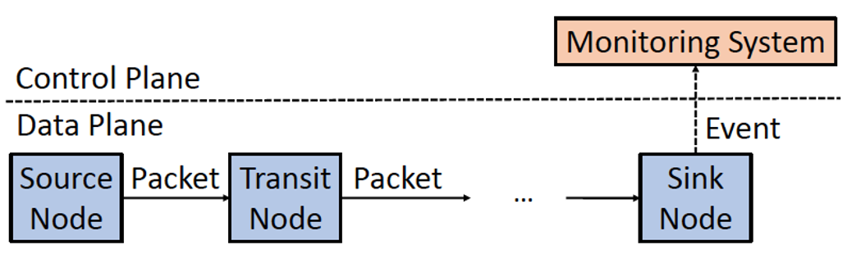
In-band Network Telemetry (INT)
Source pushes control information and device-internal states
Transit pushes states according to control information
Sink extracts INT information and reports an event
INT framework
Notes:
As an emerging technique in network measurement, In-band Network Telemetry (INT) aims to track per-node states for each packet in the data plane. Each node in INT plays one of the three roles: source, transit, and sink node.
The source node is the first node in the forwarding path of each packet. It pushes control information and device-internal states into packet.
The transit nodes are the intermediate nodes in the forwarding path. It pushes device-internal states into the packet according to the control information provided by source node.
The sink node is the last node in the forwarding path. It extracts INT information from the packet and reports it as an event to the monitoring system in control plane.

Slide 3
Limitations of INT
Significant bandwidth overhead
Linearly grow with the length of forwarding path
Reduce effective bandwidth for network applications
Increase likelihood of IP-level fragmentation
Example
5-node fat-tree topology in data center
Trace device ID, ingress port, and egress port, of 4B each
12B per-node states and 8B INT control information
68B in total → at least 4.53% of 1,500B MTU in Ethernet
Notes:
However, original INT incurs significant bandwidth overhead. As mentioned before, as INT embeds the complete states of each node into each packet along its forwarding path, the bandwidth overhead grows linearly with the path length. It not only reduces the effective bandwidth for network flows of applications, but also increases the likelihood of IP-level fragmentation. Such bandwidth overhead could undermine the network performance.
Let me take an example. Consider a 5-node fat-tree topology in data center, which uses INT to trace device ID, ingress port, and egress port, of 4 bytes each. So each node needs to embed 12 bytes for the three states. Note that INT control information also costs bandwidth, which is usually 8 bytes. Therefore, original INT needs 68 bytes in this example, which accounts for at least 4.53% of the packet size under the MTU of Ethernet. If the packet size exceeds the MTU, IP-level fragmentation will be triggered.

Slide 4
Existing Studies
Sampling-based methods
Embed INT information to only a subset of sampled packets
Reduce bandwidth overhead yet with slow convergence
Cannot retrieve INT information unless collecting sufficient packets
Other methods
Designed for specific telemetry tasks
All existing methods suffer from low generality
Cannot support all families of common applications
Notes:
To mitigate the bandwidth overhead of INT, many existing methods are proposed.
Some are sampling-based, which embed INT information to a subset of packets. It does reduce bandwidth overhead, however they suffer from slow convergence. Specifically, they cannot retrieve INT information unless collecting sufficient packets.
Other methods are designed for specific telemetry tasks
In fact, all existing methods compromise generality for bandwidth mitigation, which means that they cannot support all families of common applications. It is just our motivation of this work.

Slide 5
Our Contributions
DeltaINT, a general INT framework
Two variations: DeltaINT-O and DeltaINT-E
Extremely low bandwidth overhead
High generality and convergence
Theoretical analysis on bandwidth mitigation guarantees
Software simulation for various applications
For example, reducing up to 93% bandwidth cost in gray failure detection
P4-based hardware implementation
Open-source DeltaINT prototype
Notes:
Our work makes the following contributions:
We propose a general INT framework with two variations: DeltaINT-O and DeltaINT-E. Both the two variations can achieve extremely low bandwidth overhead with high generality and convergence.
We analyze DeltaINT to provide theoretical guarantees on bandwidth mitigation.
We also perform software simulation for different families of applications and confirm the improvement of DeltaINT. For instance, DeltaINT reduces up to 93% bandwidth overhead in gray failure detection.
Furthermore, we provide P4-based hardware implementation and deploy it into Barefoot Tofino ASIC chips.
Finally, we open-source the prototype of this work.
[(1) generality, in which it supports both packet-level and flow-level applications. We will talk about the detailed families of applications later; and (2) convergence, in which it collects real-time INT information by monitoring each packet]

Slide 6
Four Families of Applications
Per-packet-per-node monitoring
Collect per-node states for each packet (e.g., fine-grained monitoring and gray failure detection)
Per-packet aggregation
Aggregate per-node states for each packet (e.g., congestion control)
Static per-flow aggregation
Collect static per-node states for each flow (e.g., path tracing)
Dynamic per-flow aggregation
Aggregate per-node states for each flow (e.g., latency measurement)
Notes:
Before talking about how we mitigate the bandwidth overhead, we first introduce the classification of common applications including four families. This works aims to cover all of them for high generality.
- Per-packet-per-node monitoring is the first family which corresponds to the original INT framework. It aims to collect the states for each packet in a per-node basis. One application is fine-grained monitoring, which requires high accuracy to monitor data traffic. Another application is gray failure detection, which detects the node remaining functional yet underperforming.
The second family is per-packet aggregation, which summarizes per-node states for each packet with some aggregation function (e.g.. min and max). An application is congestion control, which collects the maximum link utilization for each packet along the forwarding path to adapt sending-rate.
Another family is static per-flow aggregation, which collects per-node states for each flow. In this family, we assume that the forwarding path and per-node states are static for each given flow. An application is path tracing, which collects the device ID of each node to trace the path of a flow.
The final family is dynamic per-flow aggregation, which summarizes per-node states for each flow with some aggregation function (e.g., median and quantile). An application is latency measurement, which collects latency statistics (e.g., 99th percentile latency) for flow-level monitoring.

Slide 7
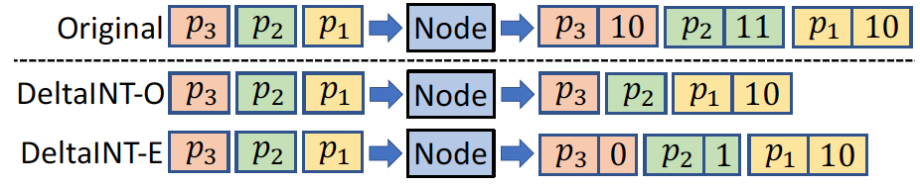
Our Solution
Key observation
Delta, the change between current state and embedded state
Delta is often negligible at most time in typical applications
For example, relatively stable hop latency and static device IDs
Motivating example
Notes:
(be quick for the previous slides)
Our solution originates from a key observation about deltas. We define delta as the change between two states, current state and embedded state. Current state refers to the state provided by the node for each traversed packet, while embedded state is the state that has been recently embedded into a packet. We observe that delta is often negligible (i.e., within some predefined threshold) at most time in typical applications. For example, hop latency is relatively stable unless microbursts occur; some static states like device ID are well-defined and totally unchanged. It motivates us to mitigate bandwidth overhead by embedding the complete states only if the delta is not negligible.
We give a motivating example to briefly show how we use the observation. Suppose that there are three packets, p1, p2, and p3, arriving at the node in order, and their current states are 10, 11, and 10, respectively. For original INT, it just embeds all the complete states. In contrast, DeltaINT only inserts a complete state if its delta exceeds a predefined threshold, say 1 in this example. Specifically, DeltaINT first embeds the current state 10 into p1, and update the embedded state as 10. For packet p2 and p3 whose current states are 11 and 10, their deltas are 1 and 0, respectively. As both the deltas are negligible, i.e., not exceeding the threshold of 1, DeltaINT will not embed the complete states 11 and 10 for the two packets.
While DeltaINT has two variations on processing the negligible deltas, which make a trade-off between bandwidth overhead and measurement accuracy. For DeltaINT-O, it directly omits the two negligible deltas for the minimum possible bandwidth overhead. The monitoring system will use the current state of p1 (i.e., 10) to approximate the states for p2 and p3. It undermines the measurement accuracy yet it is acceptable for common INT applications. For DeltaINT-E, it encodes the two negligible deltas (i.e., one and zero) into p2 and p3 with limited extra bandwidth overhead. And the monitoring system can reconstruct the current states of p2 and p3 by adding their encoded deltas with the current state of p1 for full measurement accuracy.
As the two variations are common in most design details, in the following slides, I will refer to them by DeltaINT-O and DeltaINT-E separately only when there are differences, while using DeltaINT to collectively refer to them in most cases. In practical deployment, we can choose one variation according to the requirement of network management application.

Slide 8
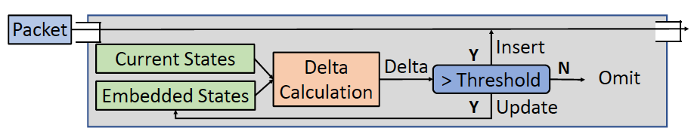
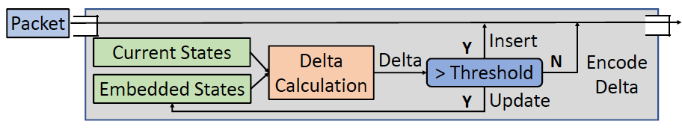
Per-node Architecture in DeltaINT
Per-node architecture
Calculate the delta between current states and embedded states
Only if the delta exceeds a threshold, we insert current states into a packet and update the embedded state
How to maintain embedded states efficiently in data plane?
DeltaINT-O
DeltaINT-E
Notes:
- Here is the per-node architecture of DeltaINT. For each traversed packet, we first calculate the delta between the current state and the embedded state. Only if the delta exceeds the predefined threshold, we insert the complete state into the packet and update the embedded state. The only difference between DeltaINT-O and DeltaINT-E is that if the delta does not exceed the threshold (i.e., negligible), DeltaINT-O simply omits it while DeltaINT-E encodes the delta into packet.
- Note that the current states are directly provided by underlying hardware, so we do not need to record them manually. For example, the node can continuously update its local
timer, and loads the current time as the current state of ingress timestamp when a packet arrives, However, how to maintain embedded states efficiently in the data plane with limited resources is a challenge.

Slide 9
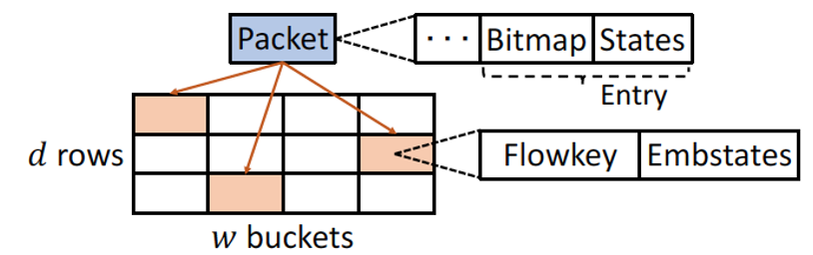
Sketching in DeltaINT
Sketch-based technique
Store approximate information with limited memory and computations
Track embedded states in the data plane with limited resources
Per-node sketch data structure
Each bucket stores a flowkey and the embedded states
Each entry of a packet includes a bitmap and the states being embedded
Notes:
To address the challenge, we exploit sketch-based techniques, which can store approximate information with limited memory and computations. Then, we can track embedded states in the data plane with limited resources. However, none of existing methods can support general INT applications. Therefore, we pose a sketch composed of d rows each with w buckets. We deploy such a sketch in each node. In each bucket, we store a flowkey, the identification of a flow (e.g., 5 tuples), and the embedded states. For each traversed packet carrying INT information, it consists of multiple entries. Each entry corresponds to a node, including a bitmap and the states being embedded. The length of bitmap equals the number of states being tracked. Each bit indicates whether the corresponding state is embedded in this node.

Slide 10
Primitives in DeltaINT
Four primitives to form DeltaINT workflow
StateLoad
Hash flowkey and load embedded states from the first bucket matching flowkey
DeltaCalc
Calculate the delta and compare with the predefined threshold
StateUpdate
Update flowkey and relevant embedded states in the hashed buckets
MetadataInsert
Insert a bitmap and the states with non-negligible deltas into the packet
Encode negligible deltas into the packet by Huffman coding if DeltaINT-E is used
Fit DeltaINT into applications with slight changes to primitives
Notes:
Based on the aforementioned sketch, we provide four primitives in DeltaINT framework to serve various INT applications, including StateLoad, DeltaCalc, StateUpdate, and MetadataInsert.
For StateLoad, it hashes the flowkey of the incoming packet to locate multiple buckets in the sketch. Then, it loads the embedded states from the first bucket storing the same flowkey as the current packet.
For DeltaCalc, it calculates the delta between the current state and the embedded state got by StateLoad. Then, it compares the delta with the predefined threshold to determine whether to embed the complete state or not.
For StateUpdate, it updates the flowkey and the relevant embedded states of the hashed buckets in the sketch.
For MetadataInsert, it inserts INT information including a bitmap and the complete states with non-negligible deltas into the packet. If DeltaINT-E is used, we encode the negligible deltas into packet by Huffman coding. I will introduce the details of delta encoding in the next slide.
We can easily fit DeltaINT into different applications only with slight changes to primitives.
[For example, in per-packet aggregation, we just use DeltaCalc to calculate delta for aggregated state instead of original state.]

Slide 11
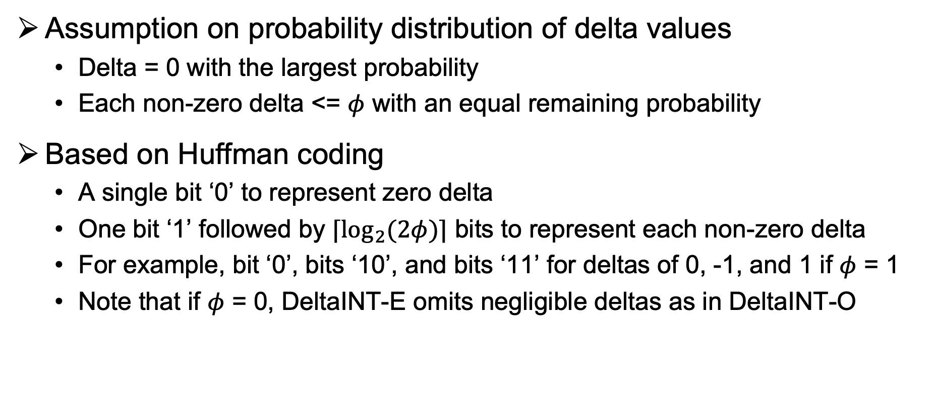
Delta Encoding in DeltaINT-E
Assumption on probability distribution of delta values
Delta = 0 with the largest probability
Each non-zero delta <= $φ$ with an equal remaining probability
Based on Huffman coding
A single bit ‘0’ to represent zero delta
One bit ‘1’ followed by $⌈\log_{2}{(2φ)⌉}$ bits to represent each non-zero delta
For example, bit ‘0’, bits ‘10’, and bits ‘11’ for deltas of 0, -1, and 1 if $φ$ = 1
Note that if $φ$ = 0, DeltaINT-E omits negligible deltas as in DeltaINT-O
Notes:
Our evaluation confirms the assumption that in common applications, most negligible deltas are zero and DeltaINT-E has limited extra bandwidth overhead than DeltaINT-O.

Slide 12
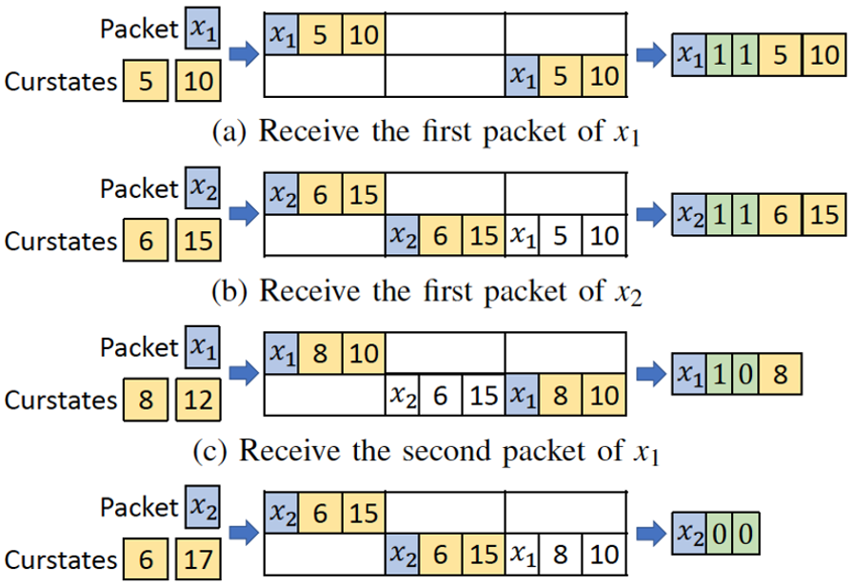

Update Example of DeltaINT-O
Receive the first packet of $x_{1}$
Receive the first packet of $x_{2}$
Receive the second packet of $x_{1}$
Receive the second packet of $x_{2}$
Notes:
Let’s take an example to show how DeltaINT-O works. Suppose that there are four packets belonging to two flows x1 and x2. In this example, we focus on two states, whose thresholds are 0 and 2.
First, DeltaINT receives the first packet belonging to x1. Since no bucket matches x1, DeltaINT-O updates the hashed buckets with flowkey x1, and the current states, 5 and 10. Then, it directly embeds a bitmap with two bits of 1 and the complete current states.
Next, DeltaINT-O receives the second packet belonging to another flow x2. Since no bucket matches x2, DeltaINT-O performs similar process as the previous packet to update the sketch and the packet. Note that the first bucket in the sketch, which stored the INT information of x1, has been overwritten with the information of x2.
After that, DeltaINT-O receives the third packet belonging to x1. It loads the embedded states, 5 and 10, from the sketch, and calculates the deltas, 3 and 2. Since the delta of the first state exceeds the corresponding threshold, DeltaINT-O updates the embedded state and inserts the current state 8 into the packet. Note that the second bit of the bitmap is set as 0 to indicate that the second state is not embedded into the packet.
Finally, DeltaINT-O receives the last packet belonging to x2. After loading the embedded states, 6 and 15, it gets the deltas, 0 and 2. As both of them are within the thresholds, it only inserts a bitmap with two bits of 0 into the packet.

Slide 13
Update Example of DeltaINT-E
Receive the first packet of $x_{1}$
Receive the first packet of $x_{2}$
Receive the second packet of $x_{1}$
Receive the second packet of $x_{2}$
Notes:
Here is an example of DeltaINT-E, which receive the same four packets as in the previous example of DeltaINT-O. The first two steps in DeltaINT-E are the same as in the previous example, as both the variations needs to embed the complete states for non-negligible deltas. For the third packet, as the delta of the first state is non-negligible while that of the second state is negligible, DeltaINT-E embeds the complete state 8 into packet, while encoding the negligible delta 2 into the packet represented by three bits ‘1xx’, where ‘xx’ are two bits to encode a non-zero delta under the threshold of 2. For the last packet, as both deltas are negligible, DeltaINT-E need to encode them into the packet. Note that the threshold of the first state is zero, so DeltaINT-E directly omit the zero delta while encoding the second negligible delta in three bits ‘1xx’.

Slide 14
Evaluation
Methodology
For software simulation, we use both bmv2 and NS3
For hardware implementation, we compile P4 in Barefoot Tofino switch
For sketch in the data plane, we keep 1MB memory and 1 hash function
Experiments
Gray failure detection
Congestion control
Path tracing
Latency measurement
Fine-grained monitoring
Hardware resource usage
Notes:
Finally, I talk about the evaluation of this work. We have both software simulation and hardware implementation. For the former, we use both bmv2 and NS3. For the latter, we compile P4 in Barefoot Tofino switch. For per-node sketch in the data plane, we keep 1MB memory and 1 hash function. We evaluate DeltaINT in the following experiments, gray failure detection, congestion control, path tracing, latency measurement, and hardware resource usage.

Slide 15
Gray Failure Detection
Tracked states
8-bit device ID, 8-bit ingress port, 8-bit egress port, and 32-bit latency
Bandwidth usage
DeltaINT-O (8.1 bits) mitigates 93% bandwidth usage of INT-Path (112 bits)
DeltaINT-E (16.8 bits) also significantly reduces INT bandwidth overhead
Reason: DeltaINT only embeds critical states with non-negligible deltas
(a) Different epoch lengths
(b) Different thresholds
Notes:
In gray failure detection, we compare DeltaINT with INT-Path. In this application, we focus on three states: 8-bit device ID, 8-bit ingress port, 8-bit egress port, and 32-bit latency. For bandwidth usage, we concern average bit cost, the average number of bits used by each packet to carry INT information. The result is that DeltaINT-O can mitigate at most 93% bandwidth usage of INT-Path and DeltaINT-E also significantly reduce INT bandwidth overhead. The improvement holds under different epoch lengths and thresholds. The reason is that both DeltaINT-O and DeltaINT-E only embed the complete states with non-negligible deltas, while INT-Path embeds all complete states for each packet. DeltaINT-E uses more bandwidth than DeltaINT-O due to delta encoding but the extra overhead is limited.

Slide 16
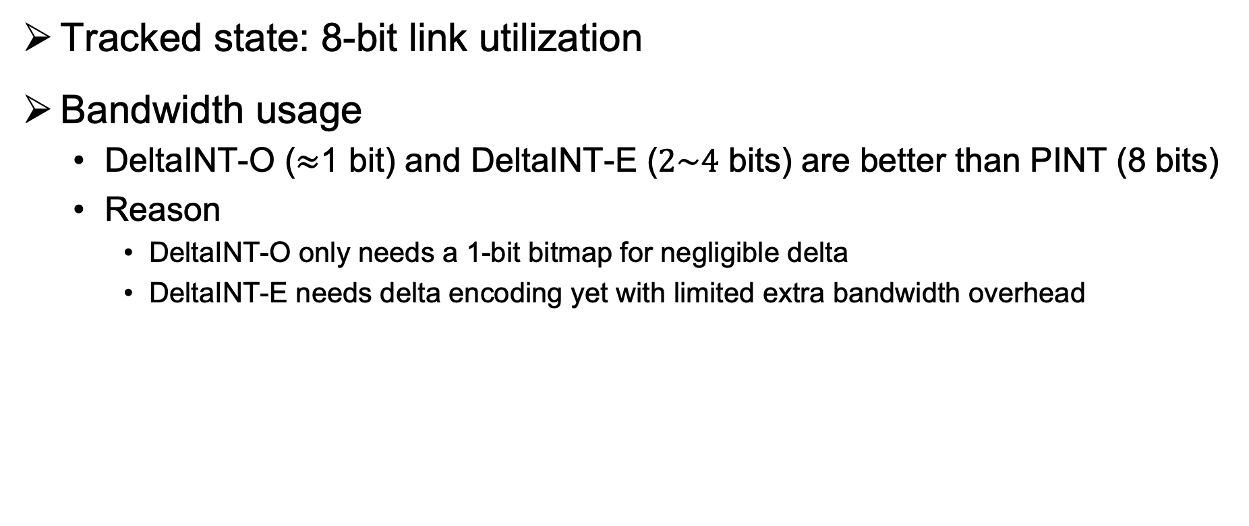
Congestion Control
Tracked state: 8-bit link utilization
Bandwidth usage
DeltaINT-O ($≈$1 bit) and DeltaINT-E ($2\sim 4$ bits) are better than PINT (8 bits)
Reason
DeltaINT-O only needs a 1-bit bitmap for negligible delta
DeltaINT-E needs delta encoding yet with limited extra bandwidth overhead
(a) Web search workload
(b) Hadoop workload
Notes:
In congestion control, we use the state-of-the-art work, PINT, as the baseline. We track 8-bit link utilization. For bandwidth usage, we still consider average bit cost. The figures show that under both the web search workload and Hadoop workload, the average bit of PINT is always 8 bits, while that of DeltaINT-O decreases to nearly 1 bit and that of DeltaINT-E increases from 2 to 4 bits. The reason is that DeltaINT-O only needs an 1-bit bitmap for non-negligible delta, such that the controller can be aware of the stable link utilization. While DeltaINT-E needs to encode negligible delta with more bandwidth overhead. But both of them are much smaller than PINT due to avoiding most complete states.

Slide 17

Path Tracing
Tracked state: 8-bit device ID (threshold = 0)
Bandwidth usage
DeltaINT-O ($≈$1 bit) is better than PINT (8 bits)
Reason: DeltaINT-O only needs a 1-bit bitmap for non-first packets of each flow due to static device ID with negligible delta
(a) Kentucky Datalink
(b) Fat Tree
Notes:
For path tracing, we track the 8-bit device ID. As PINT suggests, we take two topologies, Kentucky datalink and fat tree, to evaluate the bandwidth usage. Note that the threshold is zero for static states, where DeltaINT-E also omits zero delta as in DeltaINT-O. So we only show the result of DeltaINT-O. The results are similar that DeltaINT-O has smaller average bit overhead than PINT due to a similar reason as mentioned before.
//The results shows that DeltaINT-O requires nearly 1 bit on average which is smaller than PINT of 8 bits. The reason is similar as the previous application, i.e., DeltaINT-O only needs an 1-bit bitmap for non-first packets of each flow due to static device ID with negligible delta

Slide 18
Path Tracing
Convergence
Average number: DeltaINT-O (1) vs. PINT (120)
Tail (99th percentile) number: DeltaINT-O (1) vs. PINT (350)
Reason
DeltaINT-O only embeds per-node device ID in the first packet of each flow
PINT needs sufficient sampled packets to retrieve per-flow device IDs
Notes:
In path tracing, we also take another experiment to evaluate the convergence. Specifically, we consider the average and tail (aka 99th percentile) number of required packets sent by a flow to collect all static states. Here we take Kentuncky Datalink as an example. The results show that for PINT, the average number is 120 and the tail number is 350 in this topology. However, DeltaINT-O only needs a single packet. The reason is that DeltaINT-O just embeds the static states into the first packet of each flow, while PINT needs sufficient sampled packets to retrieve per-flow device IDs.

Slide 19
Latency Measurement
Tracked state: 8-bit latency
Bandwidth usage
(a) DeltaINT-O (3 bits), DeltaINT-E (5.4 bits), and PINT (8.9 bits)
(b) DeltaINT-O (4 bits), DeltaINT-E (6.3 bits), and PINT (8.9 bits)
Reason: DeltaINT only embeds critical latency with non-negligible delta
(a) Web search workload
(b) Hadoop workload
Notes:
In the application of latency measurement, the result is similar that DeltaINT-O and DeltaINT-E are better than PINT in two workloads. The reason is also similar that DeltaINT only embeds critical latency with non-negligible delta.

Slide 20
Fine-grained monitoring
Tracked state: 32-bit latency
Bandwidth usage in web search workload
DeltaINT-O decreases from 11.2 bits to 2.1 bits
DeltaINT-E decreases from 12.8 bits to 7.7 bits, and increases to 8.7 bits
Original INT uses 57.8 bits
(a) Web search workload
(b) Hadoop workload
Notes:
In the last application, fine-grained monitoring, we focus on per-packet-per-node 32-bit latency with high accuracy to monitor normal data traffic. We also use two workloads. As the results are similar, we focus on web search workload here. First, the results are similar that DeltaINT-O and DeltaINT-E have much smaller bandwidth overhead than original INT due to avoiding complete states. Second, note that DeltaINT-E experiences a trend that the average bit cost first decreases and then increases. The reason is that when the threshold starts to increase, DeltaINT-E can avoid more complete states and hence reduce bandwidth overhead. However, as threshold continues to become larger, the extra cost for delta encoding becomes significant.

Slide 21
Fine-grained monitoring
Measurement accuracy
Average relative error between reported latency and actual latency
Results
Both original INT and DeltaINT-E can achieve full accuracy
DeltaINT-O suffers from large average relative error
Reason: DeltaINT-O omits negligible deltas while DeltaINT-E encodes them
(a) Web search workload
(b) Hadoop workload
Notes:
We emphasize that although DeltaINT-O has large ARE in this application, it just means that we should use DeltaINT-E for network applications requiring high accuracy. But in other common applications, the accuracy loss of DeltaINT-O does not affect the functionality, which has been confirmed by previous experiments.

Slide 22
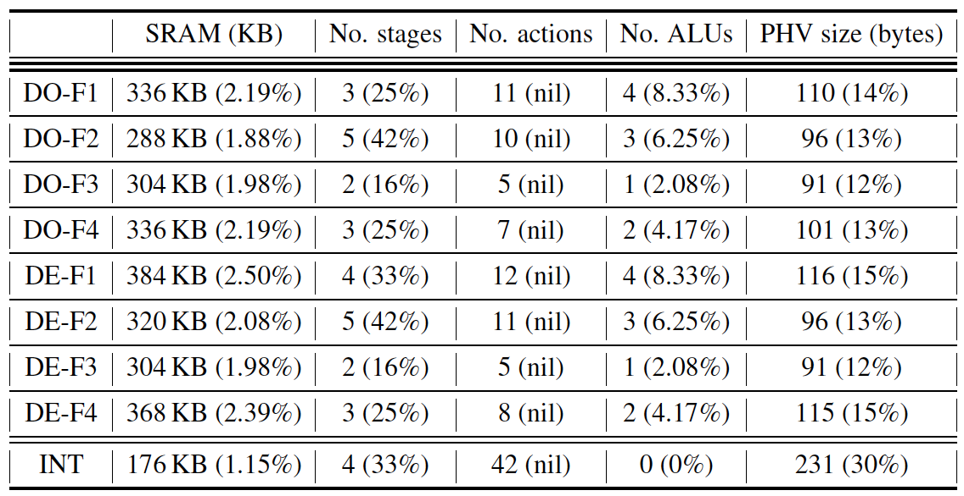
Hardware Resource Usage
Hardware resource usage
Percentages in brackets are fractions of total resource usage
DO and DE incur slightly more SRAM, stages, and stateful ALUs
DO and DE need to track embedded states in the data plane
INT incurs more PHV sizes and actions
INT has larger bandwidth overhead and hence more information to process and transmit
Notes:
Finally, we evaluate hardware resource usage on Barefoot Tofino switch. F1 – F4 refers to DeltaINT in the four families of applications. We use the four representative applications mentioned before. INT refers to the original INT framework for F2, which incurs the most number of stages in DeltaINT. We compile them in the same testbed. Percentages in brackets are fractions of total resource usage. The result shows that DeltaINT incurs slightly more SRAM, stages, and stateful ALUs than the original INT. The reason is that DeltaINT needs to track embedded states in the data plane. However, original INT incurs more PHV sizes and actions. The reason is that INT has larger bandwidth overhead than DeltaINT, so it needs more information to process and transmit in the data plane.

Slide 23
Conclusion
DeltaINT, a novel INT framework to achieve extremely low bandwidth overhead
Generality
Convergence
Evaluation on various applications
Both variations incur less bandwidth usage than state-of-the-art methods
Source code:
http://adslab.cse.cuhk.edu.hk/software/deltaint
Notes:
To conclude, we propose DeltaINT, a novel INT framework that achieves extremely low bandwidth overhead. It mainly aims for generality and convergence. Based on our evaluation on various applications, we confirm that DeltaINT can mitigate bandwidth usage. We also open-source our code in github, and here is the link.

Slide 24
Thank You! Q & A
Notes:
Thank you. I’d like to take your questions and comments.

