Slide 1
Lab 1
Dan Wu
danwu.bme@zju.edu.cn

Slide 2
实验报告
1) LAB1_学号_final.ipynb (60%)
Your final code and results: Jupter notebook+disclosure
2) LAB1_学号_debug.ipynb (30%)
Your debug process and wrong results: Jupiter notebook
3) LAB1_学号_discuss.md (10%)
Your discussion record with LLM or AI tools: markdown
Due next week, before the lecture 13:25
Late submission -20%

Slide 3
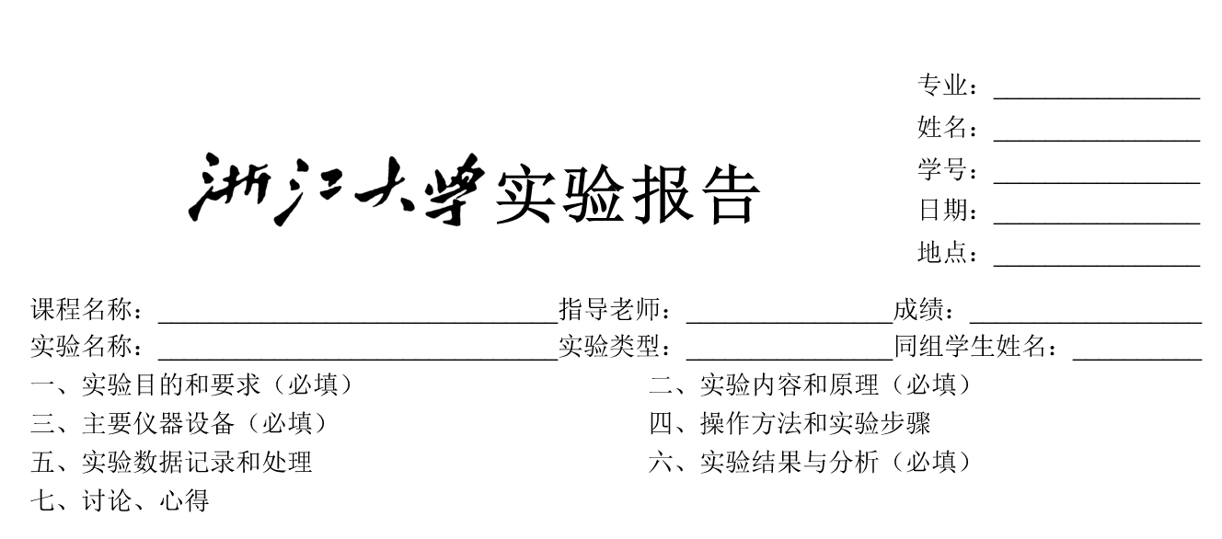
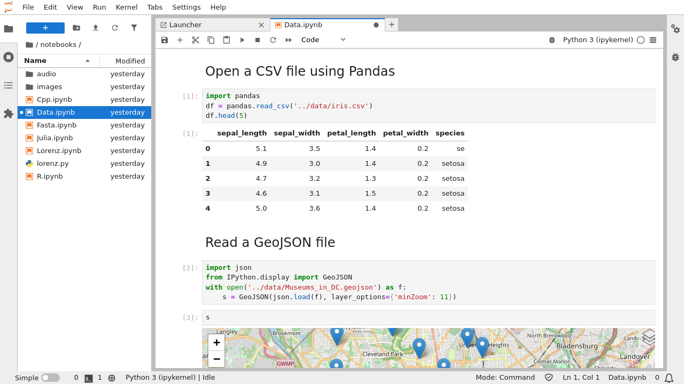
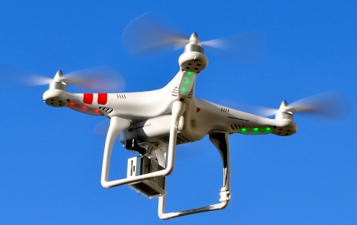
Notebook
Purpose
How it is related to the goal
Step
Parameters
If wrong, Go back and check
Result
Conclusion/Expectation
Todo

Slide 4
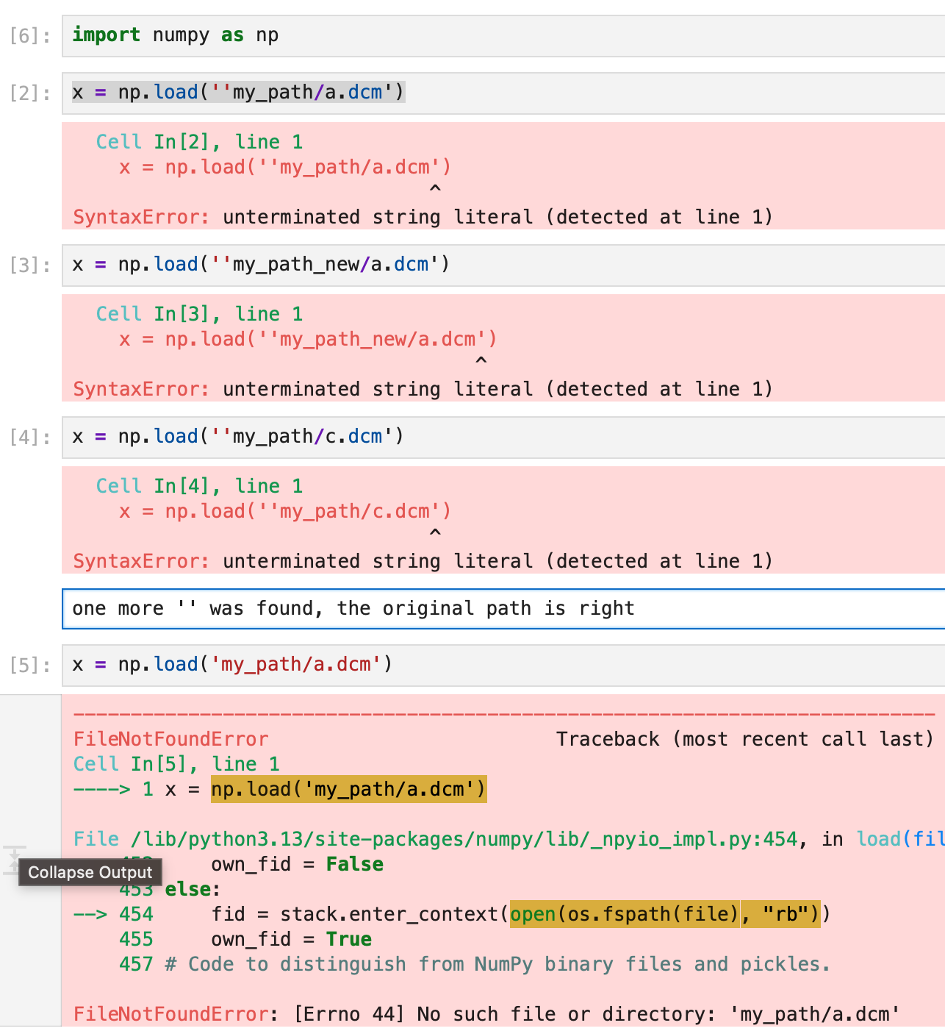
debug.ipynb
Do not delete
Do not remove
Only run it selectively
Great to add comments on the bugs
Comment:
I found the bug!

Slide 5
Human and AI Interaction Level (HAIL)
Level 0: AI
ask simple / single questions to AI
Level 1: Discuss
ask a series of related questions to AI, or discuss with AI
Level 2: Internalization
based on level 1, understand AI’s answers and can explain the AI answer to other human
Level 3: Copilot
based on Level 2, ask AI to revise / correct the human manuscript / code, with specific goals, and confirm the result by human
Level 4: Human
pure human statement

Slide 6
IDE
Matlab live editor
https://ww2.mathworks.cn/campaigns/offers/matlab-live-editor.html
Jupyter notebook
https://jupyter.org/
VS code
https://code.visualstudio.com/

Slide 7

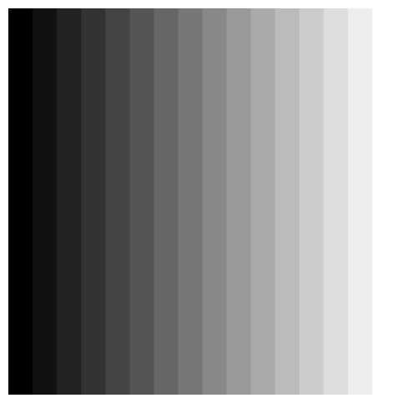
Project 1 Grey Image
Generate an image
Generate a 256x256 image with gray level from 0 (left) to 255 (right)
Generate a 256x256 image with gray level from 0 (left) to 255 (right) and each band being 16 pixels wide and increasing in value by a step of 16.
Observe the Mach band effect

Slide 8
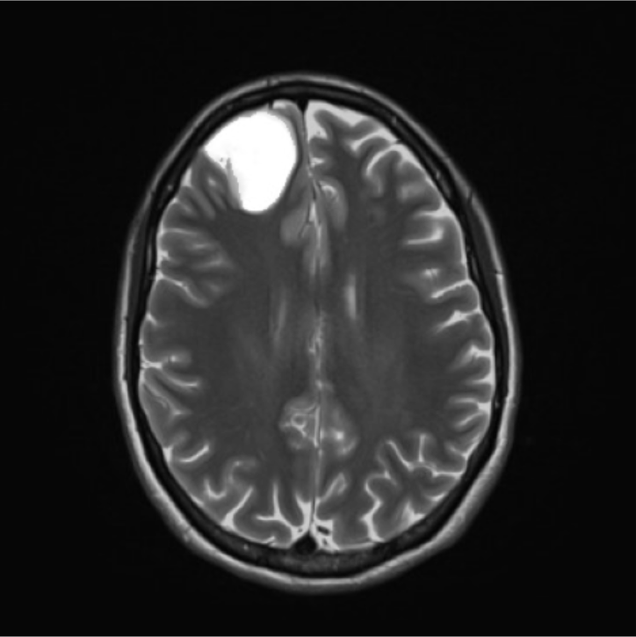
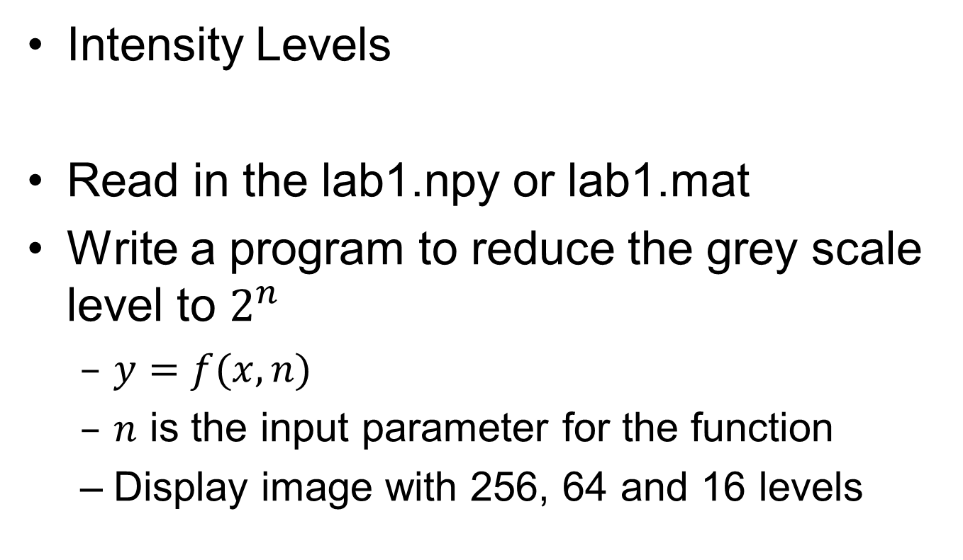
Project 2 Grey Image
Intensity Levels
Read in the lab1.npy or lab1.mat
Write a program to reduce the grey scale level to $2^{n}$
$y=f(x,n)$
$n$ is the input parameter for the function
Display image with 256, 64 and 16 levels

Slide 9
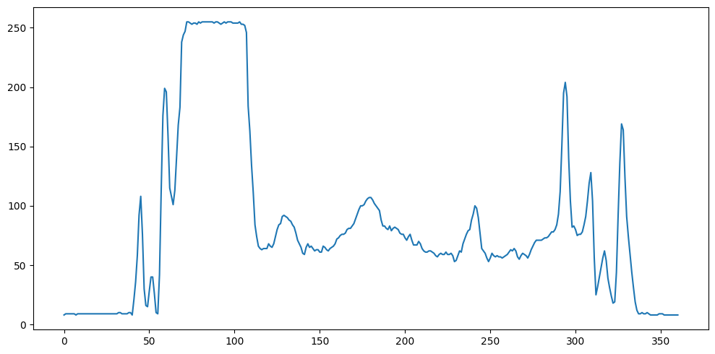
Project 3 Grey Image
Zooming and Shrinking Images
Plot a line through the image and compare the details for
Original image
Reduce the image size to 1/N
Increase the reduced image size to N

Slide 10
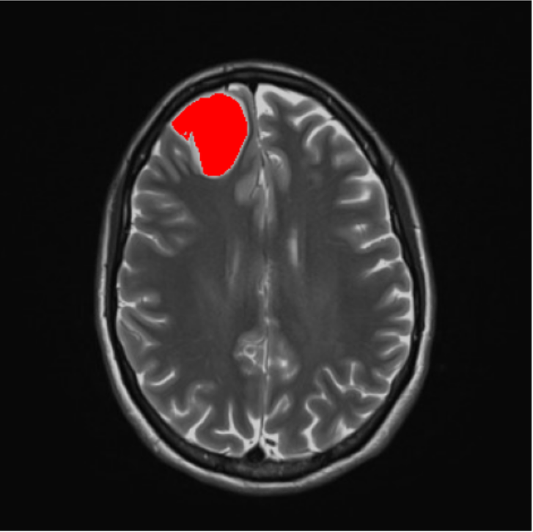
Project 4 Color Image
Color overlay
Generate the mask by I>threshold
Put the mask in the red channel to generate a color overlay image

Slide 11
Lab 1

