Slide 1
Lab 2

Slide 2
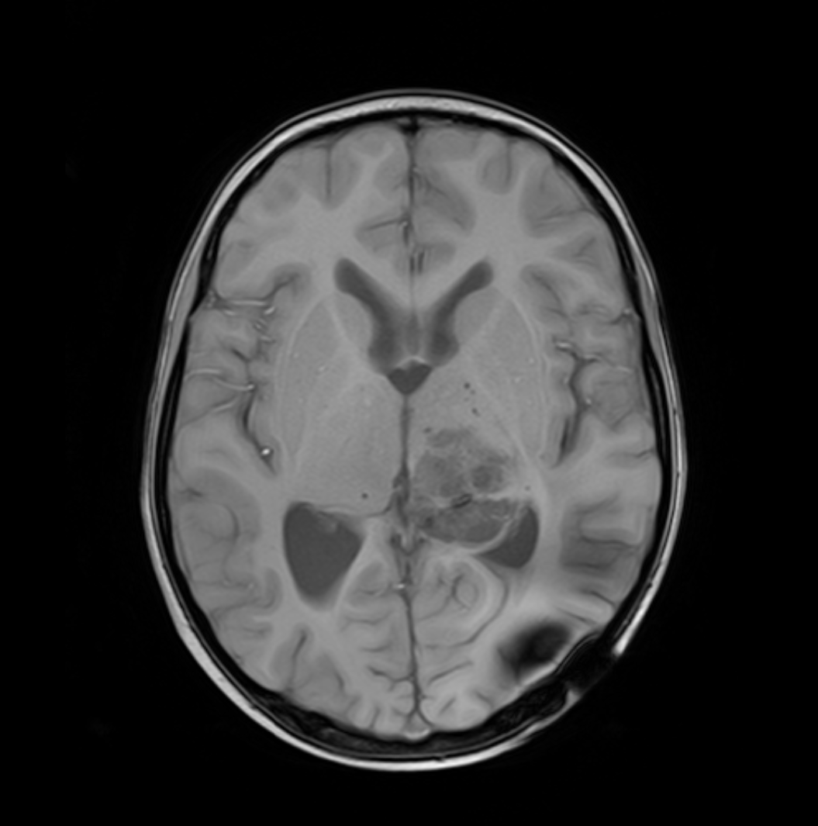
Project 1 Spatial Transform
Affine transformation:lab2_MRI.npy
Use the provided data of brain MRI, design and implement the following experiments:
Forward-Backward Rotation: Rotate the image by pi/5, then rotate it back by -theta to its original position. Perform the above rotation with Nearest Neighbor and Bilinear interpolation.
Highlights the regions (zoom-in if needed) with notable differences between the two methods using arrows.
Show and quantify the differences between the original and the recovered image.
Bonus: Compare the information loss between 1 rotation cycle (theta -> -theta) and 5 continuous rotation cycles.
Requirements:
using matrix operator

Slide 3
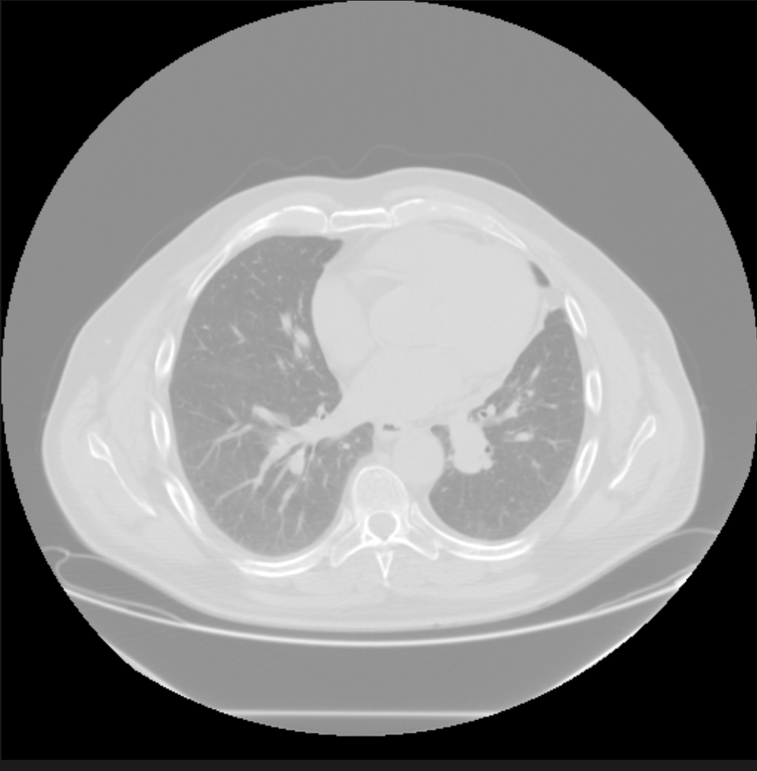
Project 2: Intensity Transform
Intensity transform: lab2_CT.npy
Design Log transform and Power transform
Adjust the parameters to achieve the best visual effect
Explain the major differences between the methods and parameters
Explain how to select the optimal parameter
Design/select parameters that are appropriate for observing lung tissue versus bone structures?
Requirements:
using matrix operator

Slide 4
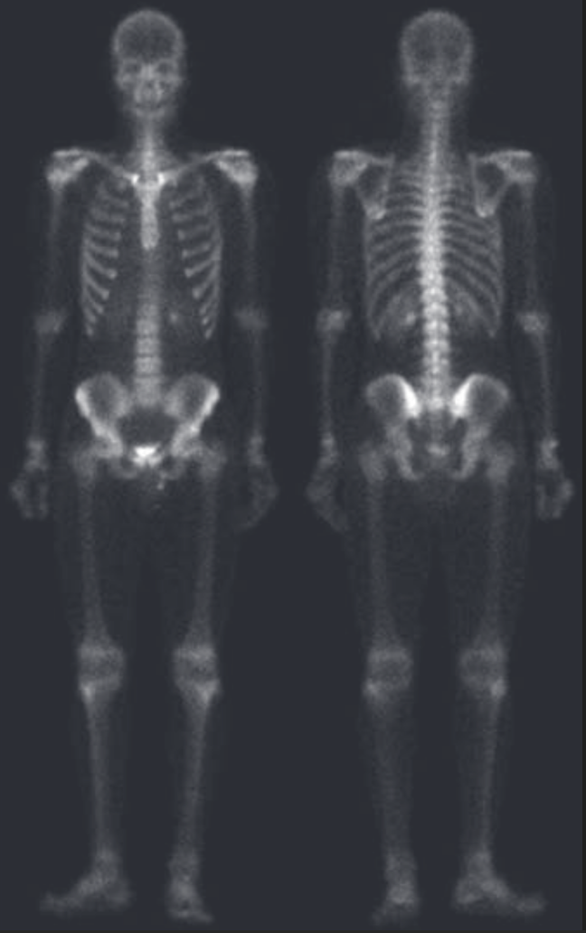
Project 3: Spatial Filter: High pass filter
Use the data of the X-Ray image, lab2_filter.npy
Write your code to enhance the image
required steps
8-neighbor Laplacian filter
3×3 Sobel filter in 2 directions
More steps with your design
Explain how the enhancement pipeline is selected and effects of each step

