Slide 1
Lab 3 - Spatial Filter and Fourier Transform
Requirements:
using matrix operator

Slide 2
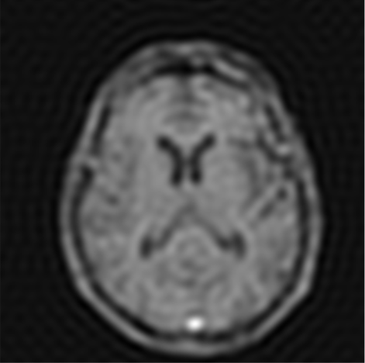
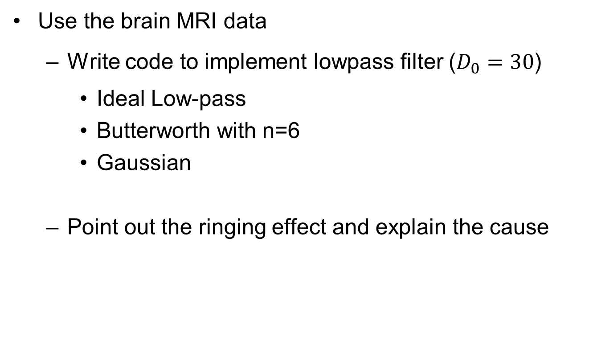
Project 1 Ringing Effect
Use the brain MRI data
Write code to implement lowpass filter ($D_{0}=30$)
Ideal Low-pass
Butterworth with n=6
Gaussian
Point out the ringing effect and explain the cause

Slide 3
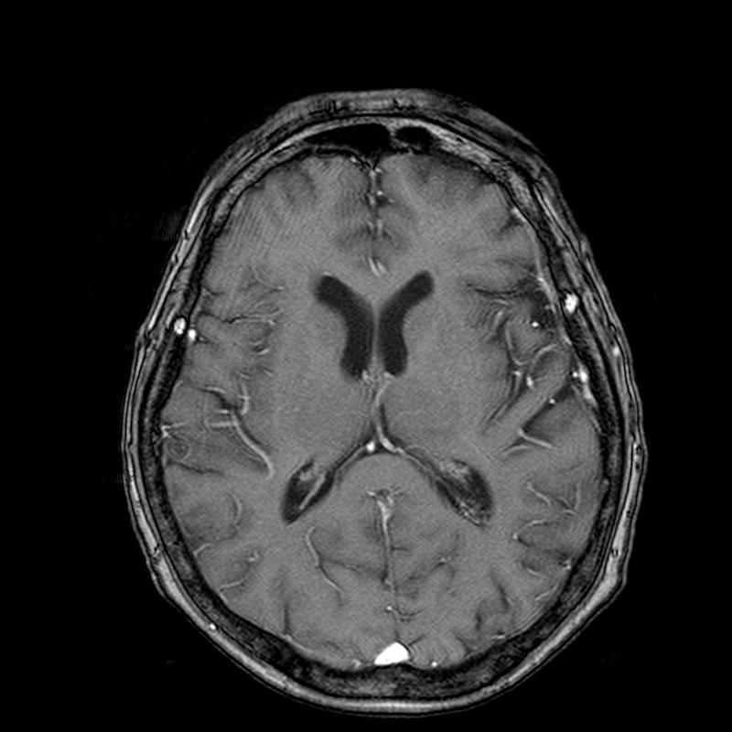
Project 2: Identical filter
Use the brain MRI data
Implement a spatial filter
Low pass Gaussian(Sigma can be 1, 3, 5)
Corresponding high pass Gaussian
Apply frequency filter
Filter based on Spatial Kernel FFT
Implement a Laplacian high pass filter
3*3 with 4 and 8 neighbor
Analysis and discuss differences between
Frequency and spatial filters
Gaussian high pass and Laplacian filter

Slide 4
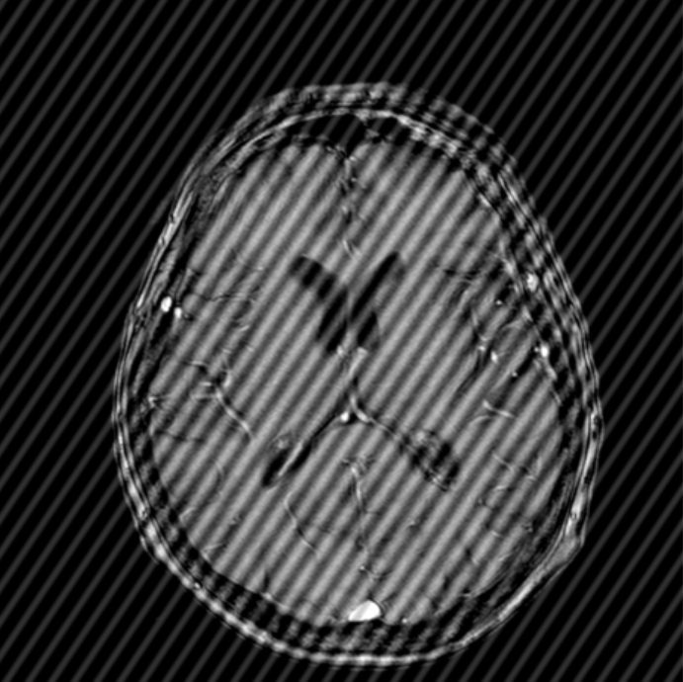
Project 3 Notch filter
Use the noised brain MRI data
Write code to implement notch filter to remove the noise.

