Slide 1
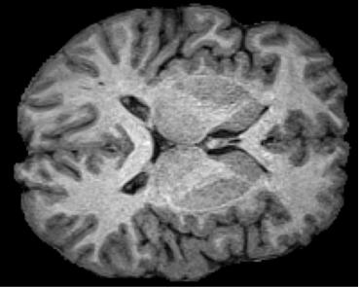
Project 1 add and estimate noise
Use the data of lab4-1, the brain MRI
Develop a program to add Gaussian noise to an image. Specify the noise mean and variance
Add pepper and salt noise to the image with different parameters
Estimate the parameters of noise model from the image
Denoise the image using the estimated noise parameters.

Slide 2
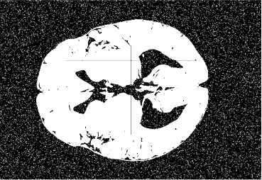
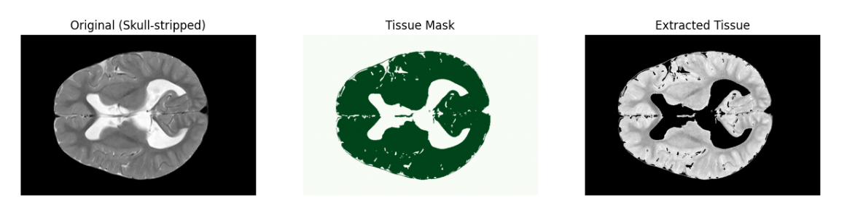
Project 2 morphological operations
Data: lab4-2 noisy_brain_mask.npy brain_tissue_mask_slice.npy original_brain_slice_.npy brain_tissue_slice.npy
-Apply morphological operations to the noisy_brain_mask.npy to denoise, remove wrong segment boundary and fill partial internal holes.
-Compaerd with the given brain mask(noisy_brain_mask.npy and brain_tissue_mask_slice.npy) and check the imperfections.

Slide 3
Project 2 morphological operations
Data: lab4-2 noisy_brain_mask.npy brain_tissue_mask_slice.npy original_brain_slice_.npy brain_tissue_slice.npy
-Visualize the final brain parenchyma region, comparing the segmentation result with the original image.
External artifact: Thin skull lines / boundary noise outside the brain parenchyma (false positives)
Internal structures: Genuine holes inside the brain (e.g., ventricles) that should be preserved (true negatives within the mask)
The integrity of the brain parenchyma boundary …

Slide 4
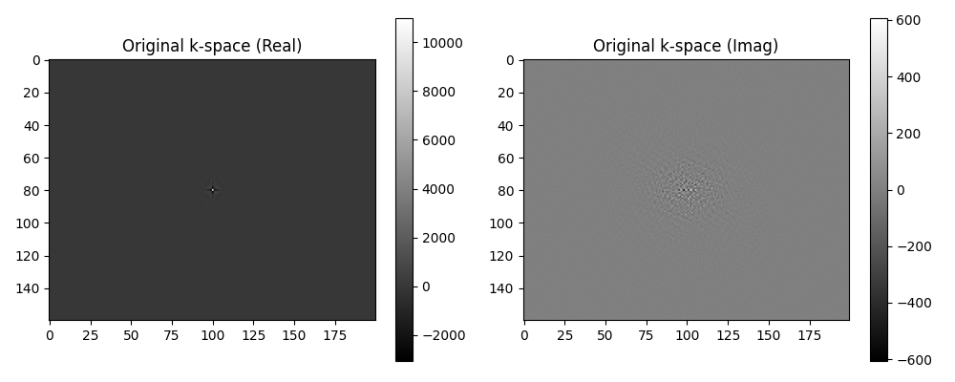
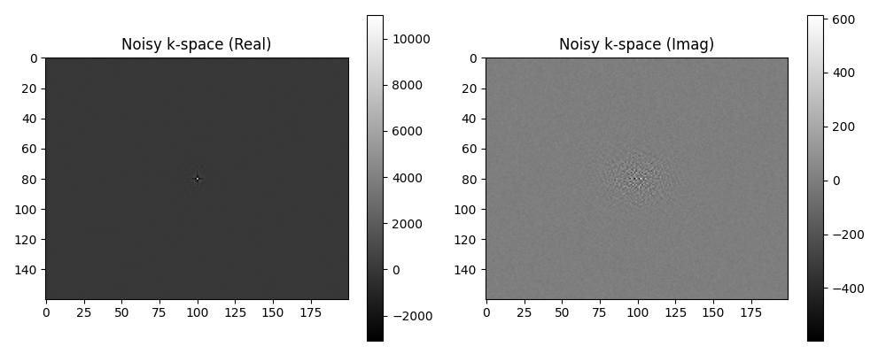
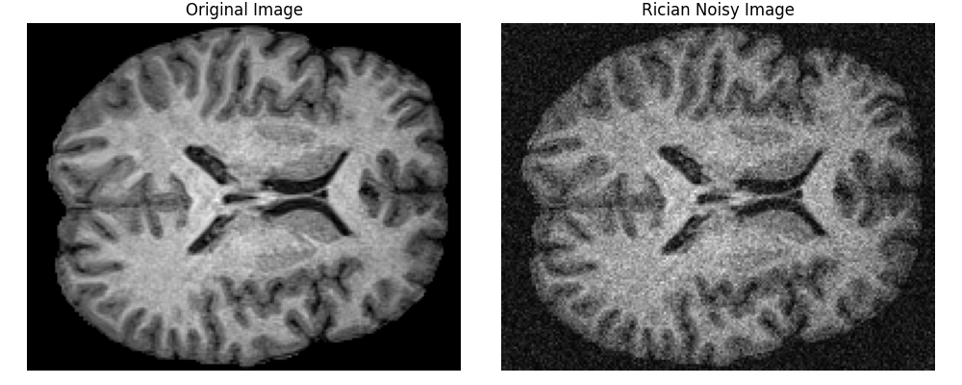
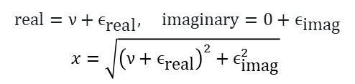
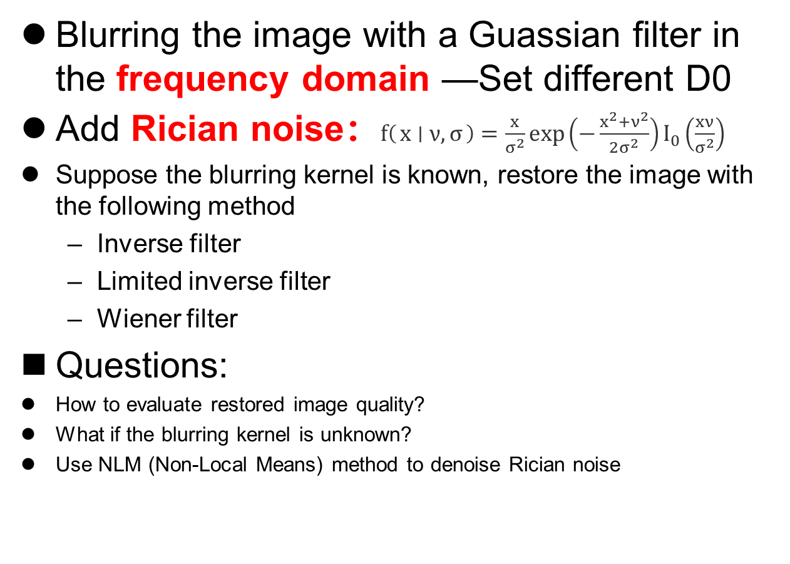
Project 3 restoration
Rician noise
$$real=ν+ϵ_{\text{real}}, imaginary=0+ϵ_{\text{imag}}$$
$x=\sqrt{{\left(ν+ϵ_{\text{real}}\right)}^{2}+ϵ_{\text{imag}}^{2}}$
Blurring the image with a Guassian filter in the frequency domain —Set different D0
Add Rician noise：$f\left(x ∣ ν,σ\right)=\frac{x}{σ^{2}}\exp\left(−\frac{x^{2}+ν^{2}}{2σ^{2}}\right)I_{0}\left(\frac{xν}{σ^{2}}\right)$
Suppose the blurring kernel is known, restore the image with the following method
Inverse filter
Limited inverse filter
Wiener filter
Questions:
How to evaluate restored image quality?
What if the blurring kernel is unknown?
Use NLM (Non-Local Means) method to denoise Rician noise

