Slide 1
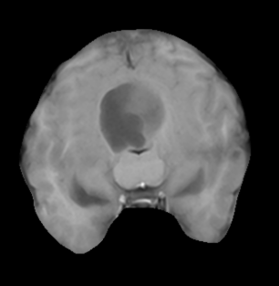
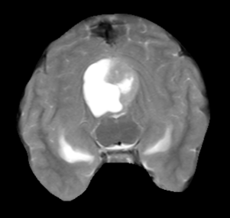
Project 1 Edge Detection
T1:
Use the data of lab5, 2 modes of the brain MRI
Implement the Sobel gradient kernel and get a binary mask with a specified threshold T.
Segment the lesion (red arrow):
5x5 smooth filter + Sobel filter + threshold T → edge
Remove brain edge
Closed operation
Connected domain processing
Discuss
Compare the effects of the 2 modes
T2:

Slide 2
Project 2 Thresholding
T1:
Implement Iterative global threshold segmentation
Test different initial T values
Implement Otsu's optimum thresholding algorithm to segment the lesion (Not call the library)
Test and compare the results on the brain
T2:

Slide 3
Project 3 Segmentation
• Use the T2w data
• Call Region Growing, K-mean Cluster, and Watershed Segmentation functions
• Implement improved K-mean clustering
– Adjust the number of clusters K and spatial coordinate (x,y) weighting to independently segment the lesion region
– Test different combinations of K and spatial weight to obtain optimal lesion segmentation
– Compare the segmentation results between standard K-mean and spatial-weighted K-mean
• Segment the lesion and calculate its volume
Suppose the image resolution is (x, y)=(1 mm, 1 mm)
T2:

