Slide 1
Lab 6 - Image Registration
Dan Wu
danwu.bme@zju.edu.cn

Slide 2
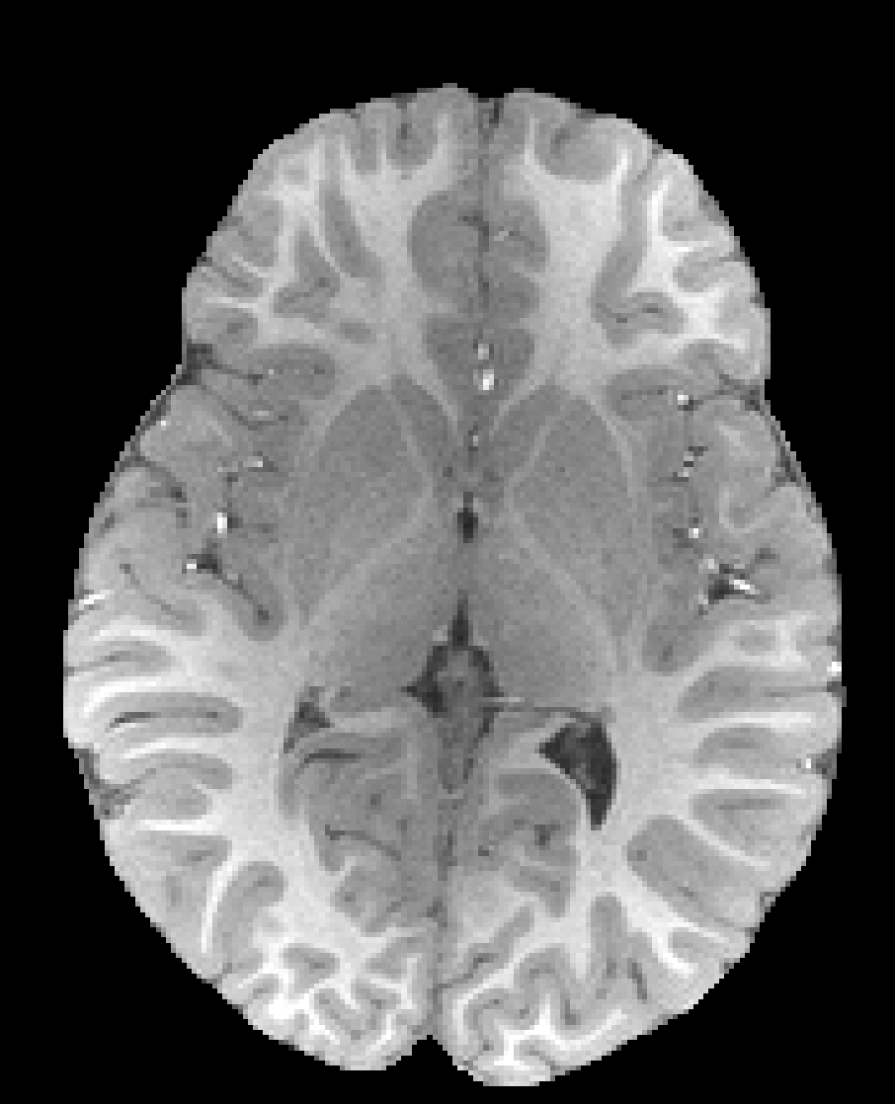
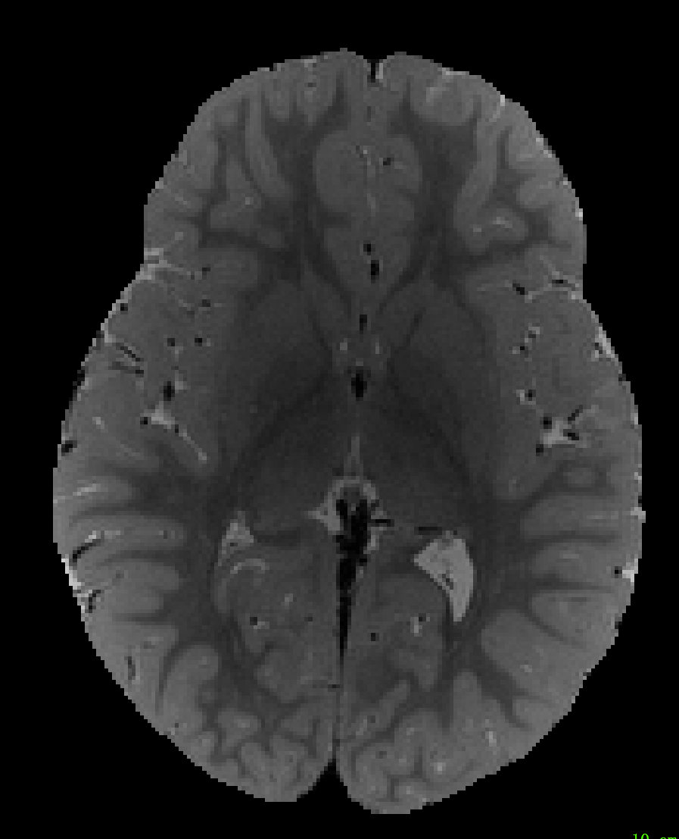
Project 1 Similarity Measure
Extract and plot one axial slice from two modalities.
Use nibabel to read .nii file in python
Write function for calculating the similarity metrics (SSD, RIU, CC, and MI) manually between the two slices, then comparing with standard library (except RIU).
The mask (can simply use threshold) is needed for all functions
T1w and the identity
T1w and T2w
T1w
T2w

Slide 3
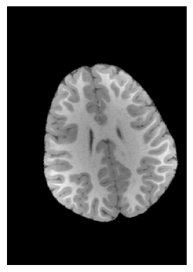
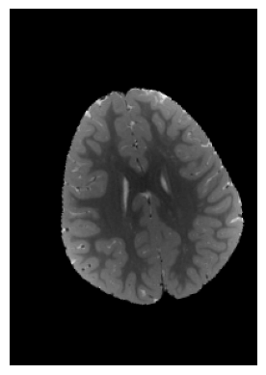
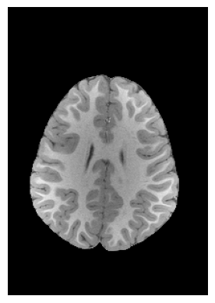
Project 2 Image Registration
Apply known rigid transformation (rotation and translation) to the T1w&T2w image.
Can use library for transformation
Demand transformation: rotate 15° and shift (10, -5)
Register the transformed images back to the target T1 image:
Inter-modality & Intra-modality
Optimization: use steepest decent method
Similarity metrics: functions in Project 1 (except MI and why?)
Compare the calculated transformation parameters with the one you applied.
Evaluate similarity indices for different task
You can also use overlap of the images
T1w
T2w
Target T1w
Bonus: Try your best to improve the registration effect by using any scientific method

Slide 4

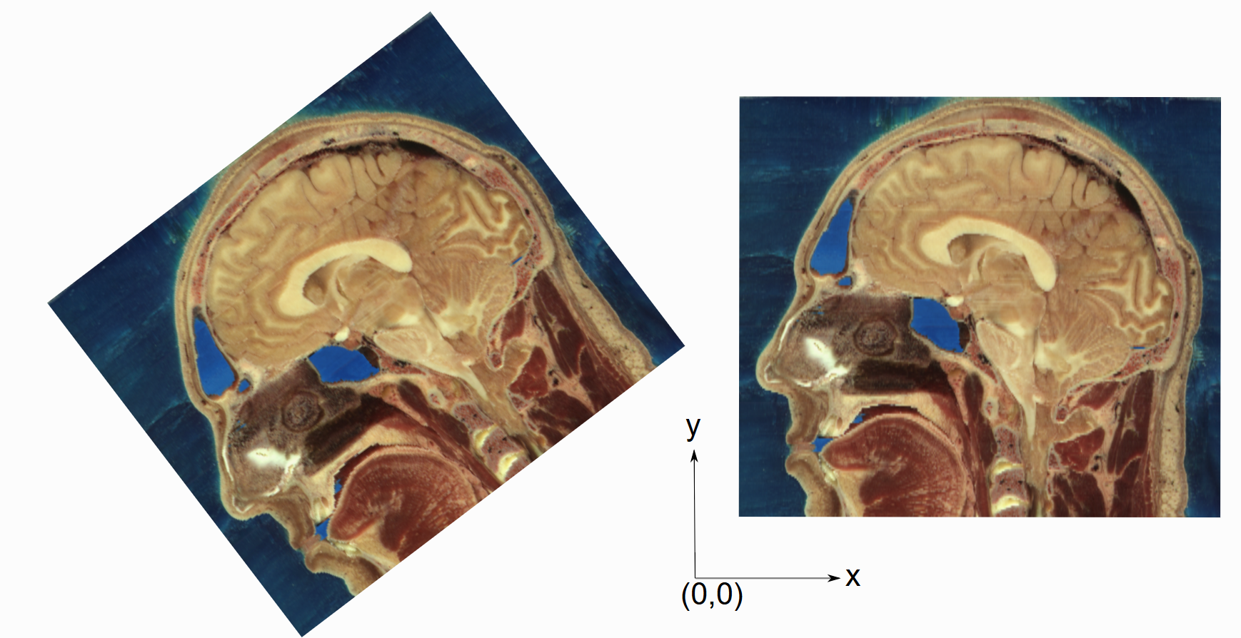
Project 3 Tool-based Co-registration
Use standard toolkits (SimpleITK) to complete the Project2 tasks
Inter-modality & Intra-modality
Try Similarity metrics in Project2
Compare with SGD method

