Slide 1
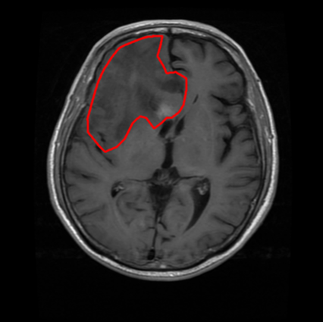
Project 1 Shape Feature & Fourier Descriptors
Use the data of lab7, real brain tumor MRI data.
Implement the Fourier Descriptors extraction.
Gradually increase the P value and observe the changes.
Discuss
The relationship between the number of descriptors P and shape fidelity.

Slide 2
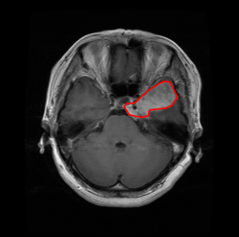
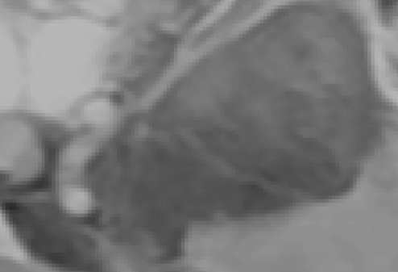
Project 2 First-Order Stats
Use the data of lab7, real brain tumor MRI data.
Find the Center of mass of the tumor to get ROI
Implement first-order histogram features calculation: Mean, Variance, Uniformity, and Entropy.
Implement an iterative 3*3 mean filter to simulate an asymptotic Gaussian blurring.
Record the dynamic changes of statistical metrics during iterations.
Discuss
The dynamic changes of statistical metrics.
Try repeating this process on the entire image instead of the ROI. (Optional)

Slide 3
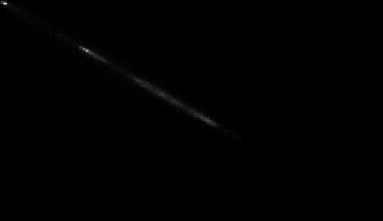
Project 3 Texture Feature & GLCM Analysis
• Use the data of lab7, quantized real tumor ROI.
Call functions to get second-order stats.
Compute the Gray-Level Co-occurrence Matrix (GLCM) based on specific spatial relationships.
Discuss
How the sampling step size interacts with periodic structural textures.

