Slide 1
Quadratic Classifier in PyTorch
Update 08/01/21

Slide 2
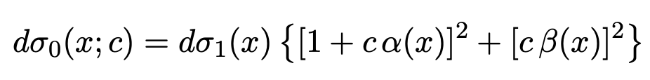
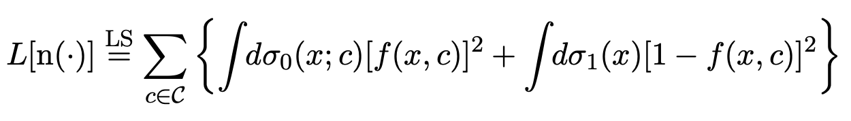
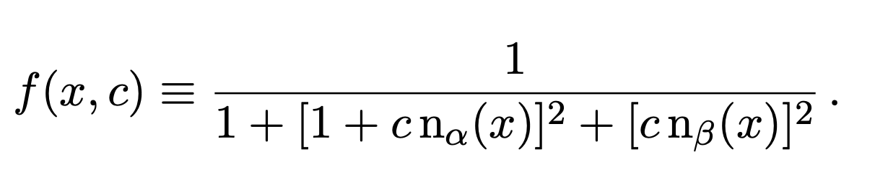
Recap of Quadratic Classifier
The EFT cross section is a quadratic polyonomial of the Wilson coefficient and must be positive:
Upon minimising the following loss functional the NN gives us an estimator of the likelihood ratio:
Prob. that the event belongs to the SM rather than to the EFT at a given Wilson coefficient
Notes:
The quadratic classifier enforces the quadratic dependence on the Wilson coefficients. This is much like how one can determine kappa and kappa tilde through a chi squared fit. We can therefore use training data that is generated at large values of c. Training only at small values of c will mean that the classifier is not able to tell apart the SM samples from the EFT samples.

Slide 3
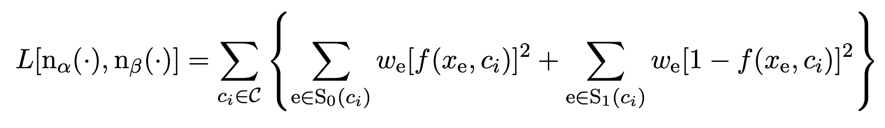
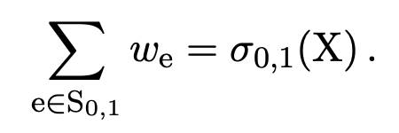
Recap of Quadratic Classifier
In practice we need to approximate the loss functional by sampling:
Our batches will have to contain as many EFT samples as SM samples at every value of the Wilson coefficient.
At LO, the weights are all equal and are normalised over the full batch:
Normalising over the mini-batch only introduces a multiplicative prefactor in front of the loss
and thus does not change the location of the minimum!

Slide 4
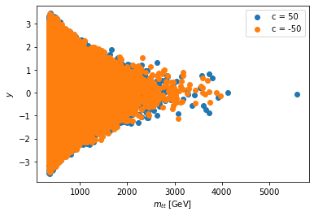
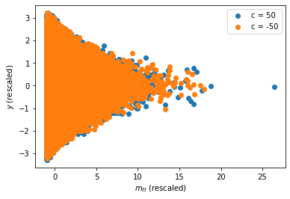
Rescale the training data
We rescale our training data to have zero mean and unit variance over the full training batch:
400k MC samples
Unscaled
Rescaled

Slide 5
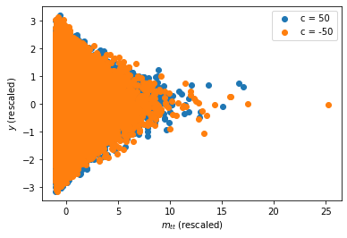

Training and validation set
We split our samples into a training set (80%) and a validation set (20%) to monitor whether we overfit or not
We rescale the validation set by the same rescaling that we used to standardise the training set:
Wilson coefficients used for training:
Validation set
100k MC samples

Slide 6
Architecture, hyperparameters, optimiser…
Two input features: invariant mass and rapidity
Architecture: {2, 15, 1} with ReLU activation function (hidden layer)
Likelihood ratio is smooth, so we do not want to be too flexible
Adam optimizer, learning rate 1e-2
We can and should experiment with the depth, width,
optimizer and learning rate

Slide 7
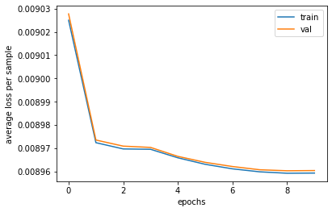
Loss function during training
Mini-batches: 100k EFT MC samples at a given value of the Wilson coefficient, plus 100k SM samples.
Four iterations per epoch
Only 10 epochs, 15 minutes
Loss function stabilises rather quickly, no learning?
Classifier cannot tell apart EFT samples from SM samples because there are no energy growing effects, simply an overall rescaling of the distribution!

Slide 8
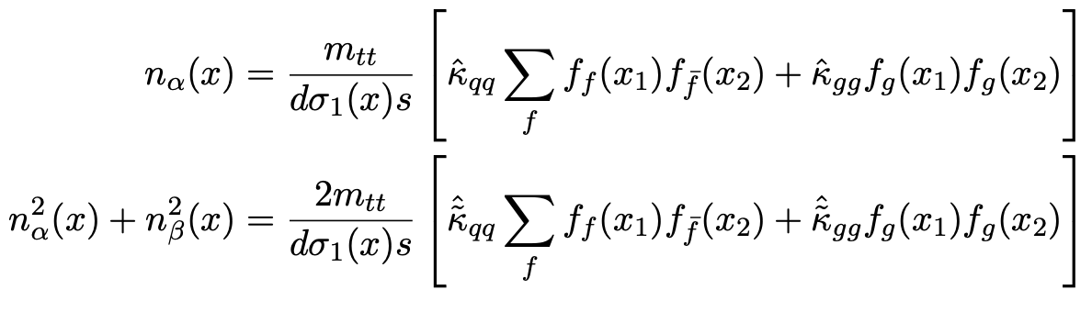
Shopping list
Generate training samples with larger values of the Wilson coefficient?
Point-by-point comparison with the analytical result to assess the performance of the classifier:
Accuracy score: given an EFT sample, what is the probability of the classifier being able to tell us so?
(See notes)

