Slide 1
Progress Report
Group 24

Slide 2
N_O_W_H_E_R_E
220 photographs
149 attributes
Some are objective
Geography
Reality
Most are subjective
Human factor
Goals
Means
My approach
Content to me

Slide 3
OUR GOAL
Interactive sequence display

Slide 4
T-SNE is a technique for dimensionality reduction that is particularly well suited for the visualization of high-dimensional datasets.
All photo are labelled with numeric annotations ➤ High dimensions
T-SNE reduces dimensions to 2
Photos can be mapped into 2-D space
Similar pictures are neighbours

Slide 5
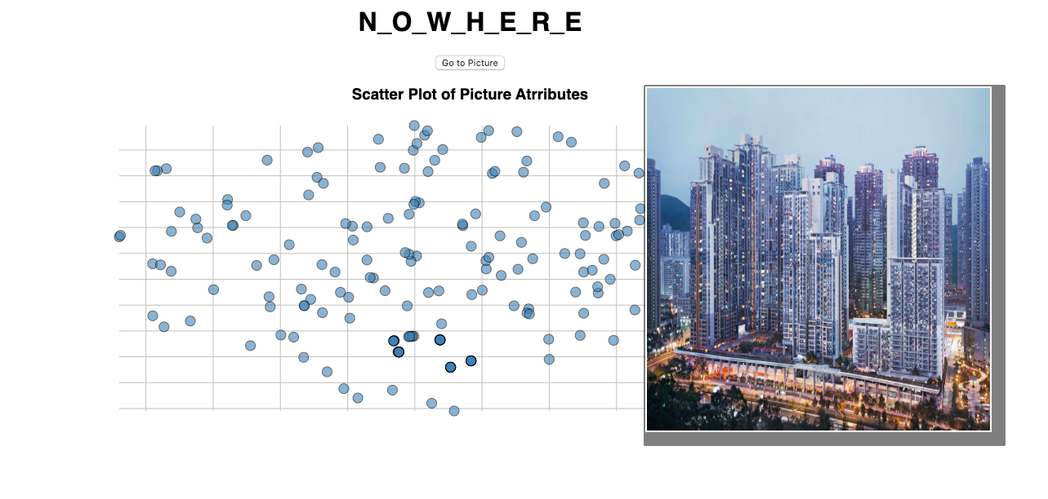


Slide 6
Final Product
Inputs to Features
Assigns image attribute values to a user’s input word or image, adding a data point.
t-SNE Mapping
Outputs a set of images close to the input, displayed in order of sorted attribute values.
React and Repeat
Users rearrange images to alter attribute values, t-SNE reproduces the modified panel.

Slide 7
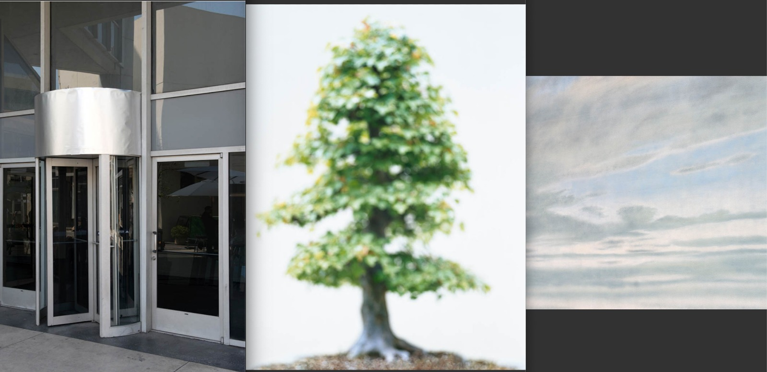
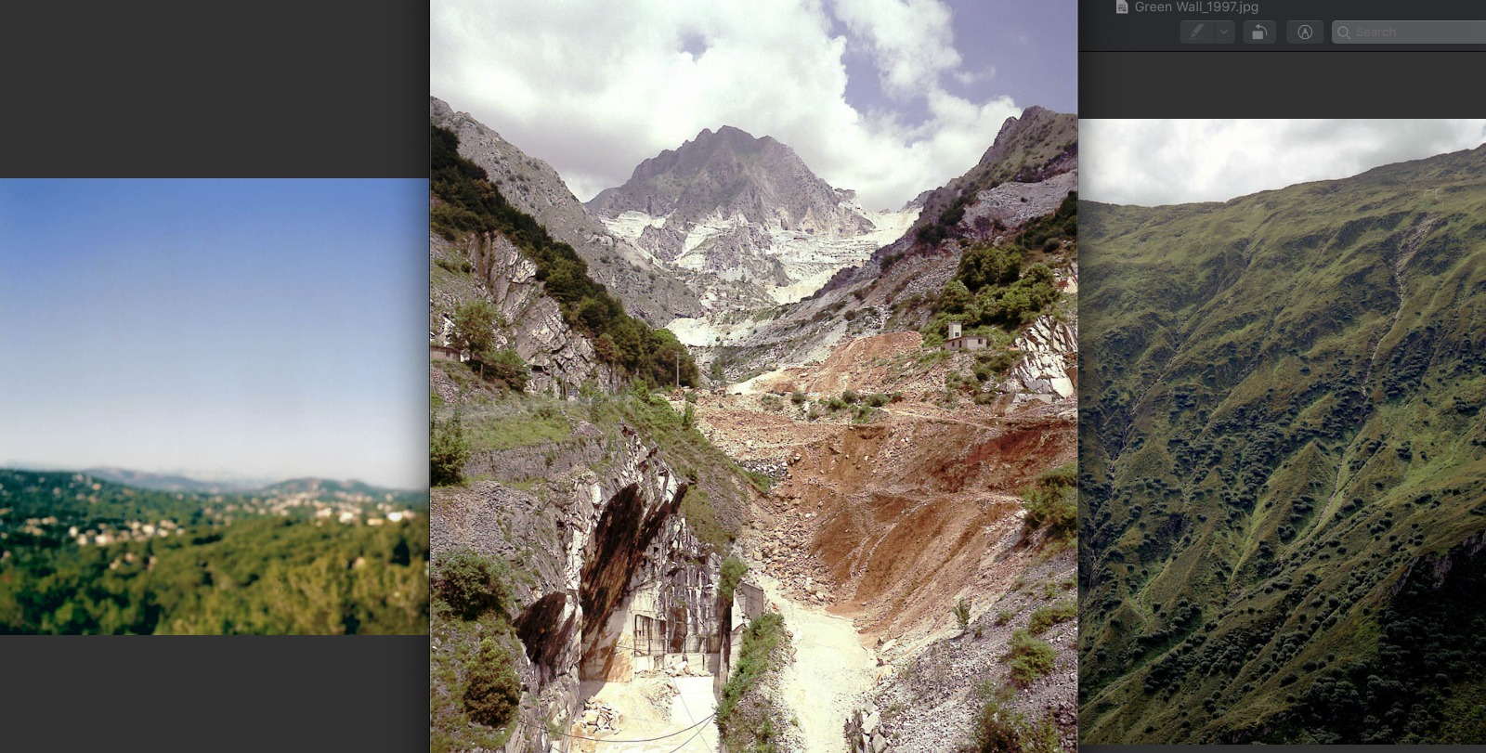
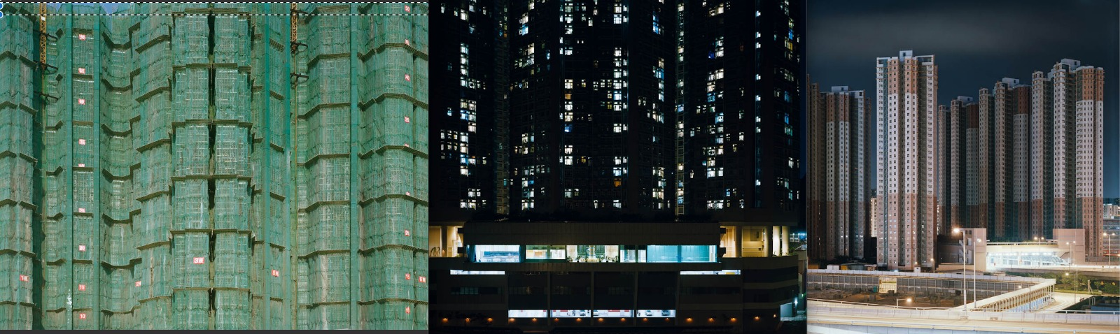

Slide 8
Going Forward
Challenges
dfdf
Going Live
ddfdfd

Slide 9
Thanks for listening!

Slide 10
Content overview
Which features have we developed so far?
How do they support our planned contributions?
What are the key challenges in the next 3 weeks?
What is the minimum set of actions for the project to go live?

Slide 11
CNN slide if it’s relevant
RESNET50 for feature extraction
1000 foods, animals and other objects recognised
What do predicted probs/classes mean?

Slide 12
Presentation design
This presentation uses the following typographies and colors:
Titles: Roboto Slab
Body copy: Muli light
You can download the fonts on these pages:
https://www.fontsquirrel.com/fonts/roboto-slab
https://www.fontsquirrel.com/fonts/muli
Lime green #dfe954 · Leaf green #9ed155 · Bottle green #50b883 Turkish blue #5fbbc5 · Teal blue #27868b · Ocean blue #266d78
You don’t need to keep this slide in your presentation. It’s only here to serve you as a design guide if you need to create new slides or download the fonts to edit the presentation in PowerPoint®

Slide 13
SlidesCarnival icons are editable shapes.
This means that you can:
Resize them without losing quality.
Change fill color and opacity.
Change line color, width and style.
Isn’t that nice? :)
Examples:

