Slide 1
Progress Report
Group 24

Slide 2
N_O_W_H_E_R_E
220 photographs
149 attributes
Some are objective
Geography
Reality
Most are subjective
Human factor
Goals
Means
My approach
Content to me

Slide 3
OUR GOAL
Interactive sequence display

Slide 4
T-SNE is a technique for dimensionality reduction that is particularly well suited for the visualization of high-dimensional datasets.
All photo are labelled with numeric annotations ➤ High dimensions
T-SNE reduces dimensions to 2
Photos can be mapped into 2-D space
Similar pictures are neighbours

Slide 5
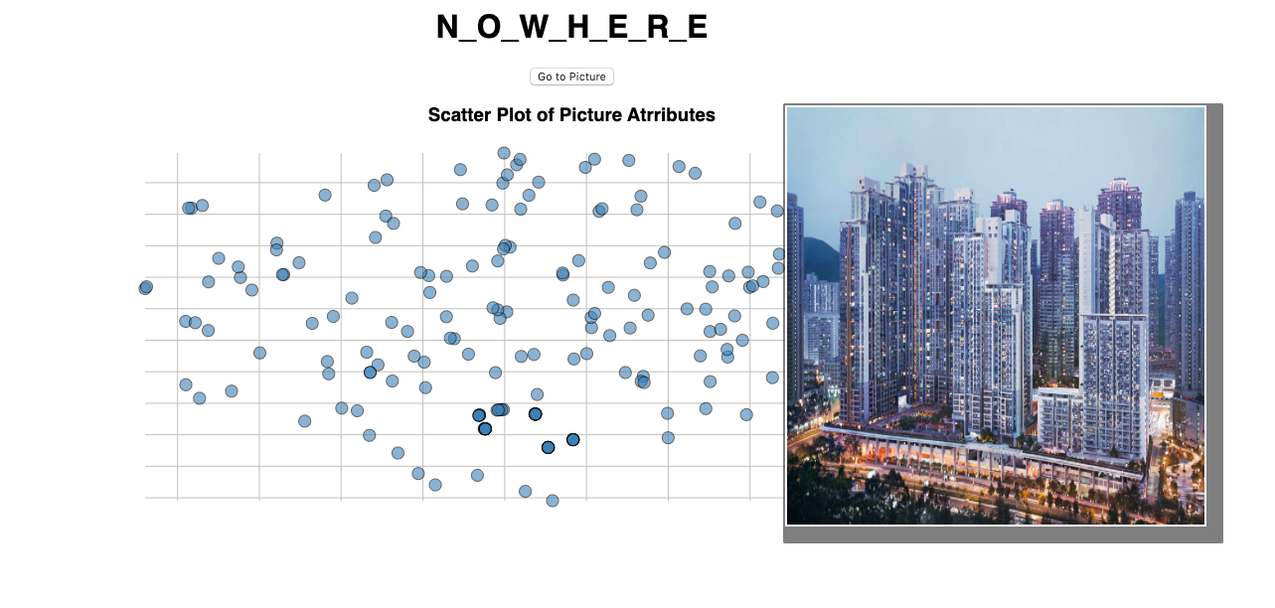


Slide 6
Final Product
Inputs to Features
Assigns image attribute values to a user’s input word or image, adding a data point.
t-SNE Mapping
Outputs a set of images close to the input, displayed in order of sorted attribute values.
React and Repeat
Users rearrange images to alter attribute values, t-SNE reproduces the modified panel.

Slide 7
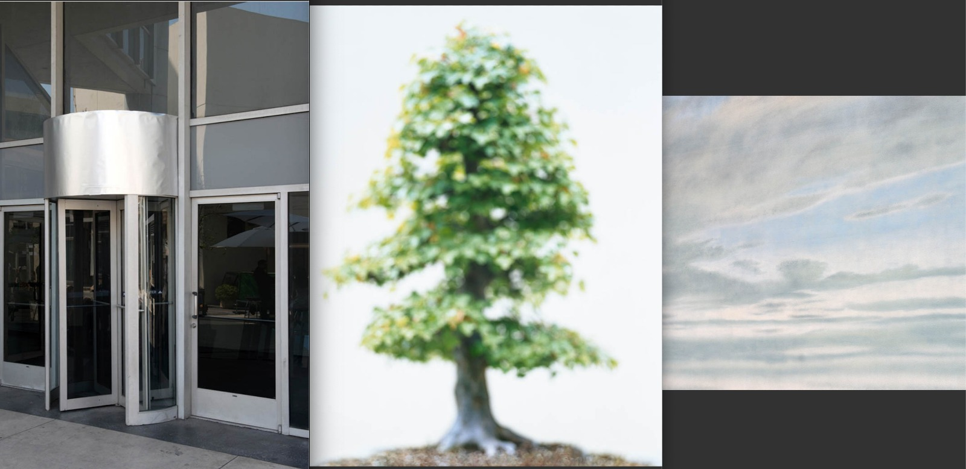
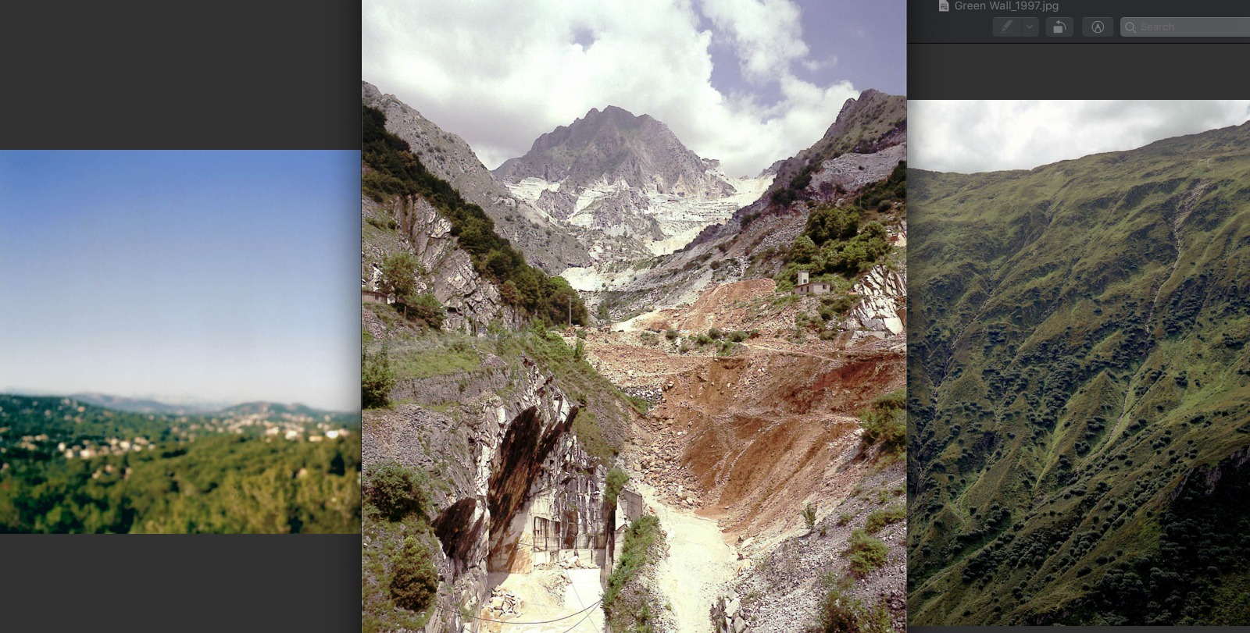
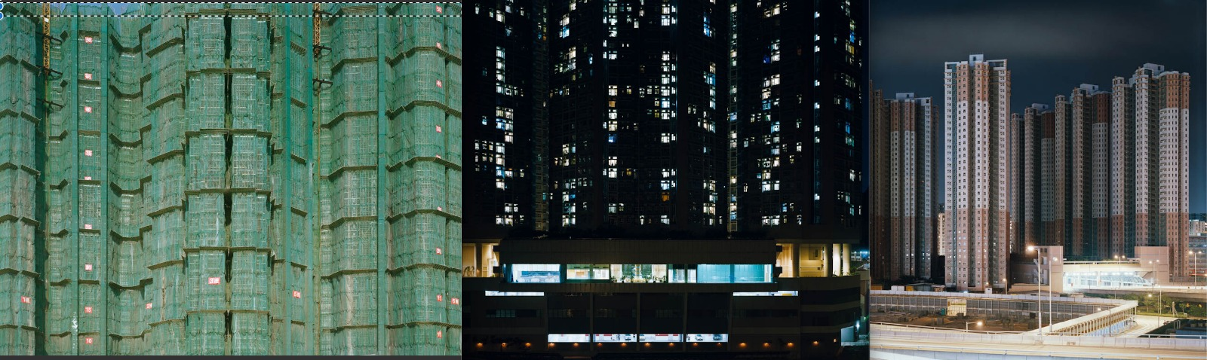

Slide 8
Going Forward
Challenges
Incorporating user input to change underlying model
Displaying sequences in a visually attractive way while still being informative
Going Live
Initial user input
photo sequence generation and display
User input changing underlying model

Slide 9
Thanks for listening!

