Slide 1
Helmet | 0.88 | 0.01
Without Helmet | 0.01 | 0.86
Background | 0.11 | 0.12
 | Helmet | Without Helmet
Class | Image | Instances
All | 966 | 2921
Without Helmet | 966 | 505
Helmet | 966 | 2416

Slide 2
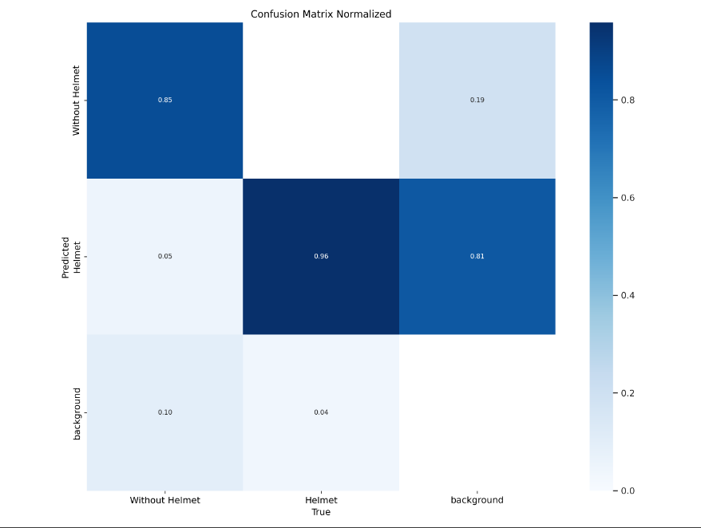

Slide 3
