Slide 1



Implementing the
segmentation technique as a plugin for the GIMP
By: Matthew Marsh
Supervisors: Prof Shaun Bangay
Mrs Adele Lobb

Slide 2
Problem statement:
The open source community require a quick, easy to use segmentation tool with matting capabilities.
Aim:
The GIMP is an open source image editing package that requires such a tool.
The GIMP allows extra tools to be added as plugins
Implement a quick, easy to use segmentation tool with matting capabilities as a plugin for the GIMP

Slide 3
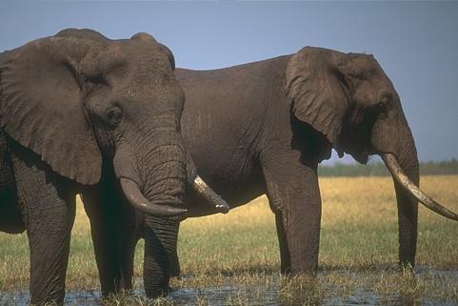
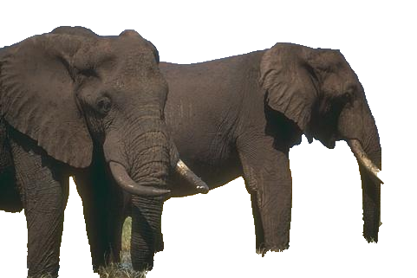
What is image segmentation?
The process of separating an image into foreground and background parts.
Foreground = object of interest
Background = the rest of the image

Slide 4
Image Segmentation Cont
Every pixel has an alpha value, which sets its opacity
Image segmentation labels all foreground pixels with a full alpha value of 1,
Background pixels labelled with a value of 0
Can cause jagged edges in finely textured objects
Matting smoothes these edges

Slide 5
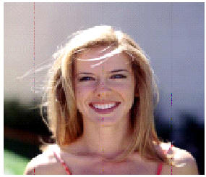
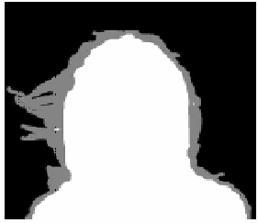
Matting
Labels pixels with alpha values between the maximum and minimum values
Creates edges which vary smoothly from background to foreground.
The image on the right is known as the alpha matte

Slide 6
How computers perform segmentation
Information encapsulated in the digital image is used to calculate the best segmentation.
Edge detection and region detection methods are most commonly used to segment images.
Boundary information is the edge information in an image which can be gained by noting the difference between the colours of nearby pixels. A large difference in colour will indicate an edge.
A region is the area enclosed by an edge, and the colours of neighbouring pixels in a region are similar.

Slide 7
“GrabCut”
Need to decide on a segmentation technique
“GrabCut” has been chosen
  Uses both region and boundary information
  Uses new graph cut technique
  Includes a method of border matting

Slide 8
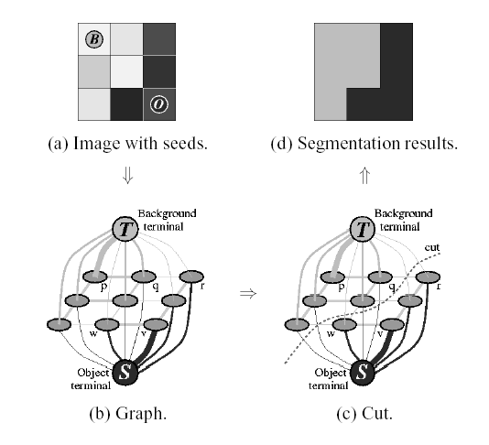
How “GrabCut” Works

Slide 9
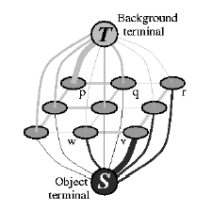
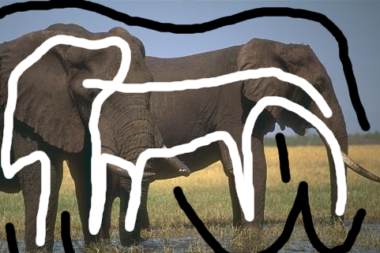
Clue Marking
Clues are used to build up region models
One model for foreground and one for background
Region models determine weights between pixel and Source and Sink nodes

Slide 10
Types of region models
3 types of region models have been developed
  Greyscale histograms
  Gaussian Mixture Models
  Colour histograms

Slide 11
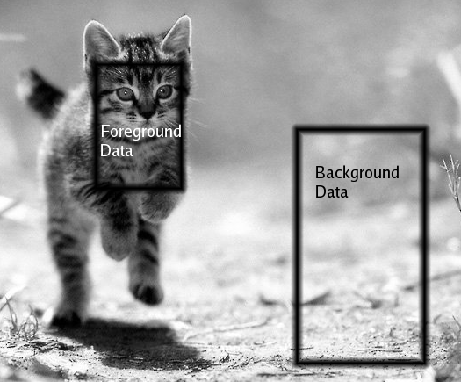
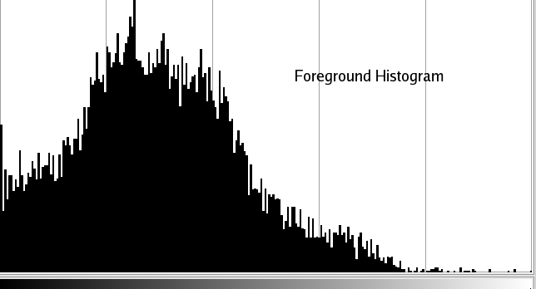
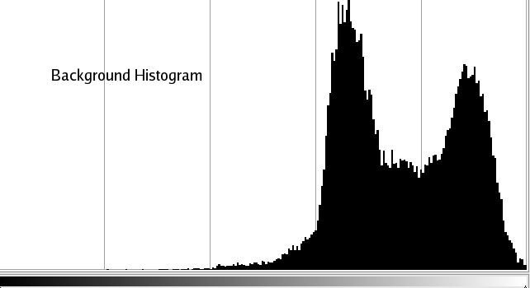
Greyscale Histograms

Slide 12
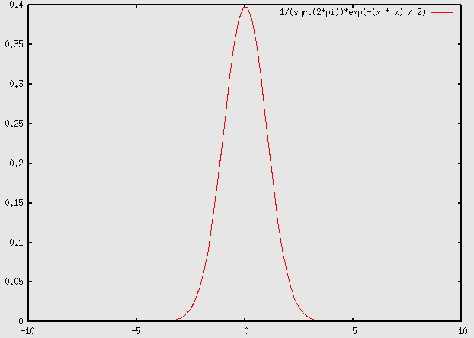
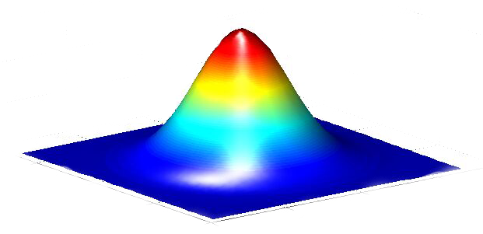
Gaussian Mixture Models
The 1D Gaussian Function
The 2D Gaussian Function

Slide 13
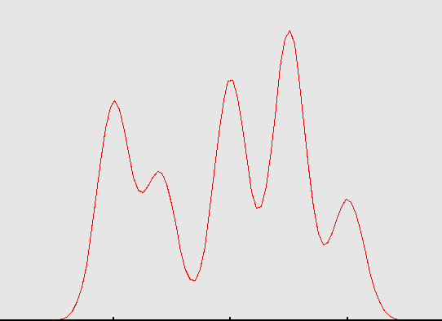
3D Gaussians
A Gaussian Mixture Model is the weighted sum of several Gaussians.
Encapsulate the concept of a colour
Each Gaussian is centred around a common colour in the image
A GMM has several common colours
In this plug-in 5 Gaussians in foreground, 5 in background

Slide 14
Colour Histograms
The sum of three histograms
One histogram for each colour channel
Thus a Red, Green and Blue histogram in RGB colour space
The probability of a pixel lying in the foreground region model is the sum of the probabilities of its red value lying in the red histogram, its blue in the blue etc.

Slide 15
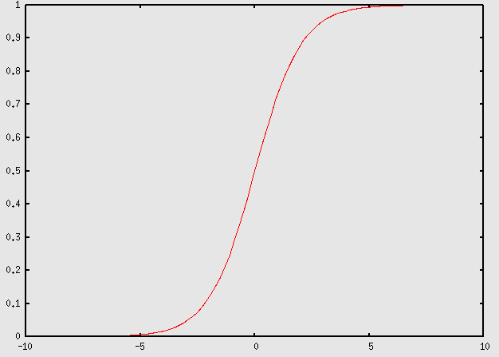
Matting Implementation
“GrabCut” adopts an approach of border matting
Assume a smooth alpha profile
Defined by the sigmoid function

Slide 16
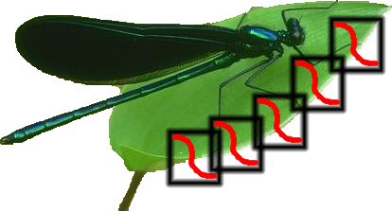
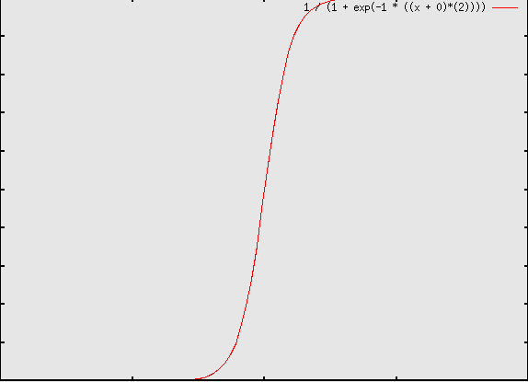
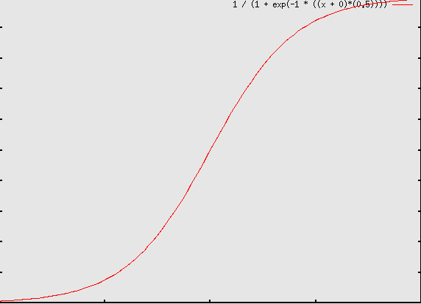
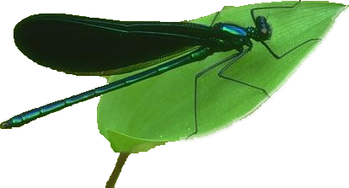
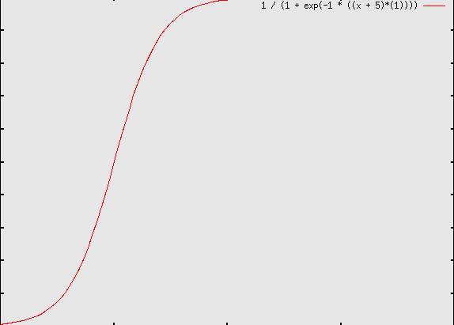
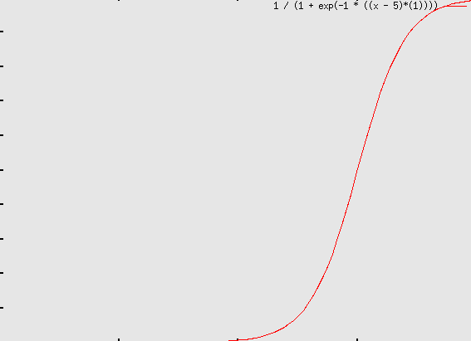
Border Matting Windows

Slide 17
Segmentation Results
Greyscale histograms proved to work well
  Implementation is fairly fast
  Results are good
GMM’s proved to be slow due to the calculation of the initial 5 Gaussians – also the initialization affected the results substantially
Colour histograms also work well, and are basically just an extension onto greyscale histograms

Slide 18
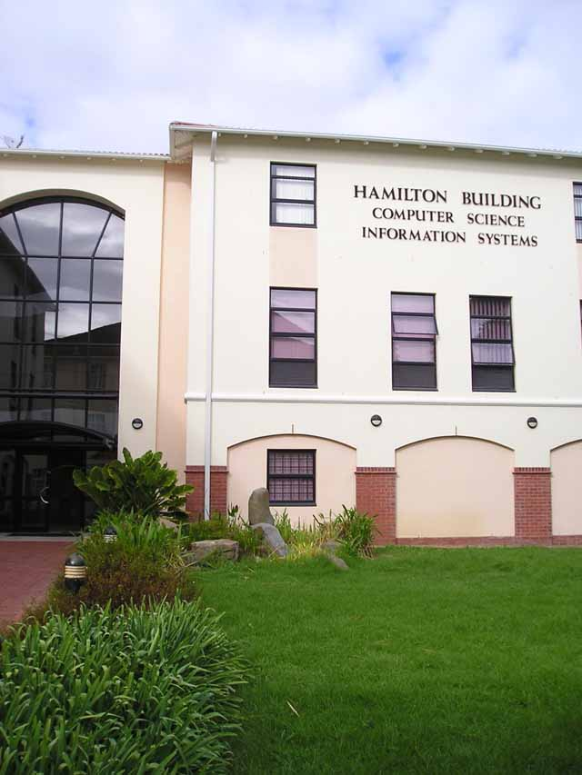
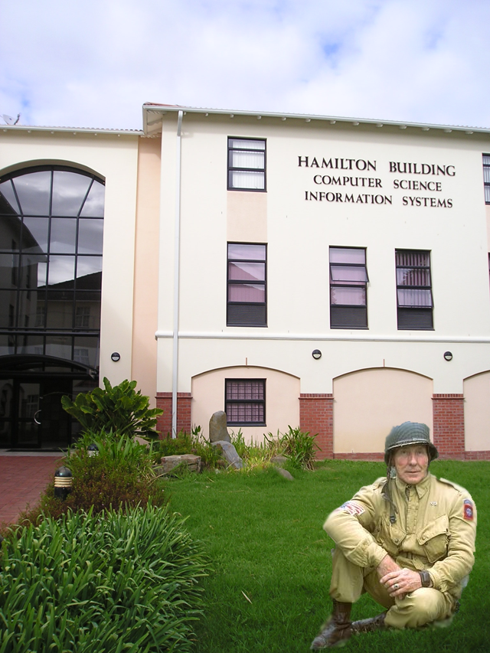
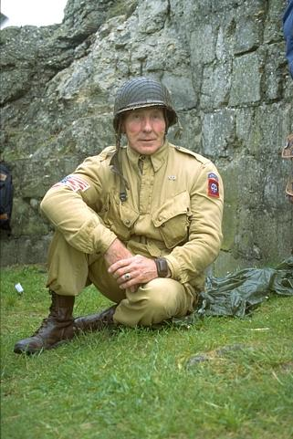
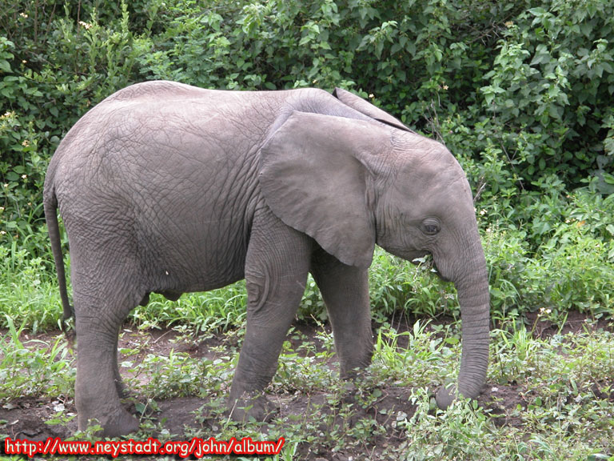
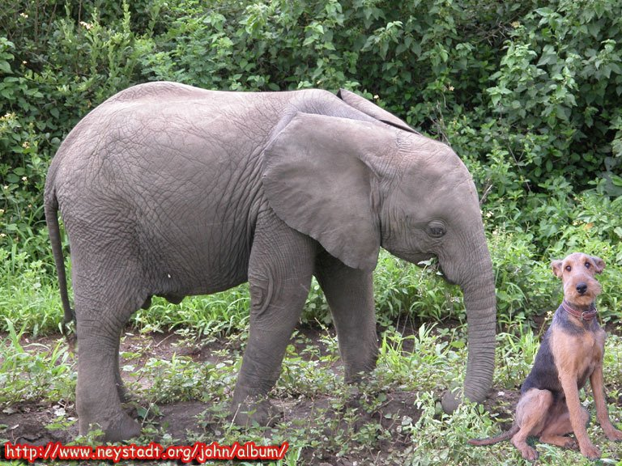
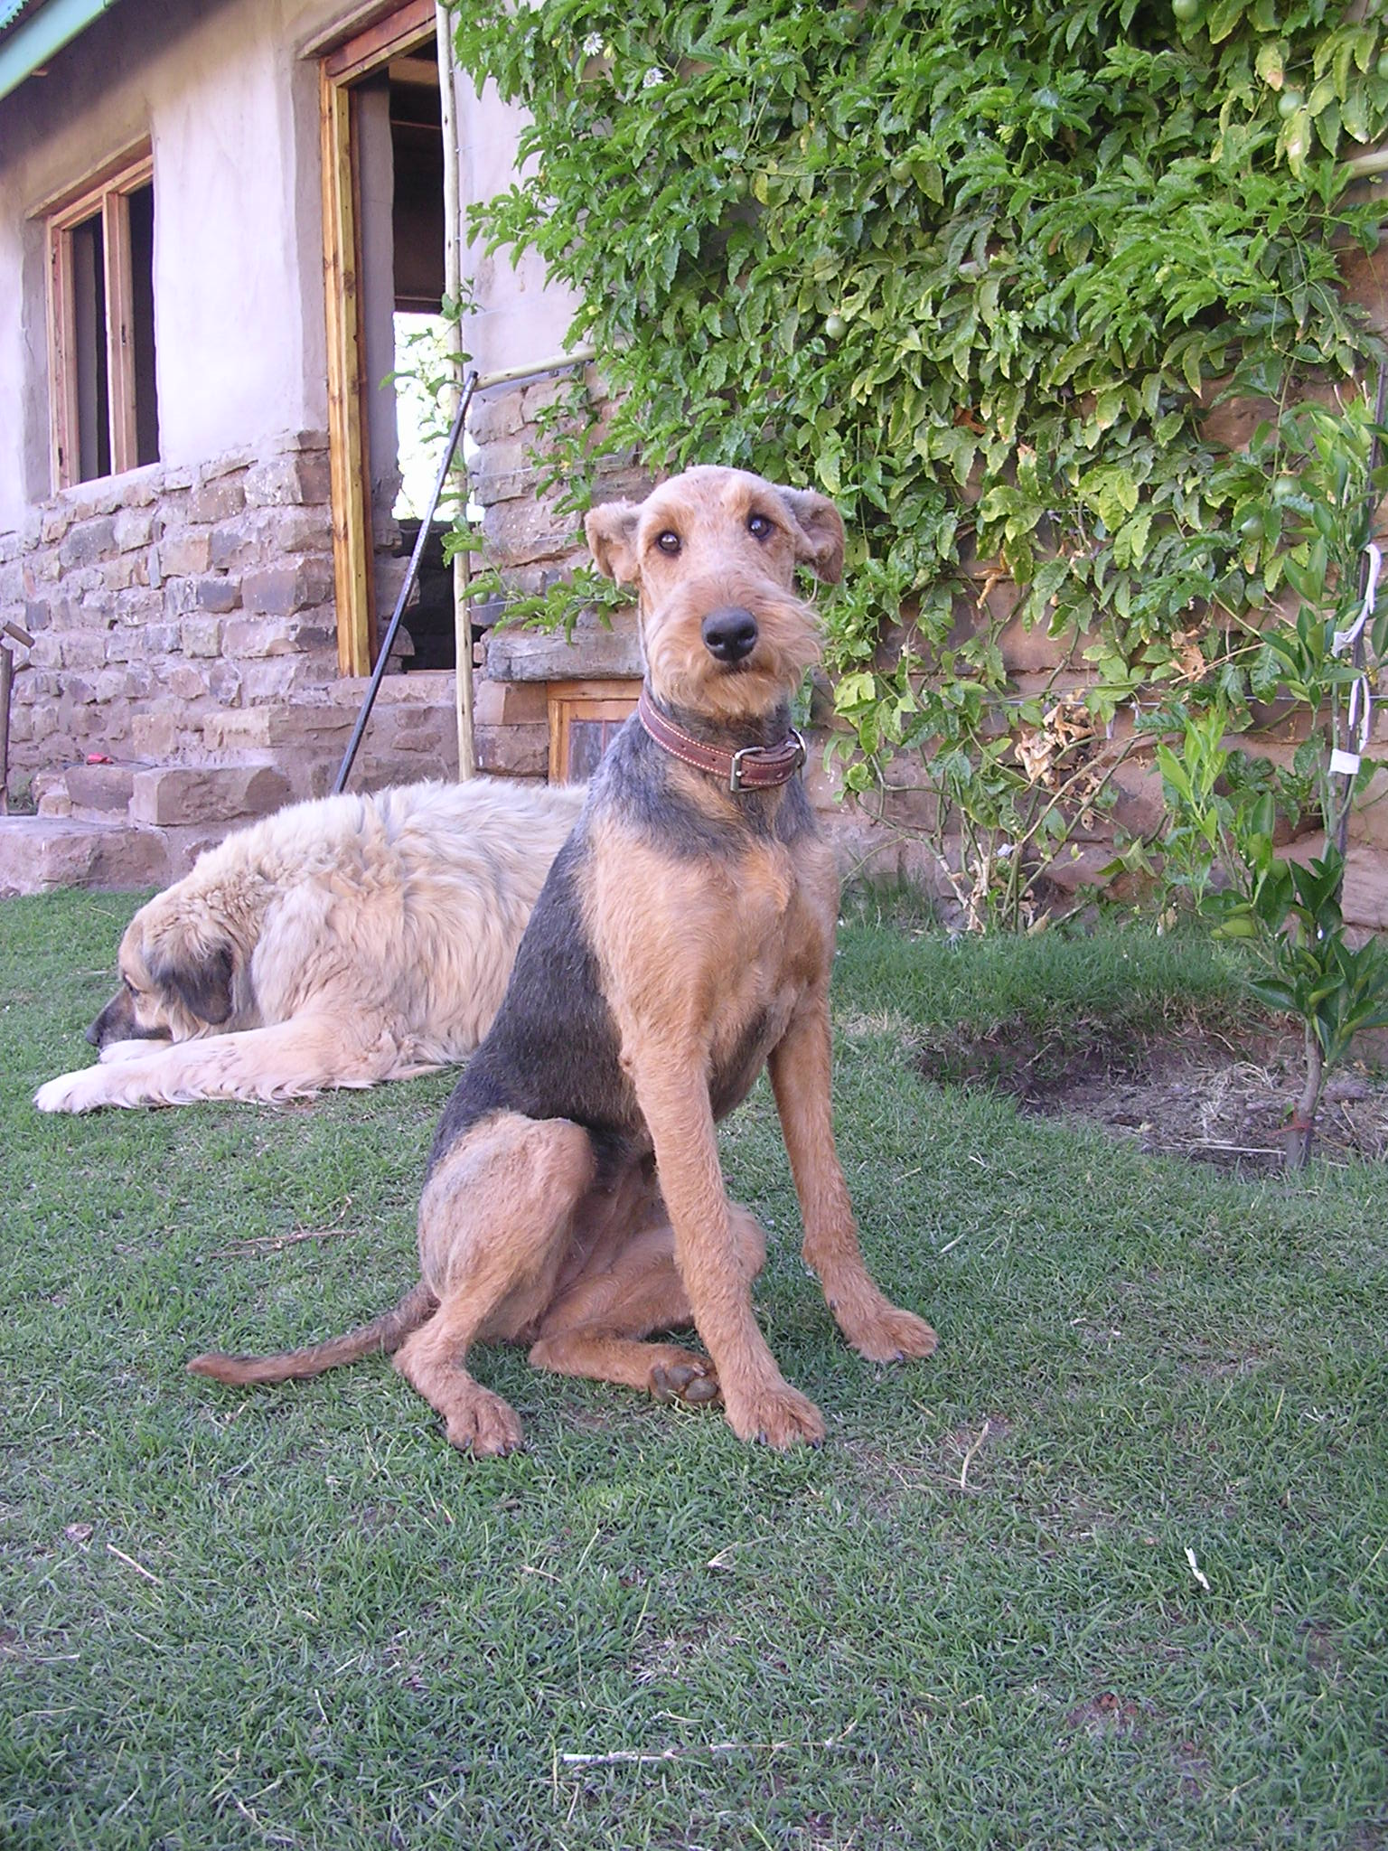
Segmentation results cont

Slide 19



Matting results
Matting significantly improved the segmentation results in most cases.
Input image
Image with matting
Image without matting

Slide 20
Conclusion
Have completed my project goal – provide open source community with a segmentation tool
Have implemented the “GrabCut” paper and tested their claims
The “GrabCut” segmentation technique is definitely usable, and produces good results.

