Slide 1
Use of SNOMED CT Compositional Grammar to Annotate Human Clinical Trials Data Elements
Kin Wah Fung, Vojtech Huser, Cynthia Burke, Minh-Diep Nguyen, Liz Amos
National Library of Medicine
National Institutes of Health
Bethesda, MD, USA
Notes:
Annotation of Research Common Data Elements Using Clinical Terminologies
Vojtech Huser, Cynthia Burke, Minh-Diep Nguyen, Liz Amos
National Library of Medicine, NIH, Bethesda, MD
Introduction
In recent years, Common Data Elements (CDEs) have been developed to unify data collection in clinical research studies. Since 2015, a CDE repository maintained by the National Library of Medicine allows retrieval of CDEs across several initiatives. With wider availability of de-identified patient-level clinical trials’ data across research studies, organizing data elements using a hierarchical system can improve ability of researchers to discover relevant data to re-use. Free text and synonym-extended search is often used to discover data elements, however using hierarchical relationships available in medical terminologies (such as Systematized Nomenclature of Medicine Clinical Terms; SNOMEDCT) may provide better search features. We present our pilot work on annotation of CDEs using a framework that is inspired by the SNOMEDCT compositional grammar (see snomed.org/scg). In addition to cross-trial data retrieval, such annotation can also help during trial design stage or in discovering overlaps across various CDE initiatives.
Methods
From an informatics and statistical perceptive, we structured all CDEs by their data type, such as boolean, date, text or number. In selecting the CDEs to analyze, we only included initiatives that in addition to individual CDEs also distribute 100 or more pre-configured case report forms (e.g.,”A questionnaire to assess migraines and headaches”). CDE initiatives that fulfilled these criteria were PROMIS, PhenX and CDEs of the National Institute of Neurological Diseases and Stroke (NINDS). We later ruled out PROMIS because their CRFs contained exclusively CDEs of value-list data type. NINDS forms were also ruled out due to ongoing development. For finding concepts, we used the official SNOMED International browser. To evaluate mapping quality, we classified CDE-SNOMEDCT_Expression mappings into classes of exact match, partial match and no match.
Preliminary Results and Conclusion
Using PhenX REDCap download option, we obtained input data on 564 forms (or possible form sections) that reflected various PhenX protocols (e.g., Sleep Apnea child protocol). These forms contained a total of 22,705 individual CDEs. In a pilot research mode, we selected the following data types: date (example: ”Date chemotherapy completed?”), boolean (example: “Are you currently in treatment for substance abuse?”) and number (example: “How old was your child when he/she completely stopped breast-feeding or being fed breast milk?”). A team of annotators annotated a total of 228 data elements. An example of an annotation would be (simplified view of the full expression): “The date the sleep disorder started?” : 298059007 Date of onset (observable entity)| + 39898005 |Sleep disorder (disorder)|. We were able to employ existing SNOMEDCT attributes within the draft concept model for observable entities (e.g., 704318007 |property type (attribute)|, or 370132008 |Scale type (attribute)|. The poster will present detailed data on exact matches identified, SNOMEDCT compositional grammar observations, and draft CDE annotation guidelines formulated by our team. The project website at https://github.com/lhncbc/CDE contains interim results for those outputs. Our pilot study suggest that CDE annotation can facilitate data discovery and CDE quality assurance. For some CDEs, we further considered ways of using the annotations to relate case report form data to observational data formatted in a common data model (e.g., the Sentinel model). For example, the annotation for the data element ‘Year inserted permanent pacemaker?’ follows a pattern that can be automatically converted into an observational data query. During the study, we have made several new concept submissions to SNOMEDCT (US content request system) with many of them accepted. We also hope to contribute to existing IHTSDO initiatives around observable entity concepts and compositional grammar. Through our participation on the NIH CDE Task Force, we hope to provide initial input for a discussion on annotation guidelines that can optionally be adopted by the CDE initiatives. Acknowledgement: This work was supported by the Intramural Research Program of National Institutes of Health, National Library of Medicine.
References
Nahm M, Shepherd J, Buzenberg A, et al. Design and implementation of an institutional case report form library. Clinical trials. 2011;8(1):94-102.

Slide 2
Routine Healthcare and Research
Observational studies are increasingly combining healthcare claims data with data collected using research Case Report Forms
AllOfUs research program will use EHR Data and healthcare claims data
Routine healthcare
SNOMED CT, LOINC, ATC, RxNorm (RxNorm Extension [outside USA drugs])
Research
Common Data Elements (CDEs)
Patient Reported Outcomes (PROs)
QUESTION:
How research data elements efforts should be related to SNOMED CT?
Notes:
Title: Use of SNOMED CT Compositional Grammar to Annotate Human Clinical Trials Data Elements
Presenter: Kin Wah Fung, National Library of Medicine, NIH
Audience
Clinical researchers, SNOMED CT content authors, SNOMED CT Compositional Grammar users, SNOMED CT users
Objectives
Introduce clinical research standardization initiatives defining research Common Data Elements (CDEs). Demonstrate examples of annotation of research data using SNOMED CT terms and SNOMED CT Compositional Grammar.
Abstract
SNOMED CT is a clinical terminology that allows data standardization predominantly in the context of routine health care delivery. In light of greater adoption of standards to exchange routine health care data, several analogous efforts are emerging for data collection in human clinical interventional trials or observational studies under the umbrella of research Common Data Elements (CDEs). Examples of CDE initiatives are PhenX toolkit or Patient-Reported Outcomes Measurement Information System (PROMIS). Research data elements are typically out of scope for inclusion in SNOMED CT due to predominantly research use context; however, in some cases, may contain overlapping concepts (clinical researchers use the term data element). An example of a research CDE is: “Form: PhenX female reproductive history; Question: On what date did the 2nd pregnancy end?”) Since 2015, a CDE repository maintained by the National Library of Medicine allows retrieval of CDEs across 12 CDE initiatives. With wider availability of de-identified patient-level clinical trials’ data (via newly emerging trial results platforms, such as Data Share by National Institute of Drug Abuse), organizing research CDEs by annotation with SNOMED CT concepts can improve ability of researchers to discover relevant data to re-use. We present our pilot work on annotation of CDEs using a framework that is inspired by the SNOMED CT compositional grammar.[1] Methods: In a pilot mode, we annotated thee sources of research CDEs: (1) PhenX data elements developed by two institutes at US National Institutes of Health (NIH) with 564 forms and 22705 elements; (2) CRF library published by Elli Lilly with 914 forms and 28310 elements; and (3) a subset of REDCap Consortium library with 10 forms and 879 elements). From an informatics and statistical perceptive, we structured all CDEs by their data type, such as boolean, date, text or number. To evaluate mapping quality, we classified mapping between the CDE and SNOMED CT Expression into classes of exact match, partial match and no match. Preliminary results: As of May 2017, three experts annotated 786 CDEs using SNOMED CT, made several new concept submissions (accepted) and produced draft guidelines for CDE annotation using SNOMED CT. Our poster presentation will present data on match accuracy and strengths and limitations of SNOMED CT compositional grammar identified. Co-authors: Vojtech Huser, Cynthia Burke, Minh-Diep Nguyen
References
CDE Annotation project repository. https://github.com/lhncbc/CDE
References
SNOMED International Event web page http://www.snomed.org/participate/attend-our-events/snomed-ct-expo
RESULTS : writing it nowdsf
Please follow these instructions carefully:
Limit the abstract, including references and all the other sections to ONE page.
Replace the text after “Title:” above with the title of your presentation.
Replace the text after “Presenter:” above with the presenter details.
Replace the text under the heading “Audience” with a short description of group(s) or people who will be most interested in your presentation. Please limit this section to no more than two lines of text.
Replace the text under the heading “Objectives” with a short description of the learning objectives of your presentation. Please limit this section to no more than three lines of text.
Replace this text, under the heading “Abstract”, with the text of the abstract of your presentation.
Either
Replace the example reference under the “References” heading below with your references; or
Delete the “References” heading and the text below it if no references are required.
Do not change page or paragraph formatting.
Do not change the heading text and do not add any additional subheadings.
Do not any add or change or apply any styles other than those used in this document.
Do change font size, color, or other characteristics except as follows:
Use italics or underline for emphasis, if required.
Do not use bold text.
Do not include any graphics or tables in your abstract.
Hyperlinks may be used, but only in the references section and with the link showing in plain text.
All references to SNOMED Clinical Terms should refer to “SNOMED Clinical Terms” or “SNOMED CT”. DO NOT use other forms like: “SNOMED-CT” (avoid the hyphen), “SCT” (not a valid abbreviation).
When you have completed your proposal, to submit it please do the following:
Complete this short online form: https://goo.gl/forms/rVNqMCb6WsZkgNzl1
Send your completed abstract document via email to: snomedctexpo@snomed.org
Thank you.

Slide 3
Standardizing data collection in research studies
Data standardization for submission to regulatory authorities (FDA, EMA, JPMC)
CDISC standards and CDISC Controlled Terminology (since early 2000s)
Since 2010s: emergence of Common Data Elements initiatives
Standardize data for any study (not just for studies undergoing regulatory submissions)
Common Data Element = data element common to multiple sets across different studies
Fixed representation of a variable to be collected within a particular analytic of clinical domain
Consists of a precisely defined question and a specified format or set of permissible values for responses (answers)
Defined unambiguously in human and machine-computable terms
Sets of CDEs can be combined into more complex questionnaires, survey instruments, and case report forms

Slide 4
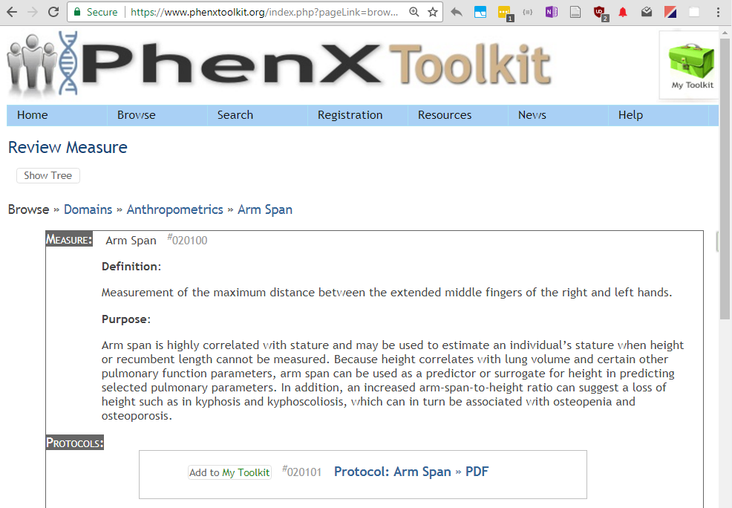
CDE initiative example: PhenX
Notes:
Webiste shown
PhenX was established in September 2007
It contains over 20k data elements and also provides groups of related CDE (called PhenX protocols) (over 900 of those)
It started as an initiative driven by researchers doing genomic studies but later expanded into other domains of medicine
What is show is once data element (Arm Span) with a definition and link the protocol (or form) where this data element is collected.

Slide 5





Challenges in developing research data elements
Overlap of research data element initiatives
Each research group (e.g., cancer, behavioral researchers) may have a separate initiative
Discovering existing defined research data elements is challenging for investigators (reliance of simple text search)
Portals: https://cde.nlm.nih.gov or https://medical-data-models.org
Researchers may not be intimately familiar with routine healthcare terminologies (e.g., SNOMED CT)
overlap of research data elements with terminologies; duplication
TA …

Slide 6
Possible solution: Annotate CDEs using SNOMED CT
Discover overlapping (or related) research data elements
Note there are three levels for annotation
Case Report Form
Case Report Form Question
Case Report Form Answer
Improve discoverability of research data elements - improve search
Demonstrate utility of routine healthcare terminologies (e.g., SNOMED CT) to researchers → (bring closer research and routine healthcare EHR data)
Assess the feasibility of using SNOMED CT Compositional Grammar to support the annotation
Extend SNOMED CT Compositional Grammar
it has known limitations
Notes:
e.g. epilepsy history form (form level example)

Slide 7
Methods
Source of CDEs:
PhenX data elements - 564 forms and 22705 elements
developed by two institutes at US National Institutes of Health (NIH)
CRF library published by Elli Lilly - 914 forms and 28310 elements
subset of REDCap Consortium library - 10 forms and 879 elements.
Separate annotation subtasks structured by CDE data type
such as boolean, date, text, number, pick-list question (radiobutton/checkbox)
Pilot experiment/ feasibility assessment
source #1 (PhenX) + convenience sample of CDEs for each data type

Slide 8
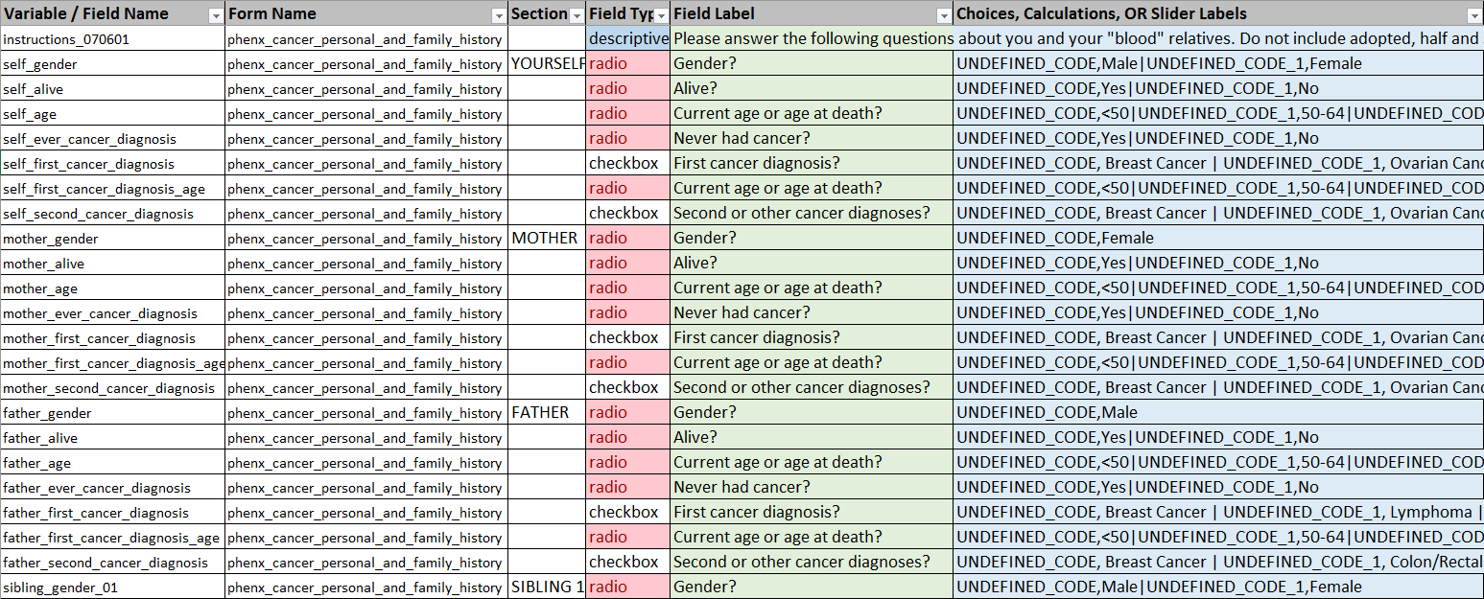
CDE Input data (PhenX, RedCAP .CSV format) Cancer Personal and Family History
Notes:
One form is shown
Green and blue columns are the most important (green question and blue – choices (if applicable)
To semanticly fully understand a given question (CDE), you need to take context into account (what is the form it is on, and what is the section)

Slide 9
Methods
Three annotators
One with SNOMED CT training (Foundation, Implementation, Content Development)
Two with no prior SNOMED CT experience (internal training provided for the project)
Feasibility pilot study
First identify SNOMED CT concepts
by simply enumerating terms linked to a give CDE
Construct SNOMED CT expression later
Identify level of match (exact, partial-high, partial-low, no match/complex/out of scope)
Expectation setting: “lessons learned” type of results (not final quantitative numbers)
Cloud based spreadsheet document (with limitations and challenges)
Ideal system would be a web-based system with user friendly searching and entering SCT terms
Notes:
librarians

Slide 10
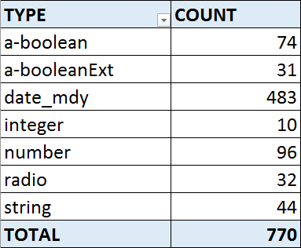
Results: Annotations made (Question level)
By data type
Convenience sample
ideally we would have CDE’s usage data
Data available on project website (GitHub repository)
https://github.com/lhncbc/CDE/tree/master/annotation

Slide 11
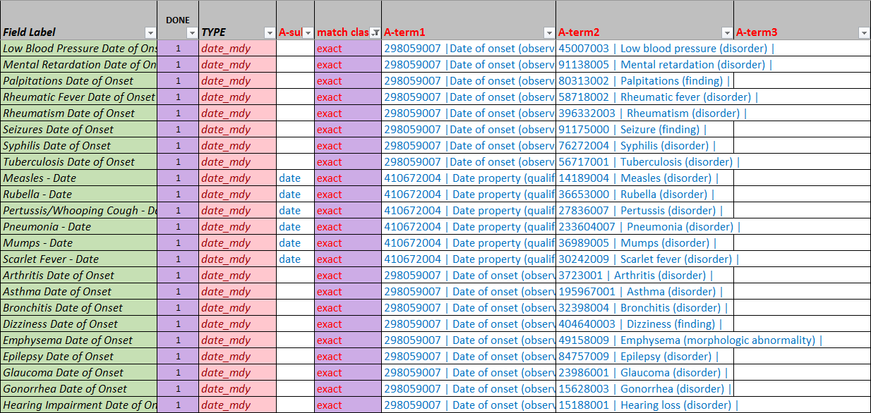
Annotation (Entering Related Concepts) on Question level
Notes:
Gathering terms for SNOMED CT expression – three right columns with SNOMED terms

Slide 12
Postcoordination
Research data elements can be very detailed and granular
Challenge: When an element is too complex to model using SNOMED CT?
SNOMED CT expressions are needed
Example:
68526006|removal of device from abdomen|:425391005|using access device|= 6174004|laparoscope|
https://confluence.ihtsdotools.org/display/DOCSTART/7.+SNOMED+CT+Expressions
Expressions must follow concept model
most relevant is Observable Entity; a chosen model may undergo revisions
Alternatives to postcoordination
Expression repository (for research data elements)
Information model postcoordination
We are considering that for some elements or element groups
Similar to defining ”CDE concept model”
Also considering limitations of the SNOMED CT Compositional grammar (extension?)

Slide 13
Results: Example 1
Simple term
Form: phenx_personal_history_of_allergies_infectious_dis
Question: Gonorrhea Date of Onset
Annotation terms
15628003 | Gonorrhea (disorder) |
298059007 | Date of onset (observable entity) |

Slide 14
Results: Example 2
Form: phenx_peripheral_arterial_disease
Question: Measure systolic blood pressure of: Left dorsalis pedis artery (mm Hg)
Annotation terms
445731001 |Dorsalis pedis arterial pressure (observable entity)|
259018001 |Millimeter of mercury (qualifier value)|
7771000 |Left (qualifier value)|
259018001 |Millimeter of mercury (qualifier value)|
SNOMED CT Expression (using SNOMED CT compositional grammar)
363787002 | Observable entity (observable entity) | : 118598001 | Measurement property | = 72313002 | Systolic arterial pressure (obs. entity)|, 704327008 | Direct site (attribute) | = ( 86547008 | Structure of dorsalis pedis artery (body structure) | : 272741003 | Laterality (attribute) | = 7771000 | Left (qualifier value) |), 246514001 | Units (attribute) | = 259018001 |Millimeter of mercury (qualifier value)|

Slide 15
List of Examples
Using syntax Form: Question
Listed in the order of increasing complexity
phenx_spirometry: Date
phenx_spirometry: Date of birth
phenx_medical_history: Hemodialysis Date of Onset
phenx_knee_height: Knee Height 3
phenx_hip_circumference: Hip Circumference measured in centimeter, first measurement
phenx_arrhythmia_atrial_and_ventricular Year inserted permanent pacemaker.
phenx_smoking_quit_attempts: Are you considering quitting smoking during the next 6 months?
ninds_mutation_analysis: Are there additional genes sequenced with no mutations detected? (Yes/No)
phenx_body_composition_suprailiac_skinfold_thickness: Was a caliper placed perpendicular to the skinfold, which should have been sloping downward and forward at a 45 degree angle extending toward the pubis symphysis, about 2.0 cm medial to the fingers?
Notes:
Last two examples demostrare our “out of scope” category

Slide 16
Results: Example 3
Question mapping vs. question+answer mapping
On the answer level, the mapping can be more accurate
Form: Screening NCI Standard Template:
Question: Does the participant meet all screening criteria? (Yes/No)
Answer: No:
444734003 |Does not meet eligibility criteria for clinical trial (finding)|
Answer: Yes
399223003 |Patient eligible for clinical trial (finding)|
Notes:
No term for screening criteria question (research process question (as opposed to a numerical result about bodily measurement) (or amount of alcohol consumption (scale-based lifestyle question)

Slide 17
Permissible Values (Answers) Annotation
Checklist and radiobutton research data elements enumerate list of possible answers
Example:
Alcohol Use Disorders Identification Test (AUDIT) (Interview Version): 3. How often do you have six or more drinks on one occasion?
Never; Less than monthly; Monthly; Weekly; Daily or almost daily (permissible values)
Smaller set of terms to annotate (n=6336 unique answer terms in PhenX pick-list questions)
Very common terms
Yes, No, Often, Rarely, True, False, Daily, 1, 2, 3, Don't Know/Refused, Never
Scale terms
Extremely Important, Quite Important, Quite Unimportant, Somewhat Important, Somewhat Unimportant
Agree strongly, agree somewhat, disagree somewhat, disagree strongly
Other terms
Bleeding from probing detected, No evidence of bleeding, Talking on phone, Tennis, Travel by bicycling, Discrete pitting of the enamel exists
Notes:
For purpose of form validation, it makes sense to look at answers in isolation

Slide 18
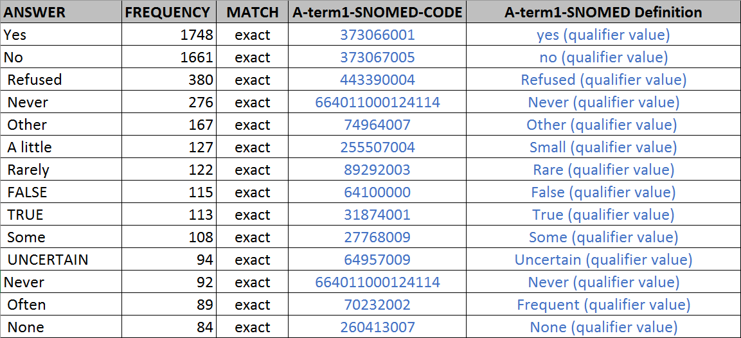
Exact Matches for Permissible Values
Notes:
While some can be matched nicely to a qualifier value, other answers would not be present in SCT

Slide 19
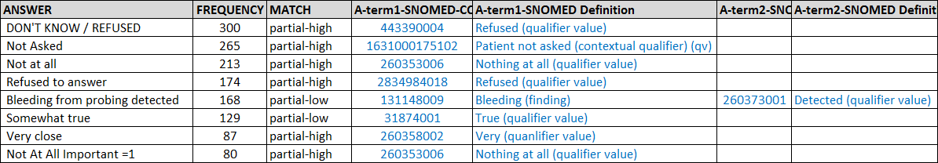
Partial Matches for Permissible Values
Notes:
Clearly not everthing should in SNOMED
And research is somewhat fine-grained (for lifestyle or diet)

Slide 20
Lessons Learned
Annotation requires significant SNOMED CT training and annotation guidelines (we are drafting those)
E.g., how to deal with misclassified data types; flavors of null (in pick-list questions)
Determining type of match is challenging
completed only for 191 elements out of 770 (24%);
preliminary results; not ready for presentation
2007 study in JAMIA (Andrew et al.) found poor agreement of 3 annotators (data annotation)
Working categories: Exact, Partial (low/high later scrapped), No-match (+ Complex/Out of scope)
In formal maps it would correspond to CorrelationIds (e.g., LOINC map)
447557004 |exact match from SCT to target|
447559001 |broad to narrow map from SCT to target| (CDE is narrower than SCT expression)
Notes:
Add examples of partial match
https://confluence.ihtsdotools.org/questions/42406452/is-there-a-snomed-ct-concept-id-expander-api-or-library
TODO sync the match classes with the slide in methods

Slide 21
Lessons Learned
Lack of software tools for working with SNOMED CT expressions
Learn from LOINC map (expression expander)
E.g., what is 363787002: 370134009=123029007,704327008=258459007, 704318007= 118556004, 246093002=273948005,370132008=30766002, 704319004=31773000
Expression builder
Load and validate concept model rules (ongoing effort around Machine Readable Concept Model)
Expression checker
Web version no longer available
Only as application download + install
https://github.com/ldthomas/apg-js2
Helpful advice obtained from community
https://confluence.ihtsdotools.org/questions
Notes:
Add examples of partial match
https://confluence.ihtsdotools.org/questions/42406452/is-there-a-snomed-ct-concept-id-expander-api-or-library
TODO sync the match classes with the slide in methods

Slide 22
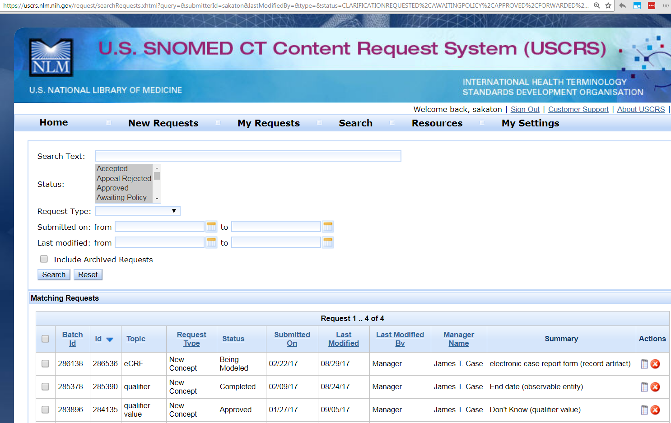
Value to SNOMED CT: New Requests
Examples of accepted terms
Electronic case report form
Arm Span
Examples of terms in Clarification status (International edition)
Don’t know (qualifier value)

Slide 23
Conclusion and Future work
Pilot effort to relate research data elements with SNOMED CT using compositional grammar
Research data elements provide a use case (rather extreme use case) for creating SNOMED CT Expressions
Future work
Prioritize mapping of research data elements that have usage data linked to them
elements used in at least 2 studies shared via a data sharing platform
Annotations can be used to pre-populate research Case Report Forms from EHR data
E.g., Date permanent pacemaker was implanted
Notes:
TODO2

Slide 24
Questions
Vojtech Huser
vojtech.huser@nih.gov
Project repository
https://github.com/lhncbc/CDE

