Slide 1
Representation
Changhe Tu
Shandong University

Slide 2
Objectives
Introduce concepts such as dimension and basis
Introduce coordinate systems for representing vectors spaces and frames for representing affine spaces
Discuss change of frames and bases
Introduce homogeneous coordinates

Slide 3
Linear Independence
A set of vectors v₁, v₂, …, v_{n} is linearly independent if
α₁v₁+α₂v₂+.. α_{n}v_{n}=0 iff α₁=α₂=…=0
If a set of vectors is linearly independent, we cannot represent one in terms of the others
If a set of vectors is linearly dependent, at least one can be written in terms of the others

Slide 4
Dimension
In a vector space, the maximum number of linearly independent vectors is fixed and is called the dimension of the space
In an n-dimensional space, any set of n linearly independent vectors form a basis for the space
Given a basis v₁, v₂,…., v_{n}, any vector v can be written as
v=α₁v₁+ α₂v₂ +….+α_{n}v_{n}
where the {α_{i}} are unique

Slide 5
Representation
Until now we have been able to work with geometric entities without using any frame of reference, such as a coordinate system
Need a frame of reference to relate points and objects to our physical world.
  For example, where is a point? Can’t answer without a reference system
  World coordinates
  Camera coordinates

Slide 6
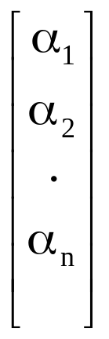
Coordinate Systems
Consider a basis v₁, v₂,…., v_{n}
A vector is written v=α₁v₁+ α₂v₂ +….+α_{n}v_{n}
The list of scalars {α₁, α₂, …. α_{n}}is the representation of v with respect to the given basis
We can write the representation as a row or column array of scalars
a=[α₁ α₂ …. α_{n}]^{T}=

Slide 7
Example
v=2v₁+3v₂-4v₃
a=[2 3 –4]^{T}
Note that this representation is with respect to a particular basis
For example, in OpenGL we start by representing vectors using the object basis but later the system needs a representation in terms of the camera or eye basis

Slide 8
Coordinate Systems
Which is correct?
Both are because vectors have no fixed location
v
v

Slide 9
Frames
A coordinate system is insufficient to represent points
If we work in an affine space we can add a single point, the origin, to the basis vectors to form a frame
v₂
v₁
P₀
v₃

Slide 10
Representation in a Frame
Frame determined by (P₀, v₁, v₂, v₃)
Within this frame, every vector can be written as
v=α₁v₁+ α₂v₂ +….+α_{n}v_{n}
Every point can be written as
P = P₀ + β₁v₁+ β₂v₂ +….+β_{n}v_{n}

Slide 11
Confusing Points and Vectors
Consider the point and the vector
P = P₀ + β₁v₁+ β₂v₂ +….+β_{n}v_{n}
v=α₁v₁+ α₂v₂ +….+α_{n}v_{n}
They appear to have the similar representations
p=[β₁ β₂ β₃] v=[α₁ α₂ α₃]
which confuses the point with the vector
A vector has no position
v
p
v
Vector can be placed anywhere
point: fixed

Slide 12
A Single Representation
If we define 0•P = 0 and 1•P =P then we can write
v=α₁v₁+ α₂v₂ +α₃v₃ = [α₁ α₂ α₃ 0 ] [v₁ v₂ v₃ P₀] ^{T}
P = P₀ + β₁v₁+ β₂v₂ +β₃v₃= [β₁ β₂ β₃ 1 ] [v₁ v₂ v₃ P₀] ^{T}
Thus we obtain the four-dimensional homogeneous coordinate representation
v = [α₁ α₂ α₃ 0 ] ^{T}
p = [β₁ β₂ β₃ 1 ] ^{T}

Slide 13
Homogeneous Coordinates and Computer Graphics
Homogeneous coordinates are key to all computer graphics systems
  All standard transformations (rotation, translation, scaling) can be implemented with matrix multiplications using 4 x 4 matrices
  Hardware pipeline works with 4 dimensional representations
  For orthographic viewing, we can maintain w=0 for vectors and w=1 for points
  For perspective we need a perspective division

Slide 14
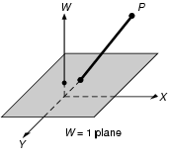
Homogeneous Coordinates
In homogeneous coordinates, we add a third coordinate to a point. (x,y) → (x,y,W)
Points (x,y,W) and (tx,ty,tW), in which t<>0, represent a same point, like(2,3,6) and (4,6,12), at least one of x, y, W is non-zero.
Each homogeneous point represents a line in 3-space, but the line not contain (0,0,0).
The figure shows us the XYW homogeneous coordinate space, with the W=1 plane and point P(X,Y,W) projected onto the W=1 plane
(x,y) → (x,y,w) ?
(x,y,w) → (x,y)
Lecture-3

Slide 15
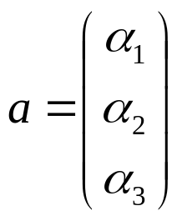
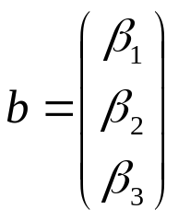
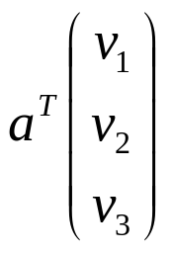
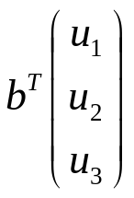
Change of Coordinate Systems
Consider two representations of a the same vector with respect to two different bases. The representations are
and
w=α₁v₁+ α₂v₂ +α₃v₃ =
=β₁u₁+ β₂u₂ +β₃u₃ =

Slide 16
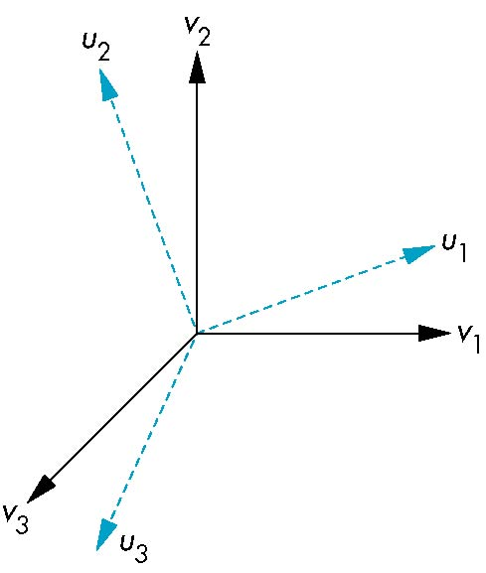

Representing second basis in terms of first
Each of the basis vectors, u1,u2, u3, are vectors that can be represented in terms of the first basis
u₁ = γ₁₁v₁+γ₁₂v₂+γ₁₃v₃
u₂ = γ₂₁v₁+γ₂₂v₂+γ₂₃v₃
u₃ = γ₃₁v₁+γ₃₂v₂+γ₃₃v₃

Slide 17
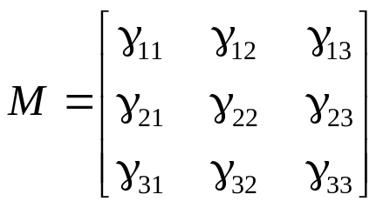
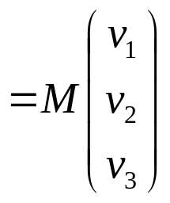
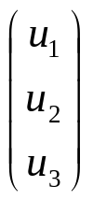
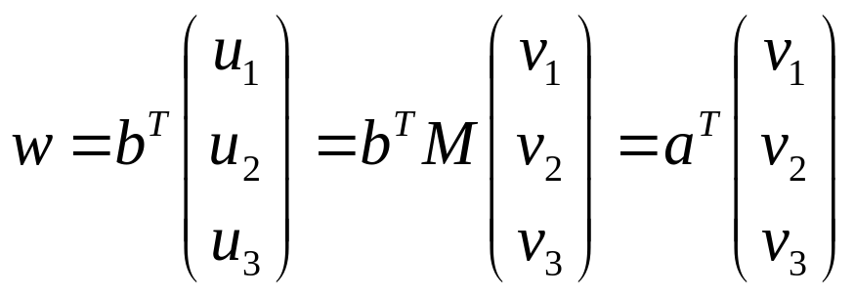

Matrix Form
The coefficients define a 3 x 3 matrix
and the bases can be related by
then

Slide 18
Change of Frames
We can apply a similar process in homogeneous coordinates to the representations of both points and vectors
Any point or vector can be represented in either frame
We can represent Q₀, u₁, u₂, u₃ in terms of P₀, v₁, v₂, v₃
u₂
u₁
v₂
Consider two frames:
(P₀, v₁, v₂, v₃)
(Q₀, u₁, u₂, u₃)
Q₀
P₀
v₁
u₃
v₃

Slide 19
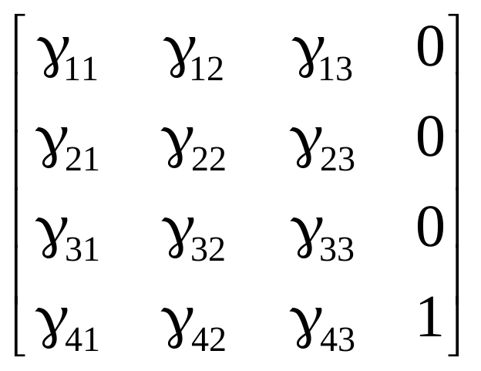
Representing One Frame in Terms of the Other
Extending what we did with change of bases
u₁ = γ₁₁v₁+γ₁₂v₂+γ₁₃v₃
u₂ = γ₂₁v₁+γ₂₂v₂+γ₂₃v₃
u₃ = γ₃₁v₁+γ₃₂v₂+γ₃₃v₃
Q₀ = γ₄₁v₁+γ₄₂v₂+γ₄₃v₃ +P₀
defining a 4 x 4 matrix
M =

Slide 20
Working with Representations
Within the two frames any point or vector has a representation of the same form
a=[α₁ α₂ α₃ α₄ ]^{T} in the first frame
b=[β₁ β₂ β₃ β₄ ]^{T} in the second frame
where α₄ = β₄ = 1 for points and α₄ = β₄ = 0 for vectors and
The matrix M is 4 x 4 and specifies an affine transformation in homogeneous coordinates
a=M^{T}b

Slide 21
Affine Transformations
Every linear transformation is equivalent to a change in frames
Every affine transformation preserves lines
However, an affine transformation has only 12 degrees of freedom because 4 of the elements in the matrix are fixed and are a subset of all possible 4 x 4 linear transformations

Slide 22
The World and Camera Frames
When we work with representations, we work with n-tuples or arrays of scalars
Changes in frame are then defined by 4 x 4 matrices
In OpenGL, the base frame that we start with is the world frame
Eventually we represent entities in the camera frame by changing the world representation using the model-view matrix
Initially these frames are the same (M=I)

Slide 23
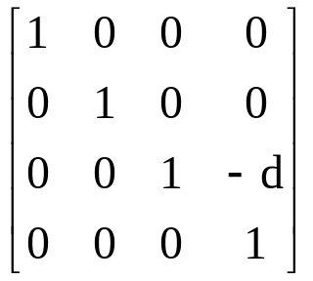
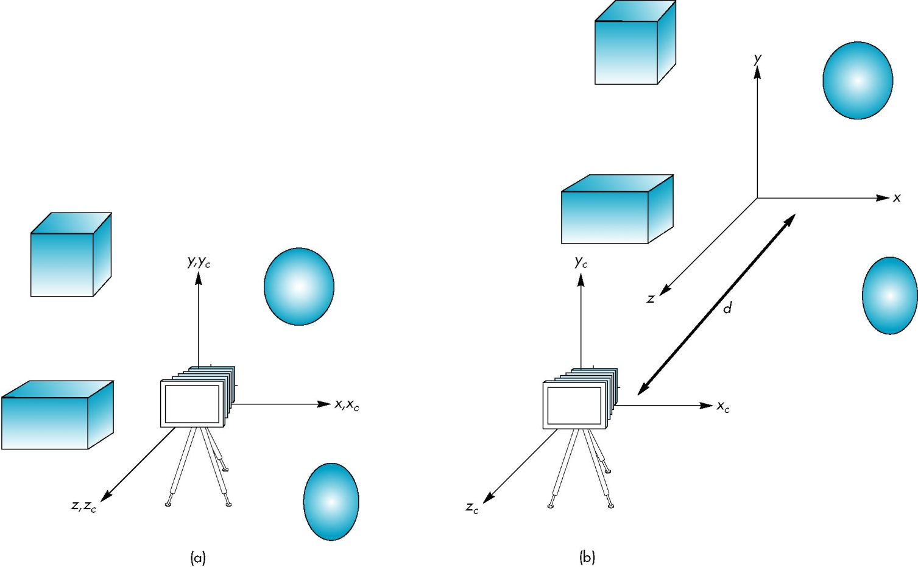
Moving the Camera
If objects are on both sides of z=0, we must move camera frame
M =

