Slide 1
OpenGL Transformations
Changhe Tu
Shandong University

Slide 2
Objectives
Learn how to carry out transformations in OpenGL
  Rotation
  Translation
  Scaling
Introduce OpenGL matrix modes
  Model-view
  Projection

Slide 3
OpenGL Matrices
In OpenGL matrices are part of the state
Multiple types
  Model-View (GL_MODELVIEW)
  Projection (GL_PROJECTION)
  Texture (GL_TEXTURE) (ignore for now)
  Color(GL_COLOR) (ignore for now)
Single set of functions for manipulation
Select which to manipulated by
  glMatrixMode(GL_MODELVIEW);
  glMatrixMode(GL_PROJECTION);

Slide 4
Current Transformation Matrix (CTM)
Conceptually there is a 4 x 4 homogeneous coordinate matrix, the current transformation matrix (CTM) that is part of the state and is applied to all vertices that pass down the pipeline
The CTM is defined in the user program and loaded into a transformation unit
C
p
p’=Cp
vertices
CTM
vertices

Slide 5
CTM operations
The CTM can be altered either by loading a new CTM or by postmutiplication
Load an identity matrix: C ← I
Load an arbitrary matrix: C ← M
Load a translation matrix: C ← T
Load a rotation matrix: C ← R
Load a scaling matrix: C ← S
Postmultiply by an arbitrary matrix: C ← CM
Postmultiply by a translation matrix: C ← CT
Postmultiply by a rotation matrix: C ← C R
Postmultiply by a scaling matrix: C ← C S

Slide 6
Rotation about a Fixed Point
Start with identity matrix: C ← I
Move fixed point to origin: C ← CT
Rotate: C ← CR
Move fixed point back: C ← CT ⁻¹
Result: C = TR T ^{–1} which is backwards.
This result is a consequence of doing postmultiplications.
Let’s try again.

Slide 7
Reversing the Order
We want C = T ^{–1} R T
so we must do the operations in the following order
C ← I
C ← CT ⁻¹
C ← CR
C ← CT
Each operation corresponds to one function call in the program.
Note that the last operation specified is the first executed in the program

Slide 8
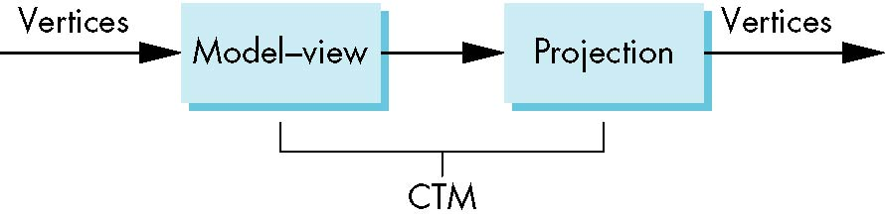
CTM in OpenGL
OpenGL has a model-view and a projection matrix in the pipeline which are concatenated together to form the CTM
Can manipulate each by first setting the correct matrix mode

Slide 9
Rotation, Translation, Scaling
Load an identity matrix:
glLoadIdentity()
Multiply on right:
glRotatef(theta, vx, vy, vz)
theta in degrees, (vx, vy, vz) define axis of rotation
glTranslatef(dx, dy, dz)
glScalef( sx, sy, sz)
Each has a float (f) and double (d) format (glScaled)

Slide 10
Example
Rotation about z axis by 30 degrees with a fixed point of (1.0, 2.0, 3.0)
Remember that last matrix specified in the program is the first applied
glMatrixMode(GL_MODELVIEW);
glLoadIdentity();
glTranslatef(1.0, 2.0, 3.0);
glRotatef(30.0, 0.0, 0.0, 1.0);
glTranslatef(-1.0, -2.0, -3.0);

Slide 11
Arbitrary Matrices
Can load and multiply by matrices defined in the application program
The matrix m is a one dimension array of 16 elements which are the components of the desired 4 x 4 matrix stored by columns
In glMultMatrixf, m multiplies the existing matrix on the right
glLoadMatrixf(m)
glMultMatrixf(m)

Slide 12
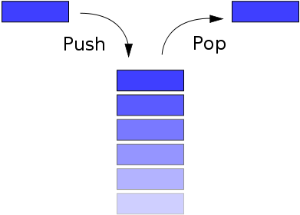
Matrix Stacks
In many situations we want to save transformation matrices for use later
  Traversing hierarchical data structures (Chapter 10)
  Avoiding state changes when executing display lists
OpenGL maintains stacks for each type of matrix
  Access present type (as set by glMatrixMode) by
glPushMatrix()
glPopMatrix()

Slide 13
Push and Pop Matrix
glMatrixMode(GL_MODELVIEW);
glLoadIdentity();
glLookAt(someParameters); // set camera position
glMultMatrix(obj1.matrix);
obj1.render();
//now I want to draw another //object in another position.
//I can do this...
glLoadIdentity();
glLookAt (sameParameters than before);
glMultMatrix(obj2.matrix);
obj2.render();
//but this is ugly.. you have to //compute the camera matrix for //every object. You can do //something better.
glMatrixMode(GL_MODELVIEW);
glLoadIdentity();
glLookAt(someParameters); // set camera position
glPushMatrix(); // save camera matrix
glMultMatrix(obj1.matrix);
obj1.render();
glPopMatrix(); // get camera matrix
glPushMatrix(); // save camera matrix
glMultMatrix(obj2.matrix);
obj2.render();
glPopMatrix(); // get camera matrix
glPush... etc... etc...

Slide 14
Reading Back Matrices
Can also access matrices (and other parts of the state) by query functions
For matrices, we use as
glGetIntegerv
glGetFloatv
glGetBooleanv
glGetDoublev
glIsEnabled
double m[16];
glGetFloatv(GL_MODELVIEW, m);

Slide 15
Using Transformations
Example: use idle function to rotate a cube and mouse function to change direction of rotation
Start with a program that draws a cube (colorcube.c) in a standard way
  Centered at origin
  Sides aligned with axes

Slide 16
main.c
void main(int argc, char **argv)
{
glutInit(&argc, argv);
glutInitDisplayMode(GLUT_DOUBLE | GLUT_RGB |
GLUT_DEPTH);
glutInitWindowSize(500, 500);
glutCreateWindow("colorcube");
glutReshapeFunc(myReshape);
glutDisplayFunc(display);
glutIdleFunc(spinCube);
glutMouseFunc(mouse);
glEnable(GL_DEPTH_TEST);
glutMainLoop();
}

Slide 17
Idle and Mouse callbacks
void spinCube()
{
theta[axis] += 2.0;
if( theta[axis] > 360.0 ) theta[axis] -= 360.0;
glutPostRedisplay();
}
void mouse(int btn, int state, int x, int y)
{
if(btn==GLUT_LEFT_BUTTON && state == GLUT_DOWN)
axis = 0;
if(btn==GLUT_MIDDLE_BUTTON && state == GLUT_DOWN)
axis = 1;
if(btn==GLUT_RIGHT_BUTTON && state == GLUT_DOWN)
axis = 2;
}

Slide 18
Display callback
void display()
{
glClear(GL_COLOR_BUFFER_BIT | GL_DEPTH_BUFFER_BIT);
glLoadIdentity();
glRotatef(theta[0], 1.0, 0.0, 0.0);
glRotatef(theta[1], 0.0, 1.0, 0.0);
glRotatef(theta[2], 0.0, 0.0, 1.0);
colorcube();
glutSwapBuffers();
}
Note that because of fixed from of callbacks, variables
such as theta and axis must be defined as globals
Camera information is in standard reshape callback

Slide 19
Using the Model-view Matrix
In OpenGL the model-view matrix is used to
  Position the camera
    Can be done by rotations and translations but is often easier to use gluLookAt
  Build models of objects
The projection matrix is used to define the view volume and to select a camera lens

Slide 20
Model-view and Projection Matrices
Although both are manipulated by the same functions, we have to be careful because incremental changes are always made by postmultiplication
  For example, rotating model-view and projection matrices by the same matrix are not equivalent operations. Postmultiplication of the model-view matrix is equivalent to premultiplication of the projection matrix

Slide 21
Smooth Rotation
From a practical standpoint, we are often want to use transformations to move and reorient an object smoothly
  Problem: find a sequence of model-view matrices M₀,M₁,…..,M_{n} so that when they are applied successively to one or more objects we see a smooth transition
For orientating an object, we can use the fact that every rotation corresponds to part of a great circle on a sphere
  Find the axis of rotation and angle
  Virtual trackball (see text)

Slide 22
Incremental Rotation
Consider the two approaches
  For a sequence of rotation matrices R₀,R₁,…..,R_{n} , find the Euler angles for each and use R_{i}= R_{iz} R_{iy} R_{ix}
    Not very efficient
  Use the final positions to determine the axis and angle of rotation, then increment only the angle
Quaternions can be more efficient than either

Slide 23
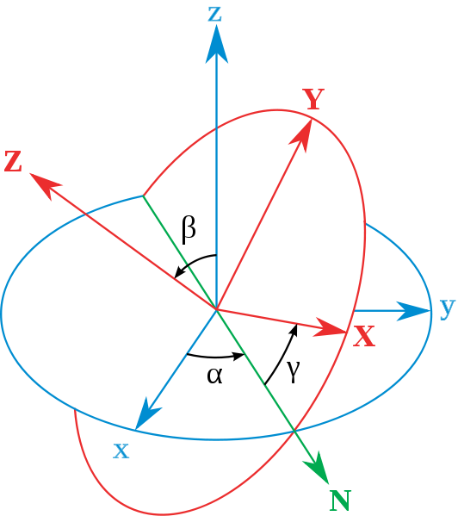
Definition of Euler Angles
Set xyz as reference frame. We call the intersection of plane xoy and plane XoY N. Euler Angles is defined as follows:
α: angle between x-axis and N;
β: angle between z- and Z-axis;
γ: angle between N and X-axis.

Slide 24
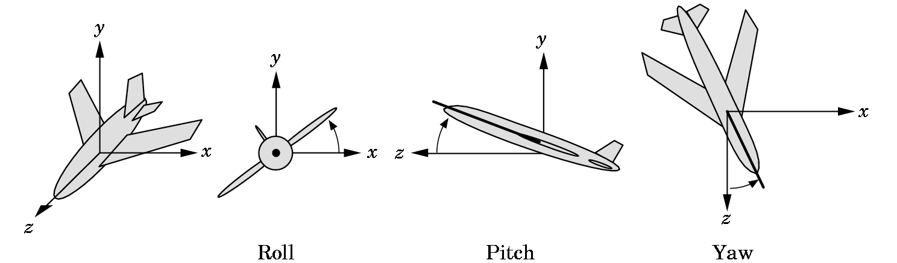
Euler Angles for 3D Rotation
滚动
颠簸
摇摆

Slide 25
Disadvantages of Using Euler Angle
Independent rotations about each coordinate axis angle interpolation for animation generates bizarre motions
Rotations are order-dependent, and there are no conventions about the order to use
Widely used anyway, because they're “simple”

Slide 26
Euler Rotation Problems
Rotations with Euler angles to change from one orientation to another are not unique. Example: (x,y,z) rotation to achieve the following:
R
R
y
y
z
x
y
OR
z
z
x
x
R
z
x
y
R
z
y
Rotate(180, 1,0,0) Rotate(180, 0,1,0) then Rotate(180,0,0,1)
Euler angles: (0,0,0) -> (180,0,0) Euler angles: (0,0,0) -> (0,180,180)

Slide 27

Euler Rotation Problems
Gimbal Lock problem

Slide 28
Quaternions
Extension of imaginary numbers from two to three dimensions
Requires one real and three imaginary components i, j, k
Quaternions can express rotations on sphere smoothly and efficiently. Process:
  Model-view matrix → quaternion
  Carry out operations with quaternions
  Quaternion → Model-view matrix
q=q₀+q₁i+q₂j+q₃k

Slide 29
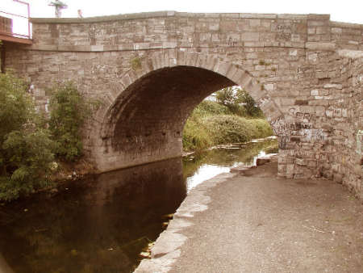
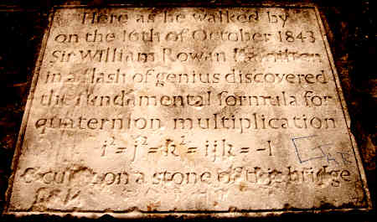
Quaternion Plaque on Broom Bridge in Dublin, Ireland
Here as he walked by on the 16th of October 1843 Sir William Rowan Hamilton in a flash of genius discovered the fundamental formula for quaternion multiplication
i²=j²=k²=ijk= -1
& cut it on a stone of this bridge

Slide 30
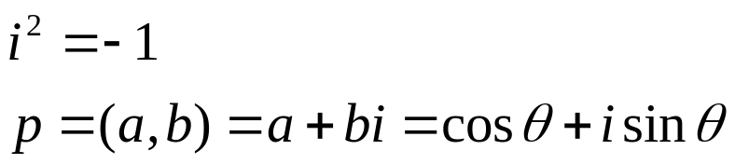
The basic idea
Imaginary
Complex numbers can represent 2D rotation
(a,b)
θ
Real
This is a completely made up mathematical concept, but it turns out to be very useful.

Slide 31
Complex Number advantages
Imaginary
A normalized complex number uniquely represents a rotation
Multiplying two complex numbers together add the rotation angles.
(a,b)
θ
Real
So, make θ into a complex number c_{θ} and ω into a complex number c_{ω,} then
c_{θ}c_{ω} = c_{θ+ω}

Slide 32
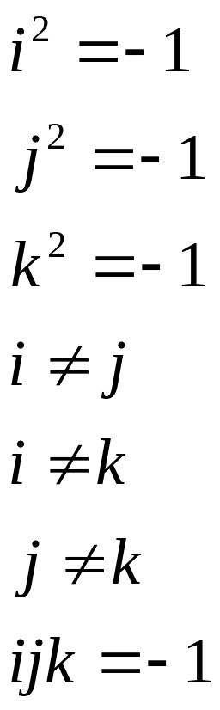
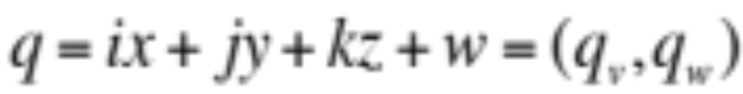

The main idea
Think of 4 element vectors.
A unit quaternion:

Slide 33
Basic Operations
Multiplication: QR = (qv x rv + rwqv + qwrv,
qwrw - qv.rv)
Addition: Q+R = (qv+rv, qw+rw)
Conjugate: Q* = (-qv, qw)
Norm (magnitude) = QQ* = Q*Q = qx*qx+qy*qy+qz*qz+qw*qw
Identity i = (0,1)
Inverse Q = (1/ Norm(Q)) Q*
Imaginary
real
-1

Slide 34
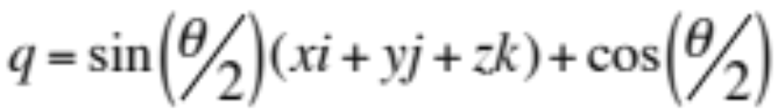
How much do we really need to know?
A quaternion represents a rotation.
q₁ * q₂ represent rotation q₂ followed by rotation q₁.
q and –q are the same rotation.
Let (x, y, z) be a normalized vector and θ an angle
is a rotation around (x,y,z) by θ radians

Slide 35
Creating a Quaternion
You’re given a Vector v and an angle to rotate around that vector of θ. The quaternion to do that will be:
public static Quaternion CreateFromAxisAngle(Vector3 axis, float angle)
{
Quaternion quaternion;
float num2 = angle * 0.5f;
float num = (float) Math.Sin((double) num2);
float num3 = (float) Math.Cos((double) num2);
quaternion.X = axis.X * num;
quaternion.Y = axis.Y * num;
quaternion.Z = axis.Z * num;
quaternion.W = num3;
return quaternion;
}

Slide 36
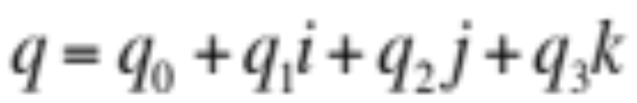
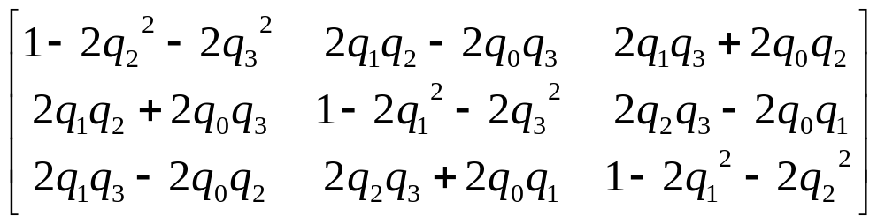
Quaternion to Rotation Matrix
Given
we have

Slide 37
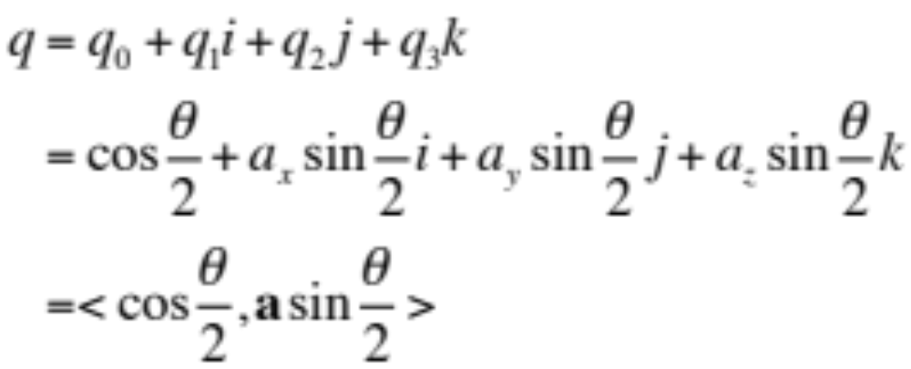
Negation Characteristics
q and –q correspond to the same orientation
  Why?

Slide 38
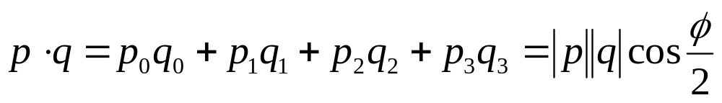
Dot Product Characteristic
Dot product is cos of ½ angle between orientations

Slide 39
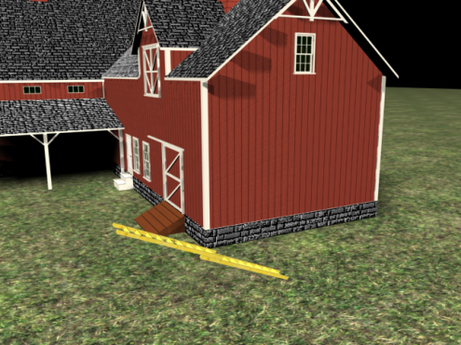
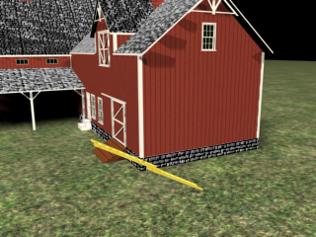
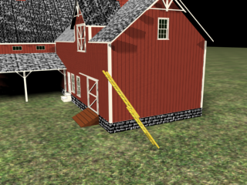
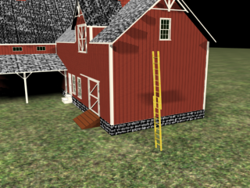
Quaterion Interpolation
One of the main reasons quaternions are so popular is that they are easy to interpolate. They are very commonly used for orientation keyframes and skeletal animation.

Slide 40
Interpolation of Rotation
Should avoid sudden change of orientation and also should maintain a constant angular speed
Each rotation can be represented as a point on the surface of a 4D unit sphere
  Need to perform smooth interpolation along this 4D sphere
R
How to interpolate
A and B to get R?
A
B

Slide 41
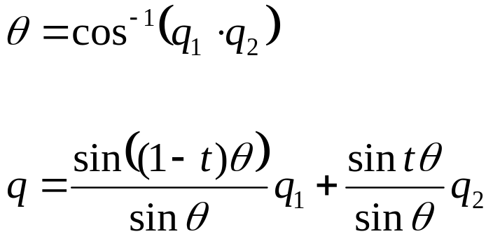
Slerp for Quaternions
Slerp is “spherical linear interpolation”
θ above is ½ of the angle
If cosine is < 0, the angle is greater than 180 degrees…

Slide 42
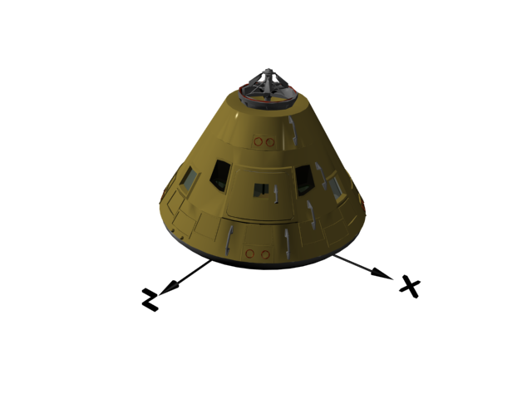
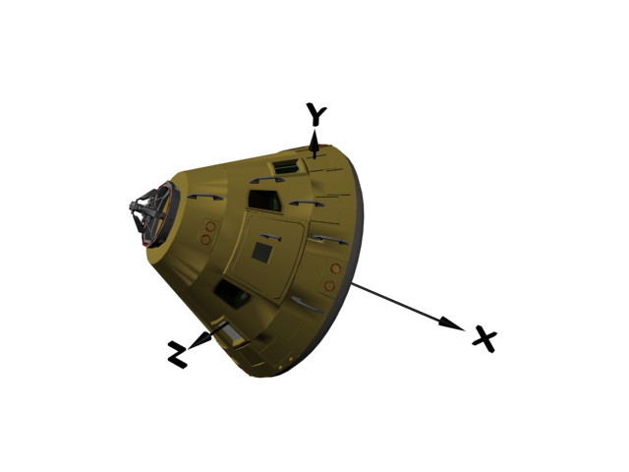
Perfect Rotations
Slerp with two quaternions will rotate from one orientation to another using a uniform angular velocity and a fixed rotation axis.

Slide 43
Going the long way around…
There’s always two possible rotations: the short way and the long way. If the cos(θ) < 0, where q is the angle between the quaternions (not the angle between the orientations), we are going the long way around. If that happens, then instead of doing Slerp(q₁, q₂, t), so Slerp(q₁, -q₂, t). Negating one quaternion will force the other path.

Slide 44
游戏编程精粹1（人民邮电出版社）
2．7．1 将四元数当作矩阵替换物
2．7．2 为什么不使用欧拉角
2．7．3 X、Y、Z和W代表什么
2．7．4 源自什么数学基础
2．7．5 四元数如何表示旋转
2．7．6 参考文献
2．8 矩阵和四元数之间的转换
2．8．1 四元数旋转
2．8．2 四元数到矩阵的转换
2．8．3 矩阵到四元数的转换
2．8．4 参考文献
2．9 四元数插值
2．9．1 四元数计算
2．9．2 四元数插值
2．9．3 示例代码
2．9．4 推导
2．10 最短弧四元数

Slide 45
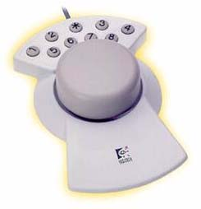
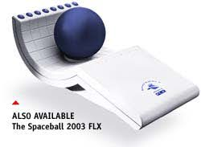
3D Rotations with Trackball
Imagine the objects are rotated along with a imaginary hemi-sphere

Slide 46
Virtual Trackball
Allow the user to define 3D rotation using mouse click in 2D windows
Work similarly like the hardware trackball devices

Slide 47
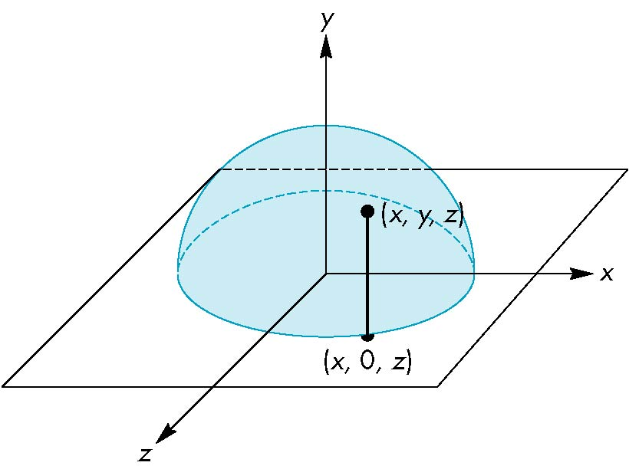
Virtual Trackball
Superimpose a hemi-sphere onto the viewport
This hemi-sphere is projected to a circle inscribed to the viewport
The mouse position is projected orthographically to this hemi-sphere
z
y
(x,y,0)
x

Slide 48
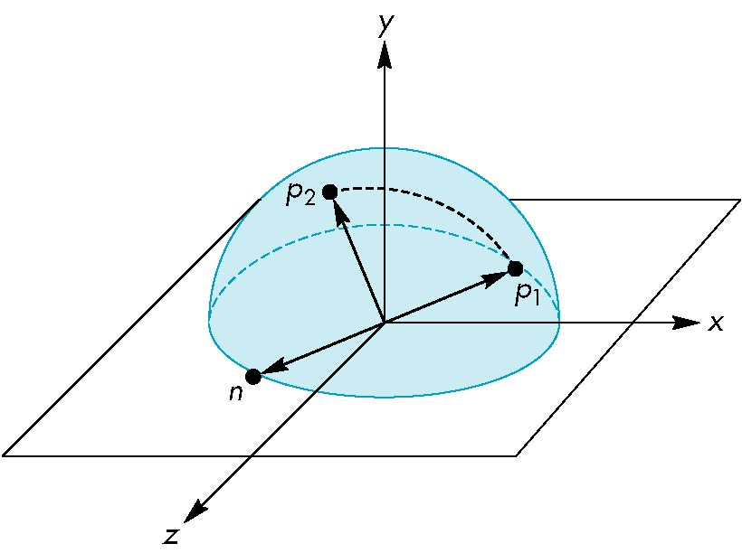
Virtual Trackball
Keep track the previous mouse position and the current position
Calculate their projection positions p₁ and p₂ to the virtual hemi-sphere
We then rotate the sphere from p₁ to p₂ by finding the proper rotation axis and angle
This rotation ( in eye space!) is then applied to the object (call the rotation before you define the camera with gluLookAt())
You should also remember to accumulate the current rotation to the previous modelview matrix
z
y
x

Slide 49
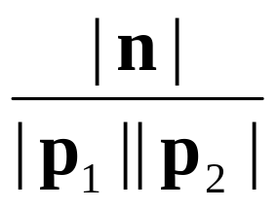
Virtual Trackball
The axis of rotation is given by the normal to the plane determined by the origin, p₁ , and p₂
The angle between p₁
and p₂ is given by
n = p₁ × p₂
z
y
| sin θ| =
x

Slide 50
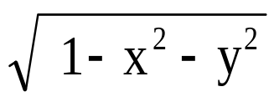
Virtual Trackball
How to calculate p₁ and p₂?
Assuming the mouse position is (x,y), then the sphere point P also has x and y coordinates equal to x and y
Assume the radius of the hemi-sphere is 1. So the z coordinate of P is
Note: normalize viewport y extend
to -1 to 1
If a point is outside the circle, project
it to the nearest point on the circle
(set z to 0 and renormalize (x,y))
z
y
(x,y,0)
x

Slide 51
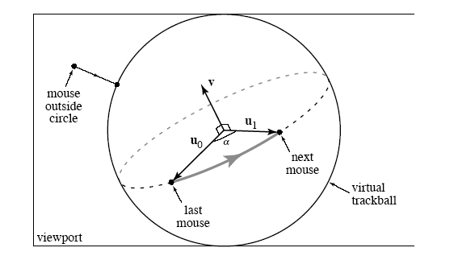
Virtual Trackball
Visualization of the algorithm

Slide 52
Example
Example from Ed Angel’s OpenGL Primer
In this example, the virtual trackball is used to rotate a color cube
The code for the colorcube function is omitted
I will not cover the following code, but I am sure you will find it useful

Slide 53
Initialization
#define bool int /* if system does not support
bool type */
#define false 0
#define true 1
#define M_PI 3.14159 /* if not in math.h */
int winWidth, winHeight;
float angle = 0.0, axis[3], trans[3];
bool trackingMouse = false;
bool redrawContinue = false;
bool trackballMove = false;
float lastPos[3] = {0.0, 0.0, 0.0};
int curx, cury;
int startX, startY;

Slide 54
The Projection Step
voidtrackball_ptov(int x, int y, int width, int height, float v[3])
{
float d, a;
/* project x,y onto a hemisphere centered within width, height , note z is up here*/
v[0] = (2.0*x - width) / width;
v[1] = (height - 2.0F*y) / height;
d = sqrt(v[0]*v[0] + v[1]*v[1]);
v[2] = cos((M_PI/2.0) * ((d < 1.0) ? d : 1.0));
a = 1.0 / sqrt(v[0]*v[0] + v[1]*v[1] + v[2]*v[2]);
v[0] *= a; v[1] *= a; v[2] *= a;
}

Slide 55
glutMotionFunc (1)
Void mouseMotion(int x, int y)
{
float curPos[3],
dx, dy, dz;
/* compute position on hemisphere */
trackball_ptov(x, y, winWidth, winHeight, curPos);
if(trackingMouse)
{
/* compute the change in position
on the hemisphere */
dx = curPos[0] - lastPos[0];
dy = curPos[1] - lastPos[1];
dz = curPos[2] - lastPos[2];

Slide 56
glutMotionFunc (2)
if (dx || dy || dz)
{
/* compute theta and cross product */
angle = 90.0 * sqrt(dx*dx + dy*dy + dz*dz);
axis[0] = lastPos[1]*curPos[2] –
lastPos[2]*curPos[1];
axis[1] = lastPos[2]*curPos[0] –
lastPos[0]*curPos[2];
axis[2] = lastPos[0]*curPos[1] –
lastPos[1]*curPos[0];
/* update position */
lastPos[0] = curPos[0];
lastPos[1] = curPos[1];
lastPos[2] = curPos[2];
}
}
glutPostRedisplay();
}

Slide 57
Idle and Display Callbacks
void spinCube()
{
if (redrawContinue) glutPostRedisplay();
}
void display()
{ glClear(GL_COLOR_BUFFER_BIT|GL_DEPTH_BUFFER_BIT);
if (trackballMove)
{
glRotatef(angle, axis[0], axis[1], axis[2]);
}
colorcube();
glutSwapBuffers();
}

Slide 58
Mouse Callback
void mouseButton(int button, int state, int x, int y)
{
if(button==GLUT_RIGHT_BUTTON) exit(0);
/* holding down left button
allows user to rotate cube */
if(button==GLUT_LEFT_BUTTON) switch(state)
{
case GLUT_DOWN:
y=winHeight-y;
startMotion( x,y);
break;
case GLUT_UP:
stopMotion( x,y);
break;
}
}

Slide 59
Start Function
void startMotion(int x, int y)
{
trackingMouse = true;
redrawContinue = false;
startX = x;
startY = y;
curx = x;
cury = y;
trackball_ptov(x, y, winWidth, winHeight, lastPos);
trackballMove=true;
}

Slide 60
Stop Function
void stopMotion(int x, int y)
{
trackingMouse = false;
/* check if position has changed */
if (startX != x || startY != y)
redrawContinue = true;
else
{
angle = 0.0;
redrawContinue = false;
trackballMove = false;
}
}

