Slide 1
Classical Viewing
Changhe Tu
Shandong University

Slide 2
Objectives
Introduce the classical views
Compare and contrast image formation by computer with how images have been formed by architects, artists, and engineers
Learn the benefits and drawbacks of each type of view

Slide 3
Classical Viewing
Viewing requires three basic elements
  One or more objects
  A viewer with a projection surface
  Projectors that go from the object(s) to the projection surface
Classical views are based on the relationship among these elements
  The viewer picks up the object and orients it how she would like to see it
Each object is assumed to constructed from flat principal faces
  Buildings, polyhedra, manufactured objects

Slide 4
Planar Geometric Projections
Standard projections project onto a plane
Projectors are lines that either
  converge at a center of projection
  are parallel
Such projections preserve lines
  but not necessarily angles
Nonplanar projections are needed for applications such as map construction

Slide 5
Perspective vs Parallel
Computer graphics treats all projections the same and implements them with a single pipeline
Classical viewing developed different techniques for drawing each type of projection
Fundamental distinction is between parallel and perspective viewing even though mathematically parallel viewing is the limit of perspective viewing

Slide 6
Taxonomy of Planar Geometric Projections
planar geometric projections
parallel
perspective
1 point
2 point
3 point
multiview
orthographic
axonometric
oblique
isometric
dimetric
trimetric

Slide 7
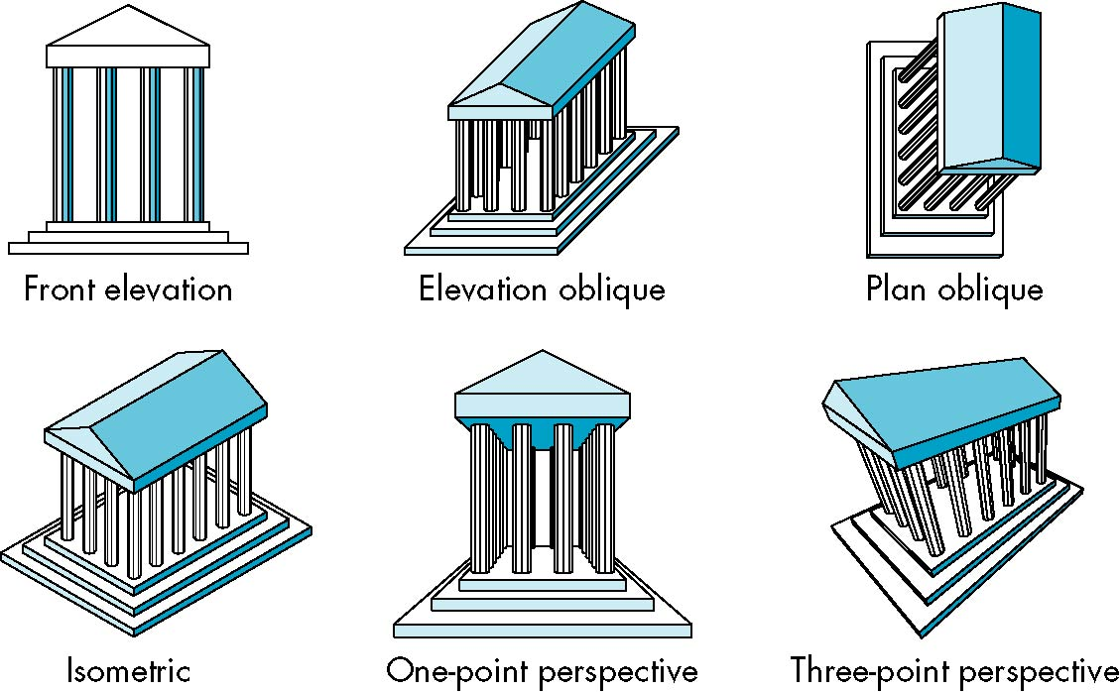
Classical Projections

Slide 8
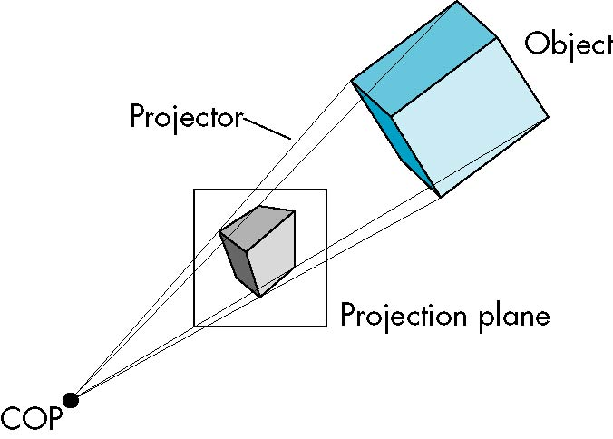
Perspective Projection

Slide 9
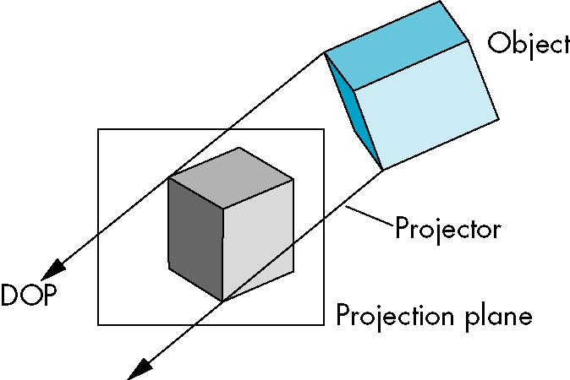
Parallel Projection

Slide 10
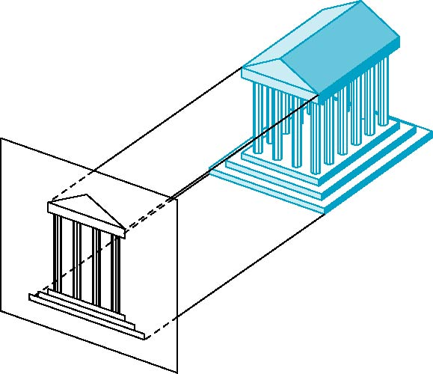
Orthographic Projection
Projectors are orthogonal to projection surface

Slide 11

Multiview Orthographic Projection
Projection plane parallel to principal face
Usually form front, top, side views
isometric (not multiview
orthographic view)
front
in CAD and architecture,
we often display three
multiviews plus isometric
side
top

Slide 12
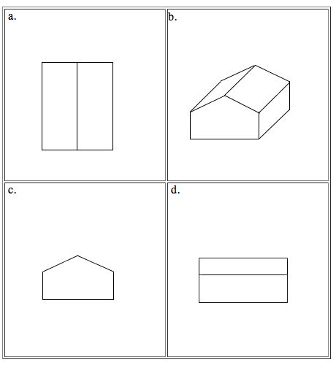
Multiview Orthorgraphic

Slide 13
Advantages and Disadvantages
Preserves both distances and angles
  Shapes preserved
  Can be used for measurements
    Building plans
    Manuals
Cannot see what object really looks like because many surfaces hidden from view
  Often we add the isometric

Slide 14
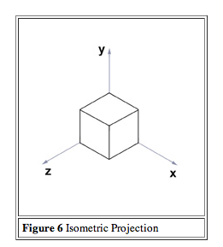
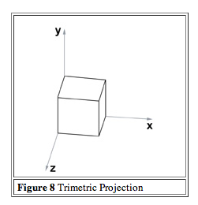
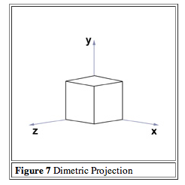
Axonometric Projection

Slide 15
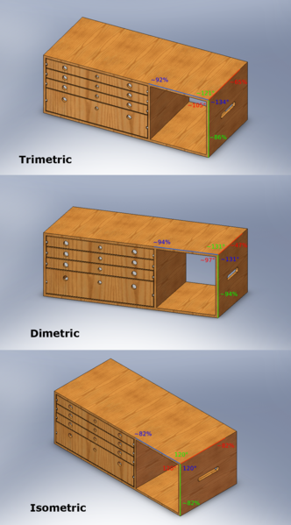

Slide 16
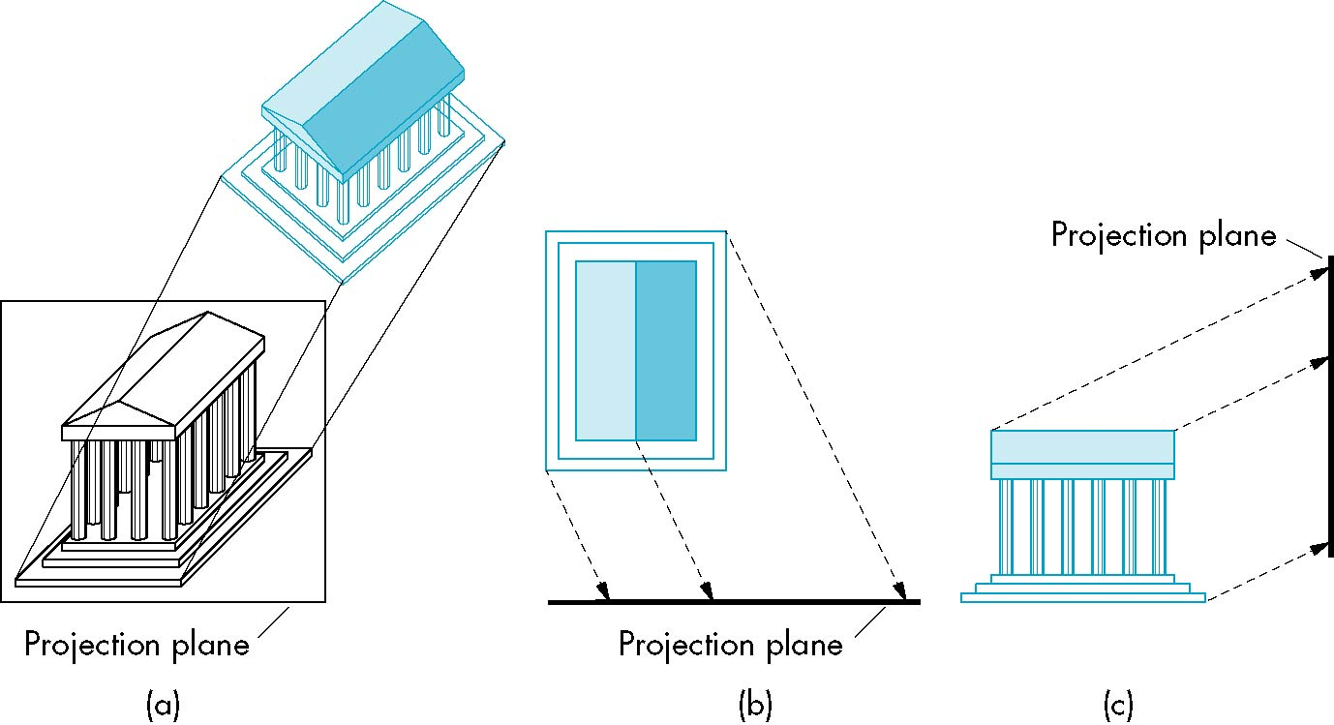
Oblique Projection
Arbitrary relationship between projectors and projection plane

Slide 17
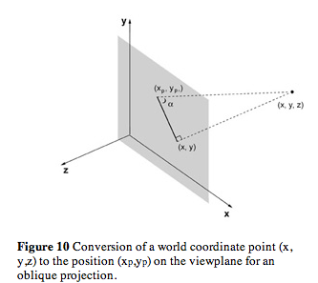
Oblique Projection

Slide 18
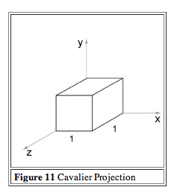
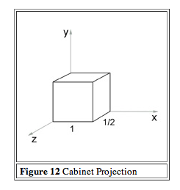
Two Oblique Projections

Slide 19
Advantages and Disadvantages
Can pick the angles to emphasize a particular face
  Architecture: plan oblique, elevation oblique
Angles in faces parallel to projection plane are preserved In physical world, cannot create with simple camera; possible with bellows (皮腔) camera or special lens (architectural)

Slide 20
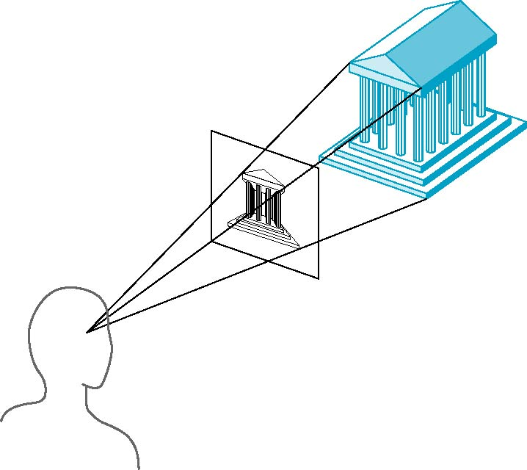
Perspective Projection
Projectors converge at center of projection

Slide 21
Vanishing Points
Parallel lines (not parallel to the projection plane) on the object converge at a single point in the projection (the vanishing point)
Drawing simple perspectives by hand uses these vanishing point(s)
vanishing point

Slide 22
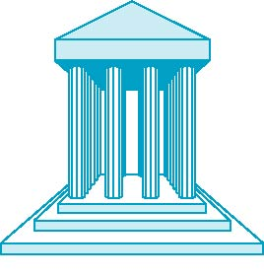
One-Point Perspective
One principal face parallel to projection plane
One vanishing point for cube

Slide 23
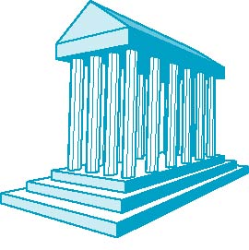
Two-Point Perspective
On principal direction parallel to projection plane
Two vanishing points for cube

Slide 24
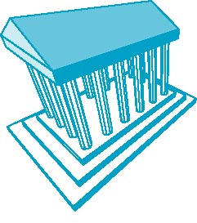
Three-Point Perspective
No principal face parallel to projection plane
Three vanishing points for cube

Slide 25
Advantages and Disadvantages
Objects further from viewer are projected smaller than the same sized objects closer to the viewer (diminution)
  Looks realistic
Equal distances along a line are not projected into equal distances (nonuniform foreshortening)
Angles preserved only in planes parallel to the projection plane
More difficult to construct by hand than parallel projections (but not more difficult by computer)

