Slide 1
Projection Matrices
Changhe Tu
Shandong University

Slide 2
Objectives
Derive the projection matrices used for standard OpenGL projections
Introduce oblique projections
Introduce projection normalization

Slide 3
Normalization
Rather than derive a different projection matrix for each type of projection, we can convert all projections to orthogonal projections with the default view volume
This strategy allows us to use standard transformations in the pipeline and makes for efficient clipping

Slide 4
Pipeline View
modelview
transformation
projection
transformation
perspective
division
4D → 3D
nonsingular
clipping
projection
3D → 2D
against default cube

Slide 5
Notes
We stay in four-dimensional homogeneous coordinates through both the modelview and projection transformations
  Both these transformations are nonsingular
  Default to identity matrices (orthogonal view)
Normalization lets us clip against simple cube regardless of type of projection
Delay final projection until end
  Important for hidden-surface removal to retain depth information as long as possible

Slide 6
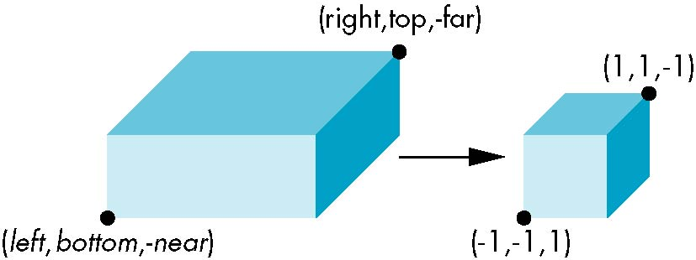
1、Orthogonal Normalization
glOrtho(left,right,bottom,top,near,far)
normalization ⇒ find transformation to convert
specified clipping volume to default

Slide 7
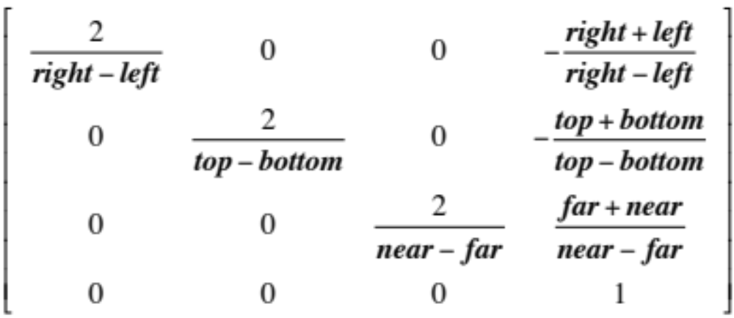
Orthogonal Matrix
Two steps
  Move center to origin
    T(-(left+right)/2, -(bottom+top)/2,(near+far)/2))
  Scale to have sides of length 2
    S(2/(left-right),2/(top-bottom),2/(near-far))
P = ST =

Slide 8
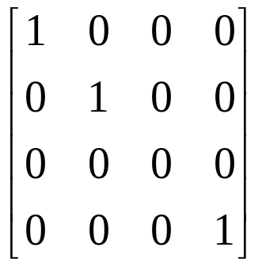
Final Projection
Set z =0
Equivalent to the homogeneous coordinate transformation
Hence, general orthogonal projection in 4D is
M_{orth} =
P = M_{orth}ST

Slide 9
2、Oblique Projections
The OpenGL projection functions cannot produce general parallel projections such as
However if we look at the example of the cube it appears that the cube has been sheared
Oblique Projection = Shear + Orthogonal Projection

Slide 10
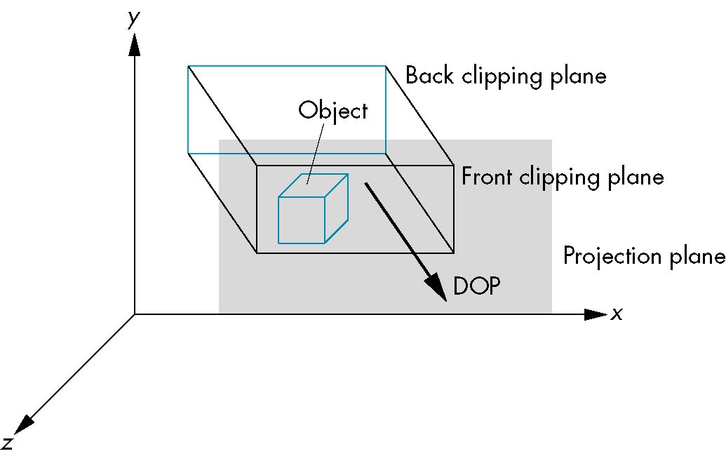
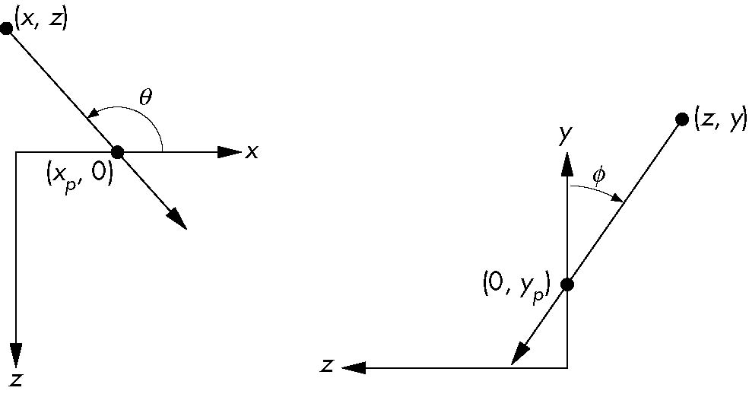
General Shear
top view
side view

Slide 11
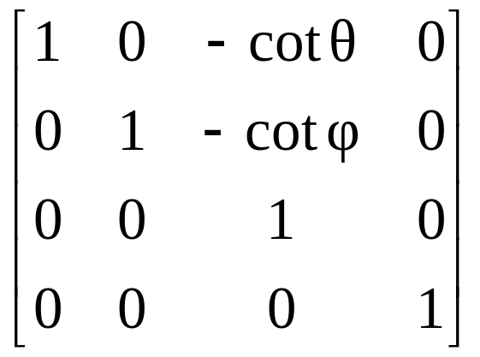
Shear Matrix
xy shear (z values unchanged)
Projection matrix
General case:
H(θ,φ) =
P = M_{orth} H(θ,φ)
P = M_{orth} STH(θ,φ)

Slide 12
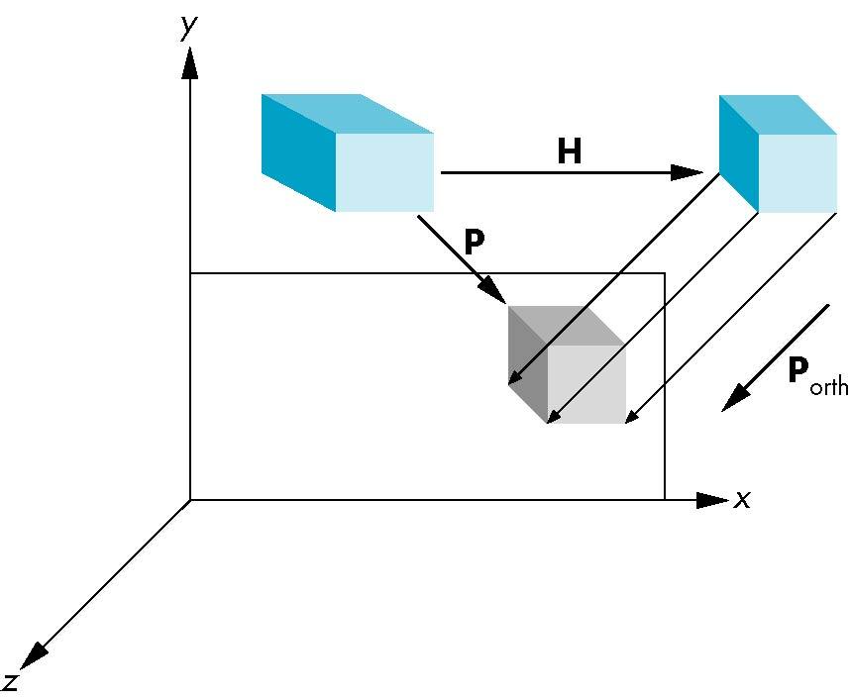
Equivalency

Slide 13
Effect on Clipping
The projection matrix P = STH transforms the original clipping volume to the default clipping volume
object
top view
z = 1
DOP
DOP
x = -1
x = 1
far plane
z = -1
clipping
volume
near plane
distorted object
(projects correctly)

Slide 14
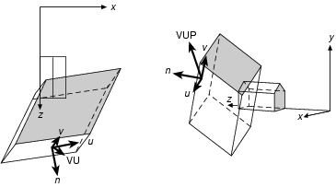
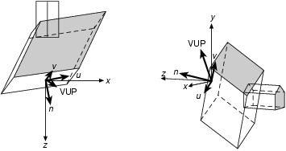
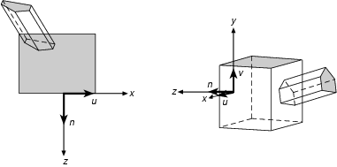
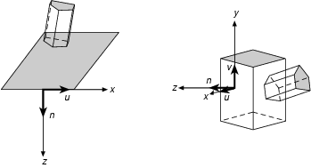
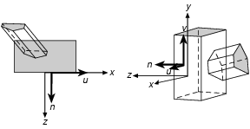
Step 1-4
N_{par}=S_{par}*T_{par}*SH_{par}*R*T(-VRP)

Slide 15
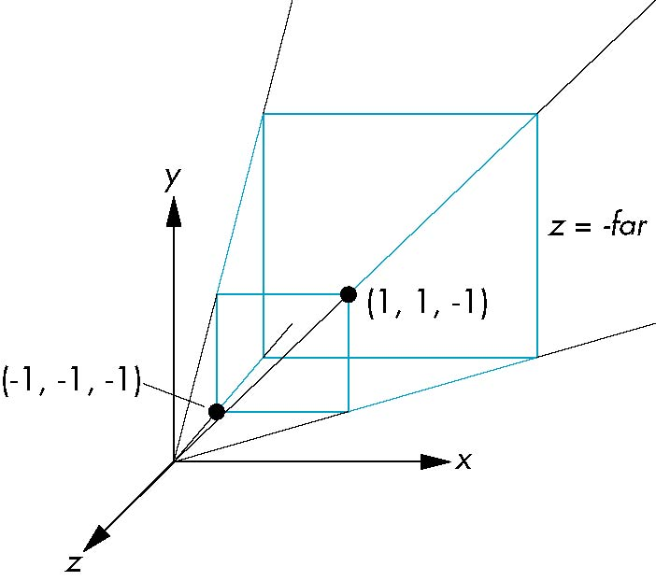
3、Simple Perspective
Consider a simple perspective with the COP at the origin, the near clipping plane at z = -1, and a 90 degree field of view determined by the planes
x = ±z, y = ±z

Slide 16
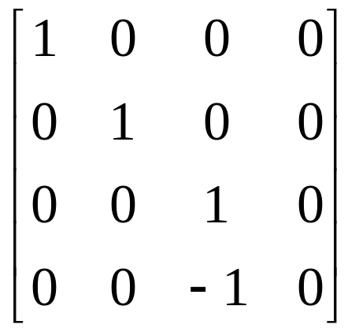
Perspective Matrices
Simple projection matrix in homogeneous coordinates
Note that this matrix is independent of the far clipping plane
M =

Slide 17
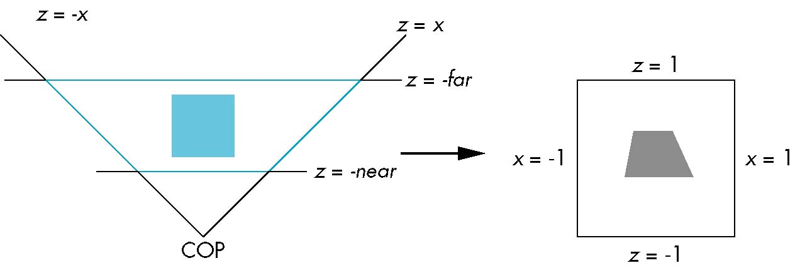
Normalization Transformation
distorted object
projects correctly
original clipping
volume
original object
new clipping
volume

Slide 18
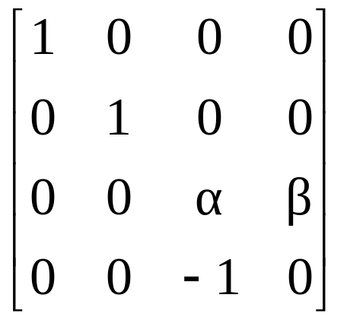
Generalization
N =
after perspective division, the point (x, y, z, 1) goes to
x’’ = -x/z
y’’ = -y/z
Z’’ = -(α+β/z)
which projects orthogonally to the desired point
regardless of α and β

Slide 19
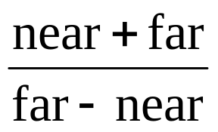
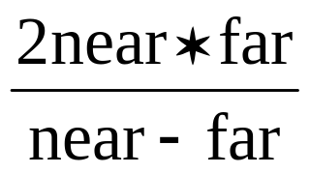
Picking α and β
If we pick
α =
β =
the near plane is mapped to z = -1
the far plane is mapped to z =1
and the sides are mapped to x = ± 1, y = ± 1
Hence the new clipping volume is the default clipping volume

Slide 20
Normalization and Hidden-Surface Removal
Although our selection of the form of the perspective matrices may appear somewhat arbitrary, it was chosen so that if z₁ > z₂ in the original clipping volume then for the transformed points z₁’ > z₂’
Thus hidden surface removal works if we first apply the normalization transformation
However, the formula z’’ = -(α+β/z) implies that the distances are distorted by the normalization which can cause numerical problems especially if the near distance is small

Slide 21
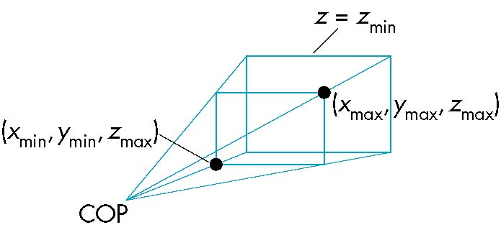
4、OpenGL Perspective
glFrustum allows for an unsymmetric viewing frustum (although gluPerspective does not)

Slide 22
OpenGL Perspective Matrix
The normalization in glFrustum requires an initial shear to form a right viewing pyramid, followed by a scaling to get the normalized perspective volume. Finally, the perspective matrix results in needing only a final orthogonal transformation
P = NSH
our previously defined
perspective matrix
shear and scale

Slide 23
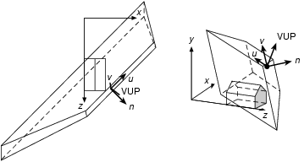
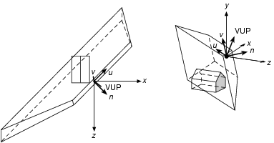
Step 1 Translate VRP to origin

Slide 24
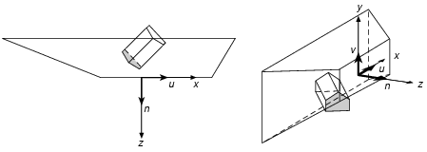
Step 2 Rotate VRC

Slide 25
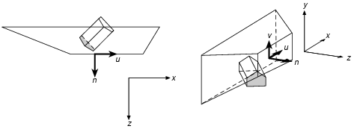
Step 3 Translate COP to Origin

Slide 26
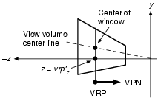

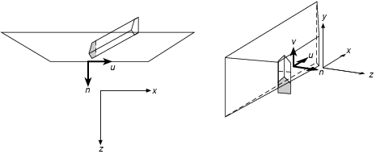
Step 4 Shear
To transform the center line into the –z axis.
The shear matrix is SH_{par}, the same as that for the parallel projection !!

Slide 27
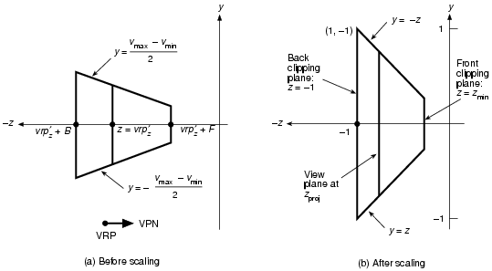
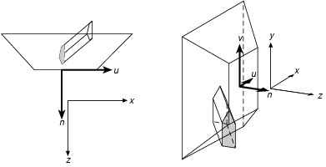
Step 5 Scale view to canonical view
And Finally we have: N_{per}=S_{per}*SH_{par}*T(-PRP)*R*T(-VRP)

Slide 28
Why do we do it this way?
Normalization allows for a single pipeline for both perspective and orthogonal viewing
We stay in four dimensional homogeneous coordinates as long as possible to retain three-dimensional information needed for hidden-surface removal and shading
We simplify clipping

