Slide 1
Shading in OpenGL
Changhe Tu
Shandong University

Slide 2
Objectives
Introduce the OpenGL shading functions
Discuss polygonal shading
  Flat
  Smooth
    Gouraud
    Phong

Slide 3
Steps in OpenGL shading
Enable shading and select model
Specify normals
Specify material properties
Specify lights

Slide 4
Normals
In OpenGL the normal vector is part of the state
Set by glNormal*()
  glNormal3f(x, y, z);
  glNormal3fv(p);
Usually we want to set the normal to have unit length so cosine calculations are correct
  Length can be affected by transformations
  Note that scaling does not preserved length
  glEnable(GL_NORMALIZE) allows for autonormalization at a performance penalty

Slide 5
Normal for Triangle
n
plane n ·(p - p₀ ) = 0
p₂
n = (p₂ - p₀ ) ×(p₁ - p₀ )
p
p₁
normalize n ← n/ |n|
p₀
Note that right-hand rule determines outward face

Slide 6
Enabling Shading
Shading calculations are enabled by
  glEnable(GL_LIGHTING)
  Once lighting is enabled, glColor() ignored
Must enable each light source individually
  glEnable(GL_LIGHTi) i=0,1…..
Can choose light model parameters
  glLightModeli(parameter, GL_TRUE)
    GL_LIGHT_MODEL_LOCAL_VIEWER do not use simplifying distant viewer assumption in calculation
    GL_LIGHT_MODEL_TWO_SIDED shades both sides of polygons independently

Slide 7
Defining a Point Light Source
For each light source, we can set an RGBA for the diffuse, specular, and ambient components, and for the position
GL float diffuse0[]={1.0, 0.0, 0.0, 1.0};
GL float ambient0[]={1.0, 0.0, 0.0, 1.0};
GL float specular0[]={1.0, 0.0, 0.0, 1.0};
Glfloat light0_pos[]={1.0, 2.0, 3,0, 1.0};
glEnable(GL_LIGHTING);
glEnable(GL_LIGHT0);
glLightv(GL_LIGHT0, GL_POSITION, light0_pos);
glLightv(GL_LIGHT0, GL_AMBIENT, ambient0);
glLightv(GL_LIGHT0, GL_DIFFUSE, diffuse0);
glLightv(GL_LIGHT0, GL_SPECULAR, specular0);

Slide 8
Distance and Direction
The source colors are specified in RGBA
The position is given in homogeneous coordinates
  If w =1.0, we are specifying a finite location
  If w =0.0, we are specifying a parallel source with the given direction vector
The coefficients in the distance terms are by default a=1.0 (constant terms), b=c=0.0 (linear and quadratic terms). Change by
a= 0.80;
glLightf(GL_LIGHT0, GLCONSTANT_ATTENUATION, a);

Slide 9
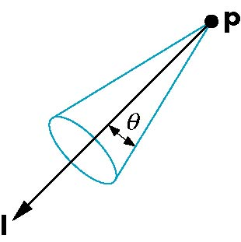
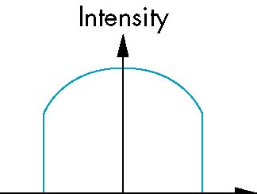
Spotlights
Use glLightv to set
  Direction GL_SPOT_DIRECTION
  Cutoff GL_SPOT_CUTOFF
  Attenuation GL_SPOT_EXPONENT
    Proportional to cos^{α}φ
−θ
φ
θ

Slide 10
Global Ambient Light
Ambient light depends on color of light sources
  A red light in a white room will cause a red ambient term that disappears when the light is turned off
OpenGL also allows a global ambient term that is often helpful for testing
  glLightModelfv(GL_LIGHT_MODEL_AMBIENT, global_ambient)

Slide 11
Moving Light Sources
Light sources are geometric objects whose positions or directions are affected by the model-view matrix
Depending on where we place the position (direction) setting function, we can
  Move the light source(s) with the object(s)
  Fix the object(s) and move the light source(s)
  Fix the light source(s) and move the object(s)
  Move the light source(s) and object(s) independently

Slide 12
Material Properties
Material properties are also part of the OpenGL state and match the terms in the modified Phong model
Set by glMaterialfv()
GLfloat ambient[] = {0.2, 0.2, 0.2, 1.0};
GLfloat diffuse[] = {1.0, 0.8, 0.0, 1.0};
GLfloat specular[] = {1.0, 1.0, 1.0, 1.0};
GLfloat shine = 100.0
glMaterialfv(GL_FRONT, GL_AMBIENT, ambient);
glMaterialfv(GL_FRONT, GL_DIFFUSE, diffuse);
glMaterialfv(GL_FRONT, GL_SPECULAR, specular);
glMaterialfv(GL_FRONT, GL_SHININESS, shine);

Slide 13
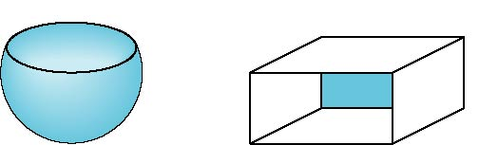
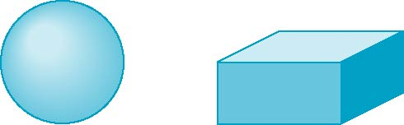
Front and Back Faces
The default is shade only front faces which works correctly for convex objects
If we set two sided lighting, OpenGL will shade both sides of a surface
Each side can have its own properties which are set by using GL_FRONT, GL_BACK, or GL_FRONT_AND_BACK in glMaterialf
back faces not visible
back faces visible

Slide 14
Emissive Term
We can simulate a light source in OpenGL by giving a material an emissive component
This component is unaffected by any sources or transformations
GLfloat emission[] = 0.0, 0.3, 0.3, 1.0);
glMaterialf(GL_FRONT, GL_EMISSION, emission);

Slide 15
Transparency
Material properties are specified as RGBA values
The A value can be used to make the surface translucent
The default is that all surfaces are opaque regardless of A
Later we will enable blending and use this feature

Slide 16
Efficiency
Because material properties are part of the state, if we change materials for many surfaces, we can affect performance
We can make the code cleaner by defining a material structure and setting all materials during initialization
We can then select a material by a pointer
Tradeoff between computation cost and rendering quality
  Diffuse
  Specular
typedef struct materialStruct {
GLfloat ambient[4];
GLfloat diffuse[4];
GLfloat specular[4];
GLfloat shineness;
} MaterialStruct;

Slide 17
Polygonal Shading
Shading calculations are done for each vertex
  Vertex colors become vertex shades
By default, vertex shades are interpolated across the polygon
  glShadeModel(GL_SMOOTH);
If we use glShadeModel(GL_FLAT); the color at the first vertex will determine the shade of the whole polygon

Slide 18
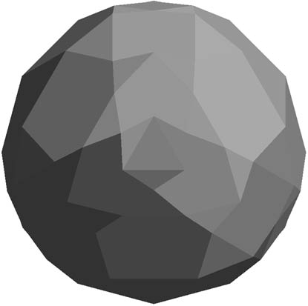
Polygon Normals
Polygons have a single normal
  Shades at the vertices as computed by the Phong model can be almost same
  Identical for a distant viewer (default) or if there is no specular component
Consider model of sphere
Want different normals at
each vertex even though
this concept is not quite
correct mathematically

Slide 19
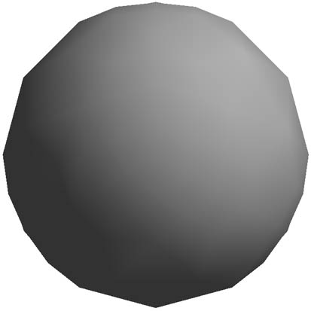
Smooth Shading
We can set a new normal at each vertex
Easy for sphere model
  If centered at origin n = p
Now smooth shading works
Note silhouette edge

Slide 20
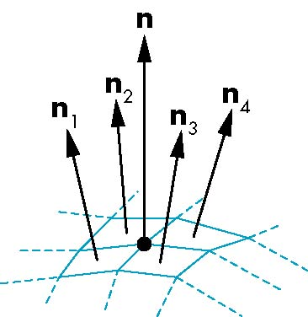
Mesh Shading
The previous example is not general because we knew the normal at each vertex analytically
For polygonal models, Gouraud proposed we use the average of the normals around a mesh vertex
n = (n₁+n₂+n₃+n₄)/ |n₁+n₂+n₃+n₄|

Slide 21
Gouraud and Phong Shading
Gouraud Shading
  Find average normal at each vertex (vertex normals)
  Apply modified Phong model at each vertex
  Interpolate vertex shades across each polygon
Phong shading
  Find vertex normals
  Interpolate vertex normals across edges
  Interpolate edge normals across polygon
  Apply modified Phong model at each fragment

Slide 22
Comparison
If the polygon mesh approximates surfaces with a high curvatures, Phong shading may look smooth while Gouraud shading may show edges
Phong shading requires much more work than Gouraud shading
  Until recently not available in real time systems
  Now can be done using fragment shaders (see Chapter 9)
Both need data structures to represent meshes so we can obtain vertex normals

Slide 23
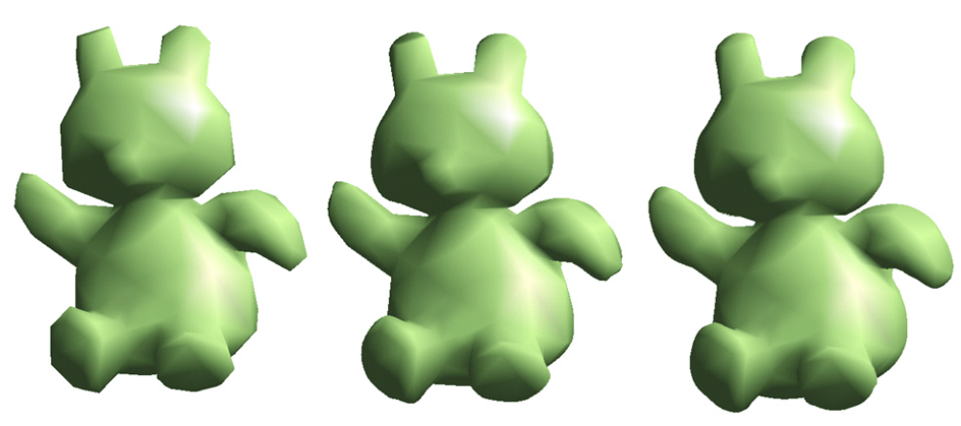
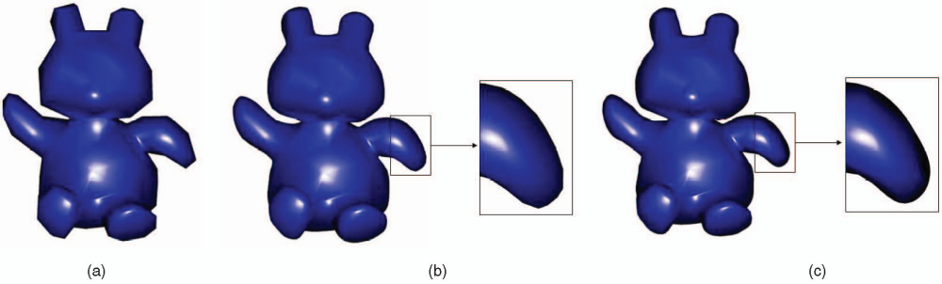
Gouraud and Phong shading

Slide 24
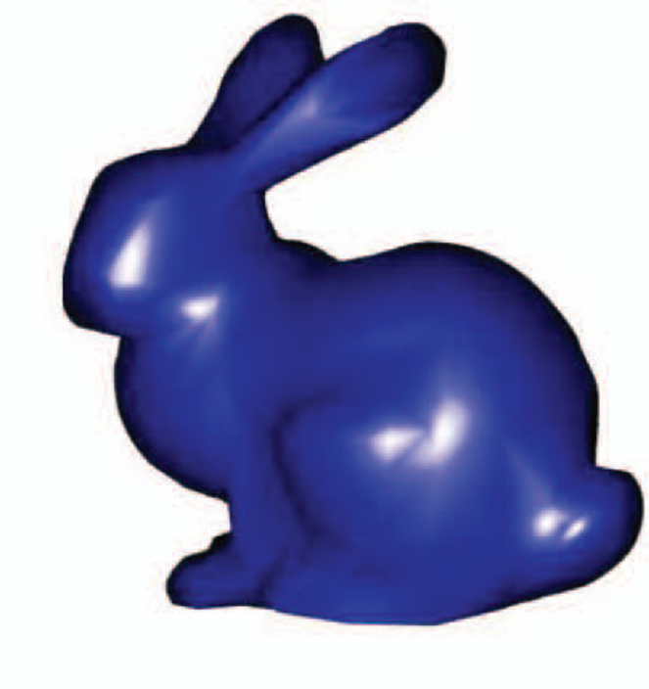
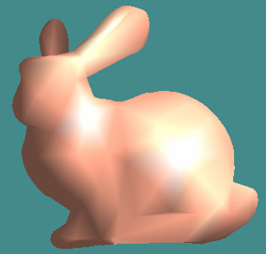
Gouraud and Phong Shading

Slide 25
