Slide 1
Implementation I
Changhe Tu
Shandong University

Slide 2
Objectives
Introduce basic implementation strategies
Clipping
Scan conversion

Slide 3
Overview
At end of the geometric pipeline, vertices have been assembled into primitives
Must clip out primitives that are outside the view frustum
  Algorithms based on representing primitives by lists of vertices
Must find which pixels can be affected by each primitive
  Fragment generation
  Rasterization or scan conversion

Slide 4
Required Tasks
Clipping
Rasterization or scan conversion
Transformations
Some tasks deferred until fragement processing
  Hidden surface removal
  Antialiasing

Slide 5
Rasterization Meta Algorithms
Consider two approaches to rendering a scene with opaque objects
For every pixel, determine which object that projects on the pixel is closest to the viewer and compute the shade of this pixel
  Ray tracing paradigm
For every object, determine which pixels it covers and shade these pixels
  Pipeline approach
  Must keep track of depths

Slide 6
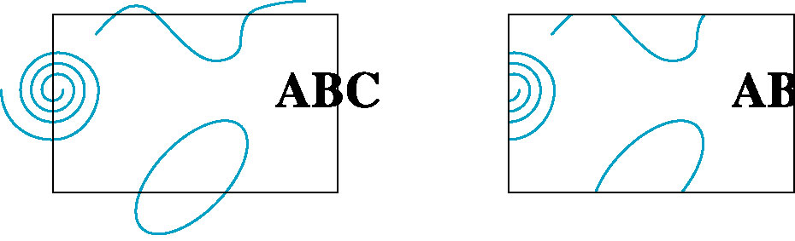
Clipping
2D against clipping window
3D against clipping volume
Easy for line segments polygons
Hard for curves and text
  Convert to lines and polygons first

Slide 7
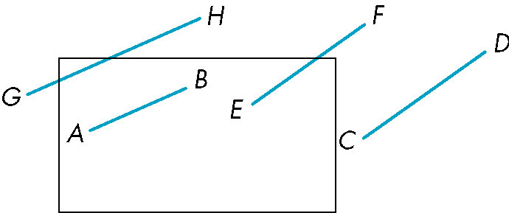
Clipping 2D Line Segments
Brute force approach: compute intersections with all sides of clipping window
  Inefficient: one division per intersection

Slide 8
Cohen-Sutherland Algorithm
Idea: eliminate as many cases as possible without computing intersections
Start with four lines that determine the sides of the clipping window
y = y_{max}
x = x_{min}
x = x_{max}
y = y_{min}

Slide 9
The Cases
Case 1: both endpoints of line segment inside all four lines
  Draw (accept) line segment as is
Case 2: both endpoints outside all lines and on same side of a line
  Discard (reject) the line segment
y = y_{max}
x = x_{min}
x = x_{max}
y = y_{min}

Slide 10
The Cases
Case 3: One endpoint inside, one outside
  Must do at least one intersection
Case 4: Both outside
  May have part inside
  Must do at least one intersection
y = y_{max}
x = x_{min}
x = x_{max}

Slide 11
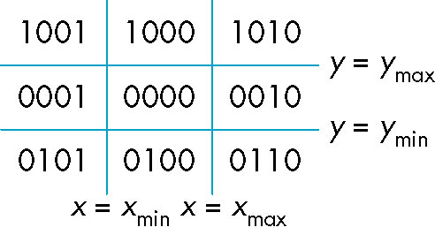
Defining Outcodes
For each endpoint, define an outcode
Outcodes divide space into 9 regions
Computation of outcode requires at most 4 subtractions
b₀b₁b₂b₃
b₀ = 1 if y > y_{max}, 0 otherwise
b₁ = 1 if y < y_{min}, 0 otherwise
b₂ = 1 if x > x_{max}, 0 otherwise
b₃ = 1 if x < x_{min}, 0 otherwise

Slide 12
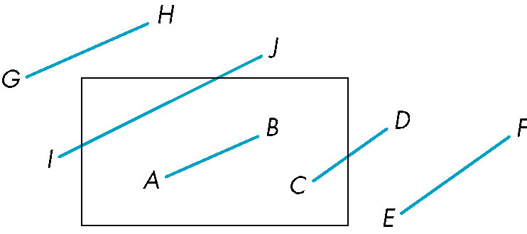
Using Outcodes
Consider the 5 cases below
AB: outcode(A) = outcode(B) = 0
  Accept line segment

Slide 13
Using Outcodes
CD: outcode (C) = 0, outcode(D) ≠ 0
  Compute intersection
  Location of 1 in outcode(D) determines which edge to intersect with
  Note if there were a segment from A to a point in a region with 2 ones in outcode, we might have to do two interesections

Slide 14
Using Outcodes
EF: outcode(E) logically ANDed with outcode(F) (bitwise) ≠ 0
  Both outcodes have a 1 bit in the same place
  Line segment is outside of corresponding side of clipping window
  reject

Slide 15
Using Outcodes
GH and IJ: same outcodes, neither zero but logical AND yields zero
Shorten line segment by intersecting with one of sides of window
Compute outcode of intersection (new endpoint of shortened line segment)
Reexecute algorithm

Slide 16
Efficiency
In many applications, the clipping window is small relative to the size of the entire data base
  Most line segments are outside one or more side of the window and can be eliminated based on their outcodes
Inefficiency when code has to be reexecuted for line segments that must be shortened in more than one step

Slide 17
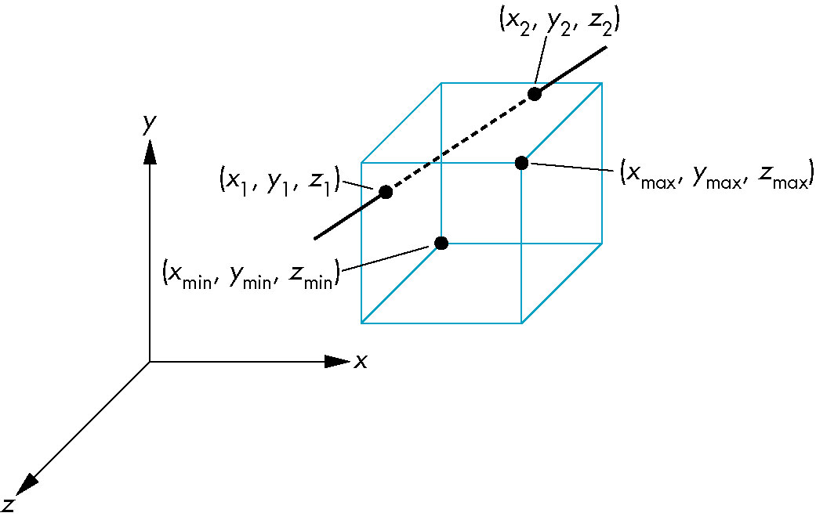
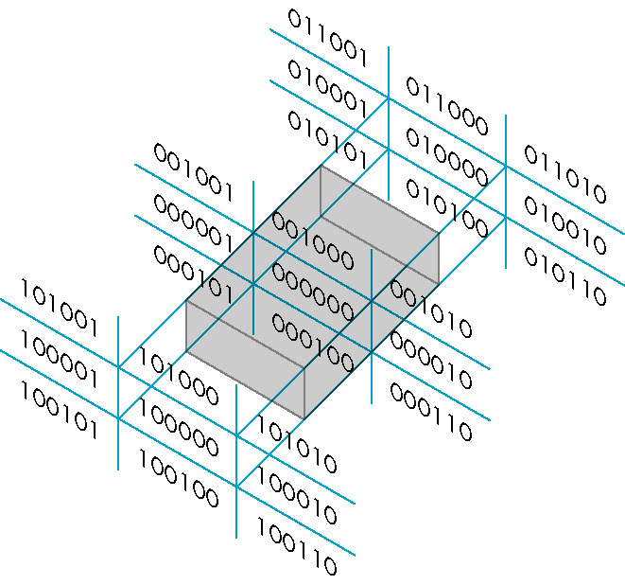
Cohen Sutherland in 3D
Use 6-bit outcodes
When needed, clip line segment against planes

Slide 18
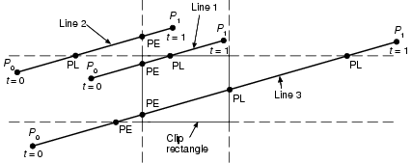
Liang-Barsky Clipping
x=x₀ + t(x₁ – x₀)
y=y₀ + t(y₁ – y₀)
For each clip edge (to upright rectangle), we can easily calculate a value t corresponding to the intersection point between the edge and the line segment. We get four values of t in total.
Intersections can be classified as PE or PL (How to?)
Divide t into two groups({t₀’, t₀”} {t₁’, t₁”}) according to its corresponding intersection belongs to PE or PL.
We get t₀ = max (t₀’, t₀”,0),t₁ = min(t₁’, t₁”,1)
If t₀ < t₁ , the line segment between [t₀ , t₁] is visible, otherwise, the whole line is invisible

Slide 19
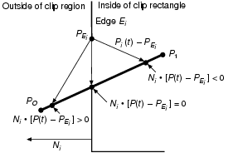
Liang-Barsky Clipping
Step 1. Calculate t
P(t)= P₀ + t(P₁ – P₀)
The value of t at the intersection satisfy:
N_{i}* [P(t) -P_{Ei}]=0
Substitute for P(t):
N_{i}* [P₀ + t(P₁ – P₀) -P_{Ei}]=0
N_{i}* [P₀ -P_{Ei} ]+ N_{i}* t(P₁ – P₀)=0
t= - N_{i}*[P₀ -P_{Ei} ]/ N_{i}* D
D =P₁ – P₀
N_{i}*D <0 then >90 then PE
N_{i}*D >0 then <90 then PL

Slide 20
Liang-Barsky Clipping
precalculate N_{i} and select a P_{Ei} for each edge
for (each line segment to be clipped){
  If (P₀ = P₁ )
    Line is degenerate so clip as a point;
  else{
    t_{e} =0; t_{l} =1;D=P₁-P₀;
    for (each candidate intersection with a clip edge){
      if (N_{i} * D !=0) { // ignore edges parallel to line
        calculate t; //See previous slide
        use sign of N_{i} * D to categorize as PE or PL;
        if (PE) t_{e} =max(t_{e}. t);
        if (PL) t_{l} =min(t_{l}. t);
      }
    }
    if (t_{e} > t_{l} ) return nil;
    else return P(t_{e}) and P(t_{l}) as true clip intersections;
  }
}

Slide 21
Liang-Barsky Clipping
Advantages:
  parametric line clipping wins when many line segments need to be clipped, since the actual calculation of the coordinates of the intersection points is postponed until needed, and testing can be done on parameter values.

Slide 22
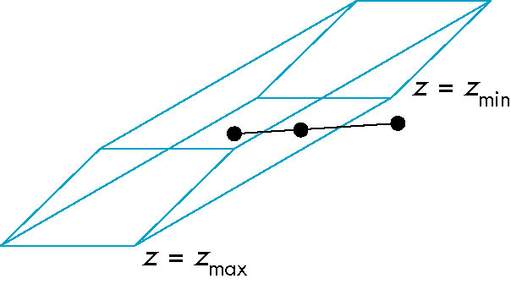
Clipping and Normalization
General clipping in 3D requires intersection of line segments against arbitrary plane
Example: oblique view

Slide 23
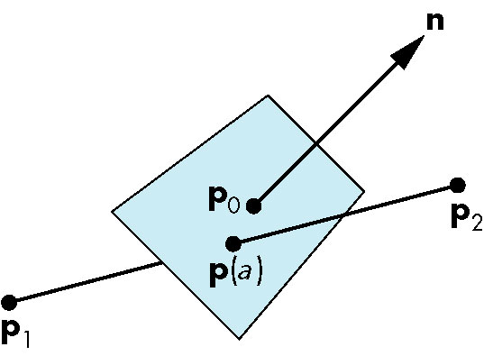
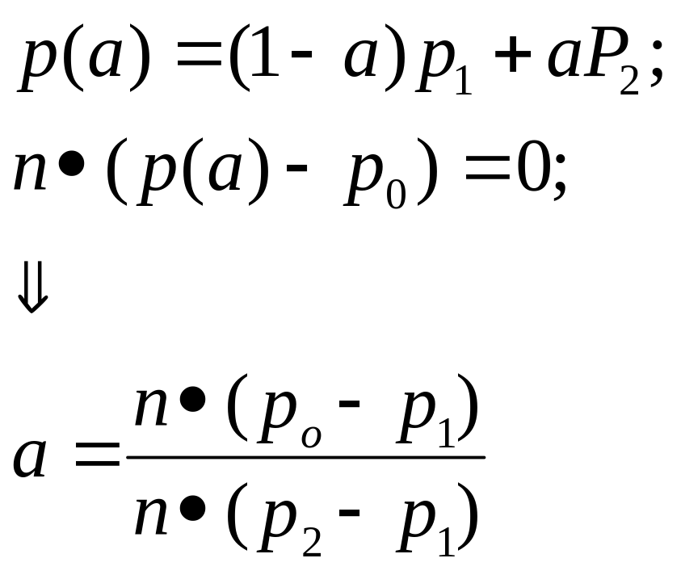
Plane-Line Intersections

Slide 24
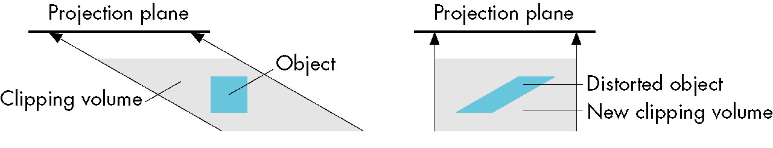
Normalized Form
top view
before normalization
after normalization
Normalization is part of viewing (pre clipping)
but after normalization, we clip against sides of
right parallelepiped
Typical intersection calculation now requires only
a floating point subtraction, e.g. is x > x_{max} ?

