Slide 1
Implementation II
Changhe Tu
Shandong University

Slide 2
Objectives
Introduce clipping algorithms for polygons
Survey hidden-surface algorithms

Slide 3
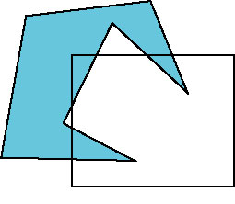
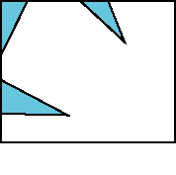
Polygon Clipping
Not as simple as line segment clipping
  Clipping a line segment yields at most one line segment
  Clipping a polygon can yield multiple polygons
However, clipping a convex polygon can yield at most one other polygon

Slide 4
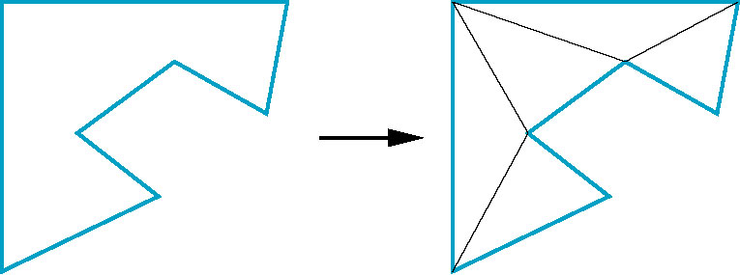
Tessellation and Convexity
One strategy is to replace nonconvex (concave) polygons with a set of triangular polygons (a tessellation)
Also makes fill easier
Tessellation code in GLU library

Slide 5
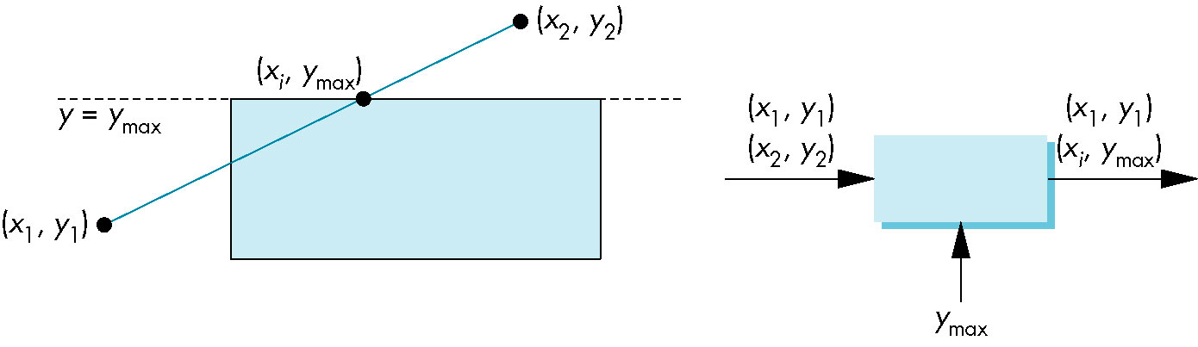
Clipping as a Black Box
Can consider line segment clipping as a process that takes in two vertices and produces either no vertices or the vertices of a clipped line segment

Slide 6
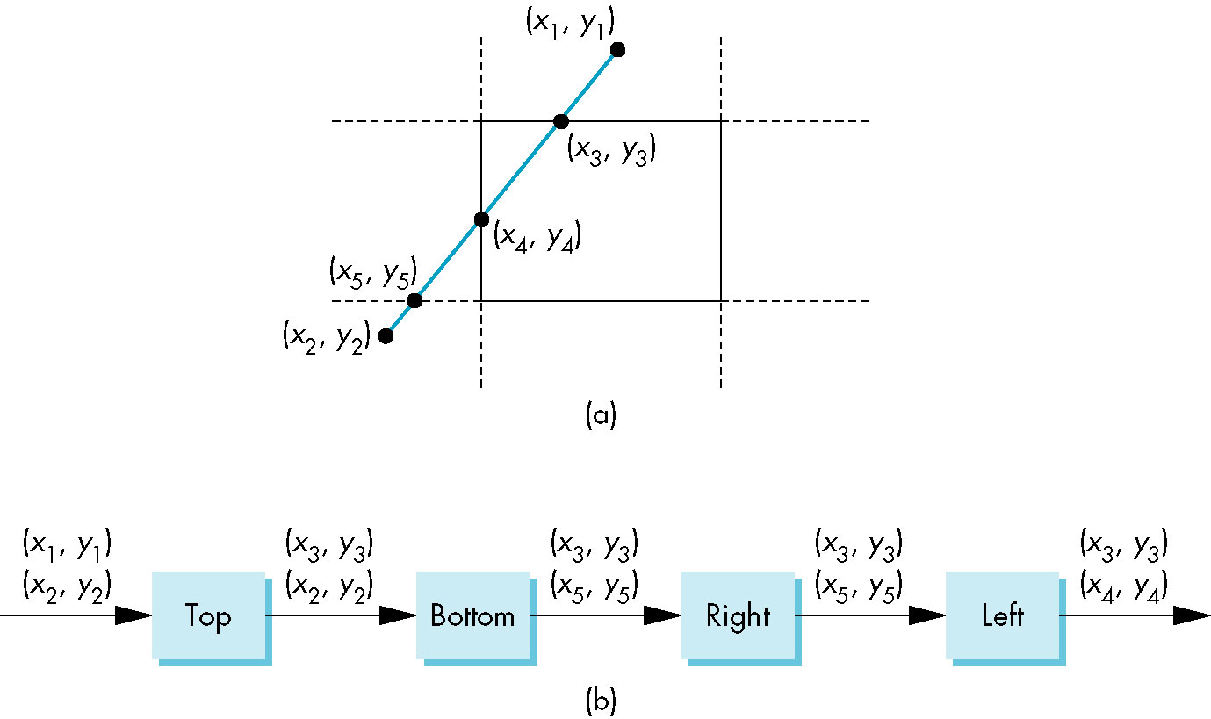
Pipeline Clipping of Line Segments
Clipping against each side of window is independent of other sides
  Can use four independent clippers in a pipeline

Slide 7
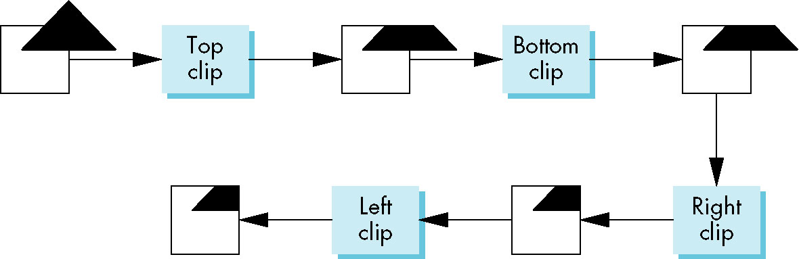
Pipeline Clipping of Polygons
Three dimensions: add front and back clippers
Strategy used in SGI Geometry Engine
Small increase in latency

Slide 8
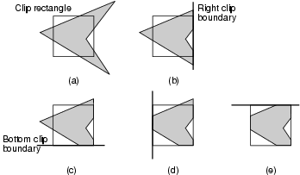
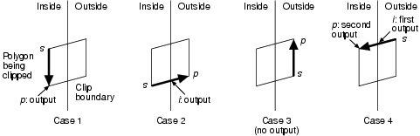
Sutherland-Hodgman Algorithm
The algorithm clips against a single, infinite clip edge and outputs another series of vertices defining the clipped polygon. In a second pass, the partially clipped polygon is then clipped against the second clip edge, and so on.
The algorithm moves around the polygon from v_{n} to v₁ and then on back to v_{n} at each step examining the relationship between successive vertices and the clip edge. At each step, zero, one, or two vertices are added to the output list of vertices that defines the clipped polygon.

Slide 9
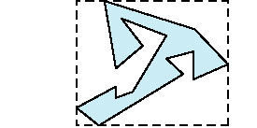
Bounding Boxes
Rather than doing clipping on a complex polygon, we can use an axis-aligned bounding box or extent
  Smallest rectangle aligned with axes that encloses the polygon
  Simple to compute: max and min of x and y

Slide 10
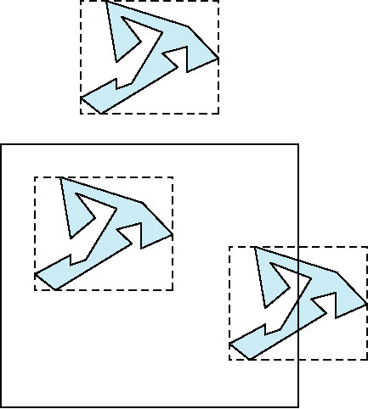
Bounding boxes
Can usually determine accept/reject based only on bounding box
reject
accept
requires detailed
clipping

Slide 11
Clipping and Visibility
Clipping has much in common with hidden-surface removal
In both cases, we are trying to remove objects that are not visible to the camera
Often we can use visibility or occlusion testing early in the process to eliminate as many polygons as possible before going through the entire pipeline

Slide 12
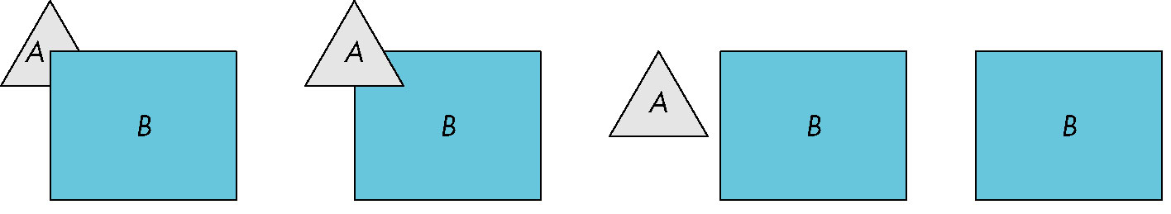
Hidden Surface Removal
Object-space approach: use pairwise testing between polygons (objects)
Worst case complexity O(n²) for n polygons
partially obscuring
can draw independently

Slide 13
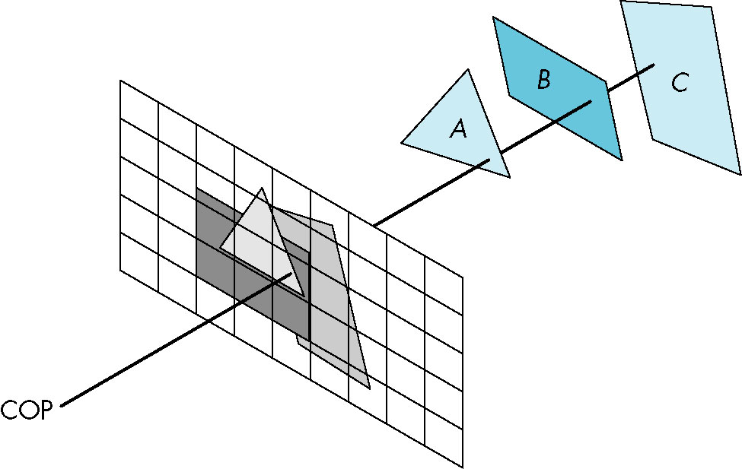
Image Space Approach
Look at each projector (nm for an n x m frame buffer) and find closest of k polygons
Complexity O(nmk)
Ray tracing
z-buffer

Slide 14
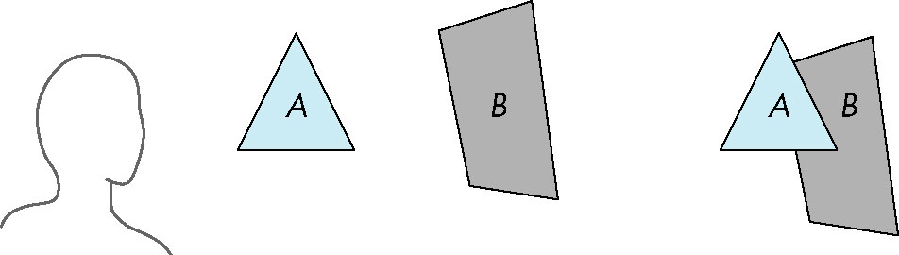
Painter’s Algorithm
Render polygons a back to front order so that polygons behind others are simply painted over
B behind A as seen by viewer
Fill B then A

Slide 15
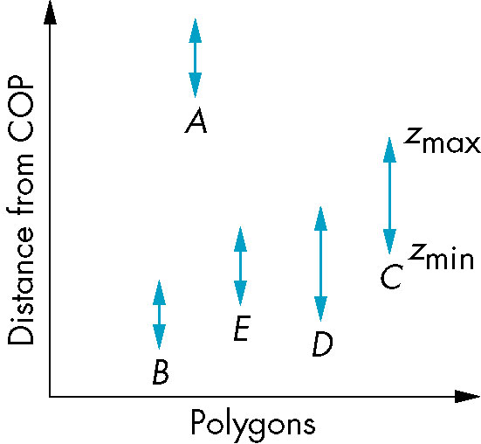
Depth Sort
Requires ordering of polygons first
  O(n log n) calculation for ordering
  Not every polygon is either in front or behind all other polygons
Order polygons and deal with
easy cases first, harder later
Polygons sorted by
distance from COP

Slide 16
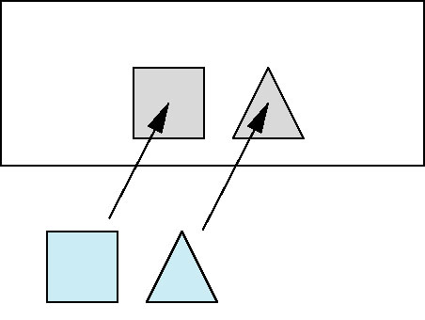
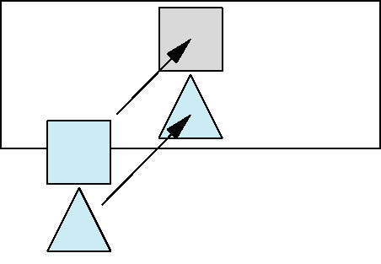
Easy Cases
(1) A lies behind all other polygons
  Can render
(2) Polygons overlap in z but not in either x or y
  Can render independently

Slide 17
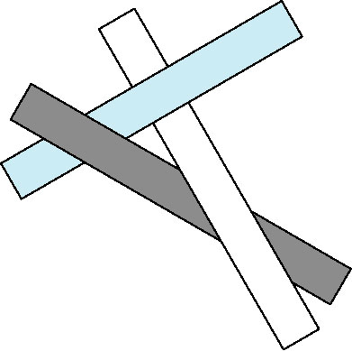
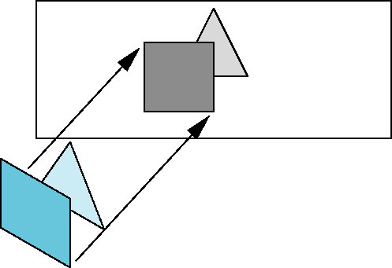
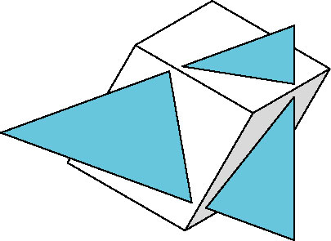
Hard Cases
cyclic overlap
(3) Overlap in all directions
but one is fully on
one side of the other
(4)
penetration

Slide 18
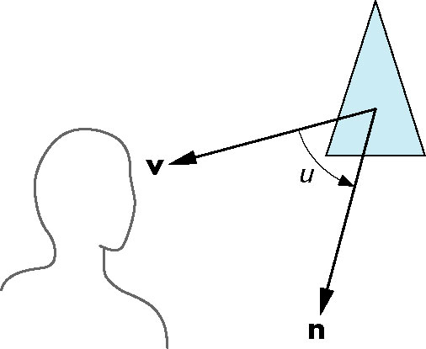
Back-Face Removal (Culling)
face is visible iff 90 ≥ θ ≥ -90
equivalently cos θ ≥ 0
or v • n ≥ 0
θ
plane of face has form ax + by +cz +d =0
but after normalization v = ( 0 0 1 0)^{T}
need only test the sign of c
In OpenGL we can simply enable culling
but may not work correctly if we have nonconvex objects

Slide 19
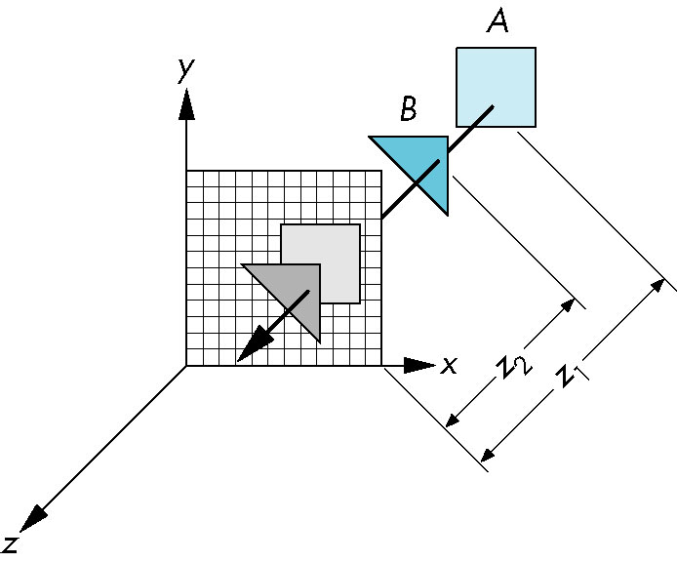
z-Buffer Algorithm
Use a buffer called the z or depth buffer to store the depth of the closest object at each pixel found so far
As we render each polygon, compare the depth of each pixel to depth in z buffer
If less, place shade of pixel in color buffer and update z buffer

Slide 20
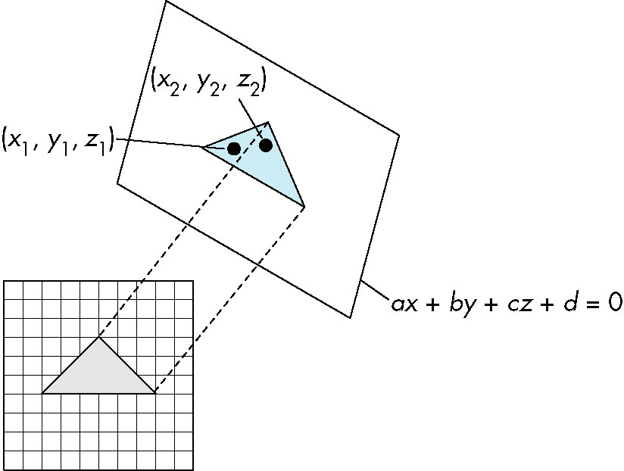

Efficiency
If we work scan line by scan line as we move across a scan line, the depth changes satisfy aΔx+bΔy+cΔz=0
Along scan line
Δy = 0
Δz = - Δx
In screen space Δx = 1

Slide 21
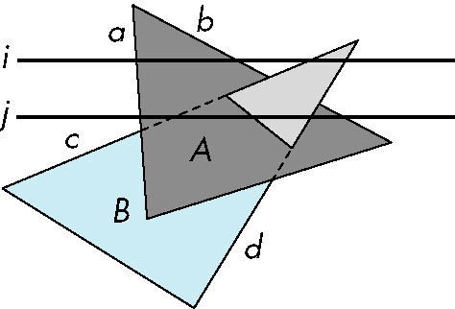
Scan-Line Algorithm
Can combine shading and hsr through scan line algorithm
scan line i: no need for depth
information, can only be in no
or one polygon
scan line j: need depth
information only when in
more than one polygon

Slide 22
Implementation
Need a data structure to store
  Flag for each polygon (inside/outside)
  Incremental structure for scan lines that stores which edges are encountered
  Parameters for planes

Slide 23
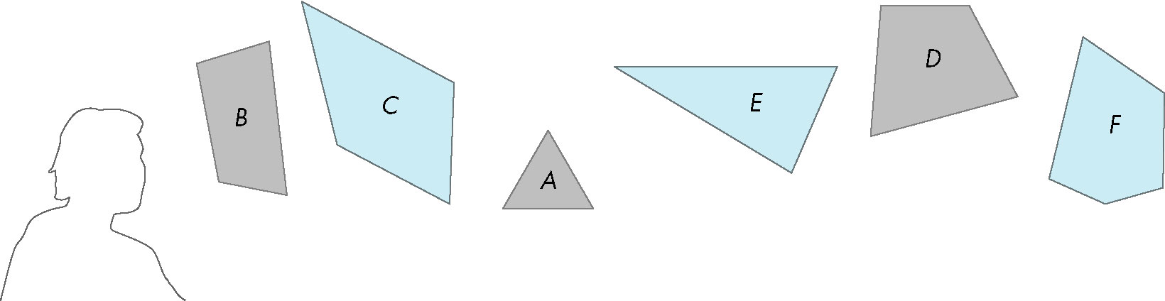
Visibility Testing
In many realtime applications, such as games, we want to eliminate as many objects as possible within the application
  Reduce burden on pipeline
  Reduce traffic on bus
Partition space with Binary Spatial Partition (BSP) Tree

Slide 24
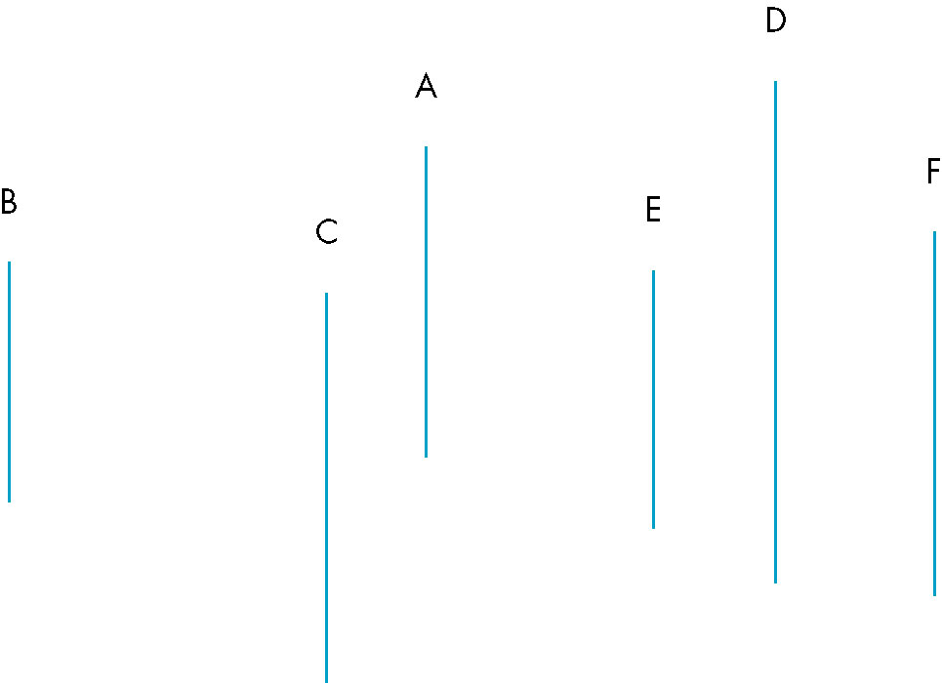
Simple Example
consider 6 parallel polygons
top view
The plane of A separates B and C from D, E and F

Slide 25
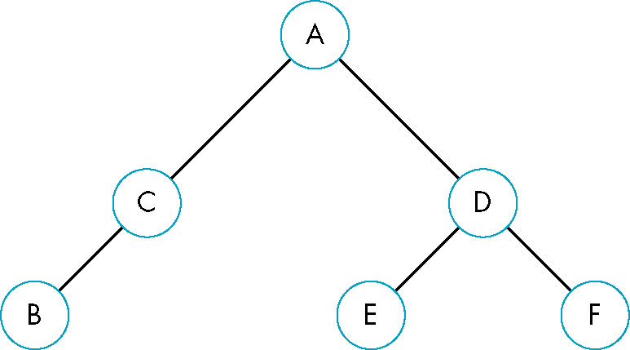
BSP Tree
Can continue recursively
  Plane of C separates B from A
  Plane of D separates E and F
Can put this information in a BSP tree
  Use for visibility and occlusion testing

Slide 26
BSP display
Type Tree
  Tree* front;
  Face face;
  Tree *back;
End
Algorithm DrawBSP(Tree T; point: w)
  //w 为视点
  If T is null then return; endif
  If w is in front of T.face then
    DrawBSP(T.back,w);
    Draw(T.face,w);
    DrawBSP(T.front,w);
  Else // w is behind or on T.face
    DrawBSP(T.front,w);
    Draw(T.face,w);
    DrawBSP(T. back,w);
  Endif
end

