Slide 1
Texture Mapping
Changhe Tu
Shandong University

Slide 2
Objectives
Introduce Mapping Methods
  Texture Mapping
  Environment Mapping
  Bump Mapping
Consider basic strategies
  Forward vs backward mapping
  Point sampling vs area averaging

Slide 3
The Limits of Geometric Modeling
Although graphics cards can render over 10 million polygons per second, that number is insufficient for many phenomena
  Clouds
  Grass
  Terrain
  Skin

Slide 4
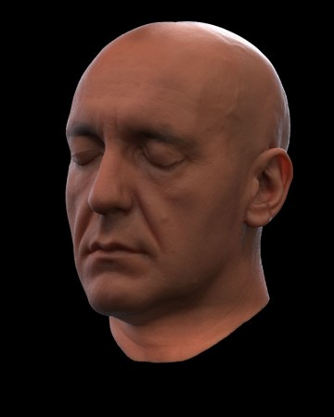

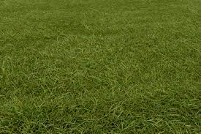
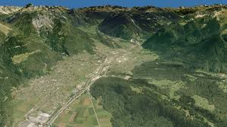
Examples

Slide 5
Three Types of Mapping
Texture Mapping
  Uses images to fill inside of polygons
Environment (reflection mapping)
  Uses a picture of the environment for texture maps
  Allows simulation of highly specular surfaces
Bump mapping
  Emulates altering normal vectors during the rendering process

Slide 6
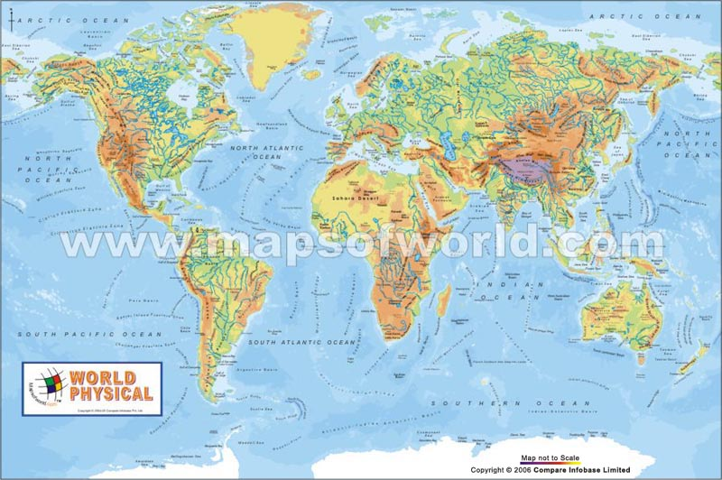
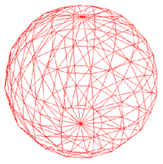
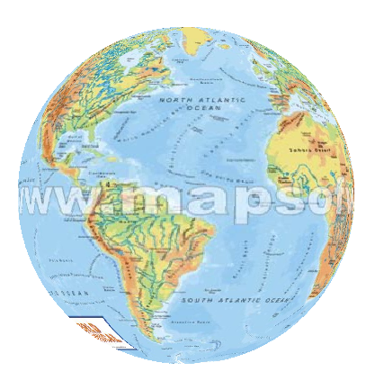
Texture Mapping
Texture
geometric model
texture mapped

Slide 7
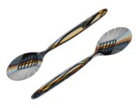
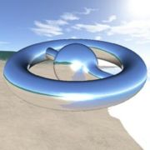
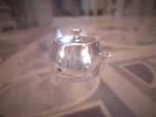
Environment Mapping

Slide 8
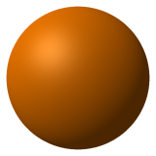
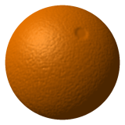

Bump Mapping
Geometric model without bump mapping
Bump Map
Mapped result

Slide 9
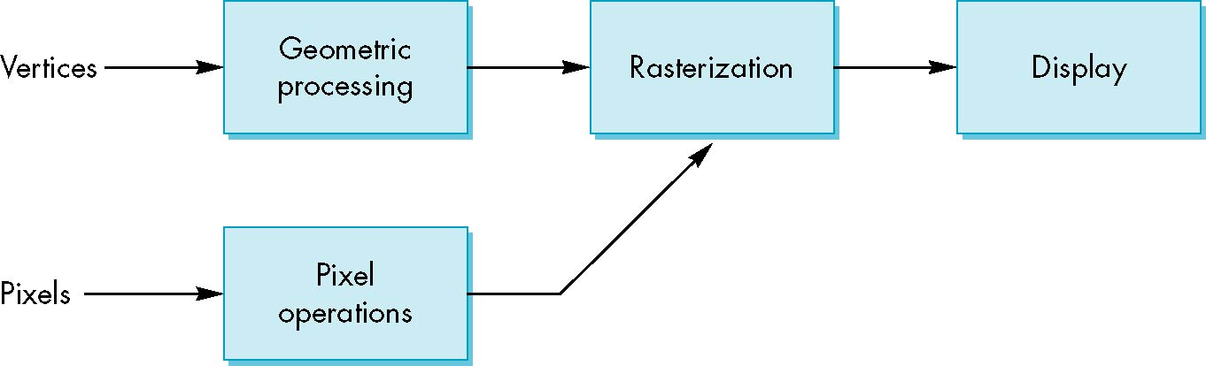
Where does mapping take place?
Mapping techniques are implemented at the end of the rendering pipeline
  Very efficient because few polygons make it past the clipper

Slide 10
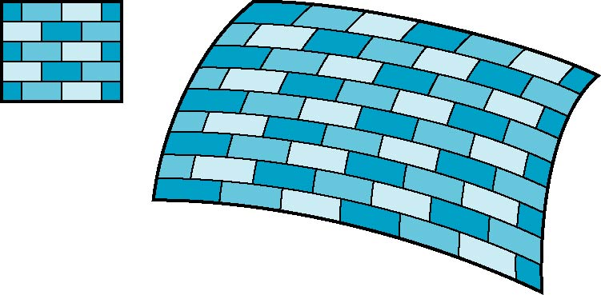
Is it simple?
Although the idea is simple---map an image to a surface---there are 3 or 4 coordinate systems involved
2D image
3D surface

Slide 11
Coordinate Systems
Parametric coordinates
  May be used to model curves and surfaces
Texture coordinates
  Used to identify points in the image to be mapped
Object or World Coordinates
  Conceptually, where the mapping takes place
Window Coordinates
  Where the final image is really produced

Slide 12
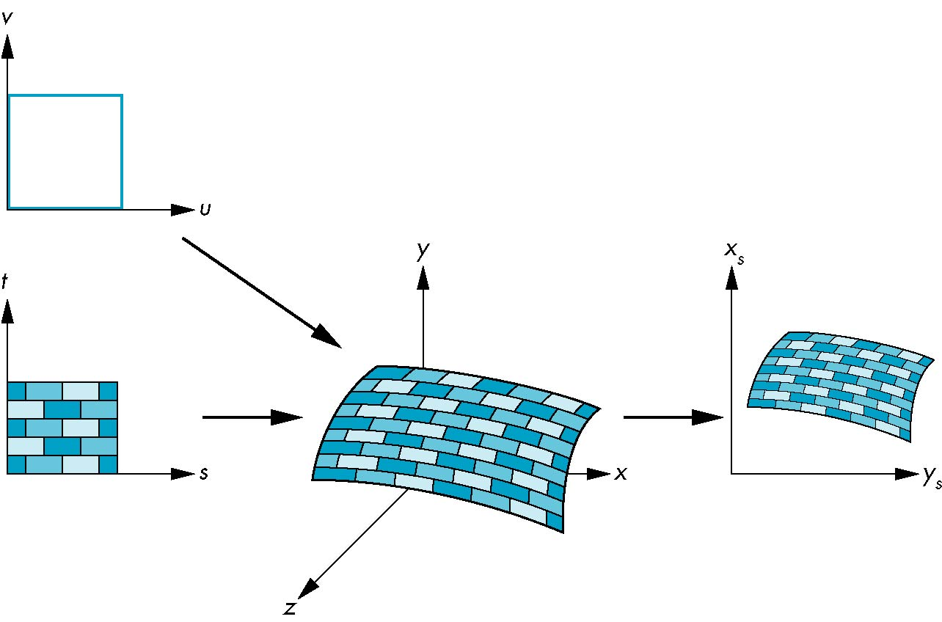
Texture Mapping
parametric coordinates
texture coordinates
window coordinates
world coordinates

Slide 13
Mapping Functions
Basic problem is how to find the maps
Consider mapping from texture coordinates to a point a surface
Appear to need three functions
  x = x(s,t)
  y = y(s,t)
  z = z(s,t)
But we really want
to go the other way
(x,y,z)
t
s

Slide 14
Backward Mapping
We really want to go backwards
  Given a pixel, we want to know to which point on an object it corresponds
  Given a point on an object, we want to know to which point in the texture it corresponds
Need a map of the form
    s = s(x,y,z)
    t = t(x,y,z)
Such functions are difficult to find in general

Slide 15
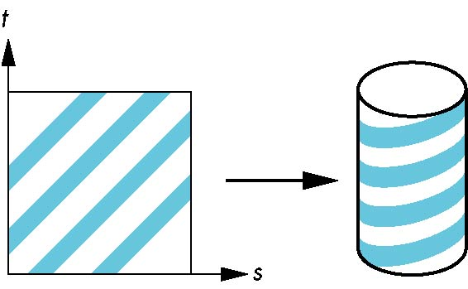
Two-part mapping
One solution to the mapping problem is to first map the texture to a simple intermediate surface
Example: map to cylinder

Slide 16
Cylindrical Mapping
parametric cylinder
x = r cos 2π u
y = r sin 2πu
z = v/h
maps rectangle in u,v space to cylinder
of radius r and height h in world coordinates
s = u
t = v
maps from texture space

Slide 17
Spherical Map
We can use a parametric sphere
x = r cos 2πu
y = r sin 2πu cos 2πv
z = r sin 2πu sin 2πv
in a similar manner to the cylinder
but have to decide where to put
the distortion
Spheres are used in environmental maps

Slide 18
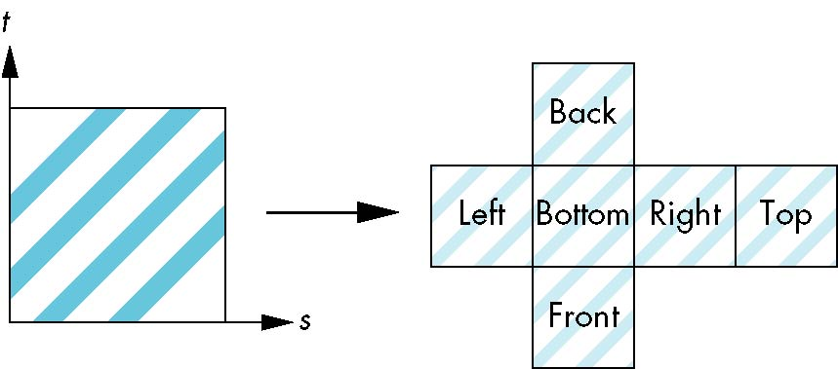
Box Mapping
Easy to use with simple orthographic projection
Also used in environment maps

Slide 19
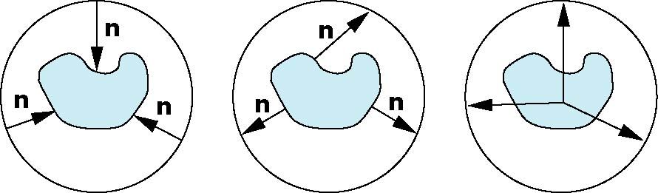
Second Mapping
Map from intermediate object to actual object
  Normals from intermediate to actual
  Normals from actual to intermediate
  Vectors from center of intermediate
actual
intermediate

Slide 20
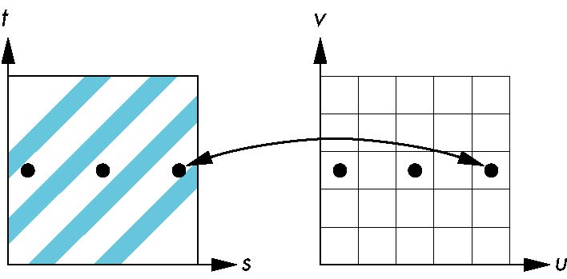
Aliasing
Point sampling of the texture can lead to aliasing errors
miss blue stripes
point samples in u,v
(or x,y,z) space
point samples in texture space

Slide 21
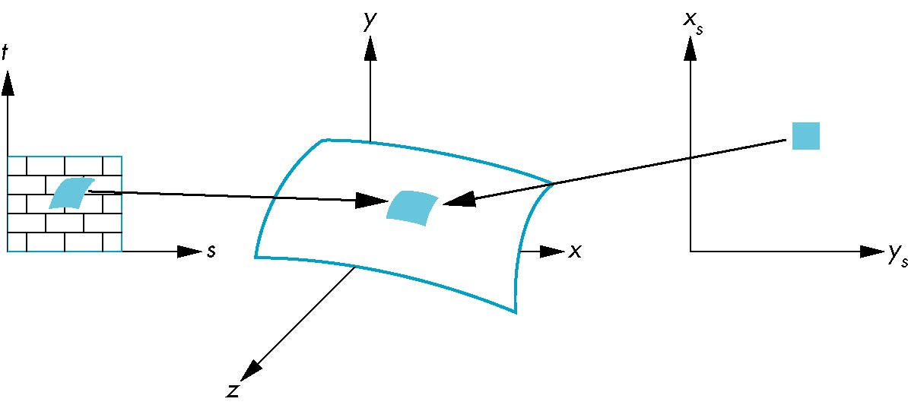
Area Averaging
A better but slower option is to use area averaging
pixel
preimage
Note that preimage of pixel is curved

