Slide 1
OpenGL Texture Mapping
Changhe Tu
Shandong University

Slide 2
Objectives
Introduce the OpenGL texture functions and options

Slide 3
Basic Strategy
Three steps to applying a texture
  specify the texture
    read or generate image
    assign to texture
    enable texturing
  assign texture coordinates to vertices
    Proper mapping function is left to application
  specify texture parameters
    wrapping, filtering

Slide 4
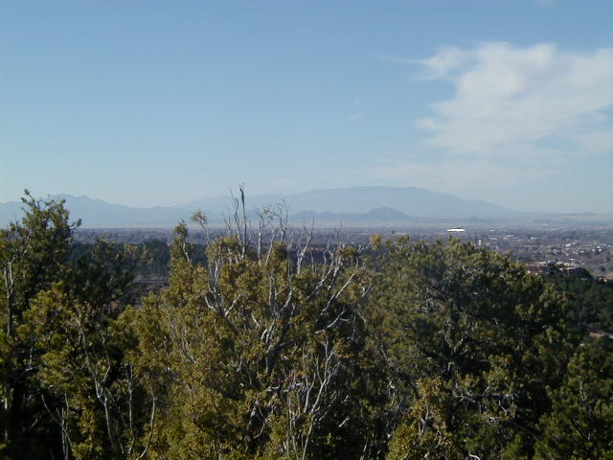
Texture Mapping
y
z
x
geometry
display
t
image
s

Slide 5
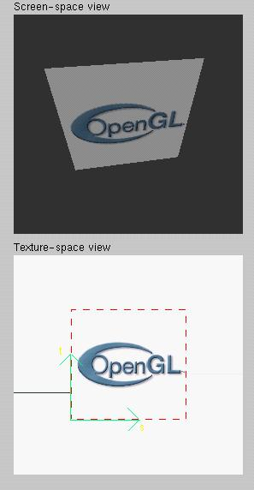
Texture Example
The texture (below) is a 256 x 256 image that has been mapped to a rectangular polygon which is viewed in perspective

Slide 6
Texture Mapping and the OpenGL Pipeline
Images and geometry flow through separate pipelines that join at the rasterizer
  “complex” textures do not affect geometric complexity
vertices
geometry pipeline
rasterizer
image
pixel pipeline

Slide 7
Specifying a Texture Image
Define a texture image from an array of
texels (texture elements) in CPU memory
  Glubyte my_texels[512][512];
Define as any other pixel map
  Scanned image
  Generate by application code
Enable texture mapping
  glEnable(GL_TEXTURE_2D)
  OpenGL supports 1-4 dimensional texture maps

Slide 8
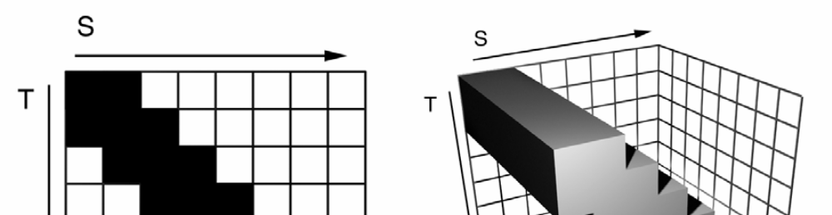
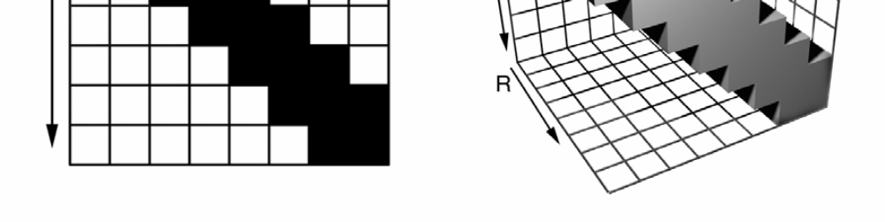
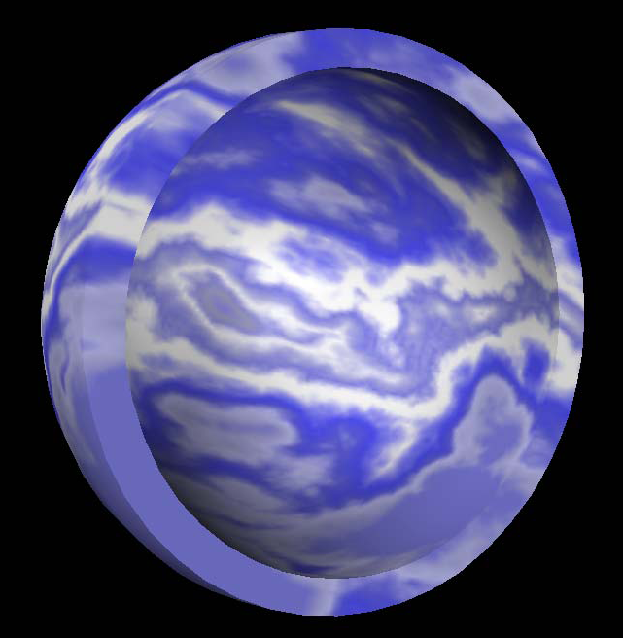
2D vs 3D textures

Slide 9
Define Image as a Texture
glTexImage2D( target, level, components,
w, h, border, format, type, texels );
target: type of texture, e.g. GL_TEXTURE_2D
level: used for mipmapping (discussed later)
components: elements per texel
w, h: width and height of texels in pixels
border: used for smoothing (discussed later)
format and type: describe texels
texels: pointer to texel array
glTexImage2D(GL_TEXTURE_2D, 0, 3, 512, 512, 0, GL_RGB, GL_UNSIGNED_BYTE, my_texels);

Slide 10
Converting A Texture Image
OpenGL requires texture dimensions to be powers of 2
If dimensions of image are not powers of 2
gluScaleImage( format, w_in, h_in,
type_in, *data_in, w_out, h_out,
type_out, *data_out );
  data_in is source image
  data_out is for destination image
Image interpolated and filtered during scaling
Notes:
If

Slide 11
Mapping a Texture
Based on parametric texture coordinates
glTexCoord*() specified at each vertex
Texture Space
Object Space
t
1, 1
(s, t) = (0.2, 0.8)
0, 1
A
a
c
(0.4, 0.2)
b
B
C
0, 0
1, 0
s
(0.8, 0.4)

Slide 12
Typical Code
glBegin(GL_POLYGON);
glColor3f(r0, g0, b0); //if no shading used
glNormal3f(u0, v0, w0); // if shading used
glTexCoord2f(s0, t0);
glVertex3f(x0, y0, z0);
glColor3f(r1, g1, b1);
glNormal3f(u1, v1, w1);
glTexCoord2f(s1, t1);
glVertex3f(x1, y1, z1);
.
.
glEnd();
Note that we can use vertex arrays to increase efficiency

Slide 13
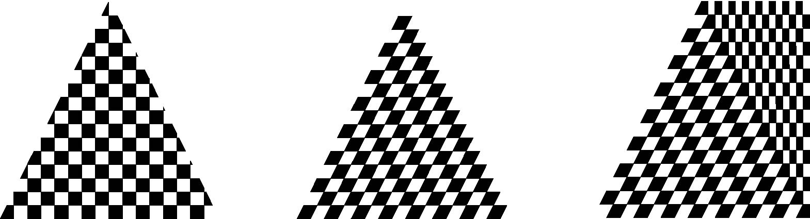
Interpolation
OpenGL uses interpolation to find proper texels from specified texture coordinates
Can be distortions
texture stretched
over trapezoid
showing effects of
bilinear interpolation
good selection
of tex coordinates
poor selection
of tex coordinates

Slide 14
Texture Parameters
OpenGL has a variety of parameters that determine how texture is applied
  Wrapping parameters determine what happens if s and t are outside the (0,1) range
  Filter modes allow us to use area averaging instead of point samples
  Mipmapping allows us to use textures at multiple resolutions
  Environment parameters determine how texture mapping interacts with shading

Slide 15
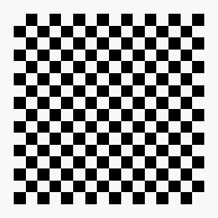
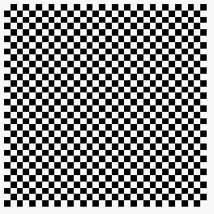

Wrapping Mode
Clamping: if s,t > 1 use 1, if s,t <0 use 0
Wrapping: use s,t modulo 1
  glTexParameteri( GL_TEXTURE_2D,
  GL_TEXTURE_WRAP_S, GL_CLAMP )
  glTexParameteri( GL_TEXTURE_2D,
  GL_TEXTURE_WRAP_T, GL_REPEAT )
t
s
GL_REPEAT
wrapping
GL_CLAMP
wrapping
texture

Slide 16
Magnification and Minification
More than one texel can cover a pixel (minification) or
more than one pixel can cover a texel (magnification)
Can use point sampling (nearest texel) or linear filtering
( 2 x 2 filter) to obtain texture values
Texture
Polygon
Texture
Polygon
Magnification
Minification

Slide 17
Filter Modes
Modes determined by
  glTexParameteri( target, type, mode )
glTexParameteri(GL_TEXTURE_2D, GL_TEXURE_MAG_FILTER,
GL_NEAREST);
glTexParameteri(GL_TEXTURE_2D, GL_TEXURE_MIN_FILTER,
GL_LINEAR);
Note that linear filtering requires a border of an
extra texel for filtering at edges (border = 1)

Slide 18
Mipmapped Textures
Mipmapping allows for prefiltered texture maps of decreasing resolutions
Lessens interpolation errors for smaller textured objects
Declare mipmap level during texture definition
  glTexImage2D( GL_TEXTURE_*D, level, … )
GLU mipmap builder routines will build all the textures from a given image
  gluBuild*DMipmaps( … )

Slide 19
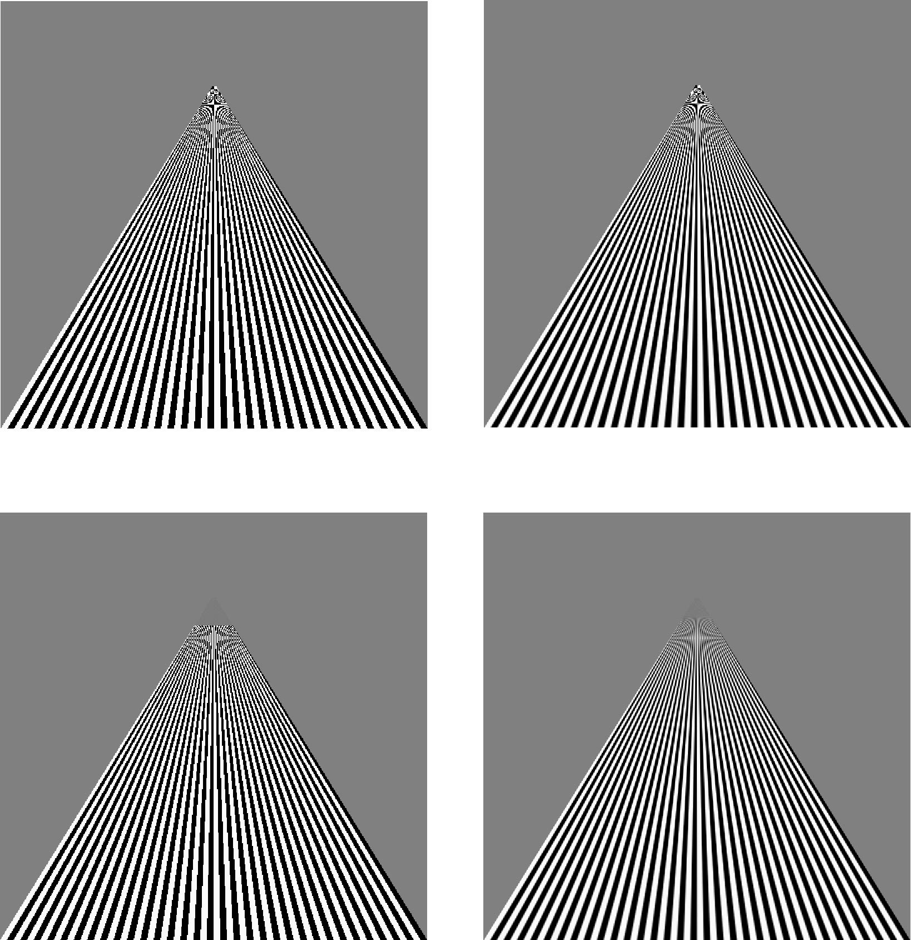
Example
point
sampling
linear
filtering
mipmapped
point
sampling
mipmapped
linear
filtering

Slide 20
Texture Functions
Controls how texture is applied
glTexEnv{fi}[v]( GL_TEXTURE_ENV, prop, param )
GL_TEXTURE_ENV_MODE modes
  GL_MODULATE: modulates with computed shade (C_{f}*C_{t})
  GL_BLEND: blends with an environmental color: C_{f}(1-C_{t})
  GL_REPLACE: use only texture color: C_{t}
  GL(GL_TEXTURE_ENV, GL_TEXTURE_ENV_MODE, GL_MODULATE);
Set blend color with GL_TEXTURE_ENV_COLOR

Slide 21
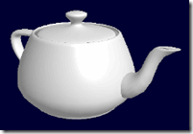
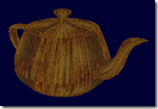
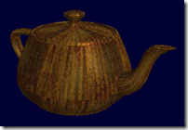
GL_MODULATE

Slide 22
Generating Texture Coordinates
OpenGL can generate texture coordinates automatically
  glTexGen{ifd}[v]()
specify a plane
  generate texture coordinates based upon distance from the plane
generation modes
  GL_OBJECT_LINEAR
  GL_EYE_LINEAR
  GL_SPHERE_MAP (used for environmental maps)

Slide 23
Texture Objects
Texture is part of the OpenGL state
  If we have different textures for different objects, OpenGL will be moving large amounts data from processor memory to texture memory
Recent versions of OpenGL have texture objects
  one image per texture object
  Texture memory can hold multiple texture objects

Slide 24
Applying Textures II
specify textures in texture objects
set texture filter
set texture function
set texture wrap mode
set optional perspective correction hint
bind texture object
enable texturing
supply texture coordinates for vertex
  coordinates can also be generated

Slide 25
Other Texture Features
Environment Maps
  Start with image of environment through a wide angle lens
    Can be either a real scanned image or an image created in OpenGL
  Use this texture to generate a spherical map
  Use automatic texture coordinate generation
Multitexturing
  Apply a sequence of textures through cascaded texture units

