Slide 1
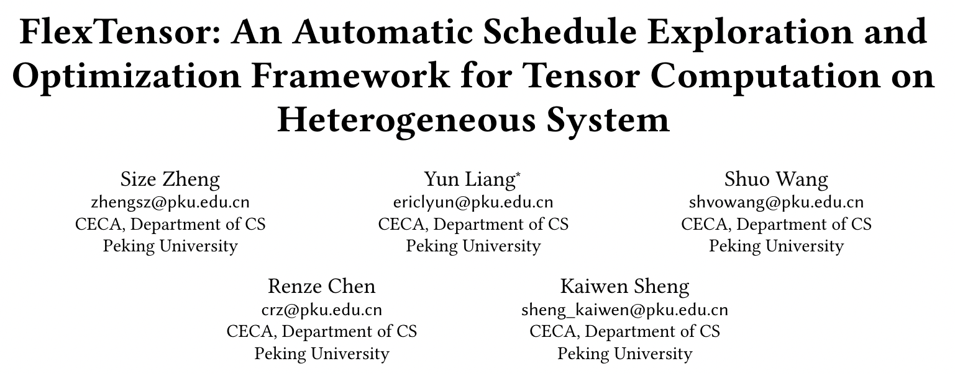
ASPLOS’ 20

Slide 2
1 Introduction
FlexTensor, a shcedule exploration and optimization framework for tensor computations on heterogeneous systems.
分为两部分，front end ， back end
Front End:
输入：Tensor computation written in Python
方法：static analysis to analyze the computation pattern.
输出：生成hardware-specific schedule space.
Back End:
输入：张量程序和schedule space
方法：heuristic and ML combined method
输出：optimized schedule configuration.

Slide 3
2 Background & Motivation
Tensor Computation & Schedules
只考虑Dense tensors
Heterogeneous Systems
CPU: 如果利用parallelism and locality
GPU: 如何利用多线程
FPGA
Motivation
不同schedule和不同硬件对performanc影响很大
如何在不同硬件下找到最好的schedule

Slide 4
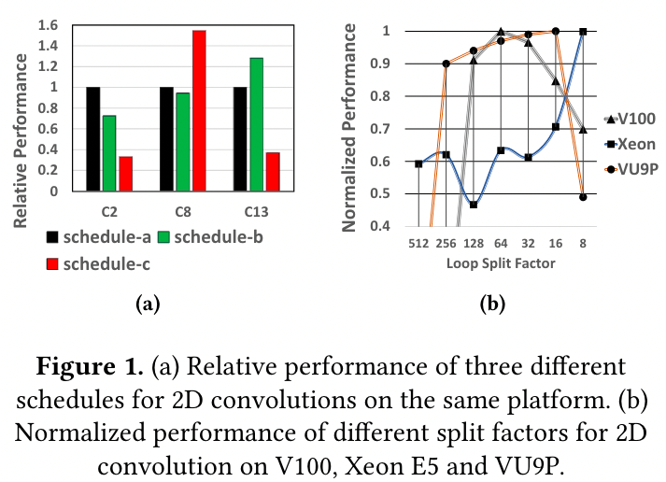

Slide 5
3 Overview of FlexTensor
The front-end
静态分析提取出有用的静态信息
利用静态信息，产生schedule space
The back-end
使用heuristic and machine learning combined approach 在空间中搜索

Slide 6
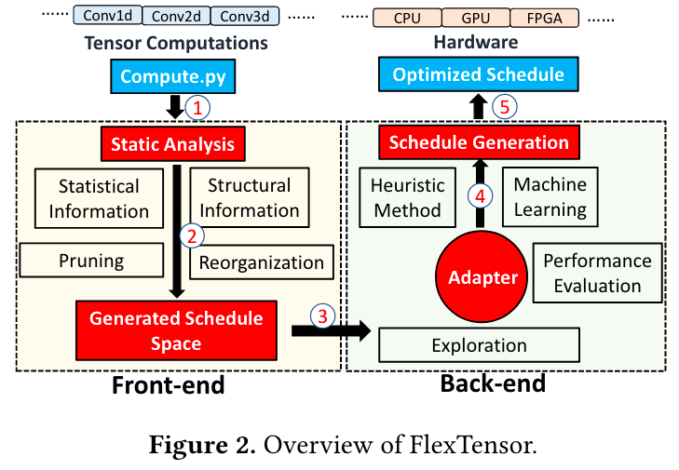

Slide 7
4 Front-end Analysis and Schedule Space
Static Analysis
Schedule Space Generation
静态分析阶段提取代码的静态信息，然后用这些信息生成schedule空间。

Slide 8
Static Analysis
statistical information
number of spatial loops (noted as #sl)
number of reduce loops (noted as #rl)
trip counts of spatial loops (noted as stc)
trip ounts of reduce loops (noted as rtc)
loop orders (noted as order)
structural information
number of nodes in mini-graph (noted as #node)
number of input tensors of each node (noted as #in)
number of output tensors of each node (noted as #out)
number of consumer nodes of each node (noted as #cs)

Slide 9
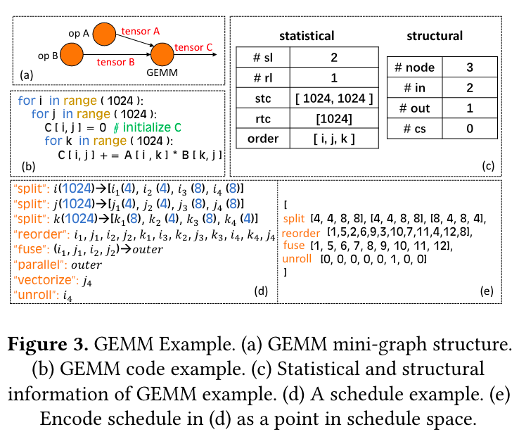

Slide 10
Schedule Space Generation
prune the design space by deleting the points that are unlikely to lead to good performance
rearrange the space by exploiting structural similarity

Slide 11
5 Back-end Exploration and Optimization
Exploration with Heuristics and Machine learning
Performance Comparison
Optimized Schedule Implementation

Slide 12

Exploration with Heuristics and Machine learning
the searching space G
已经被搜索过的点集 H
两个问题：
在H中，选择哪个点进行下一次搜索？
选定点以后，选择哪个方向搜索？
解决方法：
基于模拟退火，
Q-learning
状态是当前点
动作是方向
奖励是运行时间。

Slide 13
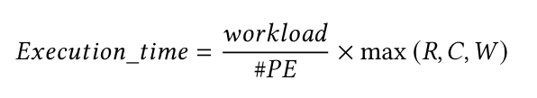
Performance Comparison
CPU和GPU都用实际硬件运行时间，因为编译和运行时间很快(小于1秒)
FPGA由于运行很慢，所以使用性能预测模型：

Slide 14
Optimized Schedule Implementation
在搜索到一个好的schedule point之后，就需要在子图上实现schdule，生成张量程序
子图上有很多结点，这些结点按照什么顺序去生成呢？
自底向上、自顶向下、循环递归
本文中采用自底向上的方式。

Slide 15
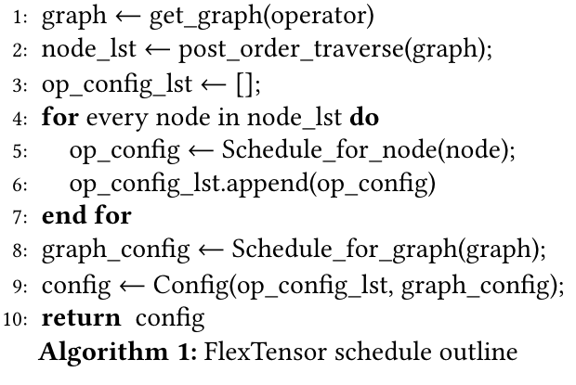

Slide 16
Optimized Schedule Implementation
对于CPU，利用局部性和并行很重要
对于GPU，利用shared memory和线程划分很重要
对于FPGA，需要考虑流水。

Slide 17
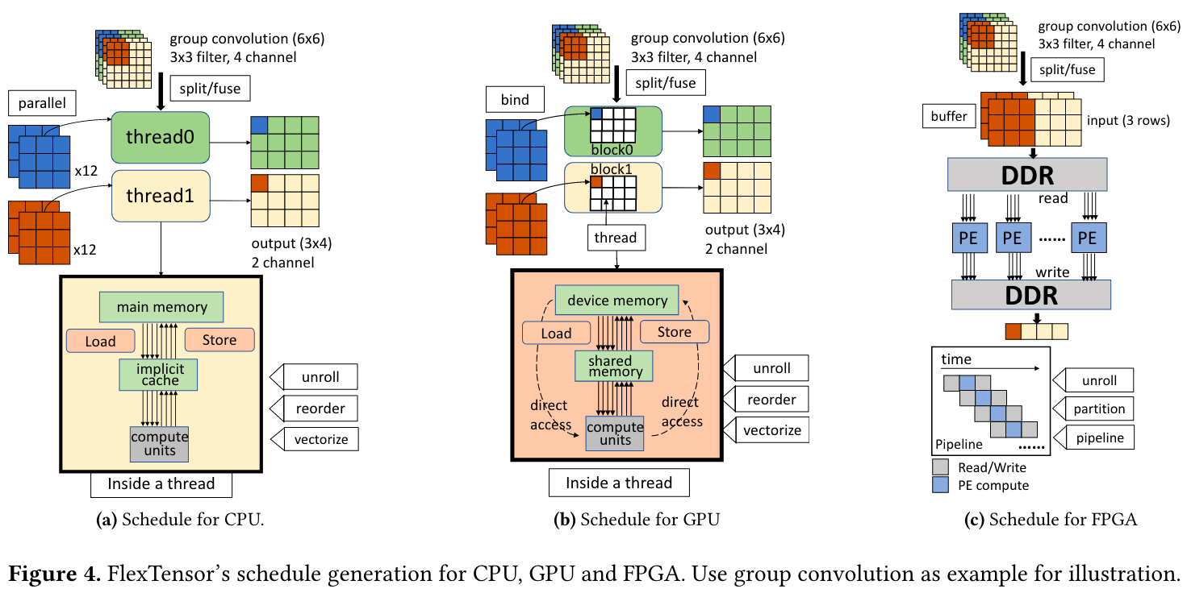

Slide 18
6 Experiments
Experiments Setup
Overall Speedups on GPUs
Detailed Performance on Heterogeneous Hardware
Performance for New Operators
Comparison to State-of-the-Art
Case Study of DNNs

Slide 19
Experiments Setup
使用TVM后端codegen
一系列tensor computation
与pytorch中的算子库对比
CPU: Intel Xeon
GPU: V100, P100, Titan X
FPGA: Xilinx VU9P FPGA

Slide 20
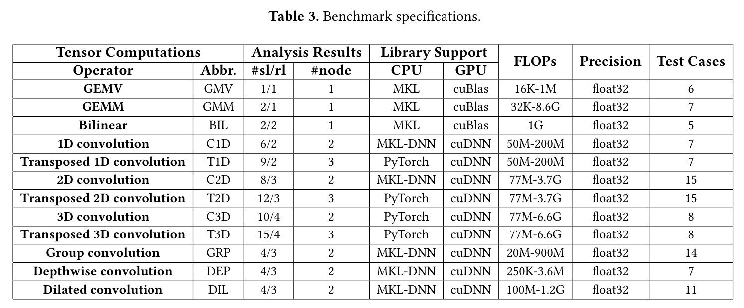

Slide 21
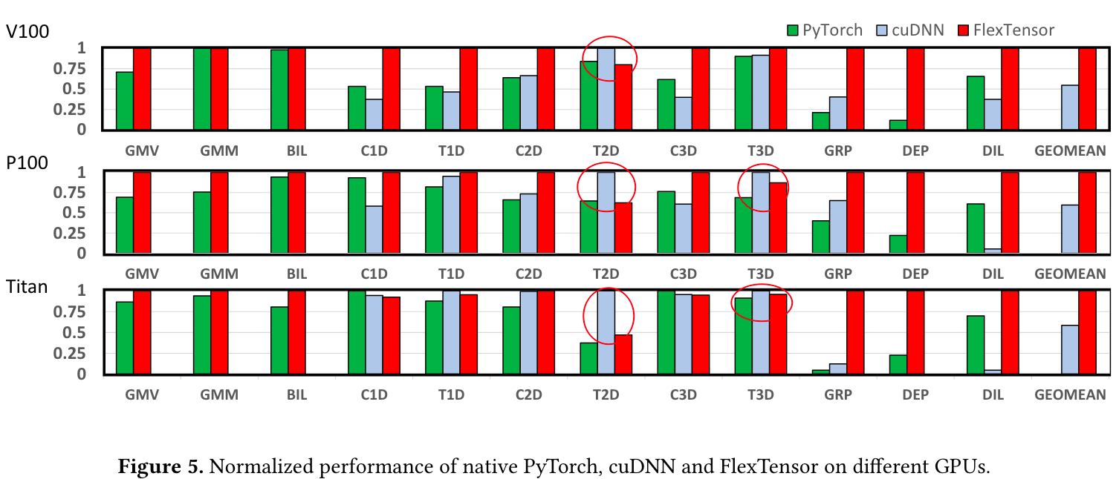
Overall Speedups on GPUs
归一化后的性能值

Slide 22
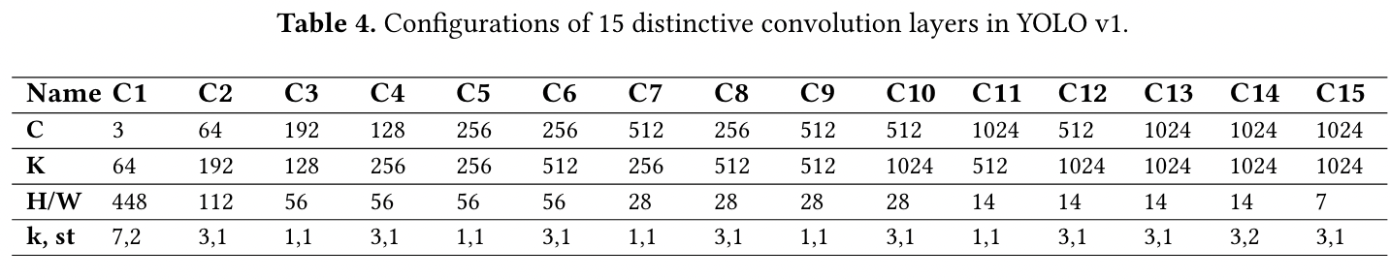
Detailed Performance on Heterogeneous Hardware
使用yolov1中的卷积算子当做测试样例
K是output channel， k是kernal size， st是stride

Slide 23
Performance for New Operators
Block circulant matrix (abbreviated as BCM) 用于嵌入式设备中
shift operation (abbreviated as SHO) 用于Shift-Net中
Hand-tuned implementation:
4-level tiling
Unroll loops to a maximum depth of 200.
FlexTensor:
BCM 2.11x on V100
SHO 1.53x on Titan X

Slide 24
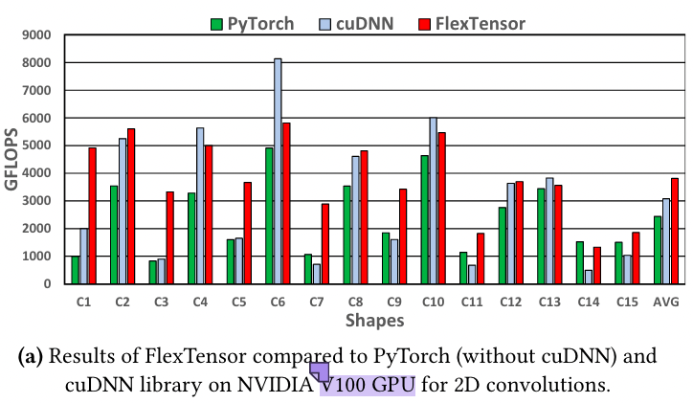

Slide 25
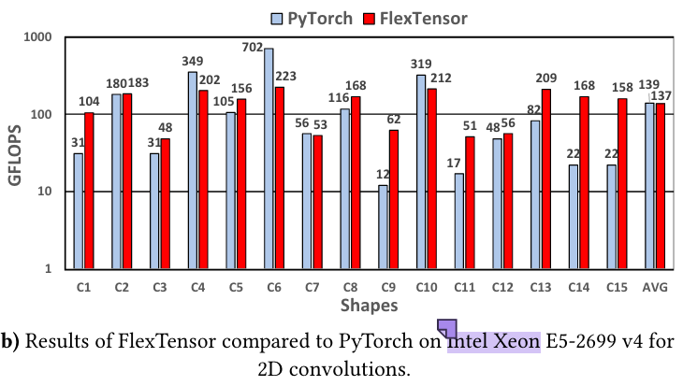

Slide 26
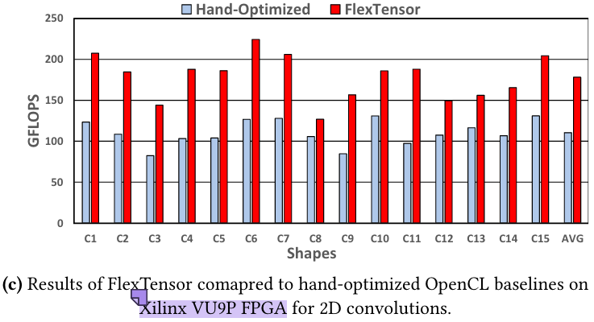

Slide 27
Comparison to State-of-the-Art
与AutoTVM比较
AutoTVM需要人工写模板，FlexTensor不用，搜索空间比AutoTVM大了2027x
Q-method: 使用Q-learning
P-method: 不使用Q-learning，随机选择下一个trail的开始位置
AutoTVM
Q-method总是比P-method收敛快
比AutoTVM性能好很多

Slide 28
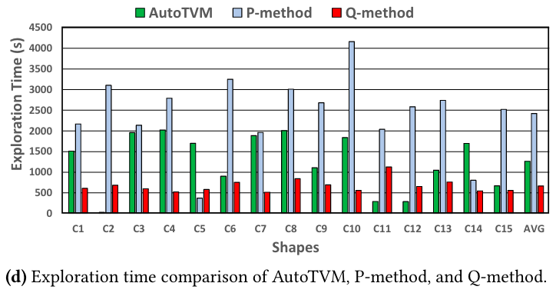

Slide 29
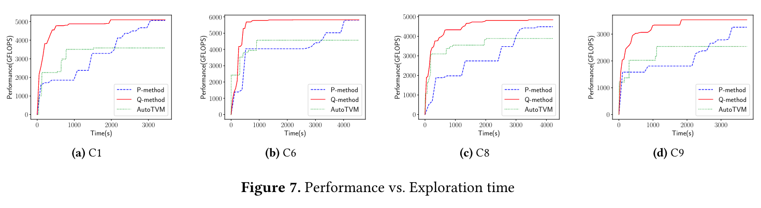

Slide 30
Case Study of DNNs
使用YOLO-v1和OverFeat模型进行测试
首先要经过子图划分，将子图给FlexTensor
在V100上，FlexTensor分别在YOLO-v1上提升了1.07x，在OverFeat上，提升了1.39x

Slide 31
IDEA
FlexTensor和AutoTVM都只是针对张量计算进行auto-tuning
没有针对整个计算图进行调度。
对于某个算子的auto-tuning的时间应该在半个小时左右，时间很是比较长，如果是整个模型，时间就会更长。

