Slide 1
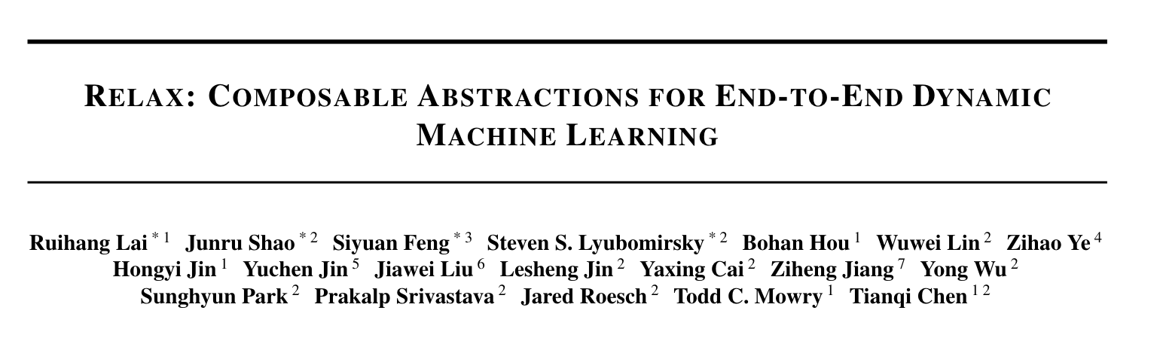

Slide 2
Abstract
需求：Dynamic shape computations非常重要。
为了优化端到端的Dynamic machine learning workloads 提出Relax(Relay Next) 这个新的IR。
这个新的IR抽象出了什么呢？
Relax introduces first-class symbolic shape annotations to track dynamic shape computations globally across the program.
It also introduces a cross-level abstraction that encapsulates computational graphs, loop-level tensor programs, and library calls in a single representation to enable cross-level optimizations.

Slide 3
Challenges
大语言模型存在大量dynamic shapes: variable-sized input messages, KV-cache context length, vocabulary sizes.
产生问题：
1. 动态shape让很多优化很难进行，例如：static memory planning.
2. 由于传统的编译器下降程序的过程都是single-shot lowering flow，很多信息（shape信息等）在下降的过程中丢失了，导致很难去进行跨边界的优化。

Slide 4
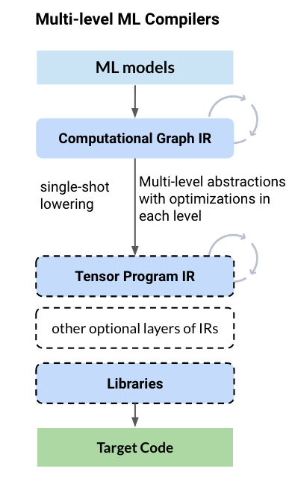

Slide 5
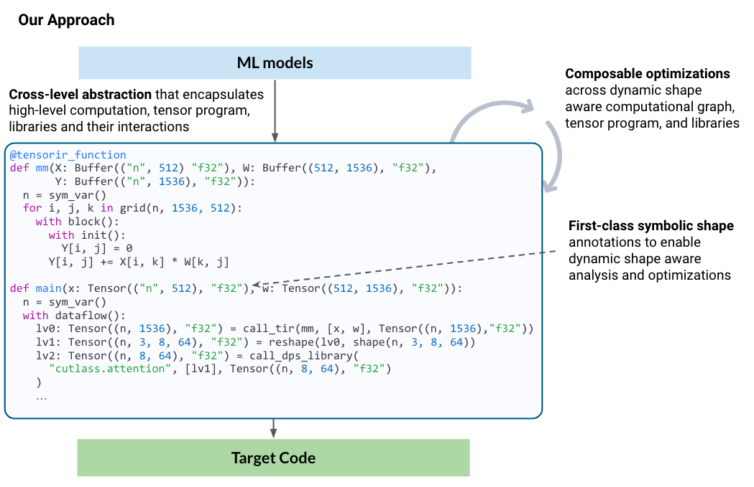
MLIR?

Slide 6
Solution
First-class symbolic shapes -> 让shape信息贯穿整个程序
Cross-level abstractions
dynamic shape-aware optimizations across levels.

Slide 7
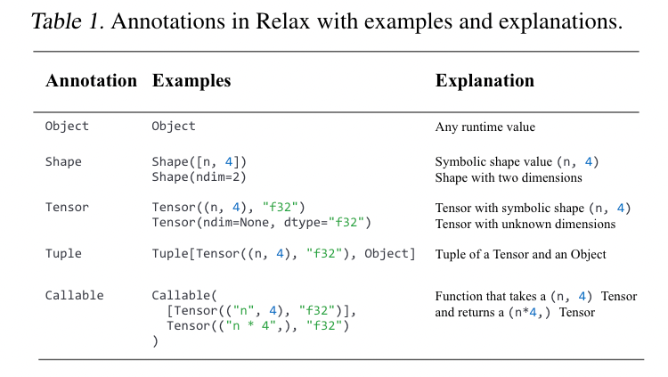
First-class symbolic shapes

Slide 8
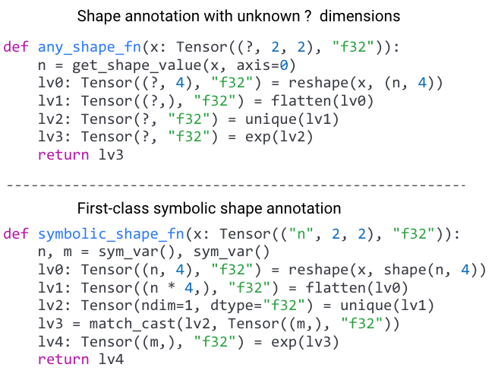

Slide 9
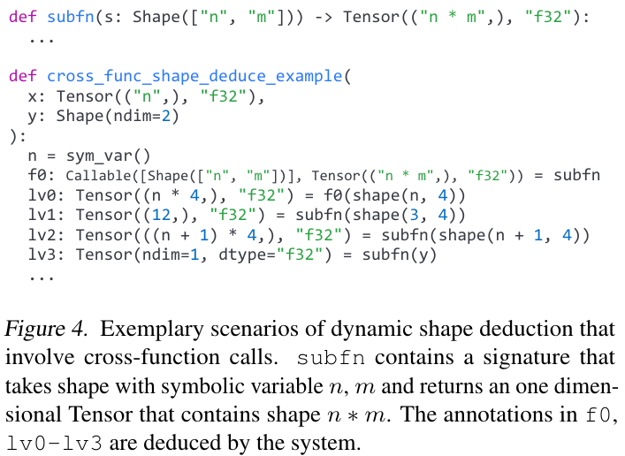
Shape Annotation Deduction

Slide 10
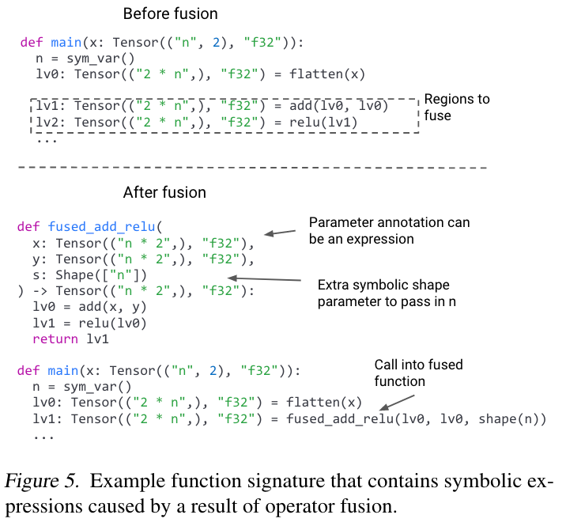

Slide 11
Cross-level abstractions
能够同时表示和优化计算图、tensor程序和库。

Slide 12
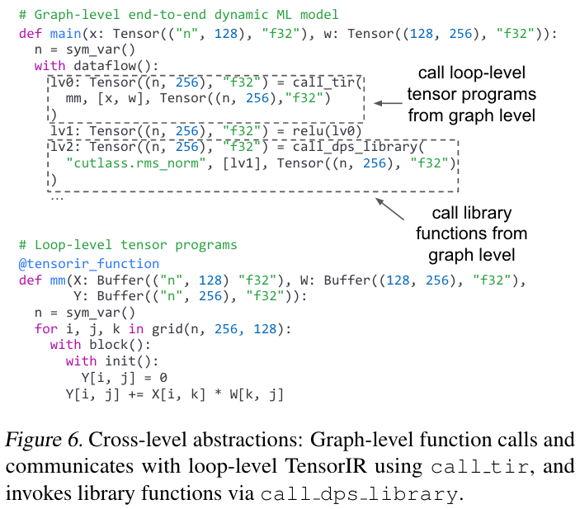

Slide 13
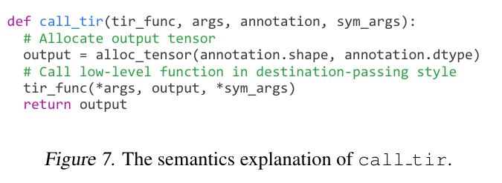

Slide 14
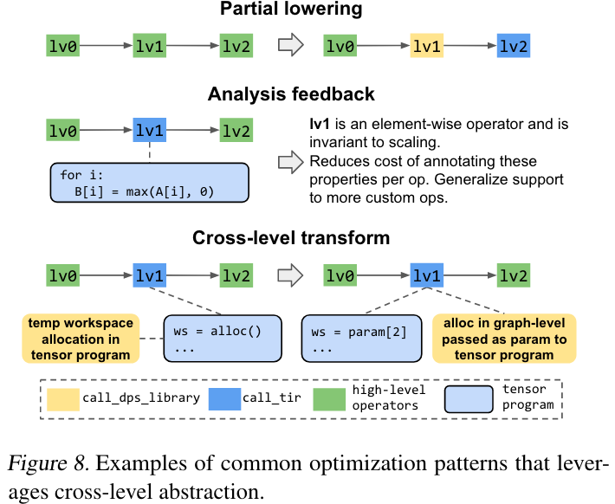

Slide 15
Benefits of cross-level abstractions
Partial lowering
Analysis feedback：分析lowering下去的代码，分析反馈回去op的属性。
Cross-level transforms：先lowering，再lifting，可以在全局统一管理内存分配和布局转换等。

Slide 16
Composable Optimizations
Cross-level dynamic shape–aware operator fusion.
Dynamic shape–aware memory planning.
Tensor operator optimizations via partial lowering.

Slide 17
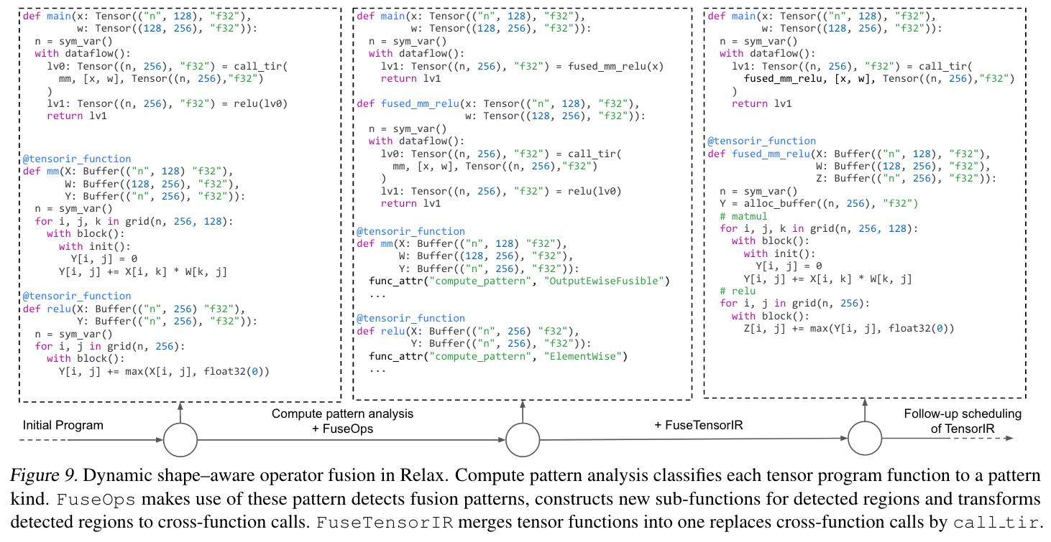
Cross-level dynamic shape–aware operator fusion.

Slide 18
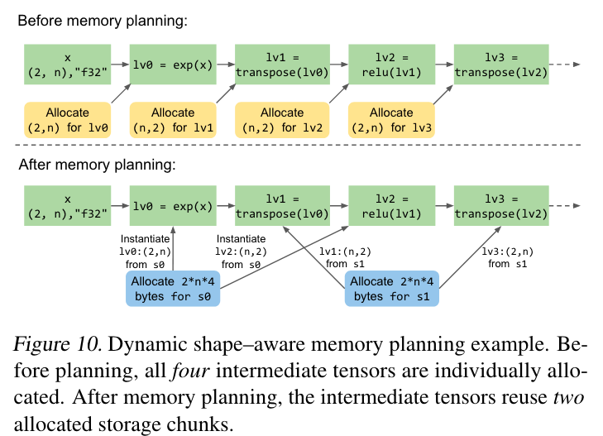
Dynamic shape–aware memory planning.

Slide 19
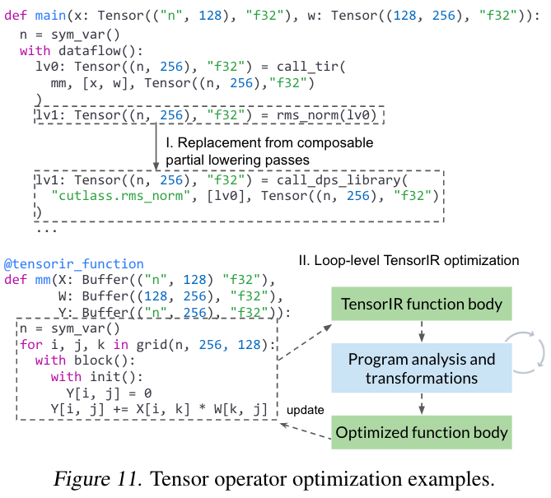
Tensor operator optimizations via partial lowering.

Slide 20
Evaluation
Can Relax bring optimized performance on emerging large language model inference?
Can Relax support a broad set of resource-constrained environments?
What is the impact of operator fusion and partial library lowering?
How well does Relax support static shapes?

Slide 21
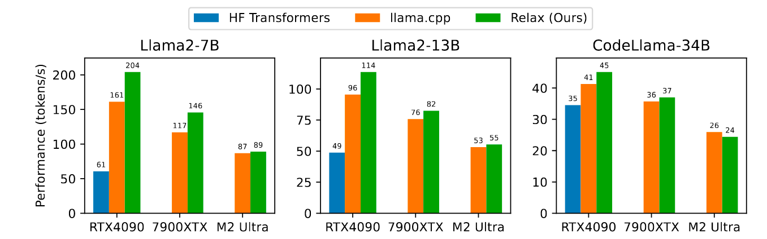
Large Language Model Inference Evaluation
We evaluate our solutions on Llama2-7B, Llama2-13B and CodeLlama-34B on NVIDIA RTX 4090, AMD 7900 XTX and Apple M2 Ultra.

Slide 22
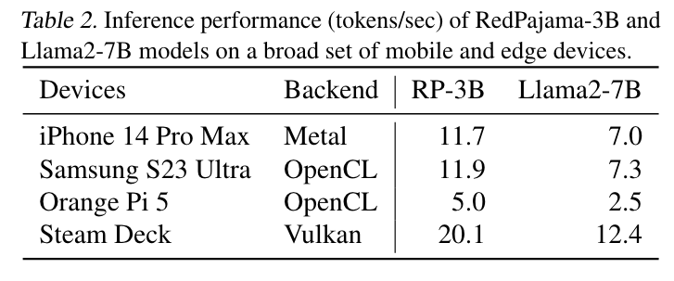
Evaluation on a Broader Set of Devices

Slide 23
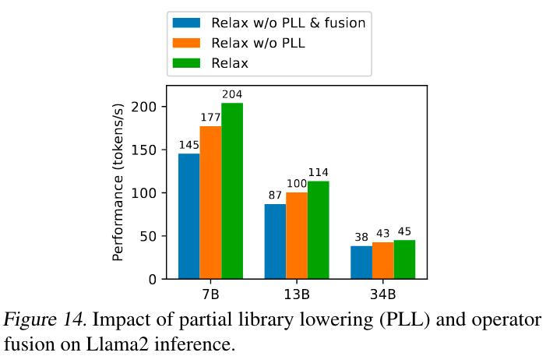
Impact of Partial Library Lowering and Fusion

Slide 24
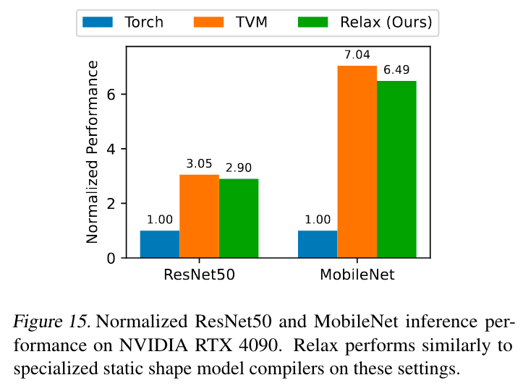
Statically Shaped Model Evaluation

Slide 25
CONCLUSION
First-class symbolic shapes & Cross-level abstractions ->
Composable optimizations of dynamic shape models

