Slide 1
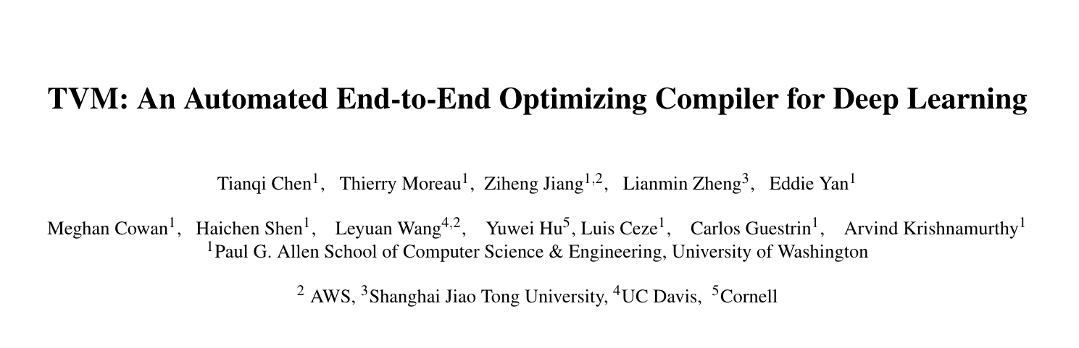
OSDI’18

Slide 2
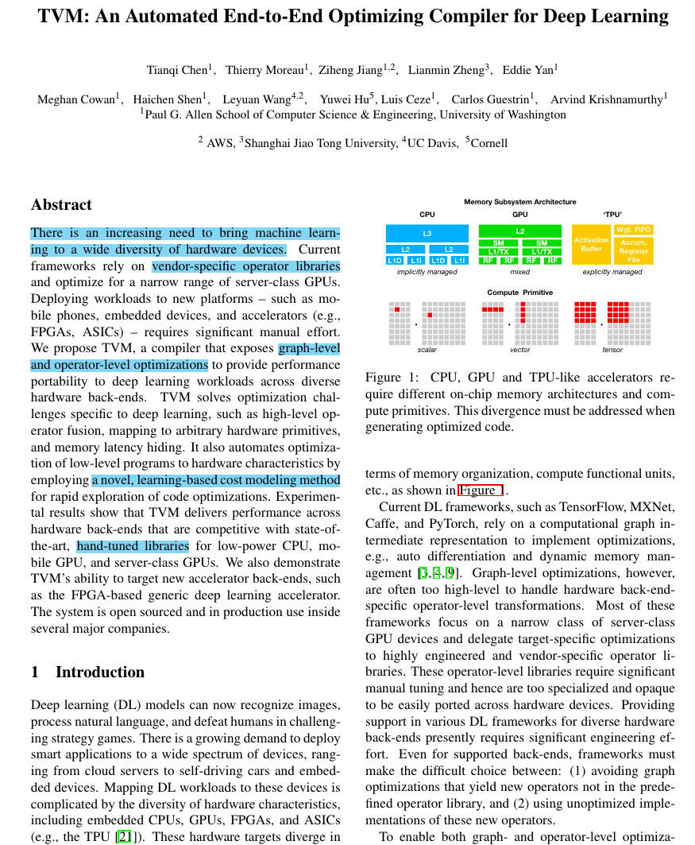
Layout of first page

Slide 3
Background & Problem
There is an increasing need to bring machine learning to a wide diversity of hardware devices.
越来越多的需要将机器学习引入到各种不同的硬件设备中。
Current frameworks rely on vendor-specific operator libraries and optimize for a narrow range of server-class GPUs. Deploying workloads to new platforms – such as mobile phones, embedded devices, and accelerators (e.g., FPGAs, ASICs) – requires significant manual effort.
算子库，将workload部署到新的设备上很难。

Slide 4
Solution & How
We propose TVM, a compiler that exposes graph-level and operator-level optimizations to provide performance portability to deep learning workloads across diverse hardware back-ends.
提出TVM，解决不同硬件间的性能可移植性。
TVM solves optimization challenges specific to deep learning, such as high-level operator fusion, mapping to arbitrary hardware primitives, and memory latency hiding. It also automates optimization of low-level programs to hardware characteristics by employing a novel, learning-based cost modeling method for rapid exploration of code optimizations.
TVM通过算子 融合，等等方式，优化深度学习任务。通过一个ML-based的cost model，去自动调优程序代码。

Slide 5
Evaluation
Experimental results show that TVM delivers performance across hardware back-ends that are competitive with state-of-the-art, hand-tuned libraries for low-power CPU, mobile GPU, and server-class GPUs. We also demonstrate TVM’s ability to target new accelerator back-ends, such as the FPGA-based generic deep learning accelerator. The system is open sourced and in production use inside several major companies.
实验表明，在各种平台都是SOTA。

Slide 6
Introduction
We built TVM, a compiler that takes a high-level specification of a deep learning program from existing frameworks and generates low-level optimized code for a diverse set of hardware back-ends.
To be attractive to users, TVM needs to offer performance competitive with the multitude of manually optimized operator libraries across diverse hardware back-ends.
不管提出什么新的系统或者范式，都得比一比性能，性能好才能说明新的东西好。用实证数据说话，不能空谈有哪些思想创新点。

Slide 7
Introduction
This goal requires addressing the key challenges described below:
Leveraging Specific Hardware Features and Abstractions.
Large Search Space for Optimization
TVM addresses these challenges with three key modules:
A tensor expression language to build operators and provide program transformation primitives. (TE)
An automated program optimization framework to find optimized tensor operators. (cost model)
A graph rewriter that takes full advantage of high- and operator-level optimizations. (图重写机制）

Slide 8
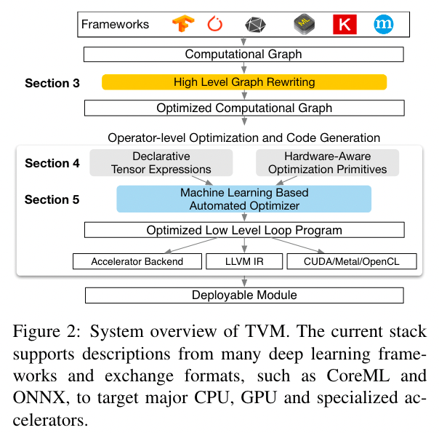
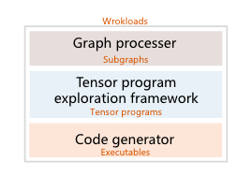
Overview
1. Enabling Tensor Language Model to Assist in Generating High-Performance Tensor Programs for Deep Learning

Slide 9
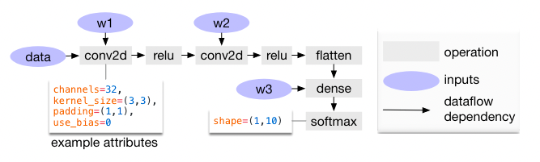
1. How to optimize Computational Graphs
如何优化这个计算图？

Slide 10
1. How to optimize Computational Graphs
Operator fusion, which fuses multiple small operations together;
Constant-folding, which pre-computes graph parts that can be determined statically, saving execution costs;
A static memory planning pass, which pre-allocates memory to hold each intermediate tensor;
and Data layout transformations, which transform internal data layouts into back-end-friendly forms.

Slide 11
Operator Fusion
Operator fusion combines multiple operators into a single kernel without saving the intermediate results in memory. This optimization can greatly reduce execution time, particularly in GPUs and specialized accelerators.
(1) injective (one-to-one map, e.g., add),
(2) reduction (e.g., sum),
(3) complexout-fusable (can fuse element-wise map to output, e.g., conv2d), and
(4) opaque (cannot be fused, e.g., sort).

Slide 12
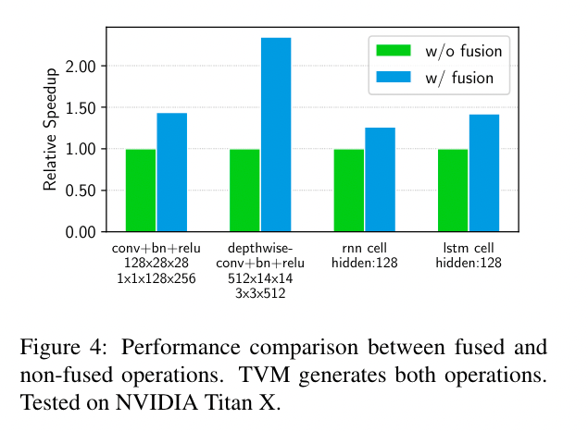
Operator Fusion
We find that fused operators generate up to a 1.2× to 2× speedup by reducing memory accesses.

Slide 13
Data Layout Transformation
Data layout optimization converts a computational graph into one that can use better internal data layouts for execution on the target hardware.
For instance, a DL accelerator might exploit 4 × 4 matrix operations, requiring data to be tiled into 4 × 4 chunks to optimize for access locality.

Slide 14
Problems
计算图的一些变换也需要硬件信息，如何更好的利用硬件信息，从计算图的变换开始，指导整个ML system的变换？

Slide 15
2. How to generate Tensor Operations
Build on Halide’s idea of decoupling descriptions from computation rules (or schedule optimizations).
Extend it to support new optimizations (nested parallelism, tensorization, and latency hiding).

Slide 16
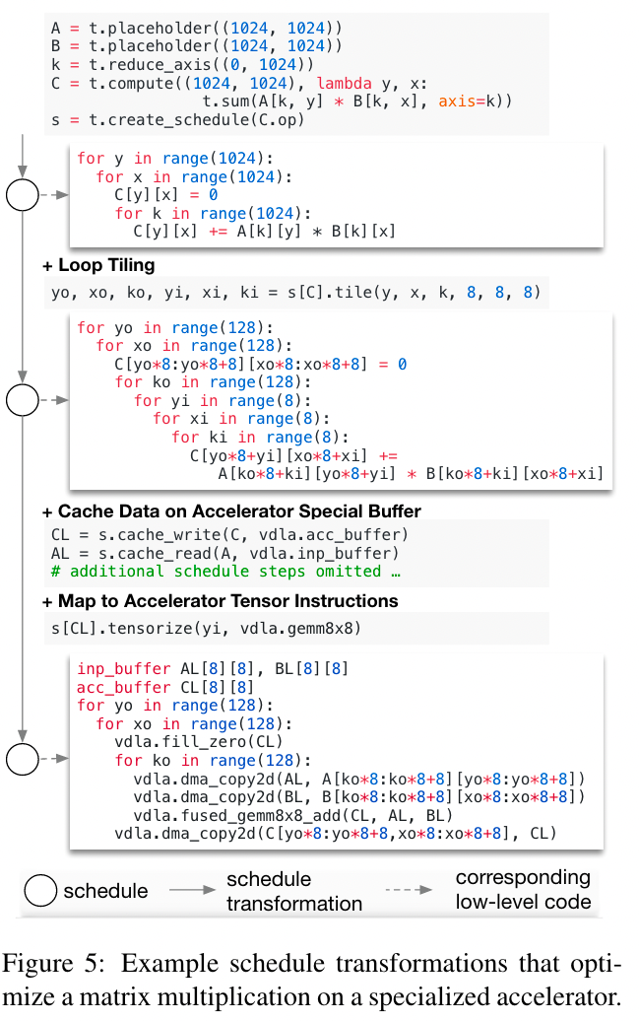
计算描述: Tensor Expression
计算描述: Tensor IR
变换规则: tiling
计算描述: Tensor IR
变换规则: cache
变换规则: tensorization
计算描述: Tensor IR

Slide 17
TVM从Halide中，借用了有用的primitives和low-level loop program AST。同时，为了在CPUs，GPUs，and TPU-like 加速器上，变换张量操作，就需要引入一些新的primitives。下面介绍新的primitives。

Slide 18
Nested Parallelism with Cooperation
简而言之，就是如何更好的利用GPU中的shared_memory，做thread之间的协作，提高数据的复用。怎么做？
需要能够描述不同memory的关键字，和thread的同步指令
由此，TVM引入memory scrope的概念，支持shared的关键字和同步指令。

Slide 19
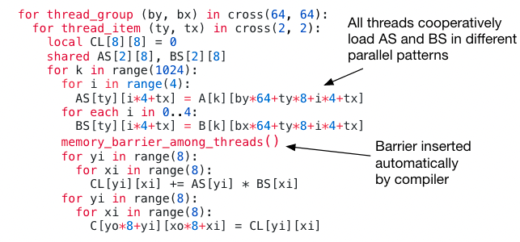

Slide 20
Tensorization
如今，类似Tensor Core和相似的DL加速器都包含针对tensor计算的一些加速指令，如何抽象这些指令？
这些指令需要的输入维度、数据layout都不一样，更重要的是，不能够提供一个固定的primitives集合，因为新的加速器都会有自己的tensor指令。怎么办？
需要有一个机制，可以注册新的tensor-intrinsic，并且，可以实现一个schedule，将代码变换成tensor-intrinsic。
TVM使用tensor-intrinsic declaration机制，去注册新的tensor-intrinsic和相对应的lowering rule。引入一个新的tensorize primitives，将代码按照declaration匹配，替换成tensor-intrinsic。

Slide 21
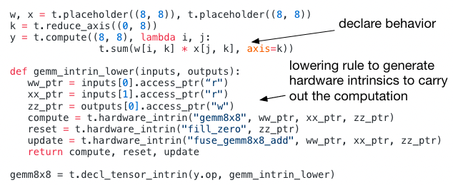
Tensorization

Slide 22
Tensorization
将代码利用tensorize primitive去变换，正好与HPC中，将复杂操作分解成一系列微内核（micro-kernel）的调用一致。
所以，也可以利用这个原语去调用一些微内核（包括算子库）
实际上，新的硬件加速器，就是将一些常用的操作（微内核，算子库）固化变成硬件去加速。

Slide 23
Explicit Memory Latency Hiding
Latency hiding refers to the process of overlapping memory operations with computation to maximize utilization of memory and compute resources.
Specialized DL accelerators such as the TPU usually favor leaner control with a decoupled access-execute (DAE) architecture and offload the problem of fine-grained synchronization to software.

Slide 24
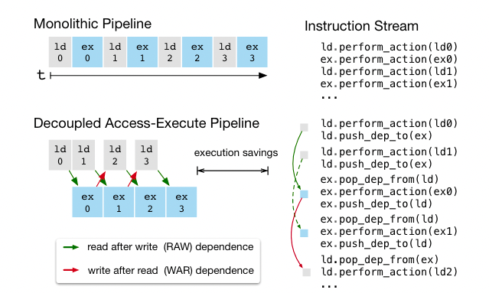
decoupled access-execute (DAE)
这就需要增加primitives 去表示和变换原有代码。

Slide 25
Explicit Memory Latency Hiding
TVM introduce a virtual threading scheduling primitive 去解决这个问题
首先用多线程schedule，将程序变成多线程，并接入同步指令保证执行的正确性。
然后，将所有virtual thread合并成一个单线程指令流。
最后，硬件通过同步指令，运行这个指令流。
简而言之，通过将程序变换成多线程，发现程序中可并行的部分，然后再用这部分指令，做Latency Hiding。

Slide 26
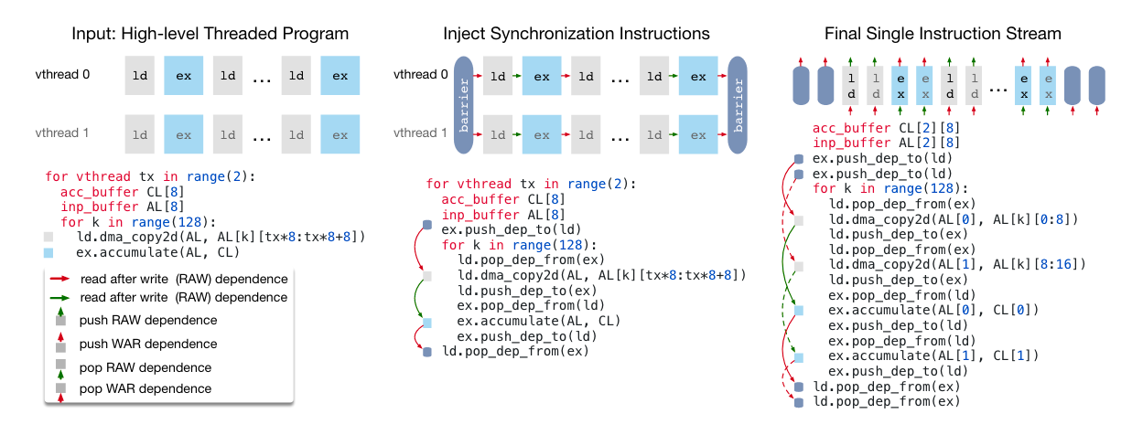
Explicit Memory Latency Hiding

Slide 27
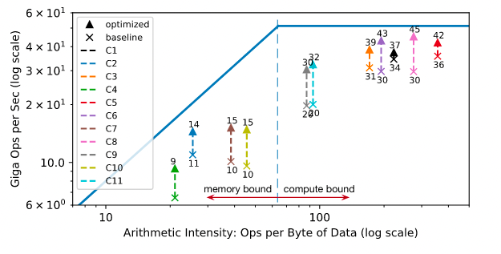
Explicit Memory Latency Hiding 的效果
ResNet

Slide 28
3. How to automate Optimization
现在有了对程序的表示（TE，TIR），有了变换原语（schedule），如何将schedule应用到表示上，变换出高性能的代码呢？哪些schedule可以使用呢？

Slide 29
Schedule Space Specification
手动指定哪些schedule可以使用， schedule space。
TVM : schedule template specification API
自动产生schedule space这个搜索空间。
TVM : generic master template for each hardware back-end

Slide 30
ML-Based Cost Model
有了搜索空间，如何在搜索空间上，高效的进行搜索呢？
Exhaustic search ?
Blockbox auto-tuning ?
Predefined cost model ?
a perfect cost model considers all factors affecting performance: memory access patterns, data reuse, pipeline dependencies, and threading patterns, among others.
ML-based cost model

Slide 31
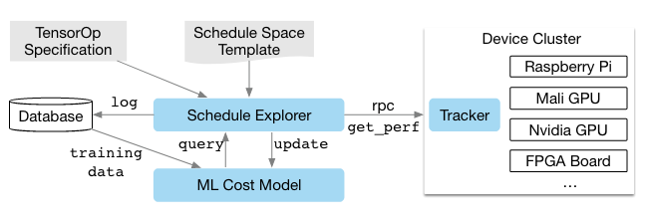
ML-Based Cost Model

Slide 32
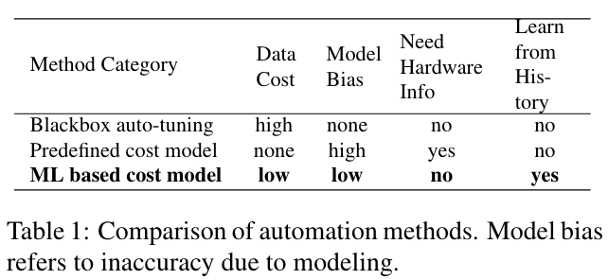
The key differences between automation methods.

Slide 33
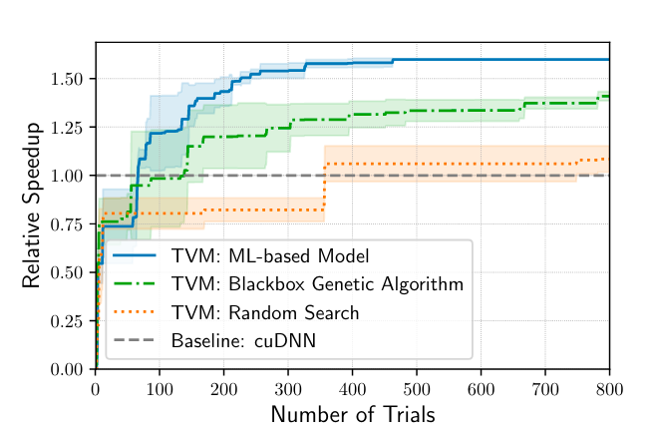
ML-based optimizer to blackbox auto-tuning methods

Slide 34
既然确定了使用cost model，应该使用什么模型做cost model呢？
需要trade-off quality and speed of cost models.
程序的什么信息给到模型里，才能有更好的效果呢？
TVM 评测了两个模型：
基于XGBoost
基于TreeRNN
Cost model 的输入是变换好的程序代码抽取出来的特征，输出是预测的时间。

Slide 35
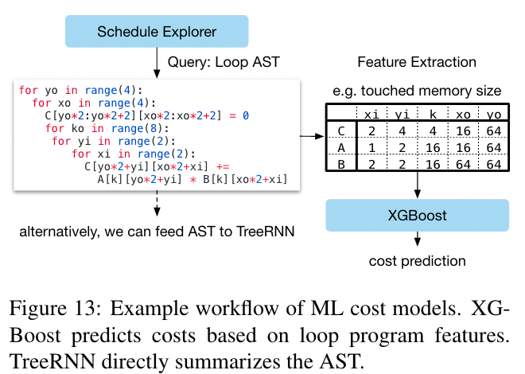
The workflow of the cost models.

Slide 36
ML-Based Cost Model
实验表明，XGBoost[1]和TreeRNN[2]效果差不多，但是前者比后者更快。
奇怪的是文章中这里没有图和实验数据来证明这一点。
[1] CHEN, T, et al. Xgboost: A scalable tree boosting system.
[2] TAI, K. et al. Improved semantic representations from tree-structured long short-term memory networks.

Slide 37
Schedule Exploration
确定了cost model，就可以用这个模型去预测一个schedule pipeline的运行时间。但是，我们还需要去训练这个cost model，怎么做？
我们可以通过在真实硬件上运行一遍这个配置，然后对比cost model给出的时间，将其作为loss，训练这个cost model。
这个配置怎么给出来呢？
我们可以用cost model预测一下整个schedule space中的所有，然后取性能最好的top-k 个配置。问题？
如果schedule space过大，那么这个方法是不切实际的。怎么办？
每次都随机选择几个配置，去训练cost model？效率不高
开始采用随机的配置，然后采用并行的模拟退化选择nearby configuration。这种random walk的方式能够收敛到lower cost的配置上。

Slide 39
Distributed Device Pool and RPC
有了上述内容以后，就可以在本机中，搜索较好的schedule。
但是，如果需要部署在其他设备上，交叉编译等等，现在的基础设施还不行。缺少与其他设备通信，和下发任务的设施。
TVM implements a customized, RPC-based distributed device pool that enables clients to run programs on a specific type of device.

Slide 40
3. How to automate Optimization

Slide 41
Evaluation
Four RQs:
Can TVM optimize DL workloads over multiple platforms?
How does TVM compare to existing DL frameworks (which rely on heavily optimized libraries) on each back-end?
Can TVM support new, emerging DL workloads (e.g., depthwise convolution, low precision operations)?
Can TVM support and optimize for new specialized accelerators?

Slide 42
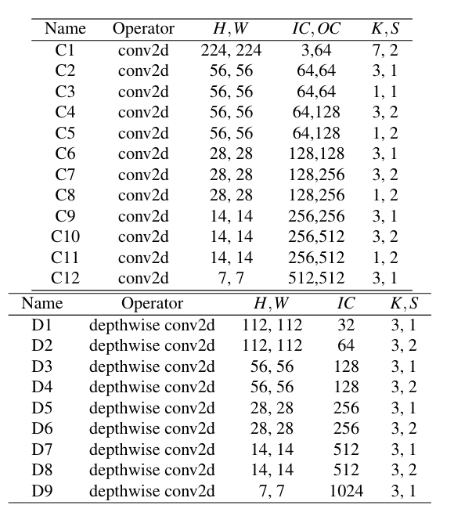

Slide 43
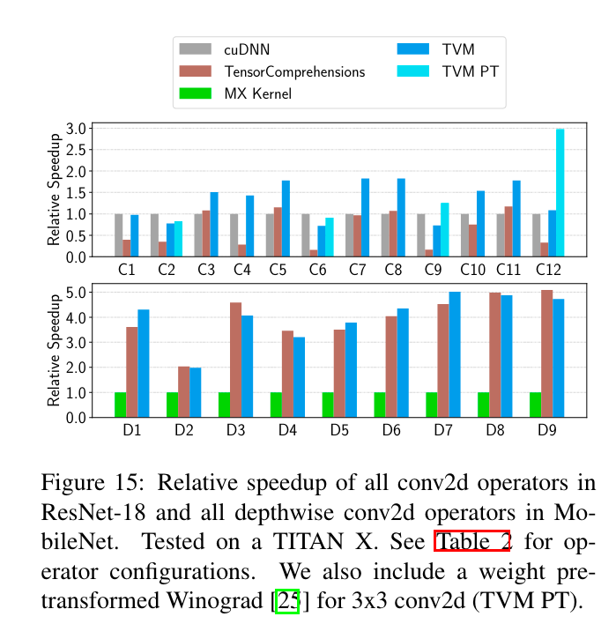
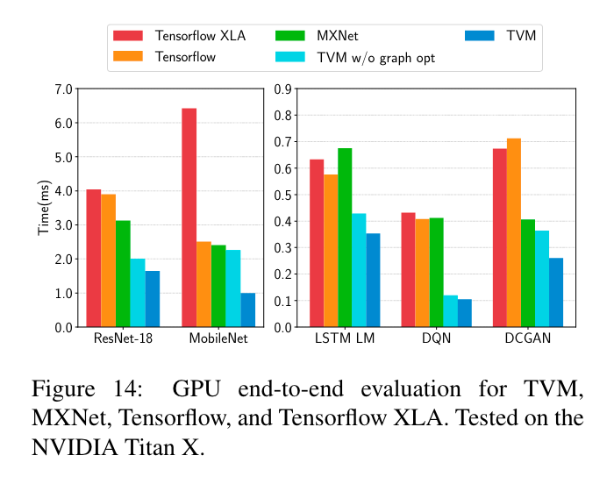
Server-Class GPU Evaluation
operator level optimization performance
End-to-end performance

Slide 44
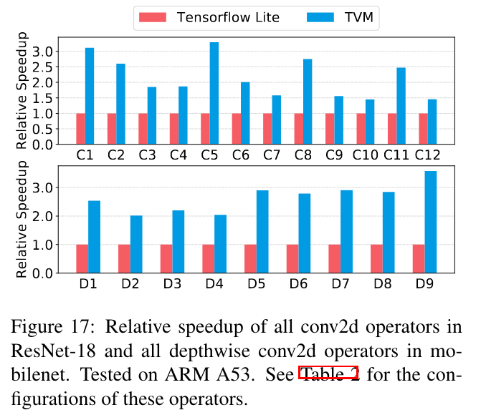
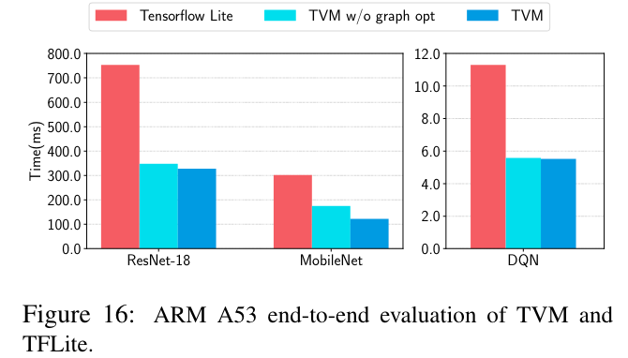
Embedded CPU Evaluation

Slide 45
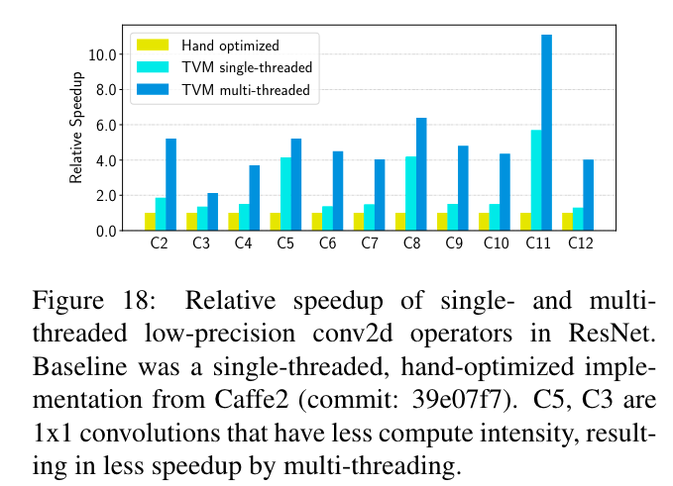
Embedded CPU Evaluation
Ultra Low-Precision Operators

Slide 46
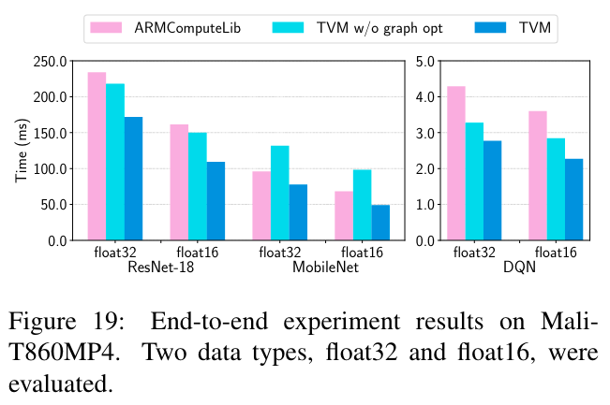
Embedded GPU Evaluation

Slide 47
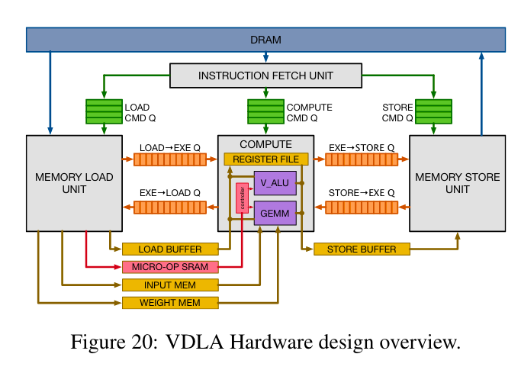
FPGA Accelerator Evaluation
他们自己用FPGA写了一个Vanilla Deep Learning Accelerator (VDLA)，然后在这个上面进行测试

Slide 48
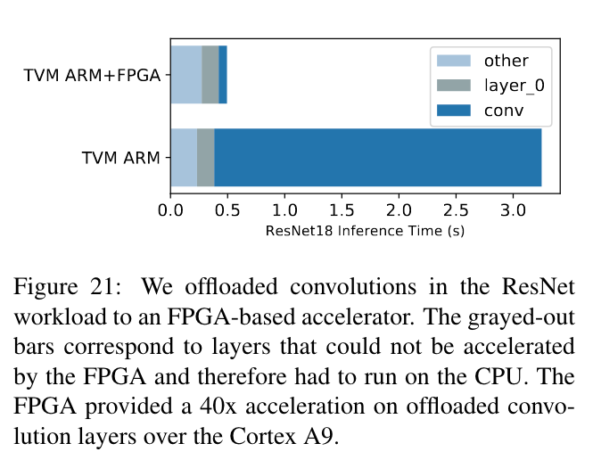
FPGA Accelerator Evaluation
End-to-End ResNet Evaluation.

Slide 50
Conclusion

Slide 51
Problems or Ideas?

